Slide 1

Research Design II
Justin Borg & Mario Mallia-Milanes
Institute of Information & Communication Technology
MCAST, Paola, Malta

Slide 2
Problem Definition
Background
- Flower classification in Malta and around the world is crucial for medicinal fields, conservation efforts, gardening, botanical research etc. With this being said, flower classification is an ever increasingly difficult task in which the demand for specialisation of this field is not being met.
Aim of Study
- Using Computer vision, Image classification and deep learning in attempt to automate the process of flower classification.
Objective
- Develop an image classification model which is able to effectively recognize and predict flowering plant images.
Notes:
There exist around 369000 different species of flowering plants all across the world, and around 1100 species in Malta.
This makes plant classification a very tedious task and with the advancement of computer vision in the past years, it makes sense to approach an automated flower classification technique.

Slide 3
Hypothesis & Questions
Hypothesis
The hypothesis of this study is that image classification with deep learning models can be used to classify Maltese endemic and non-endemic flowering plants.
Research Questions
How is the accuracy of image classification affected in deep learning models when using different types of data augmentation pre- processing layers?
How effective is image classification in classifying Maltese endemic and non-endemic flowering plants?
Notes:
Therefore, this research intends to focus on the recognition of Maltese endemic and non-endemic flowering plants.
To address the hypothesis, we ask these 2 research questions to identify the determining factors of flower image classification and the effective use of additional data augmentation preprocessing layers.

Slide 4
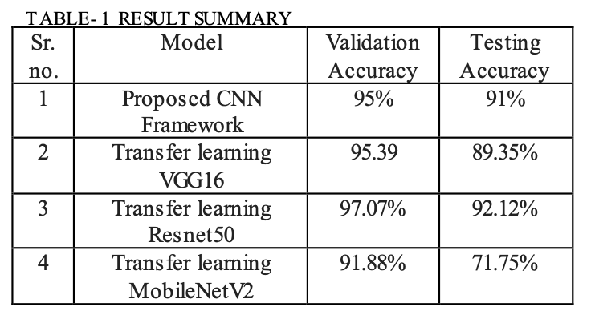
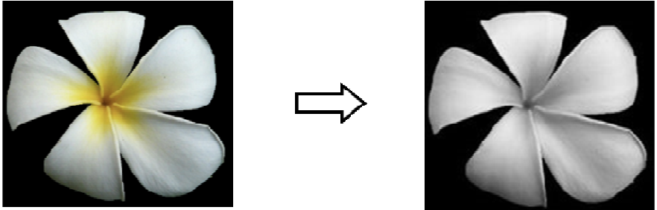
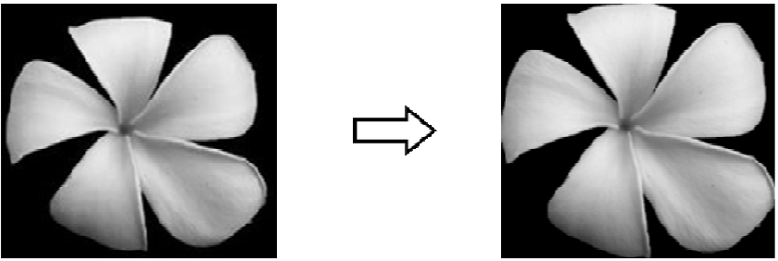
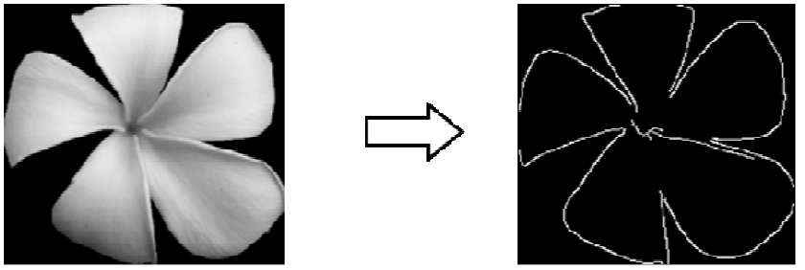
Reviewed Literature and Methodologies
C.Narvekar et al. (2020) conducted a similar study by proposing a CNN deep learning model using transfer learning in attempt to classify flower images. They obtained very good
accuracy results and the overall study was successful.
In another study by F.Siraj et al. (2010) the authors hypothesized the use of
Neural Networks and image processing to be able to understand flower
Image features found in the Malaysian Blooming Flower.
T.Tiay et al. (2014) proposed a model which uses edge and colour characteristics found in flower images to carry out flower image classification. This study uses Hu’s seven moment algorithm and the K-nearest neighbour algorithm.
Grayscale
Cropping
Edge
Notes:
F.Siraj concluded that NN have potential in building a Malaysian Blooming flower recognition system, as resulted by this study.
T.Tiay uses Hue and Saturation characteristics are obtained from histograms and the K-nearest neighbour algorithm is used for the Flower classification itself

Slide 5




Chosen Methodology
The model in this study followed the Keras Sequential model in aims of building a Convolutional Neural Network (CNN) able to classify flower images.
This in conjunction with TensorFlow’s deep learning framework were the technologies used for building our model.
Python 3.11.1 and Visual Studio Code were used as the programming language and code editor for the creation of this classification model.
Notes:
Other libraries used include; numpy for mathematical operations and PIL for image processing capabilities.

Slide 6
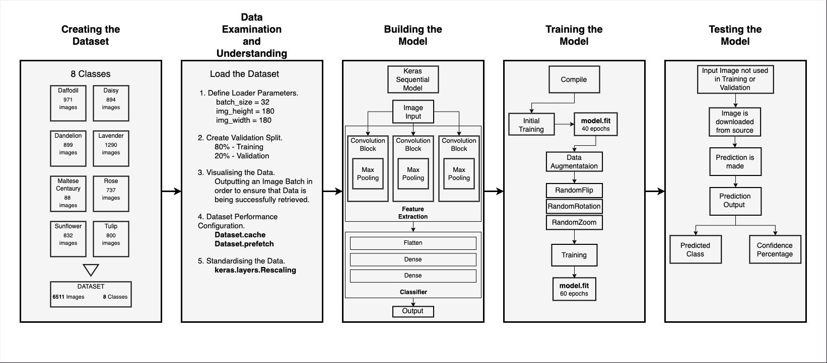
Experiment Design – Research Pipeline
Notes:
Explanation of pipeline.
Creating the Dataset.
Data Examination and Understanding
Building the model.
3 convolutional blocks.
Max pooling.
Flatten.
Dense x2.
Training the model.
Testing the model.

Slide 7

Experiment Design – Creating the Dataset
The dataset that was used in this study was made up of a mixture of publicly available flower datasets which were collected from different sources, including Kaggle and the University of Oxford.
The finished dataset contains 6511 images split into 8 classes:
Daffodil
Daisy
Dandelion
Lavender
Maltese Centaury
Rose
Sunflower
Tulip
Flower Dataset
Notes:
Explanation of Dataset.
Limitation of Maltese Centaury images.

Slide 8
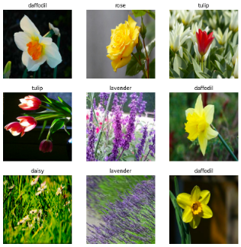
Experiment Design – Data Preparation
This phase was essential in the study as here we optimized the dataset images to be configured in the best way possible for the model training and validation.
Dataset was downloaded.
Loader Configuration (batch size – 32, image size 180x180 pixels)
Validation Split - 80% Training 20% Validation
Buffered prefetching to yield data from disk without having I/O blocking.
Some images are then visualised to test these new implementations.
Notes:
Buffered prefetching done by using Dataset.cache, TensorFlow method.
Eliminates bottleneck Possibilities.

Slide 9
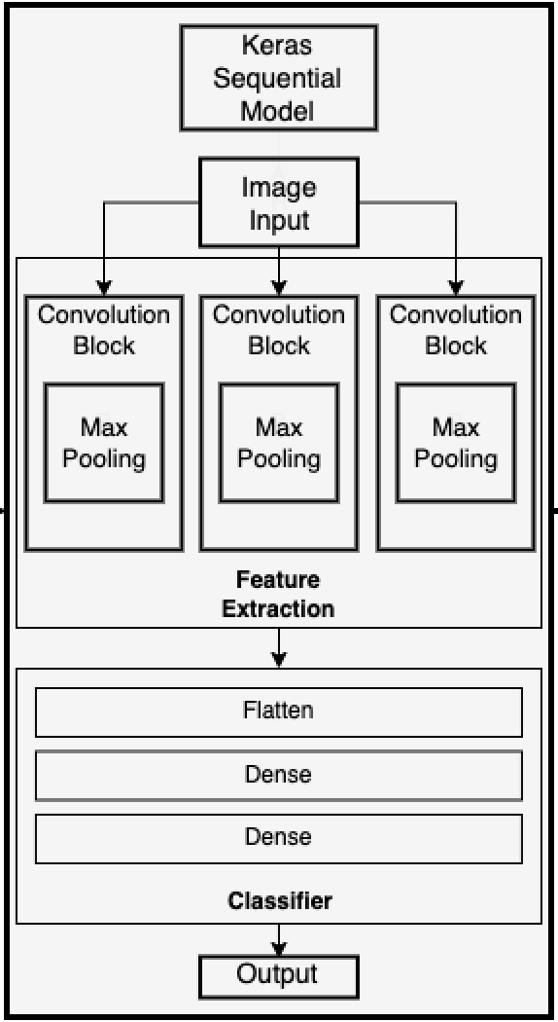
Experiment Design – Building the Model
The Convolutional Neural Network (CNN) model built in this study, consisted of 3 convolutional blocks each containing a max-pooling layer. Next, a Flatten layer and two Dense classifier layers were utilized.
The 3 convolutional blocks are used for Feature Extraction whereas the Flatten and Dense layers are used for Classification.
Dense layer is activated through the Rectified Linear Unit (ReLu) function.
Notes:
The ReLu function is a widely used activation function for many types of NN.
Facilitates the training process and helps to achieve better performance results

Slide 10
Experiment Design – Training the Model
The Training of the model came next, this phase was done in the following steps:
First, model was compiled using the Keras Adam algorithm optimizer.
SparseCategoricalCrosspentropy loss function was used to determine cross-entropy loss.
Train model for 40 epochs (Phase 1) using the Keras.fit method.
Added Data Augmentation preprocessing layers in order to combat overfitting.
Preprocessing layers used:
Iteration 1: layers.RandomFlip.
Iteration 2: layers.RandomFlip, layers.RandomRotation, layers.RandomZoom.
Lastly implemented a further Dropout layer technique to combat against overfitting.
Train model for 60 epochs (Phase 2)
Notes:
SparseCategoricalCrossentropy used to determine the cross-entropy loss between the labels and the predictions.
Keras.Fit simply trains model for a given amount of epochs (data iterations).
Overfitting occurs when there isn’t a large enough number of samples therefore the model tends to learn from unwanted noise coming from training images.
Dropout layer randomly sets activation value to 0.

Slide 11
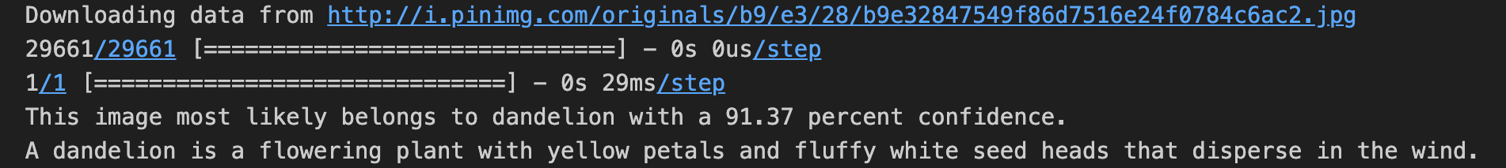
Experiment Design – Testing the Model
Model was given new images in order to conduct a prediction, prediction outputted was in the form of class prediction and confidence score.
Model first downloads the image via URL and then outputs its prediction.
Model also outputs a short description of the flower class that was predicted.
Notes:
Testing the model by giving new image URL.

Slide 12
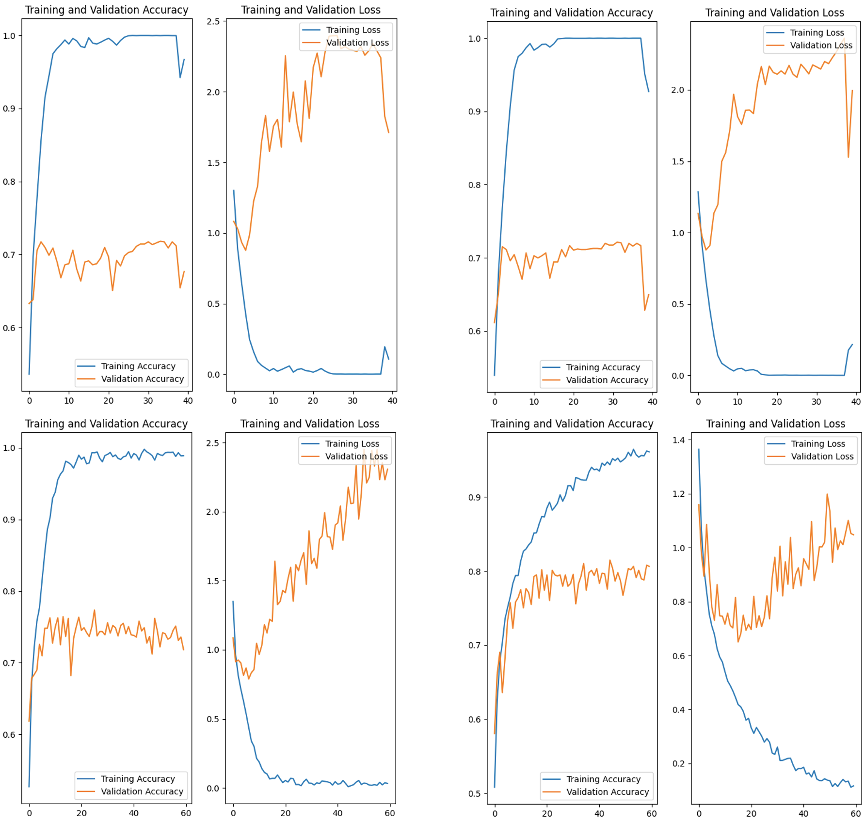
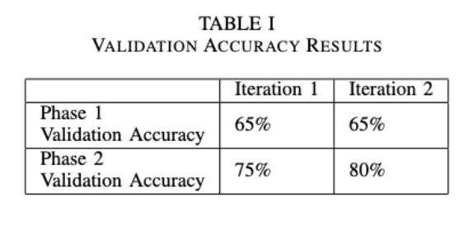
Data Collection & Results – Training And Validation
Results were generated from the prototype itself in the form of Training and Validation accuracy and loss graphs (Accuracy\Loss against epoch amount).
Iteration 2, Phase 2 Training and Validation Accuracy graph achieved the best results.
This Phase achieved the best results as a result of it containing the most preprocessing layers.
Notes:
Table shows 2 Iterations with 2 Phases each.
Training and Validation Accuracy and Loss graphs were generated by the prototype and are plotted as Accuracy\Loss against epoch amount.
Phase 1 is the 40 epoch training with no data augmentation.
Iteration 1 phase 2 is the 60 epoch training with only 1 preprocessing layer.
Iteration 2 phase 2 is the 60 epoch training with 3 preprocessing layers.

Slide 13
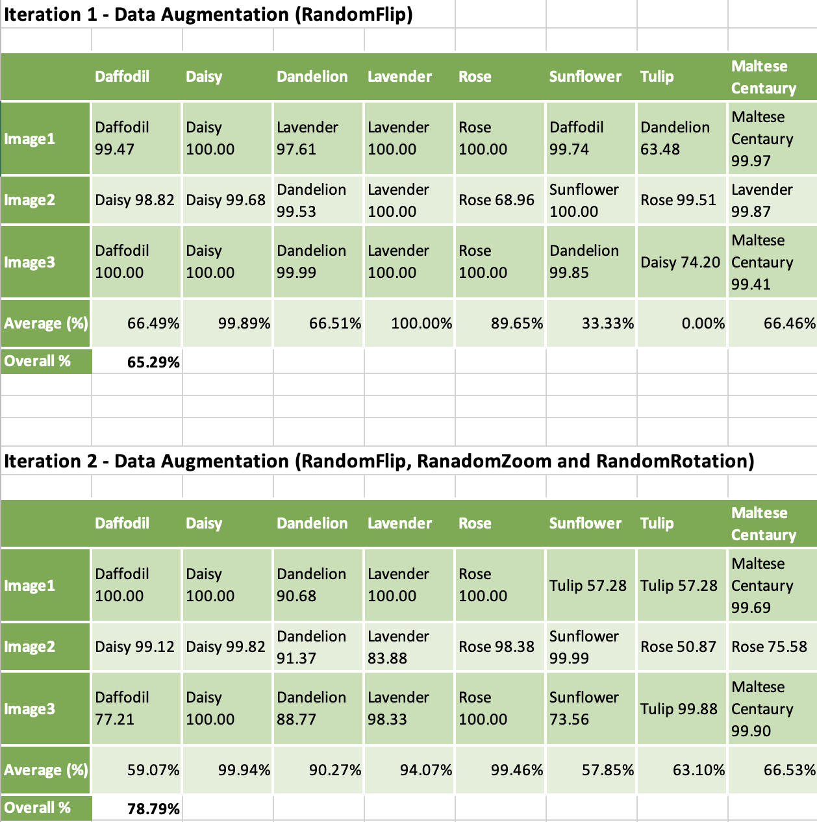
Data Collection & Results – Prediction Confidence
Tables were created to represent the prediction of each class.
Each class was tested with 3 new images.
Averages were calculated for each class, disregarding the incorrect class predictions.
Overall percentages were calculated from the average score of the entire Iteration’s classes.
Iteration 2 did significantly better than Iteration 1 with a delta of 13.50%.
Notes:
If class prediction was incorrect, the percentage value of that guess did not count to the average as it is a 0% guess.
It can be deduced that Iteration 2 obtained better results as an effect of the additional preprocessing layers used.

Slide 14
Analysis and Conclusions
The results indicate that our hypothesis holds true, a deep learning based model was able to classify different flowering plants.
Therefore, this model is able to classify Maltese endemic and non-endemic flowering plants.
Results in this study also show how drastically overfitting affects the classification results and how well data augmentation preprocessing layers work against overfitting.
While this performance is promising as a proof-of-concept, it may not yet possess the sophisticated requirements for it to be used in more complex applications within the field of flower classification.

Slide 15
Future Recommendations
Further research and implementation to the prototype can certainly make this prototype more accurate and achieve better results.
For this to be achieved:
A larger dataset which uses more precise photography techniques to obtain more centered and focused flower images, would be needed.
Further implementation towards data augmentation could eliminate completely the overfitting issue present in the current version of the prototype.

Slide 16
References
[1] C. Narvekar and M. Rao, “Flower classification using cnn and transfer learning in cnn- agriculture perspective,” in 2020 3rd International Conference on Intelligent Sustainable Systems (ICISS), 2020, pp. 660– 664.
[2] J. Kothari, “A case study of image classification based on deep learn- ing using tensorflow,” International Journal of Innovative Research in Computer and Communication Engineering, vol. 6, pp. 3888–3892, 04 2018.
[3] Q. Li, W. Cai, X. Wang, Y. Zhou, D. D. Feng, and M. Chen, “Med- ical image classification with convolutional neural network,” in 2014 13th International Conference on Control Automation Robotics Vision (ICARCV), 2014, pp. 844–848.
[4] C. Gamit, “Literature review on flower classification,” International Journal of Engineering Research Technology (IJERT), vol. 4, no. 2, 2015.
[5] F. Siraj, M. A. Salahuddin, and S. A. M. Yusof, “Digital image classi- fication for malaysian blooming flower,” in 2010 Second International Conference on Computational Intelligence, Modelling and Simulation, 2010, pp. 33–38.
[6] T. Tiay, P. Benyaphaichit, and P. Riyamongkol, “Flower recognition system based on image processing,” Proceedings of the 2014 3rd ICT International Senior Project Conference, ICT-ISPC 2014, pp. 99–102, 10 2014.
[7] J. Borg and D. Scerri, “Image classification with a deep learning model for classifying maltese endemic and non-endemic flowering plants,” Paola, PLA 9032, May 2023, [email address: justin.borg.e21729, dar- ren.sceri]@mcast.edu.mt.

Slide 17
Thank you Justin Borg, Mario Mallia-Milanes

