Slide 1
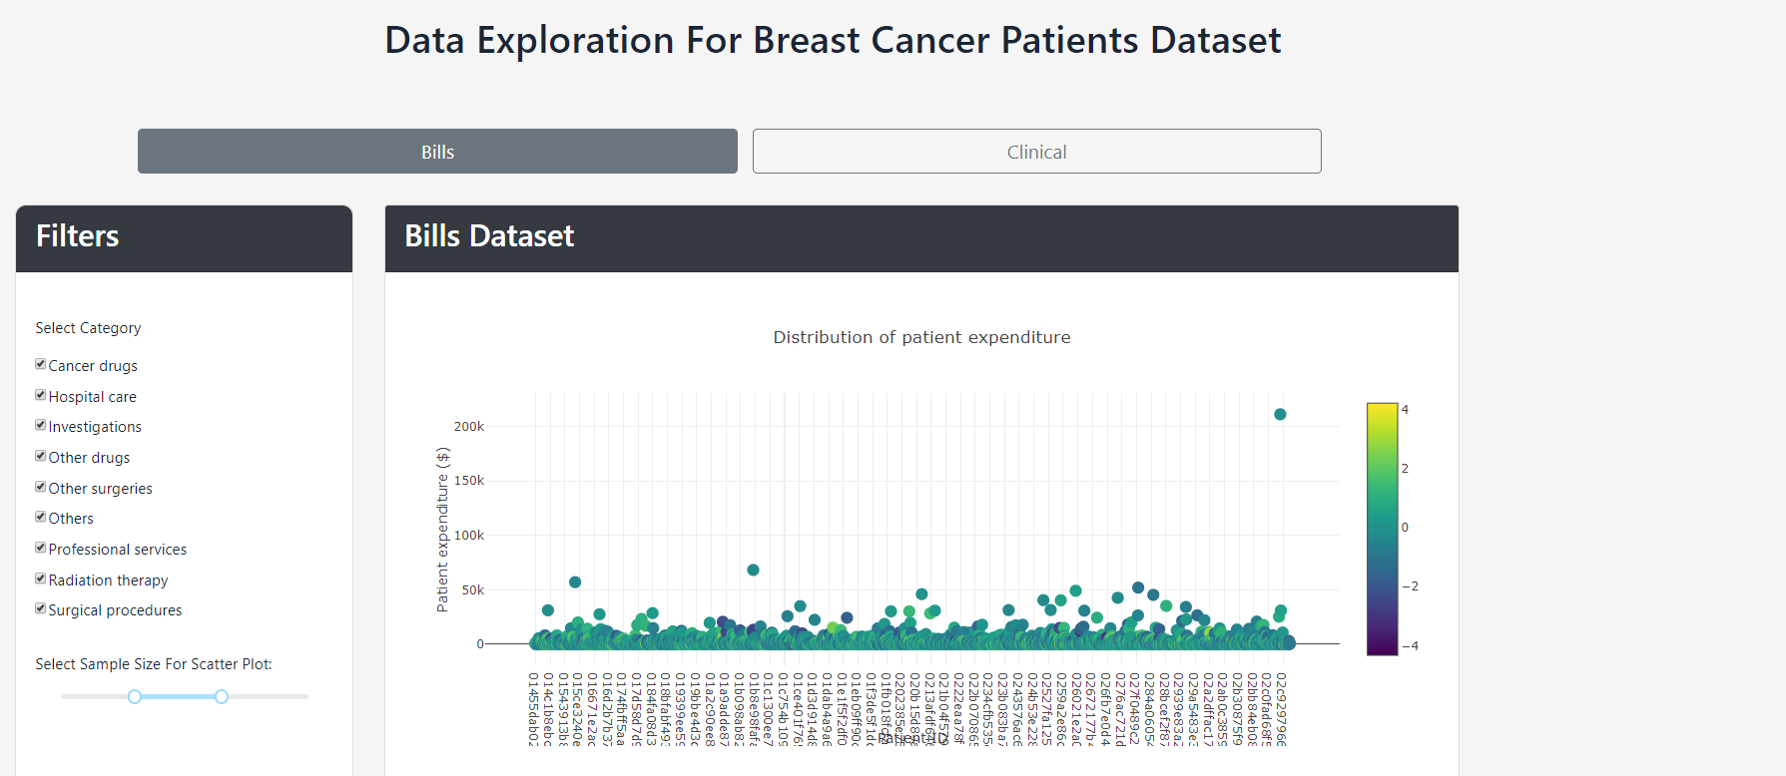
Notes:
//FOR BILLS//
Distribution of patient expenditure:
In this scatter plot, we can see the spending (sum of gross cost of each transaction) of each breast cancer patient. Please ignore the gradient.

Slide 2
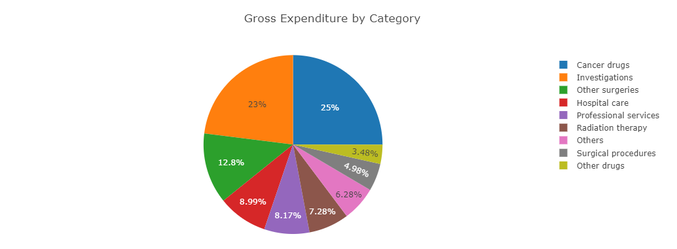
Notes:
Gross expenditure by category
This chart explains that most costs fall under 'CANCER DRUGS'.

Slide 3
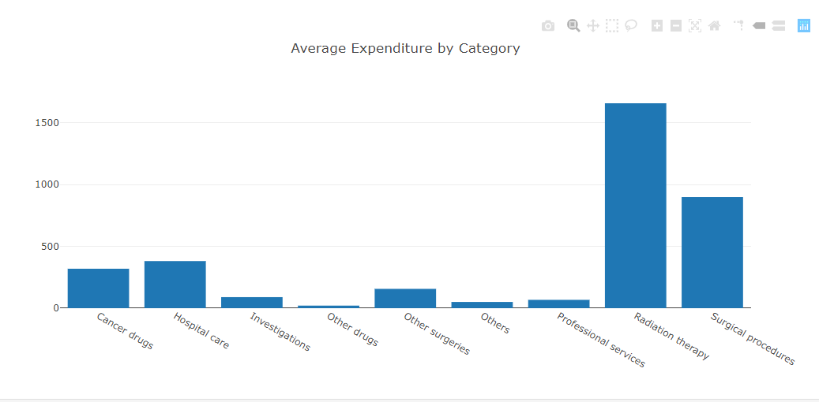
Notes:
Avg. Expenditure by category
Similar to the one above, this chart shows us the average patient expenditure by category type. This shows that 'RADIATION THERAPY' is the most expensive out of the other categories.

Slide 4
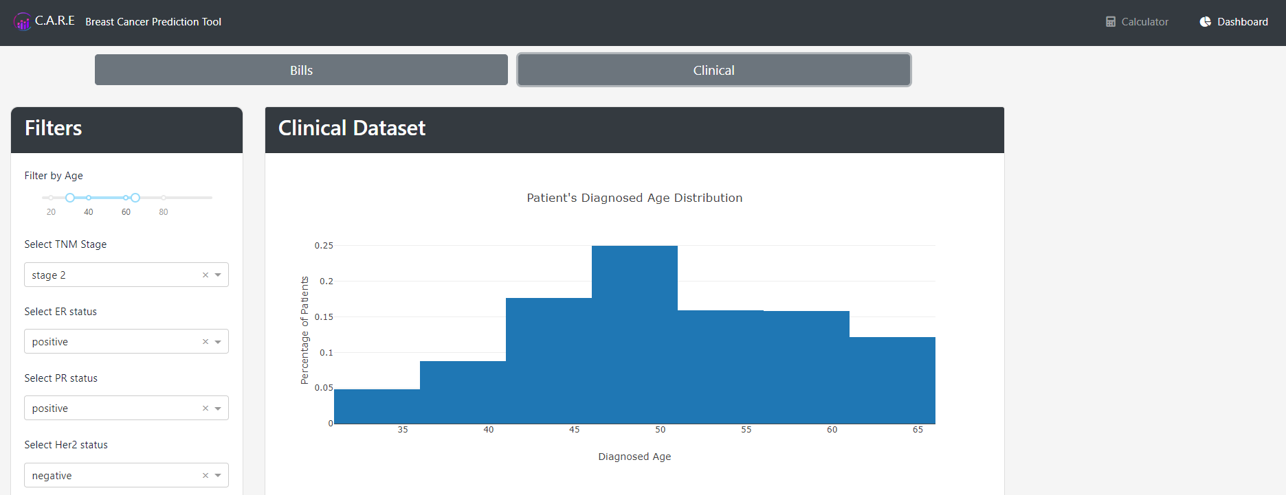
Notes:
//FOR CLINICAL//
Age distribution:
This is a histogram that displays the age distribution in the clinical datafile.
This chart will be affected by all of the filters in the panel. Which means that the histogram is showing the age distribution of those btwn the age of 30+ to 60+, tnm stage 2, er positive, pr positive, her2 negative

Slide 5
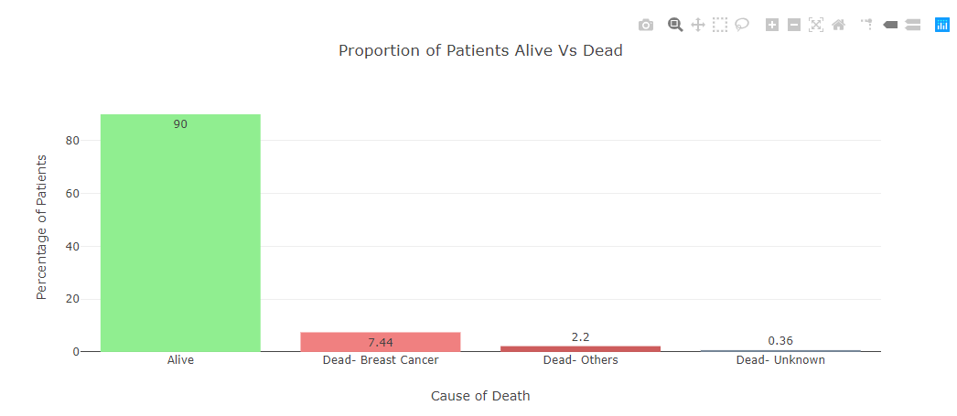
Notes:
Proportion of Alive vs Dead:
Displays the percentages of patients that are alive, dead due to breast cancer, dead due to other causes, or dead due to unknown causes.
This chart will be affected by all of the filters. Which means that the bar chart is showing the status (alive/dead) distribution of those btwn the age of 30+ to 60+, tnm stage 2, er positive, pr positive, her2 negative.

Slide 6
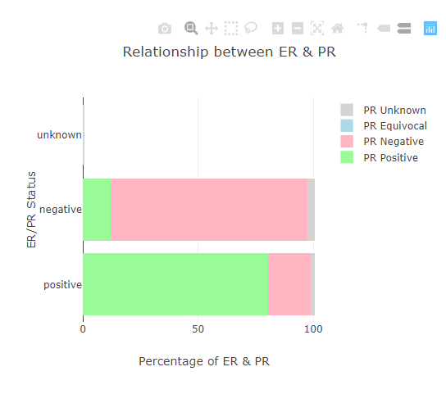
Notes:
Relationship between ER & PR:
This chart displays the relationship between ER (Estrogen) and PR (progesterone)
This chart will not be affected by the er and pr dropdown as we aim to display the relationship between the 2 hormones.
For patients btwn the age of 30+ to 60+ & tnm stage 2 , this is their er & hr relationship.
Pls let us know if you have any questions! ☺

