Slide 1

Introduction to Building and Running Groundwater Models
ARIZONA HYDROLOGICAL SOCIETY
PHOENIX CHAPTER
October 1st, 2026
Nathan Miller Justin Clark Instructors

Slide 2


BIOS
Nathan Miller
President of Arizona Matrix New World / True Environmental (Since 2007)
Justin Clark
Senior Groundwater Modeler, Hydrogeologist
Lynker Corp. (Since June 2022)
ADWR (2017-2022)
Matrix New World / True Environmental (2013-2017)
HydroGeoPhysics, Inc. (2013)

Slide 3
OVERVIEW Workshop Sections
Modeling Overview
-Modeling Terms
-Model Types
-Groundwater Models
-Model Usage
-MODFLOW Versions
-MODFLOW Models in AZ
-Guidance for MODFLOW
MODFLOW Data Extraction
-Tools and Example
-Data Visualization
Advanced Topics
-Particles and Transport
-3D Techniques
-Integrated Modeling
-Model Calibration
Calibration Example
-1 Test Model
MODFLOW Examples
-5 Test Models

Slide 4

LEARNING OUTCOMES
Training Goal
Class participants will learn what a Numerical Groundwater Model is used for and how to generate one. Model application and calibration will be tauight. Participants will gain hands-on experience using MODFLOW to model groundwater on different scales.

Slide 5
TYPES
Model Usage
Conceptual Models
Description or pictorial representation of features, processes or events of water movement in the subsurface.
Parameters for features and process can be assigned using conceptual understanding.
Numerical Models
Equations used to define the movement of water through the hydrologic cycle.
This class focuses on those that are used to estimate the hydrologic process in the groundwater system, the flow of groundwater.

Slide 6
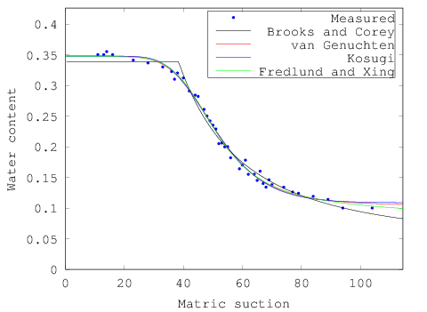
MODELING TERMS
Primary Types of Models
Process-based
Physical processes and principles approximated to evaluate the modeled system.
→ MODFLOW
→ FEFLOW
→ SWAT
→ HEC-HMS
→ Most Environmental Models
Data-driven or Empirical
Empirical or statistical equations derived from available data are used to calculate an unknown variable.
→ Brooks-Corey (1966)
→ Grenn and Ampt (1911)
→ Clapp and Hornberger (1978)
From Haverkamp and Parlange, 1986

Slide 7
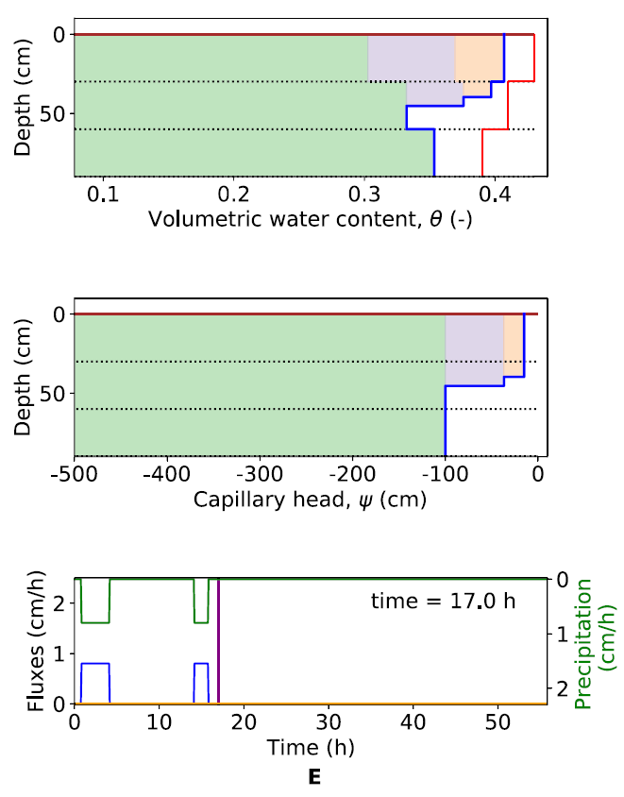
MODELING TERMS
Data-driven or Empirical Models
Empirical or statistical equations derived from available data are used to calculate an unknown variable.
Vadose zone processes are still commonly studied using empirical models. Example to right shows a modified Green-Ampt model being used to model subsurface soil moisture.
La Follette, P., Ogden, F. L., & Jan, A. (2023)
Water Content
Initial Soil Moisture
Saturated WC
One Precip. Pulse
Two Precip. Pulses

Slide 8
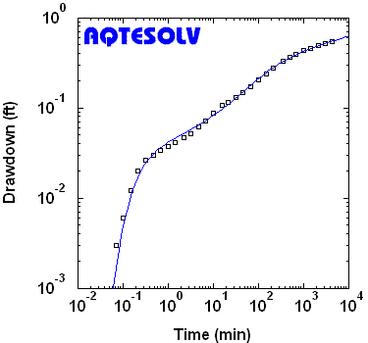
MODELING TERMS
Process-Based Models
Analytical Model
A math-formula based solution of groundwater flow through governing equation(s) and solution algorithm(s).
→ AQTESOLV
→ AquiferWin32
→ MLAEM
→ TH_Wells
Most analytical solutions assume homogeneous porous media, simple geometry and ideal boundary conditions.
Analysis of a constant-rate pumping (Tartakovsky and Neuman 2007). From AQTESOLV.com (HydroSOLVE, Inc).

Slide 9
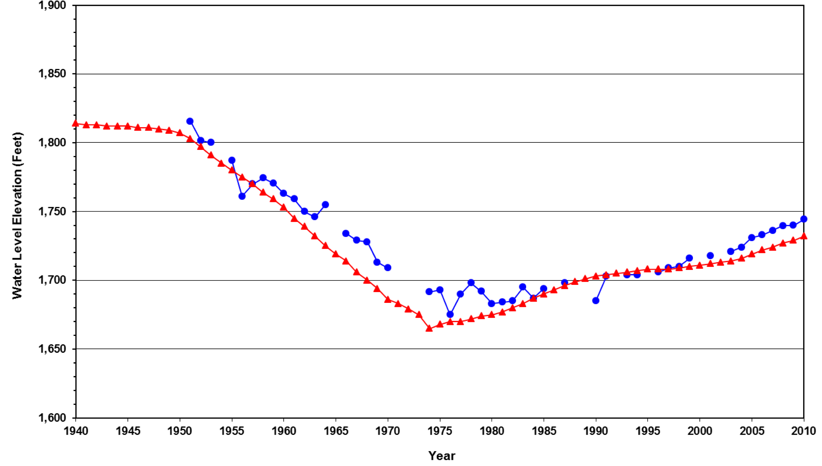
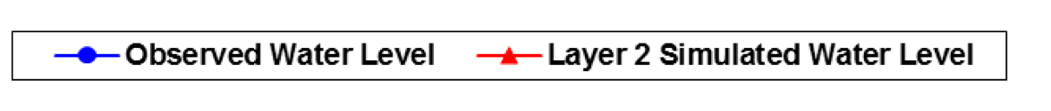
MODELING TERMS
Numerical Models
Deterministic
A model that makes a singular prediction or has a single outcome based on single set of inputs.
→ Most Predictive Groundwater Models
Results from the Tucson AMA 2010 Model for a single well with a long water level history.
ADWR
2013

Slide 10
MODELING TERMS
Numerical Models
Deterministic
Can be problematic if uncertainty or model changes are a concern.
ADWR , 2023
ADWR , 2024

Slide 11
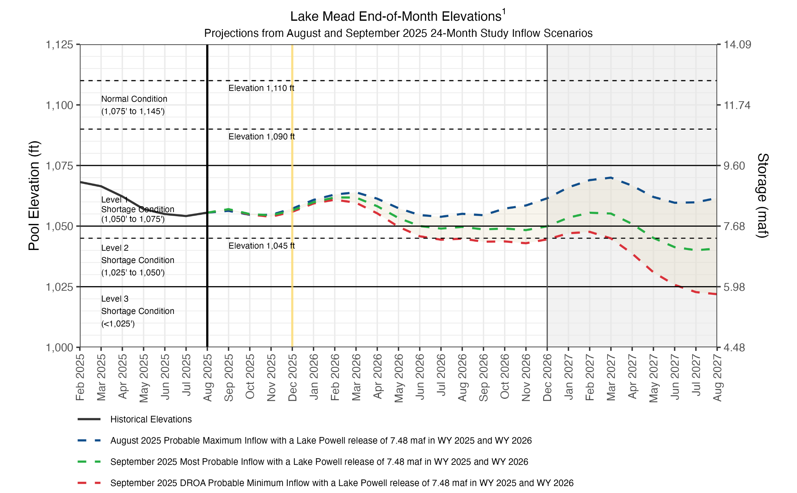
MODELING TERMS
Numerical Models
Probabilistic
A model that uses many parameter combinations based on statistical distributions and literature values.
→ Most Climate Models
→ CRSS:
USBR 2025
Colorado
River
Simulation
System

Slide 12
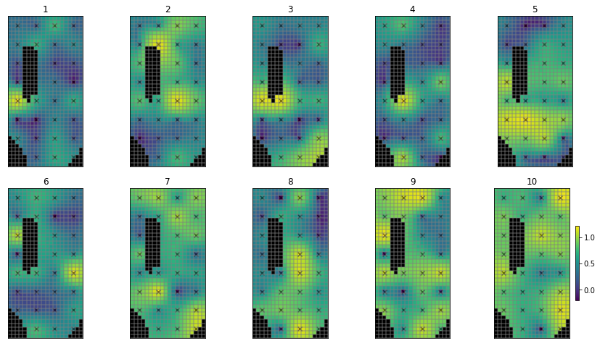
MODELING TERMS
Numerical Models
Probabilistic & Deterministic
Many use of both, for different purposes:
Deterministic
→ Management, Planning and Regulatory Decisions
Probabilistic
→ Risk Management
→ Uncertainty Analysis
GMDSI, 2023
Monte Carlo Setup Example

Slide 13
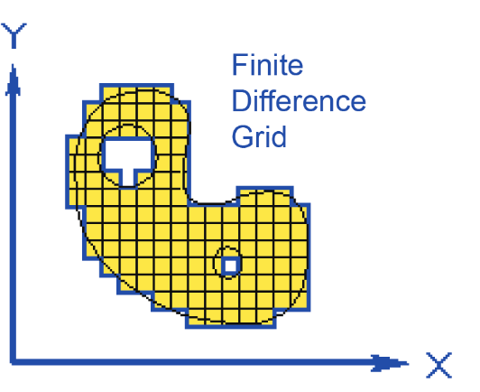
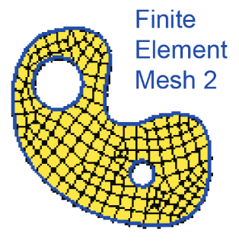
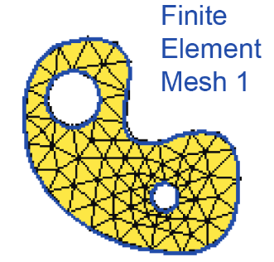
MODELING TERMS
Numerical Models
Finite Difference
Nodes in rectangular grid using layer, row, column index (i,j,k).
Finite Element
Nodes in mesh with defined connections and spatial coordinates (x,y,z).
→ FEFLOW
→ HydroGeoSphere
→ Most MODFLOW Releases

Slide 14
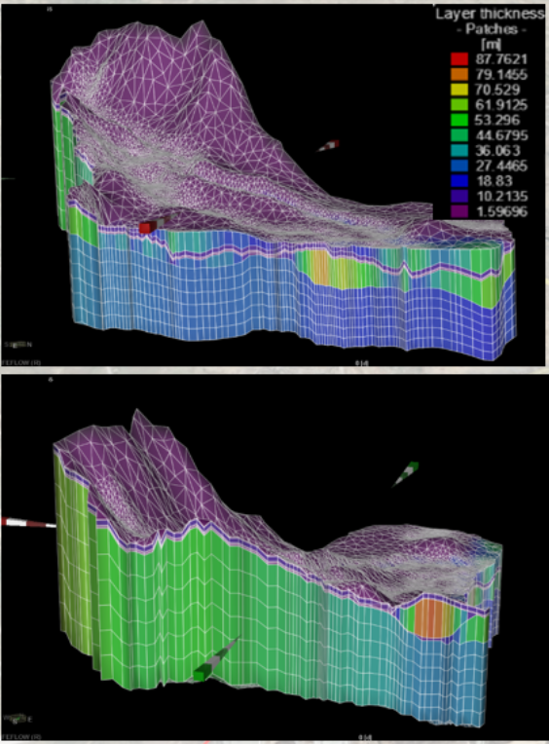
MODELING TERMS
Numerical Models
Finite Element
FELFLOW commonly used in mining industry due.
-Complex grids are often employed.
-Representation of boundary conditions often simplified.
-Run time and file size can become issues.
-Costs ~$5,000 - $8,000 per year

Slide 15
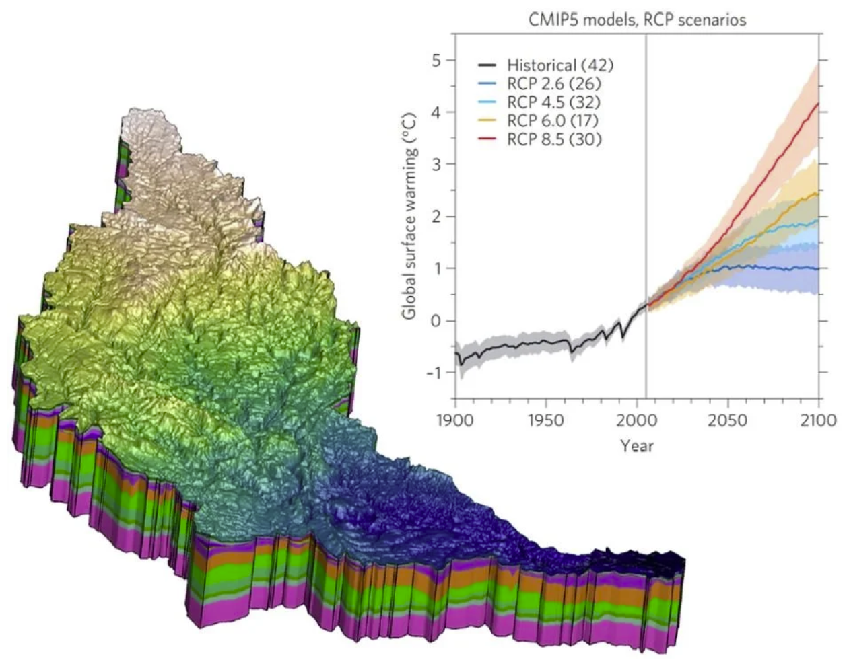
MODELING TERMS
Numerical Models
Finite Element
HydroGeoSphere is used in mining industry, contaminated sites, and integrated modeling.
-Solves unsaturated flow equation.
-Includes complex chemical and multiphase options.
-Run time can become an issue.
-Costs ~$10,000 per year

Slide 16
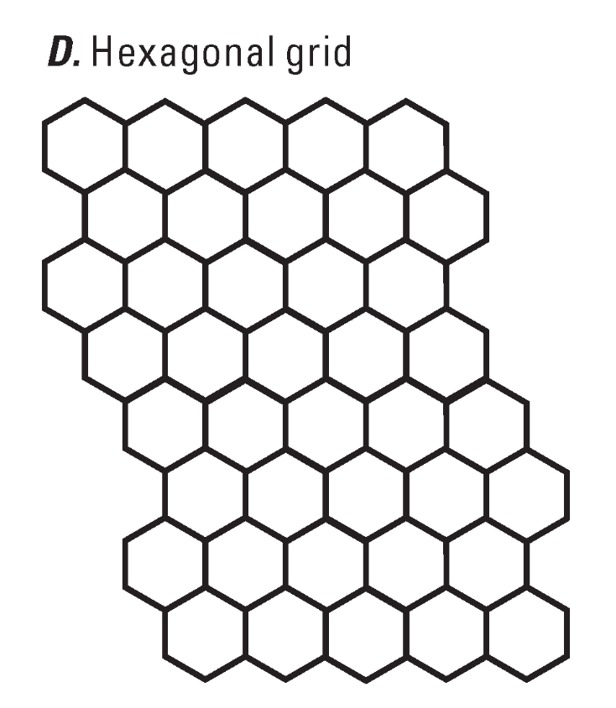
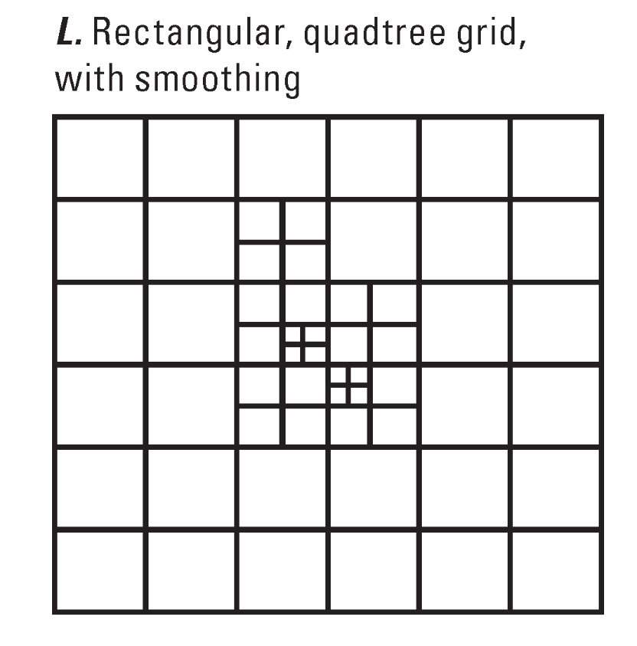
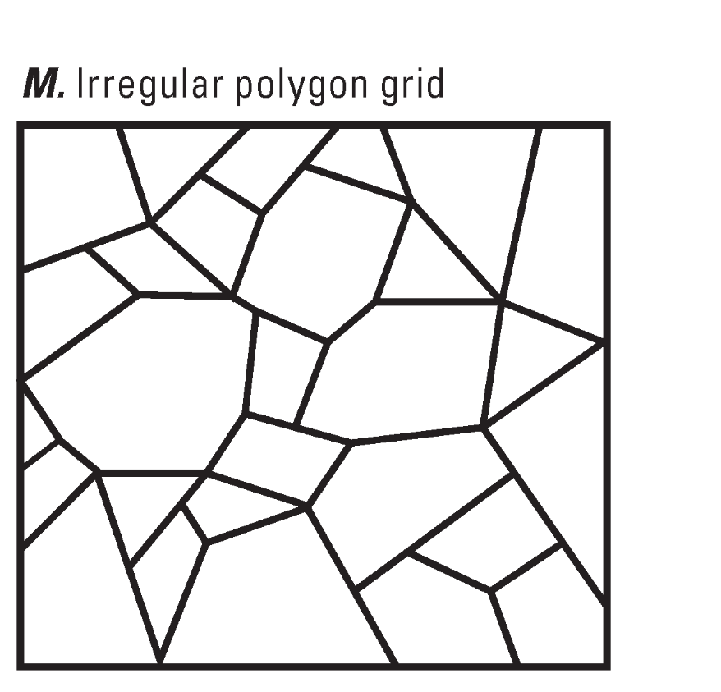
MODELING TERMS
Numerical Models
Finite Volume
Cutting-edge method developed Sorab Panday (GSI, USGS)
allowing more complex grid options.
→ MODFLOW-USG, MODFLOW 6

Slide 17
USAGE JUSTIFICATION
Why Do We Model?
Usage
-Basic understanding of groundwater system
-Estimation of aquifer properties
-Understanding the present
-Understanding the past
-Estimating future conditions
Common Applications
-Predicting the effects of groundwater pumping on future availability.
-Predicting the effects of enhanced recharge on local groundwater levels.
-Determining the direction of transport in a groundwater system to avoid potential risk.
Interpretive
Hindcasting Forecasting

Slide 18
USAGE JUSTIFICATION
When Do We Model?
When to Use a Model
A model should be used when estimating the response of an aquifer system to stresses or significant physical changes.
Cautionary Notes
All models are inexact and expressing the degree of uncertainty is necessary.
Models can be expensive and, in some cases, are not justified due to cost and desired outcomes.

Slide 19
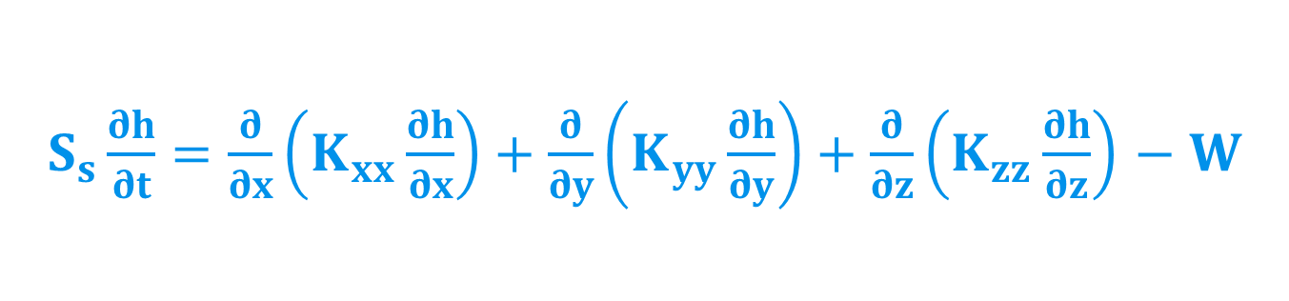
$S_{s}\frac{∂h}{∂t}=\frac{∂}{∂x}\left(K_{xx}\frac{∂h}{∂x}\right)+\frac{∂}{∂y}\left(K_{yy}\frac{∂h}{∂y}\right)+\frac{∂}{∂z}\left(K_{zz}\frac{∂h}{∂z}\right)$ $− W$
MASS CHANGE TERM
Change in Head over time
Source or Sink
Change in Head in Principal Directions of Flow
Specific Storage
Hydraulic Conductivity in Principal Directions of Flow
The Governing Equation:
Richard’s Law
(MacDonald and Harbaugh, 1988)

Slide 20
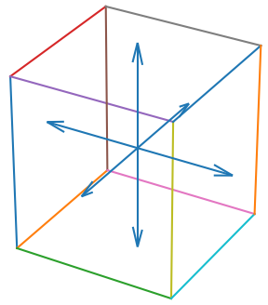
GROUNDWATER FLOW EQUATION
Governing equation is solved simultaneously for each node or volumetric block connected in a grid.
Block Model

Slide 21
MODFLOW VERSIONS
MODFLOW Versions
Outdated
-MODFLOW 88
-MODFLOW 96
-MODFLOW 2000
-MODFLOW 2005
-MODFLOW NWT
-MODFLOW LGR
Actively Being Developed
-MODFLOW One Water
-MODFLOW USG
-MODFLOW 6
-MODFLOW-SURFACT
No Longer Used
Still Used Commonly
Proprietary Version

Slide 22
MODFLOW VERSIONS
MODFLOW One Water
Release Info
MODFLOW-OWHM: One Water Hydrologic Flow Model
V1.0.0 Released in 2014
V1.0.12 Released in 2016
V2.3.0 Recently Released
Features
Ideal version for integrated and coupled hydrologic flow modeling.
-Newtonian Solver (NWT)
-Local Grid Refinement (LGR)
-Surface-Water Routing (SWR)
-Farm Process (FMP2)
-Subsidence w/Compaction (SWT)
-Riparian Evapotranspiration (RIP-ET)
-Groundwater Flow (GWF)
-Connected Linear Networks (CLN)

Slide 23
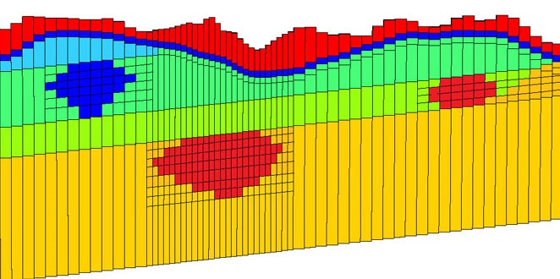
MODFLOW VERSIONS
MODFLOW USG
Release Info
MODFLOW-USG: An Unstructured Grid Version of MODFLOW
1.0 Released in 2013
2.5.0 Released in April 2025
Features
Control Volume Finite-Difference derivation allowing for complex grids
This is version contains an internal geochemical transport module
-Groundwater Flow (GWF)
-Connected Linear Networks (CLN)

Slide 24
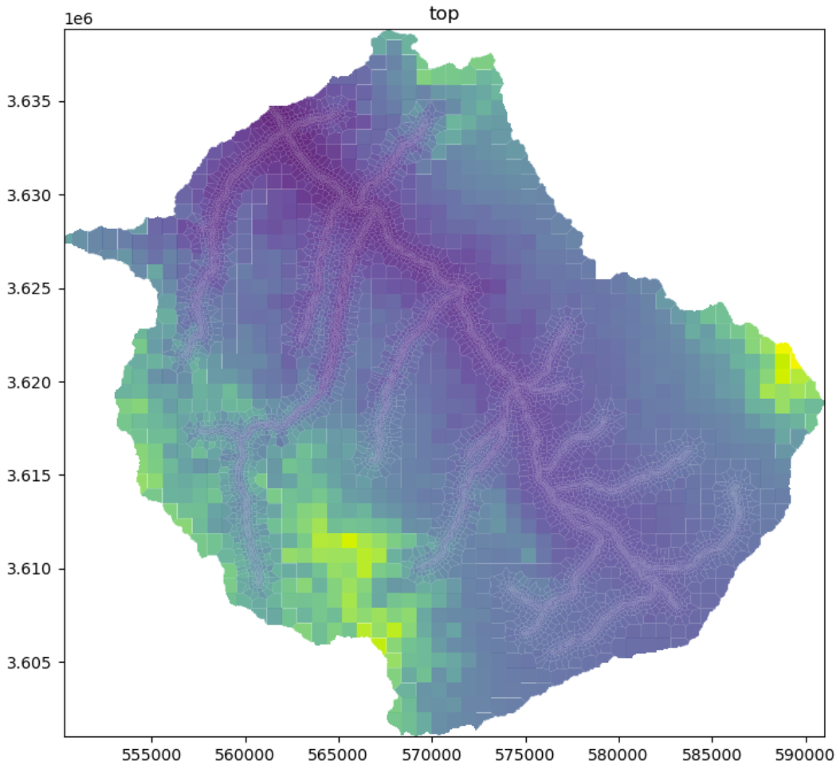
MODFLOW VERSIONS
MODFLOW 6
Release Info
MODFLOW-USG: An Unstructured Grid Versionof MODFLOW
6.0.0 Released in 2017
6.6.0 Released in December 2024
Features
Flexible grid options.
Currently being developed with new / updated features.
https://hatarilabs.com/ih-en/regional-groundwater-modeling-near-a-water-reservoir-using-modflow6-and-mf6voronoi-tutorial

Slide 25
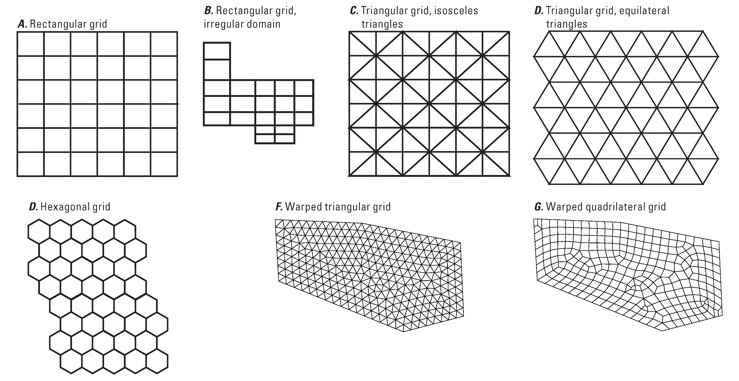
MODFLOW VERSIONS
MODFLOW USG
Structured Grids

Slide 26
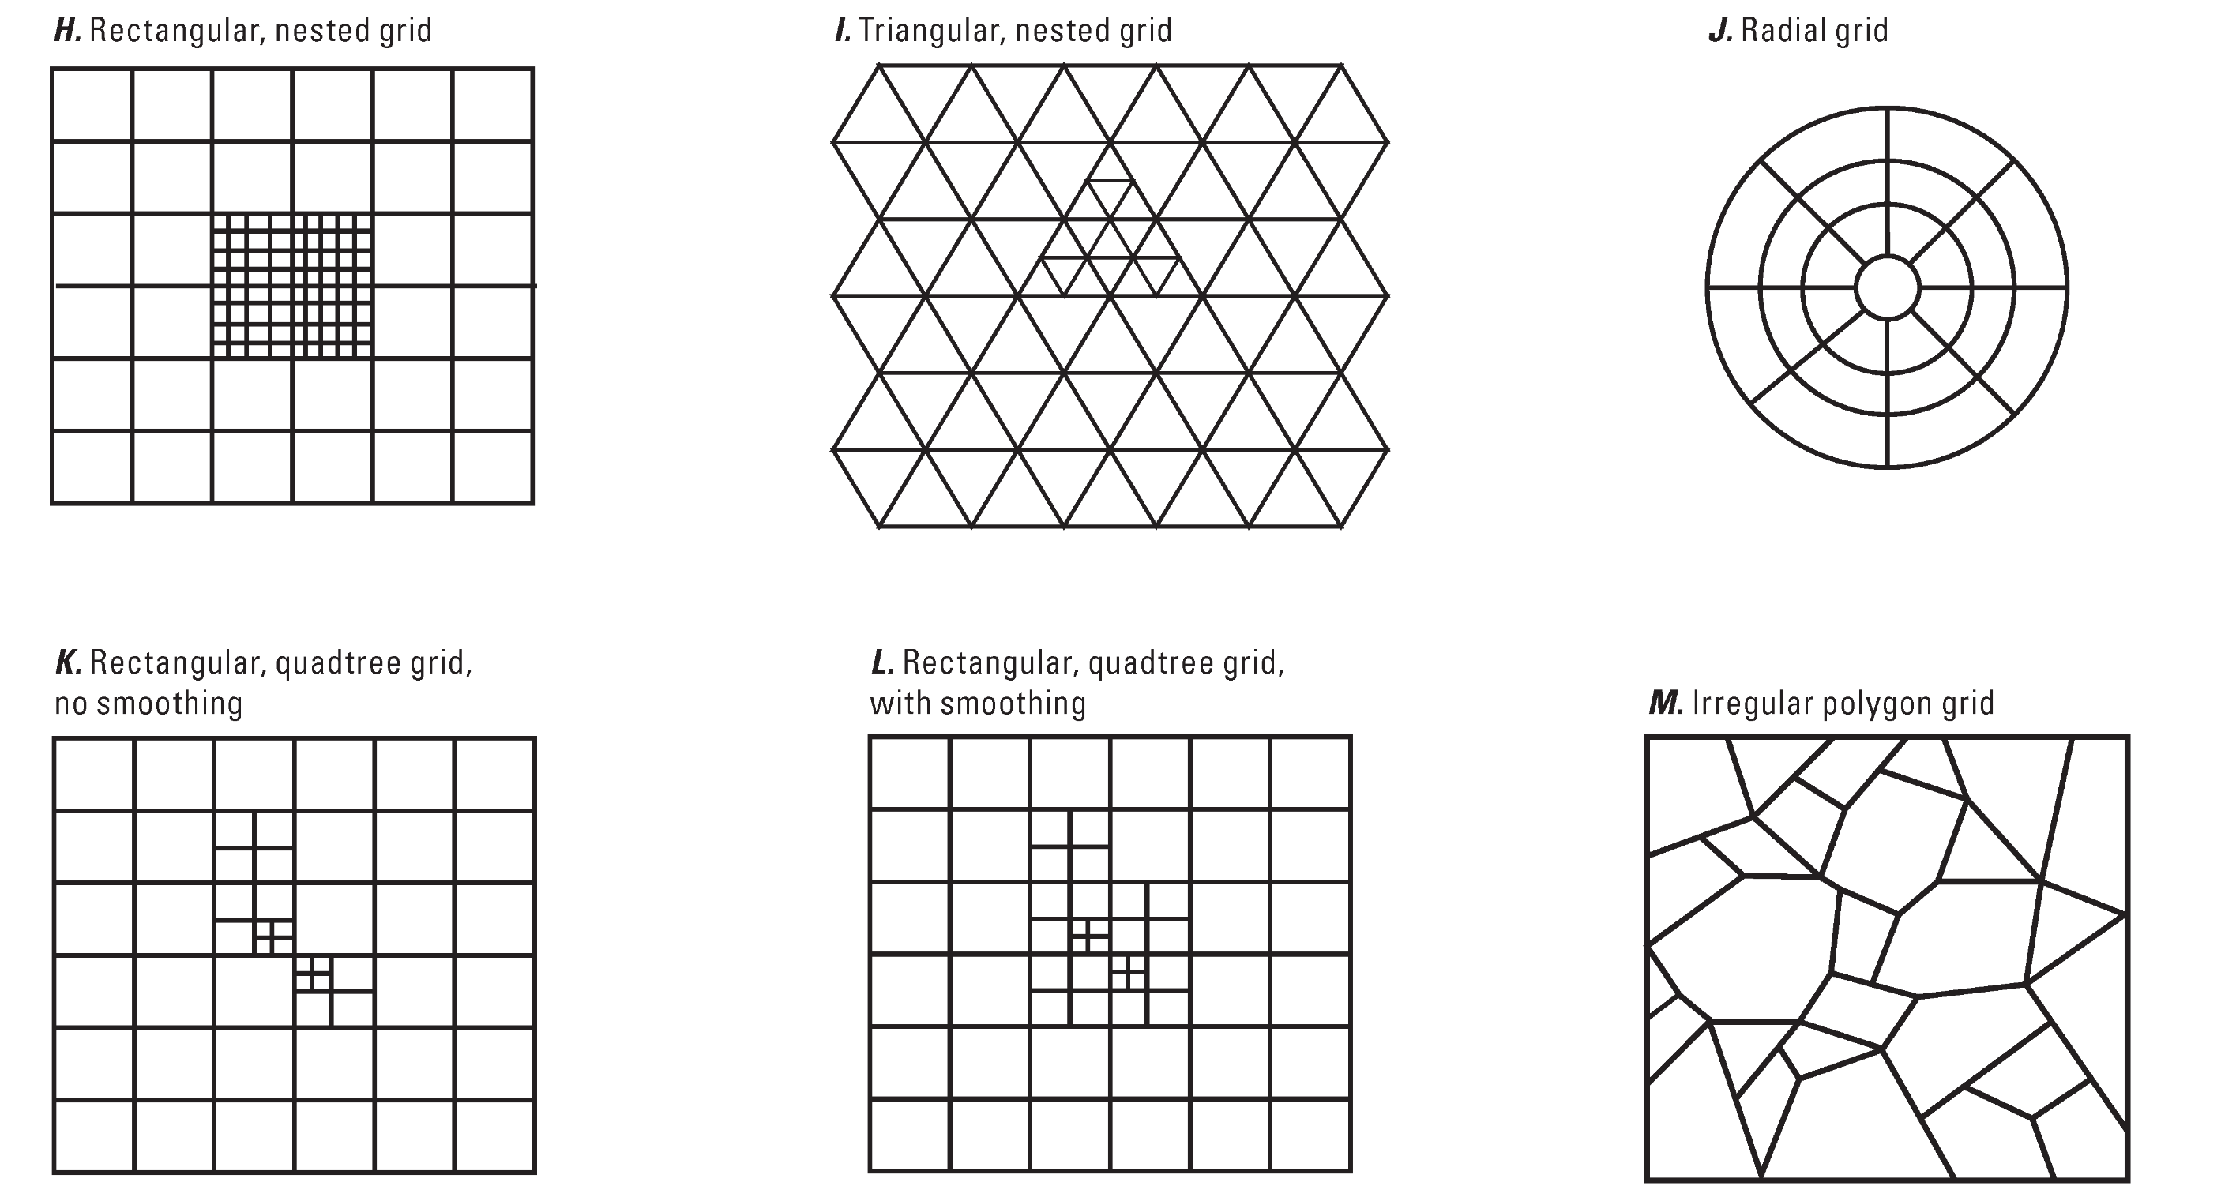

MODFLOW VERSIONS
MODFLOW USG
Unstructured Grids

Slide 27
MODFLOW VERSIONS
MODFLOW 6
Release Info
MODFLOW 6: USGS Modular Hydrologic Model
6.0.1 Released in 2017
6.0.4 Released in 2019
6.6.2 Released May 12, 2025
Features
-Object-Oriented Framework
-Complex Grids Allowed
-Control Volume Finite-Difference
-Direct Internal Coupling of Models
-Groundwater Flow (GWF)
-Groundwater Transport (GWT)
The next major iteration of MODFLOW. Allows for coupling hydrologic models. Not commonly used in the southwest.

Slide 28
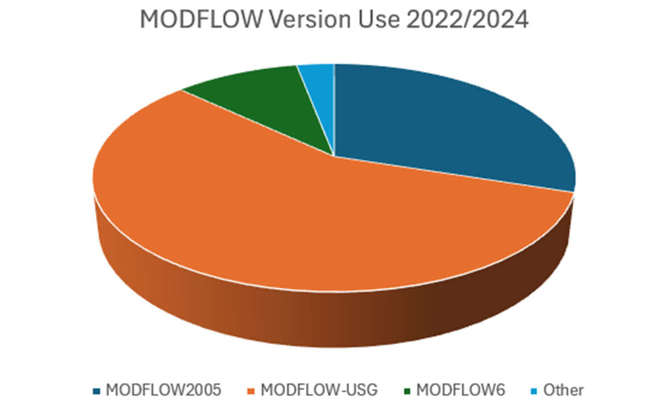
MODFLOW VERSIONS
MODFLOW-USG: 57%
MODFLOW 2005 & NWT: 30%
MODFLOW-6: 10%
Other: 3%

Slide 29
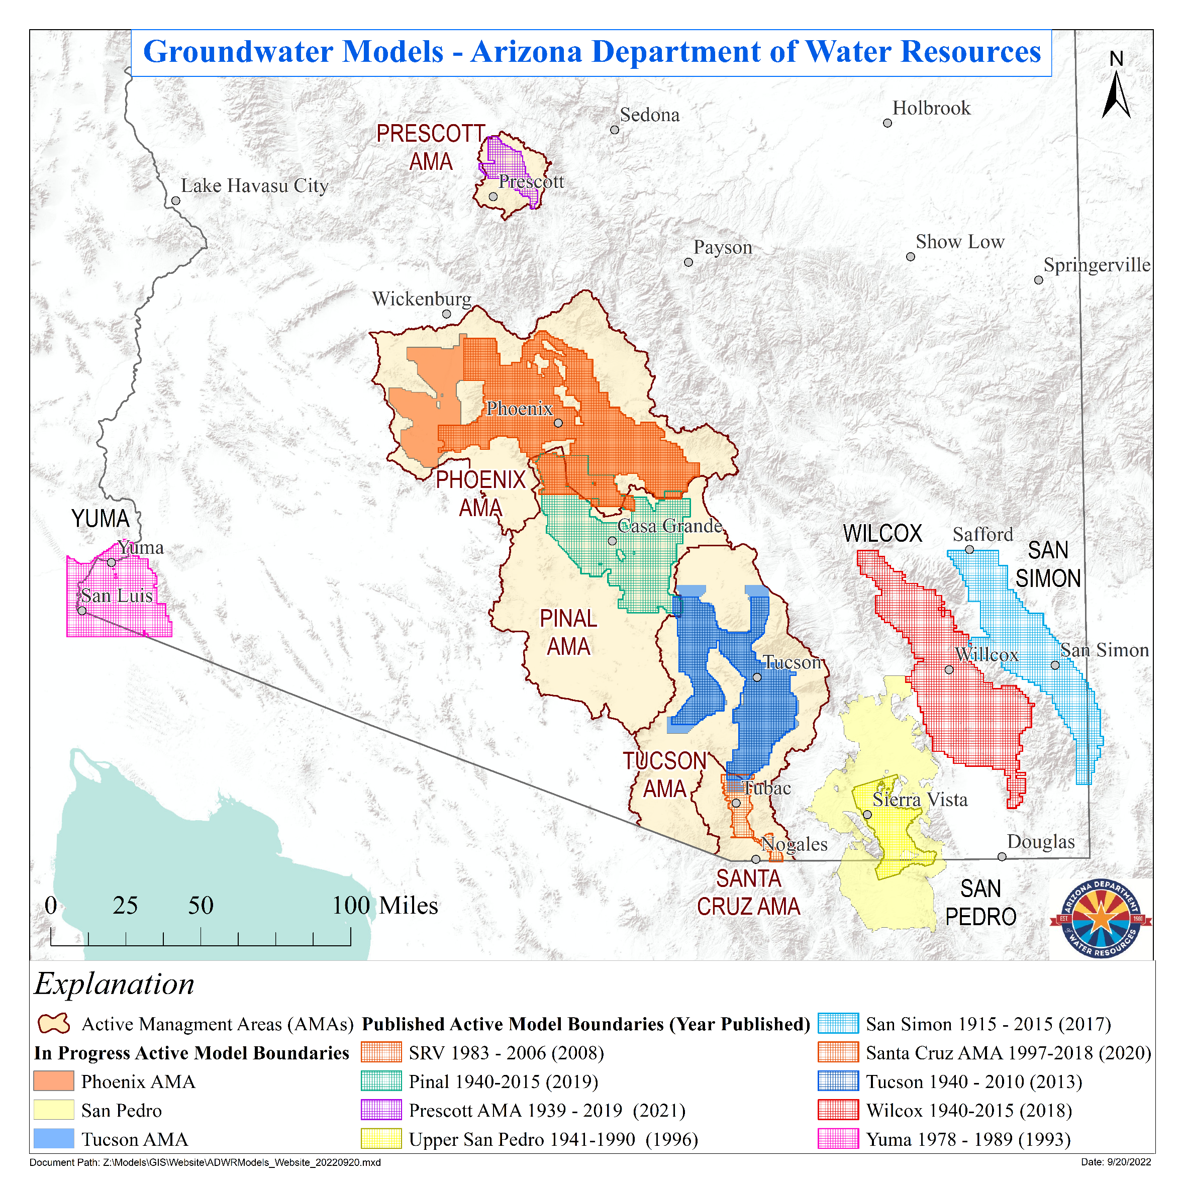
ARIZONA
MODELS
Developed
Groundwater Models
Map
ADWR
2022
Upper San Pedro (2024)

Slide 30
ARIZONA MODELS
Northern Arizona Groundwater Flow Model – NARGFM & RGRLGFM
Source: Coconino Plateau Water Advisory Council and Watershed Partnership
https://cpwac.org/wp-content/uploads/2023/05/RGRL-Groundwater-Flow-Model.pdf

Slide 31
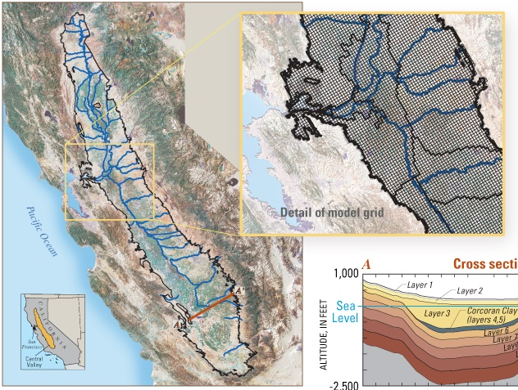
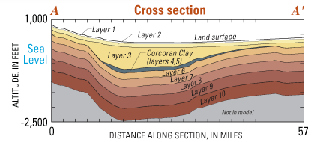
OTHER MODELS
Central Valley - CVHM

Slide 32
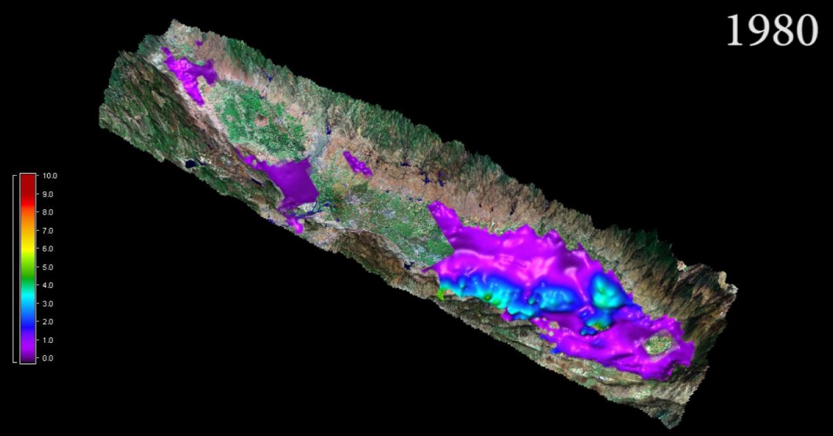
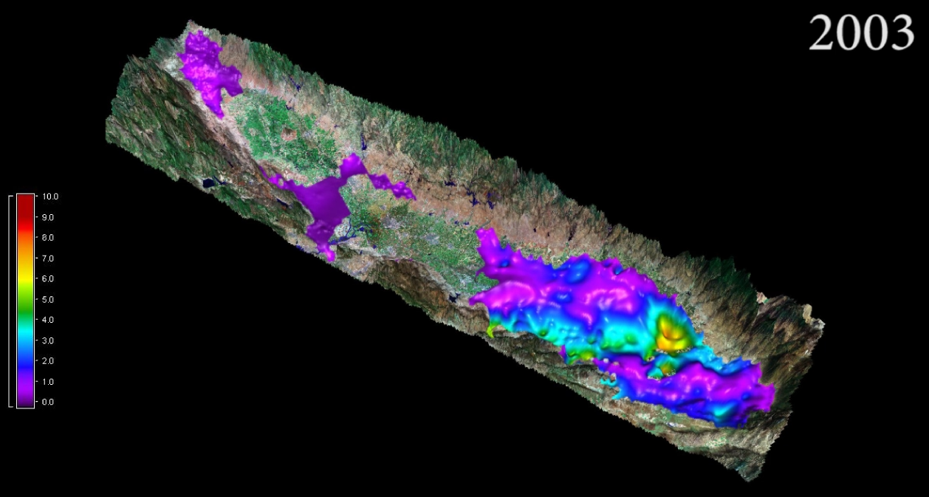
OTHER MODELS
Central Valley - CVHM
~ 4 m of subsidence in 1980
Groundwater modeling in the Central Valley of California has calculated high rates of subsidence due to groundwater pumping.

Slide 33
OTHER MODELS
Central Valley - CVHM
~ 9 m of subsidence in 2003
Groundwater modeling in the Central Valley of California has calculated high rates of subsidence due to groundwater pumping.

Slide 34
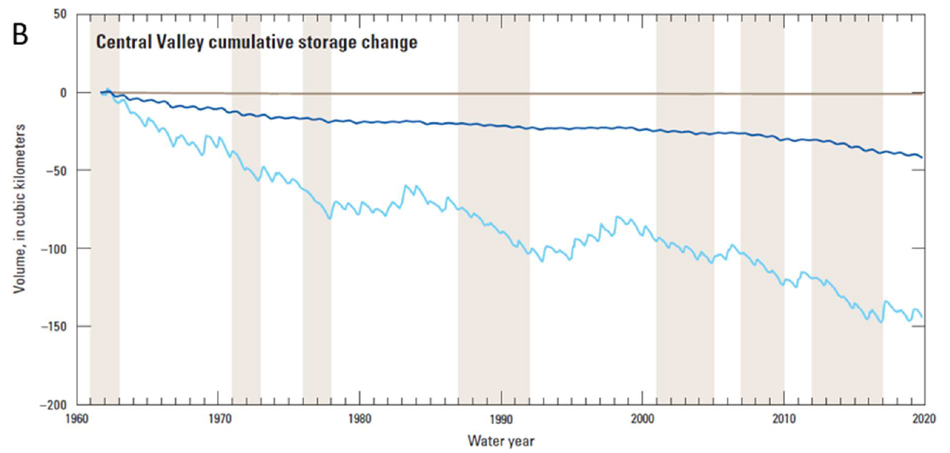
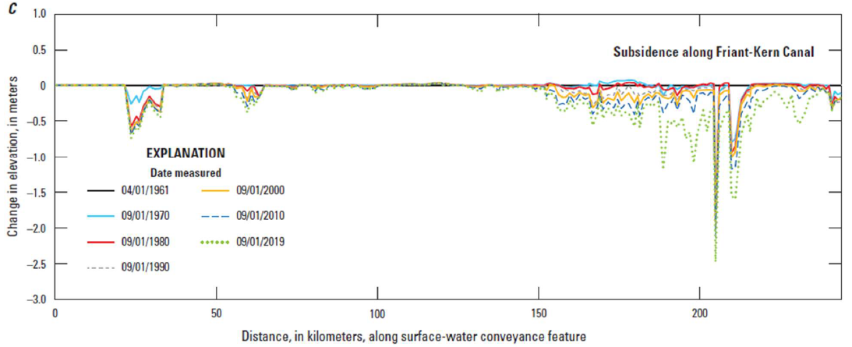
OTHER MODELS
Central Valley - CVHM
Storage loss and subsidence can be modeled in detail with MODFLOW One Water. Allows for more complex scenario analyses.
Faunt, et Al. (2024). Groundwater Sustainability and Land Subsidence in California’s Central Valley.

Slide 35
MODFLOW MODELING
Running MODFLOW
DOS Execution (Windows CMD)
The simplest way to run MODFLOW.
Running MODFLOW With a GUI
Graphical User Interfaces often have a model execution option with on-screen progress reporting. Can be very helpful but take time to learn.
MODFLOW in Linux / Unix
The source code for most versions of MODFLOW is publicly available. The OS can be changed during compiling.

Slide 36
MODFLOW MODELING
GUI Options
Groundwater Vistas
The common GUI for MODFLOW for many years. Known for good feature support and technical support. Recent updates extend 3D capabilities.
Visual MODFLOW
Strong conceptual modeling environment. Has great integration of calibration software PEST.
GMS
Provides a GIS based workflow and conceptual model framework. Advanced capabilities for visualization and meshing.
MikeSHE
Coupled model framework that makes integrated modeling more accessible. Recharge modules purchased separately.

Slide 37
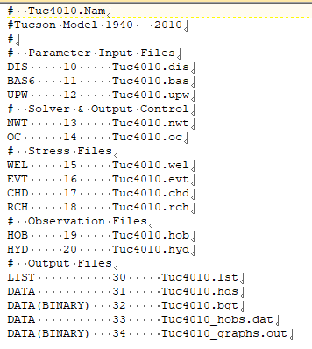
MODFLOW MODELING
Primary Control File
Name File
The file that stores
the filenames and
Fortran unit numbers
for input files read
by MODFLOW and
output files created
by MODFLOW.

Slide 38
MODFLOW MODELING
Parameter Input Files
Upstream Spatial Weighting (.UPW) Package
The package that defines the Hydraulic Properties of the modeled cells (Kx, Ky, Kz, SS, SY). Some versions of MODFLOW use the LPF or BCF Packages.
Basic Package (.BAS)
Package defining the active model grid cells and the initial head conditions.
Model Discretization (.DIS) Package
The package that defines the geometry of the model.
-Section 1: Horizontal Discretization
-Section 2: Vertical Discretization
-Section 3: Temporal Discretization

Slide 39
MODFLOW MODELING
Stress Files
Well (.WEL) or Multi-Node Well (.MNW) Package
Packages to model the process of pumping or recharging water through a groundwater well.
Stream (.STR) or Streamflow Routing (.SFR) Package
Packages that model the process of streamflow and groundwater interaction with streams (both in and out).
Recharge (.RCH) Package
A package designed to add water recharged to the surface to the uppermost groundwater layer, does not have internal lagging.
Lake (.LAK) Package
Simulates reservoirs as lakes that can rise and fall due to groundwater and stream interactions.

Slide 40
MODFLOW MODELING
Stress Files (cont.)
Constant Head (.CHD) Package
Package designed to model boundary fluxes. The constant head package defines the head at boundary cells.
Global Head (.GHB) Package
Packages designed to model boundary fluxes. The global head package defines the head at a distance from the boundary location.
Evapotranspiration (.ET or .EVT) Package
A package designed to extract water from the groundwater system to simulate ET.
Drain (.DRN) Package
A MODFLOW package designed to simulate agricultural drains and ditches.

Slide 41
MODFLOW MODELING
Observation Files
Head Observations (.HOB) Package
Allows for the extraction of modeled data at point locations in space and time. Built for comparing field head observations to model results.
Hydrograph Observations (.HYD) Package
A package that lets the user choose locations to extract modeled head data for every model timestep.
Gage (.GAGE) Package
A package that lets the user extract streamflow modeled results specific times, to compare with observation data.

Slide 42
MODFLOW MODELING
Output Files
List (.LST or .LIST) Output
Run results log file. This file documents the reading of input files, shows model solver results and budget summaries. The best way to troubleshoot a program.
Heads (.HDS) Output
The output file containing cell specific head data by layer for specified times.
Budget Output
Calculated volumetric outflow/inflow rate between two connected cells output to a binary file. Also known as the cell-by-cell budget.
Observation File Outputs
HOB, HYD and GAGE packages each make output files.

Slide 43
SECTION 2
MODFLOW Examples
-Example1: Coarse Grid
-Example2: More Cells
-Example3: More Time
-Example4: USG
-Example5: Phoenix AMA
-Example6: One Water
-Example7: MODFLOW 6

Slide 44
SECTION 3
Data Extraction Methods
-Extracting from List file
-Extracting from Heads file
-Extracting from Budget file
-Flopy
-Connecting data to maps

Slide 45
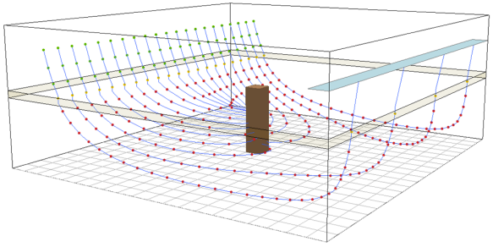
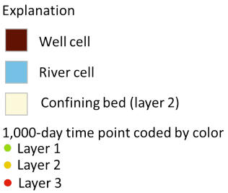
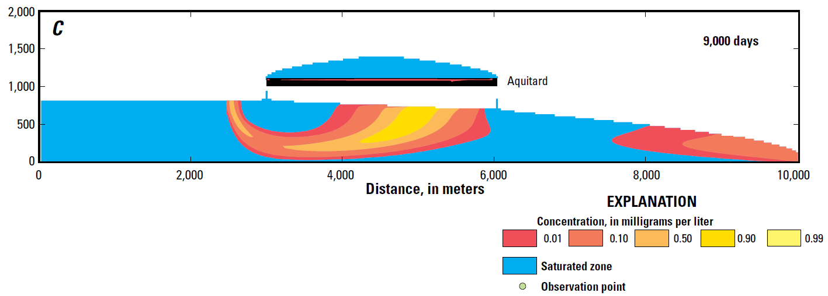
Particles and Transport
Simulation of Chemistry
MODPATH
Particle Trace Analysis
The modeling of a theoretical chemical particle emplaced into the model and simulated. Can be run forward or backward with ease.
Contaminant Transport and Groundwater Models
Geochemical species modeled as it is driven by water movement in the groundwater system. Reaction chemistry and multi-species interactions are not often modeled.
https://pubs.usgs.gov/publication/ofr20161086
MT3D
https://www.usgs.gov/software/mt3d-usgs-groundwater-solute-transport-simulator-modflow

Slide 46
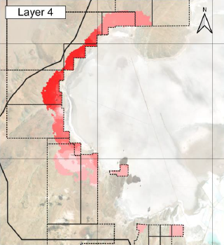
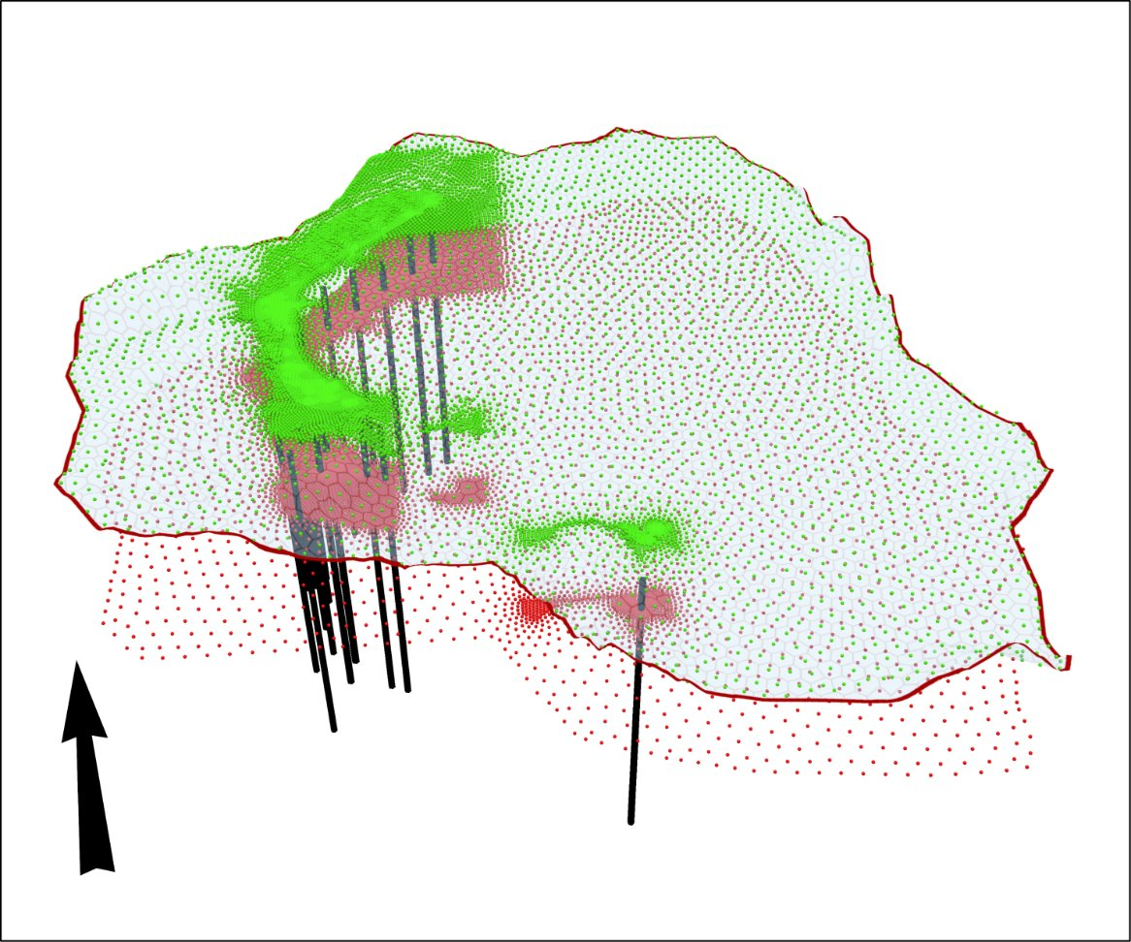


Particles and Transport
MT3D / MODFLOW-USG / MODFLOW-6

Slide 47
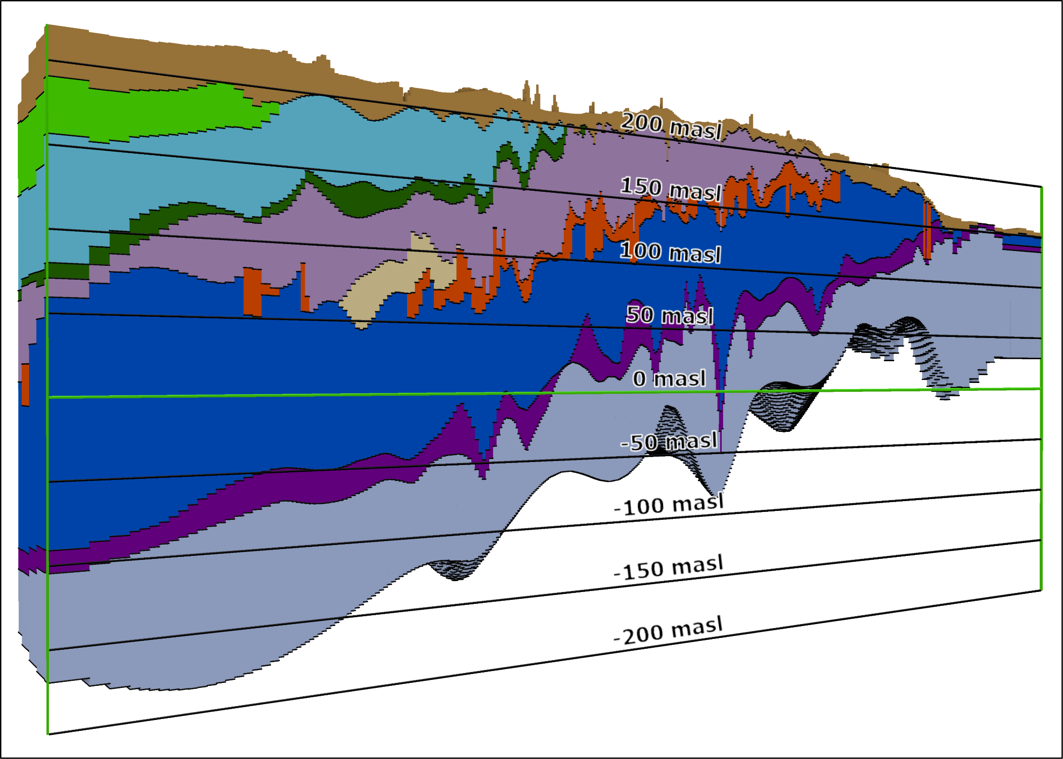
3D Methods
Current Workflows and Viewers
GIS – ArcGIS Pro, QGIS
Standard GIS programs do allow for 3D frameworks. Rendering requires good graphic capabilities.
3-D Viewers
Paraview is fast. Leapfrog is for Geology.
3-D Grid
Generation
AlgoMesh

Slide 48
Integrated Hydrological Modeling
Current Methods
Simulation of Vadose Zone Processes
The vadose zone is not explicitly modeled in most versions of MODFLOW. Careful attention must be paid implementing unsaturated flow into MODFLOW as convergence issues become more common.
Coupled Surface Water and Groundwater Models
Many recent examples and significant method development. USGS has developed GSFLOW (Precip. Runoff + MODFLOW).

Slide 49
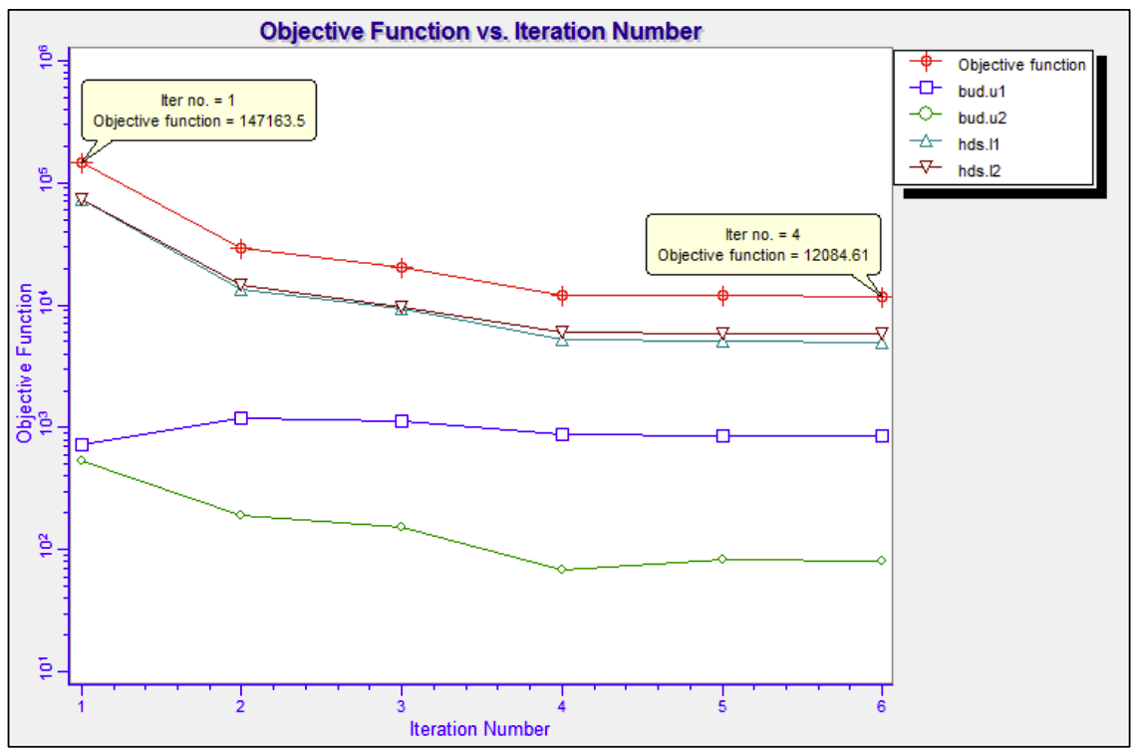
Calibration
Current Methods
PEST – External Parameter Estimation
Calibration of MODFLOW models can be done by implementing a parameter estimation tool that independently runs MODFLOW and collects results. PEST is the standard software used by most but other tools
Model Calibration within MODFLOW
Implementation of parameters within MODFLOW. These can be used for internal calibration of MODFLOW. The USGS has developed UCODE for this process.
ADWR (2021). 2021 Prescott AMA Groundwater Flow Model Update.

Slide 50
LOOKING FORWARD
Methods Being Developed
Coupled Surface Water and Groundwater Models
Many recent examples have been developed. Continued implementation in Arizona is important.
Coupled or Internal Contaminant Transport and Groundwater Models
Many codes have been developed but the process is resource intensive. Models with geochemical interactions should be used more commonly as computers capabilities improve.
Flow and Transport Animations
Being accomplished through model GUIs, GIS Software and/or automation (Python). These animated result methods can convey a lot of information quickly.

Slide 51
MODELING RESOURCES
Websites
ADWR
Groundwater modeling reports, model datasets and GIS datasets are available.
USGS
- Primary USGS MODFLOW Repository
- USGS maintains Flopy, the Python wrapper for MODFLOW.
- USGS San Diego Science Center hosts MODFLOW One Water.
Hatari Labs
A training resource with amazing video tutorials for modeling and GIS methods, varying levels of difficulty. Test datasets and Python scripts are available.
S.S. Papadopulos and Associates (SSPA)
Free tools for particle trace analyses, a model GUI (Groundwater Desktop), free contaminant transport codes.

Slide 52
MODELING RESOURCES
Written Material
USGS Guidance Documents
The user manuals for specific versions of MODFLOW and individual packages. Good input/output instructions at the end of guides.
Applied Groundwater Modeling, Second Edition: Simulation of Flow and and Advective Transport
Anderson, Woessner, Hunt (2015). Re-released classic book from 2002 has been expanded for the current digital world.
Effective Groundwater Model Calibration: With Analysis of Data, Sensitivities, Predictions, and Uncertainty
Hill and Tiedemen (2005). Reputable book about applied statistics for calibration of models.
ASTM Standards
A simple set of standard guidance documents that are useful and defensible.

Slide 53
MODELING RESOURCES
Training
Groundwater Resources Association (GRA)
MODFLOW training course at UC Davis campus.
AHS Phoenix / Tucson Chapters
Potentially offering training sessions on MODFLOW, not yet announced for 2026. We are taking suggestions.
USGS
The authors of MODFLOW offer training on using MODFLOW and Flopy. Has been affected by recent job status changes from Federal employees to private consulting companies.
GSI Environmental Inc. (Sorab Panday)
MODFLOW solvers class offered approximately every 6 months. This is an advanced level class.

Slide 54

The End
Questions?

