Slide 1
Analysis of Employee Data
Justin Cleveland
https://github.com/JustinCleveland/CaseStudy2DDS

Slide 2
Summary
Top 3 Factors Driving Attrition
Prediction Model for Employee Attrition
Prediction Model for Monthly Income

Slide 3
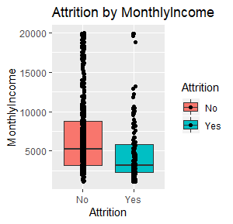
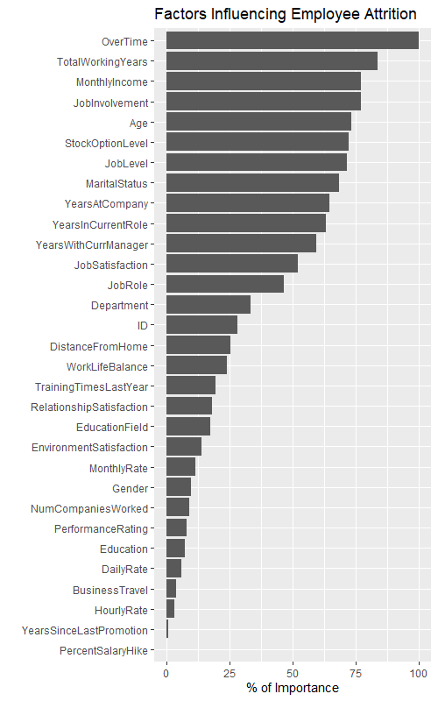
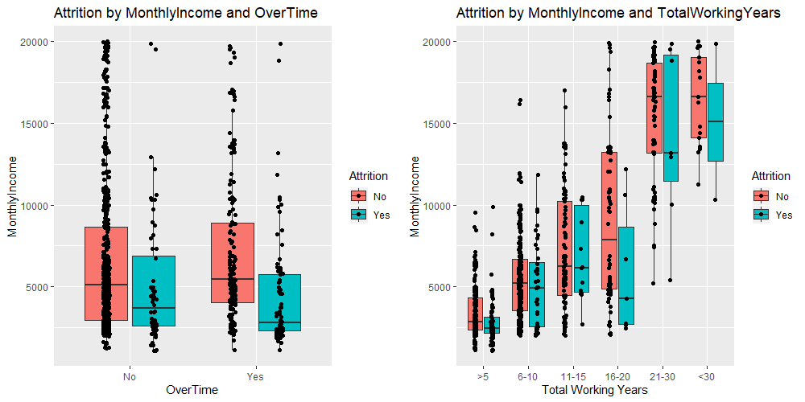
Top 3 Factor Driving Employee Attrition
Monthly Income
51% reported <$5000
71% greater propensity to leave
On average, paid <$2000 less than peers
Over Time
29% reported overtime
57% greater propensity to leave
Paid <$2500 less than peers
Total Working Years
64% reported <5 years
77% greater propensity to leave
Paid <$500 less than peers

Slide 4
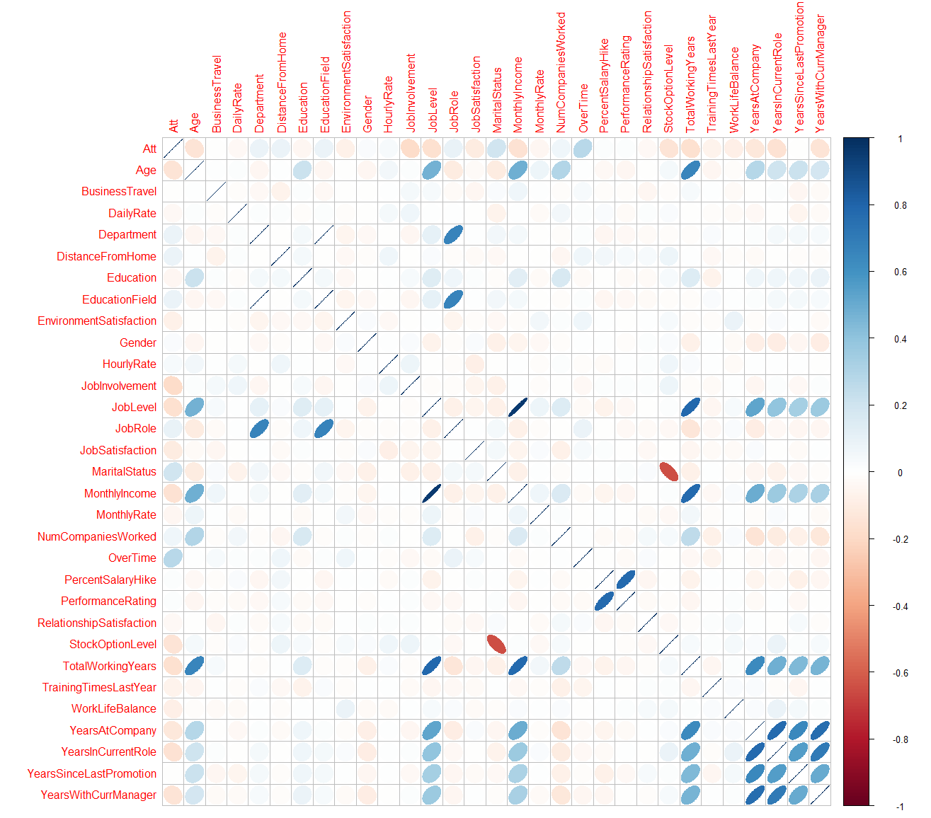
Correlation Matrix of Employee Attrition
Shows which factors influence Attrition
11 Significant factors
Significant factors (Highlighted)
Factor | corr coef | p-value
Attrition | 1 | NA
OverTime | 0.272 | 0
MaritalStatus | 0.197 | 0
JobInvolvement | -0.188 | 0
TotalWorkingYears | -0.167 | 0
JobLevel | -0.162 | 0
YearsInCurrentRole | -0.156 | 0
MonthlyIncome | -0.155 | 0
Age | -0.149 | 0
StockOptionLevel | -0.149 | 0
YearsWithCurrManager | -0.147 | 0
YearsAtCompany | -0.129 | 0
JobSatisfaction | -0.108 | 0.001
JobRole | 0.091 | 0.008
WorkLifeBalance | -0.09 | 0.008
Department | 0.087 | 0.01
DistanceFromHome | 0.087 | 0.01
EducationField | 0.087 | 0.01
EnvironmentSatisfaction | -0.077 | 0.023
TrainingTimesLastYear | -0.063 | 0.064
NumCompaniesWorked | 0.061 | 0.072
Education | -0.049 | 0.145
MonthlyRate | -0.043 | 0.203
RelationshipSatisfaction | -0.04 | 0.243
HourlyRate | 0.037 | 0.281
DailyRate | -0.034 | 0.319
Gender | 0.025 | 0.457
PercentSalaryHike | 0.015 | 0.652
PerformanceRating | 0.015 | 0.652
BusinessTravel | -0.006 | 0.857
YearsSinceLastPromotion | -0.005 | 0.893

Slide 5
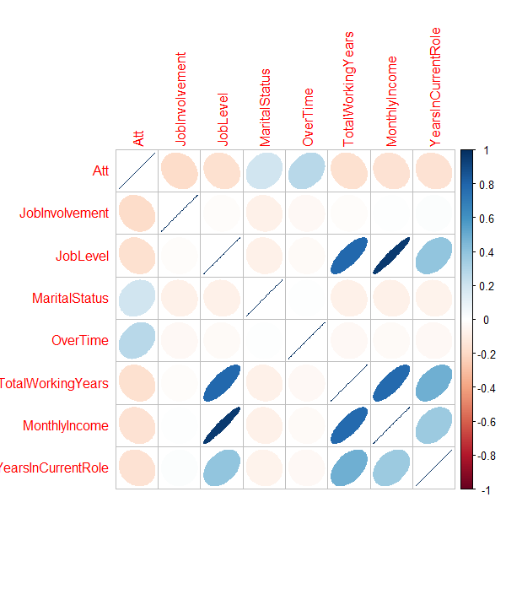
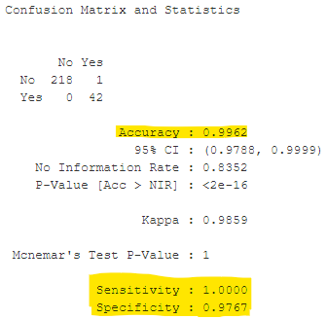
Predicting Employee Turnover
Naive Bayes Algorithm
Allows us to predict an outcome given that an event has occurred
7 Factors with the highest correlation and p-value
Achieved >95% Accuracy, Sensitivity and Specificity
Factor | corr coef | p-value
OverTime | 0.272 | <2e-16
MaritalStatus | 0.197 | <2e-16
JobInvolvement | -0.188 | <2e-16
TotalWorkingYears | -0.167 | <2e-16
JobLevel | -0.162 | <2e-16
YearsInCurrentRole | -0.156 | <2e-16
MonthlyIncome | -0.155 | <2e-16
Notes:
99% Accuracy
Percent of accurate prediction
100% Sensitivity
True positive rate
97% Specificity
True negative rate

Slide 6

Predicting Monthly Income
Model All Variables
Establish baseline for validation
29 Variables with more than 1 factor
Excluded single factor variables, example: Over18
Results
Adjusted R-squared = 91%
RMSE = 1353 / 1376 (Training and Test)
Notes:
RMSE = observed to predicted values
R2 = variance explained

Slide 7
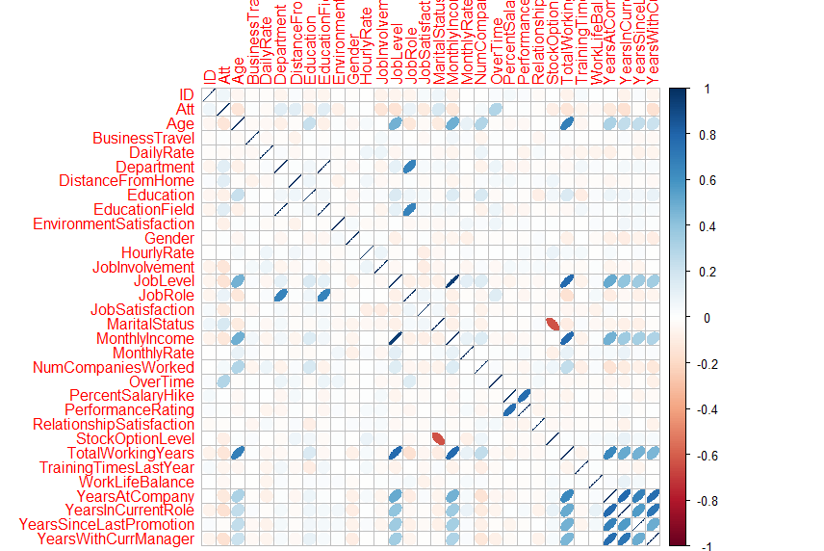

Predicting Monthly Income
Highly Correlated Variables
Slight improvement in fit
Adjusted R-squared = 92%
RMSE = 1369 / 1355 (Training and Test)
Factor | corr coef | p-value
Age | 0.49 | 0
JobLevel | 0.95 | 0
TotalWorkingYears | 0.77 | 0
Att | -0.13 | 0
JobSatisfaction | -0.08 | 0.04
MaritalStatus | -0.08 | 0.05

Slide 8
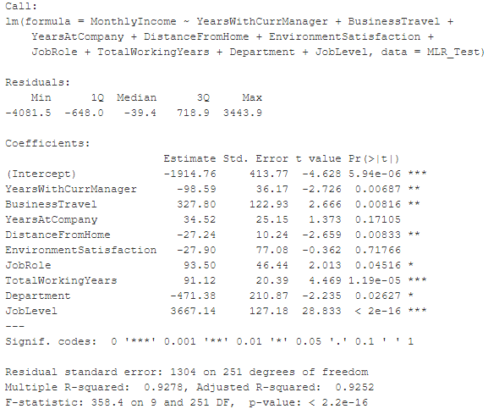
Predicting Monthly Income
Backwards Selection Method
Least significant is removed
9 Predictor Variables
Results
Final model achieving best fit
Adjusted R-squared = 93%
RMSE = 1304 / 1278 (Training and Test)
Formula:
MonthlyIncome =
-1914.8 +
YearsWithCurrManager(-98.6) +
BusinessTravel(327.8) +
YearsAtCompany(34.5) +
DistanceFromHome(-27.2) +
EnvironmentSatisfaction(-27.9) +
JobRole(93.5) +
TotalWorkingYears(91.1) +
Department(-471.4) +
JobLevel(3667.1)

