Slide 1
Java for c# Developers
Sean Blessing
August 2019

Slide 2

trainer bio
Originally from Evansville, Indiana
College – Indiana University Go Hoosiers!!!
Presently live in Mariemont, OH
Wife (14 years) and 2 kids: boy (9), girl (12)
Hobbies: Music, Travel, Hiking, Biking, Golf (renewed newbie)
23 years’ IT experience
15 years’ development
8 years’ software development management
3 years’ training experience

Slide 3
Elevator speech time!
Where are you from?
Family / Friends
Technical Experience Prior to Bootcamp
Hobbies / Something Interesting

Slide 4
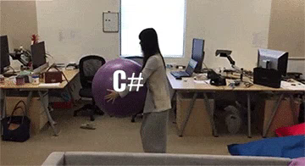
Why is java better than C#? (why is C# better than Java??)

Slide 5
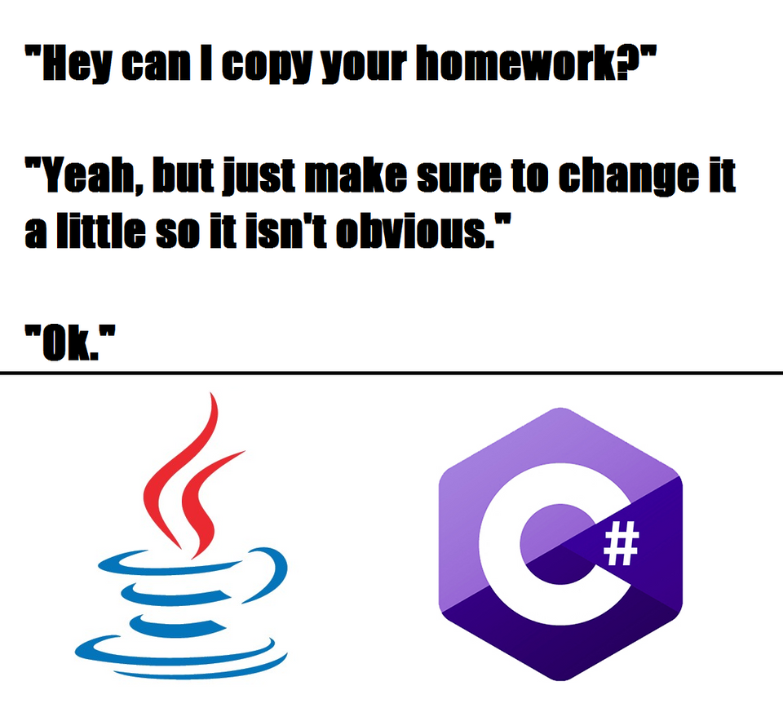
Can I copy your homework?

Slide 6
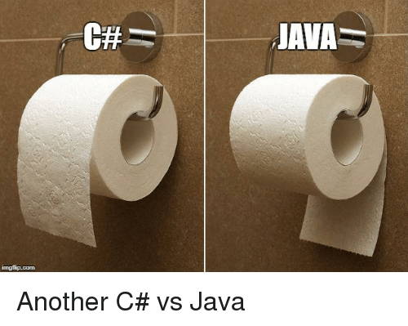
The differences are subtle…

Slide 7
Overview
Java and C# are very similar languages
Both are Object Oriented
Both are widely used in the industry
Each one can be the right solution - depending on the situation
Its always easier to learn subsequent languages

Slide 8
Key differences
The IDE: Visual Studio vs Eclipse STS (Spring Tool Suite)
Frameworks: .NET vs SDK
.NET ‘Solution’ vs Java ‘Project’
Subtle syntax differences
Method Names: camelCaseMethod() vs PascalCaseMethod()
C# syntax ‘short-cuts’
Ex: ‘get’ and ‘set’
Each one can be the right solution - depending on the situation

Slide 9
Level-set
Git & GitHub
Have you been active in pushing code to GitHub?
Have you been using CLI? We will use CLI in this class.
Capstone (PRS) Progress
Do you have a PRS DB?
Have you created PRS business classes yet?

Slide 10
Goals
Demonstrate Java Examples
This won’t be Java ‘instruction’, as you’ve already had lots of instruction!
Labs to practice Java
Project file -> Instructor provides to you now!
How to Use Eclipse.pdf
By end of instruction you should be able to create small Java programs and understand Java code confidently
Create business objects for PRS, PRSConsole app

Slide 11
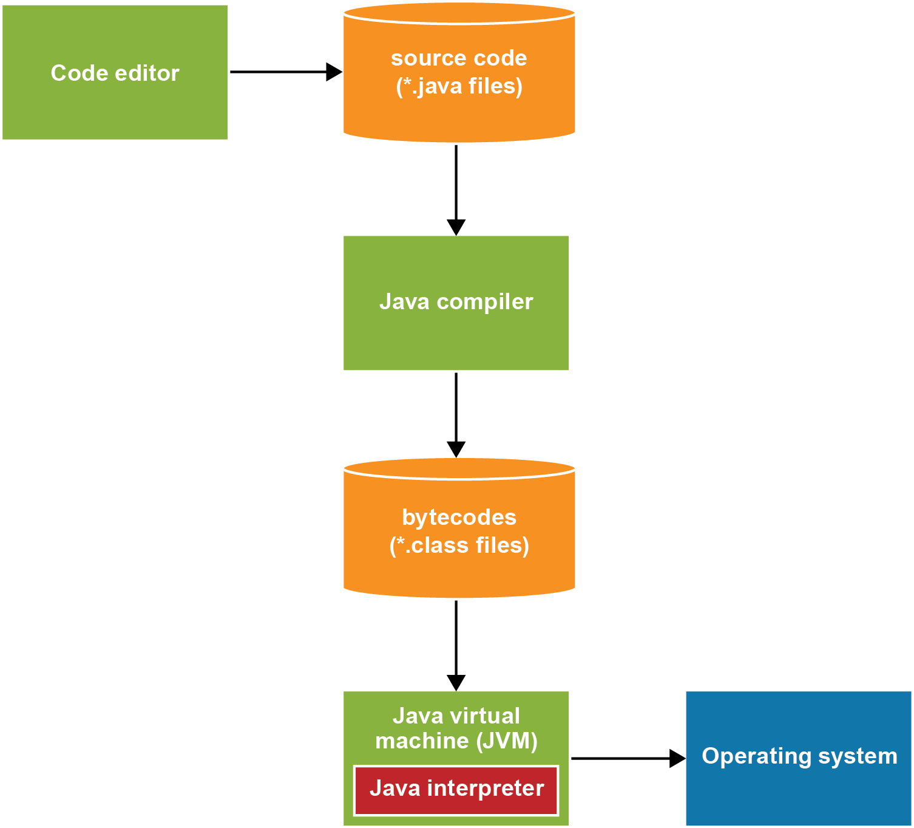
Java foundation
JDK, SDK
Java 8 (JDK 1.8) is the minimum version
Version history wiki
Source Files and Class Files
“Write once, run anywhere”

Slide 12
The ide(s)
What we’ll use: Eclipse STS
Lots of other options:
NetBeans
IntelliJ
STS – Spring Tool Suite
Spring’s version of Eclipse – provides imbedded Spring tooling so you don’t have to install separately

Slide 13
Eclipse sts overview (cont.)
VS is a more controlled environment (IMO)
Much more manual management of projects / files in Eclipse -> good and bad!
Examples:
‘Solutions’ in VS vs ‘Projects’ in Eclipse
Where do I store my stuff? -> workspaces, package structures
Managing projects: open, close delete [deleting from workspace vs local]
Importing, copy into workspace
Compile and Run
Continued…

Slide 14
Eclipse sts overview
Console – embedded in IDE vs in popup
Managing multiple projects
Git Integration is available (but not used in camp)
Package Eplorer
Perspectives – using stock vs defining your own
Creating a new project, class
Eclipse system files generated inside the project: .classpath, .project
The main method -> very similar to the C# version
The ‘TODO’ comment
Zooming in the code editor

Slide 15
First java apps
Code completion and syntax error detection
Statements & identifiers
No ‘var’ identifiers
Comments
Numeric variables & expressions
int, double
Strings
Classes, objects and methods

Slide 16
First java apps (cont.)
Console output w/ System class… similar to Console.WriteLine() in C#
System.out.print(…)
System.out.println(…)
Note: You can use System automagically… works out of the box!
Console input w/ Scanner class… similar to Console.ReadLine()
nextInt(), nextDouble()
Scanner must be imported
How does this compare with C#? Console.readLine()
Simple control statements
While
If
Runtime Errors

Slide 17
Try it! – chap 2 projects
2-1 Student Registration
2-2 Grade Converter
2-3 Rectangle Calculator

Slide 18
Primitive data types

Slide 19
Primitive data types (cont.)
Primitive types are value types (not Reference types)
Casting
Basic computations w/ primitive types
++, --, +=, etc.
The Math class
Rounding #s with Math.round(…)
java.lang.Math
EX: Math.round(x*100)
Other methods: pow, sqrt, max, min
Formatting using NumberFormat

Slide 20
Try it! – chap 3 projects
3-1 Temperature Converter
3-2 Travel Time Calculator

Slide 21
More control statements
Switch statement
Basic example
Day of week example w/ fall through
For loop w/ index
Notes:
p. 129 – Switch statement examples

Slide 22
Try it! – chap 4 projects
4-1 Table of Powers
4-2 Factorial Calculator
4-4 Common Divisor Calculator

Slide 23
Coding methods
Access modifiers
Static vs non-static
Return types
Parameters as input
Note: no optional parameters in Java!
Use method overloading instead
Notes:
p. 153

Slide 24
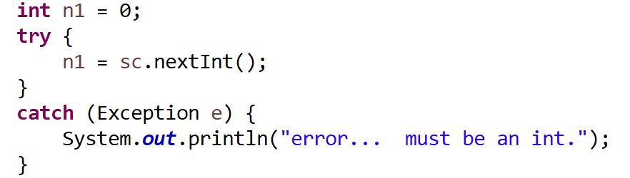
Handling exceptions
The class hierarchy – some examples
A simple try/catch example:
Notes:
p. 159

Slide 25
Data validation
The Scanner class methods which could throw an exception
Other methods we can use to validate data:
Notes:
p. 165

Slide 26
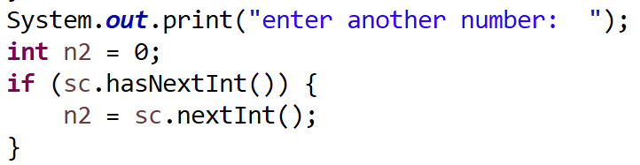
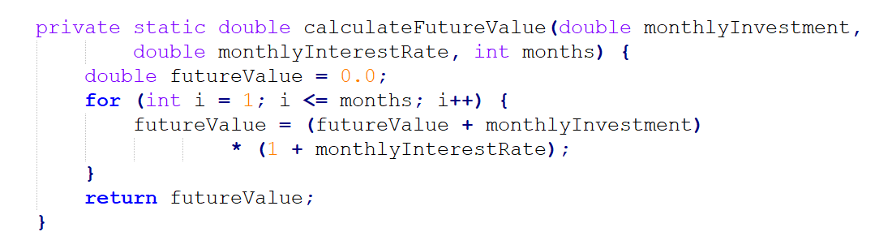
Data validation (cont.)
Simple data validation example
Another example:

Slide 27
Try it! – chap 5 projects
5-1 Dice Roller
5-2 Data Validation
5-3 Guessing Game

Slide 28
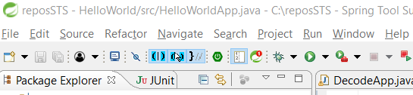
The integrated debugger
Old school debugging – print statements
The integrated debugger – imbedded in Eclipse
Accessible from the toolbar:
OR by right-clicking your project -> Debug As -> Java App
See detailed instructions in How to use Eclipse.pdf

Slide 29
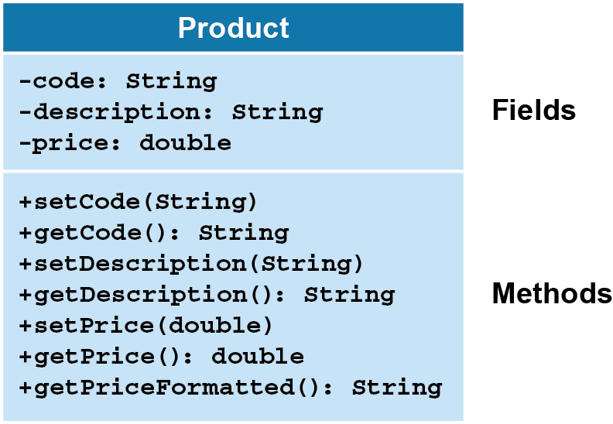
Coding classes
Concept: What is a ‘product’?
Checkpoint:
Class Diagrams
Data Modeling?
Notes:
p. 211

Slide 30
Coding classes
POJO: Plain Old Java Object
Instance variables – one for each field
Constructor(s)
Optional – In absence of developer defined constructors, Java defines a ‘default’ constructor that doesn’t accept parameters and initializes all instance variables to null, zero, or false
Recommended to have at least 2 (all and 0 parameters)
Getters / Setters
Must follow naming standards
Class name is TitleCase
InstanceVariables are camelCase
Getters and Setters must start with ‘get’ or ‘set’ (both lowercase) plus the instanceVariable name, exactly as typed
Code the Product class – in class demo [ProductManager project – use packages]

Slide 31
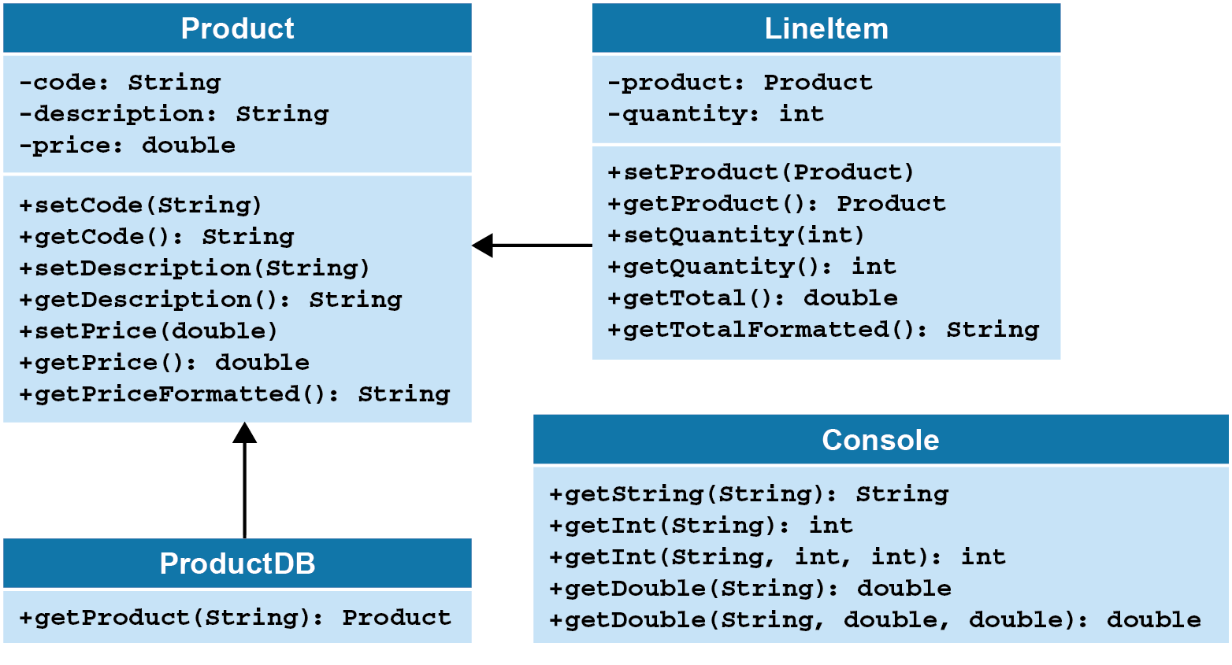
The line item class
A more complex object
The product instance variables is, itself, a reference type
Console class simplifies interaction with the console
ProductDB acts as a mock DB, providing instances of Products for given codes
Notes:
p. 247

Slide 32
Try it!
Create a Console class, but only code 1 method (instructor led)
Discuss benefits of a class like this
Any similarities to C# Console?
Now add remaining methods from Console in book_apps (instructor led)
Code the LineItem class
Create a ProductManagerApp class that will create an instance of a Product and a LineItem

Slide 33
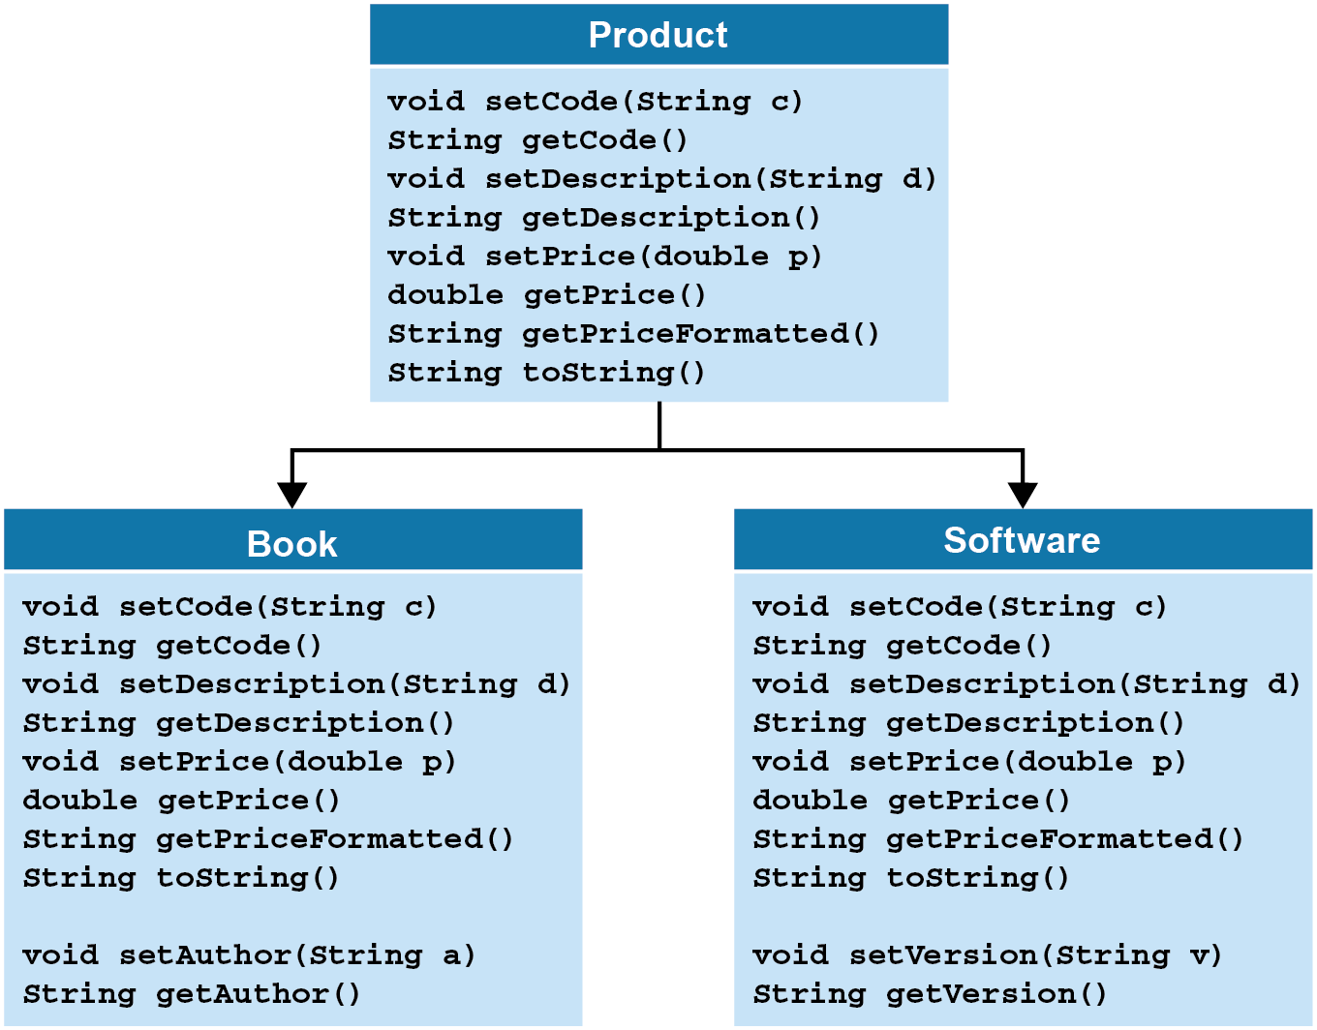
Inheritance in java
Inheritance represents the ‘is a’ relationship
Java nor C# supports multiple inheritance
Java uses the ‘extends’ keyword vs ‘:’ in C#
Product, Book, Software example

Slide 34
Inheritance in java (cont.)
The toString() method is an example of inheritance
All objects inherit from java.lang.Object
Methods of the Object class:
toString()
equals(Object)
getClass()
clone()
hashCode()
Demo – simple toString() example using previous Product, Software, and Product

Slide 35
Inheritance in java (cont.)
Abstract and Final classes – demo using previous example
Final example
Review ch08_Product project in book_apps

Slide 36
interfaces in java
Interfaces in Java are specified by the ‘implements’ keyword.
‘:’ again in C#??
Interfaces can define one or more methods
Methods are automatically public and abstract
Method ‘stubs’ only – no implementation of methods
Exception: Default methods were implemented in Java 8

Slide 37
arrays in java
Arrays are similar in Java and C#
Discuss potential differences… use of comma for rectangular arrays?
Quick demo of arrays in Java
String[] names = new String[3];
names[0] = "Ted Lewis";
names[1] = "Sue Jones";
names[2] = "Ray Thomas";
Another example:
double[] prices = {14.95, 12.95, 11.95, 9.95};
Notes:
Chapter 11 – p. 355

Slide 38
arrays in java
Looping with Arrays – traditional for loop
The ‘enhanced for’ loop – slightly different from c#
The Arrays class can be used to help deal with Arrays
fill, sort, binarySearch methods available
Sorting reference types – how does c# sort compared to Java?
Java uses the Comparable interface [demo only if time allows]

Slide 39
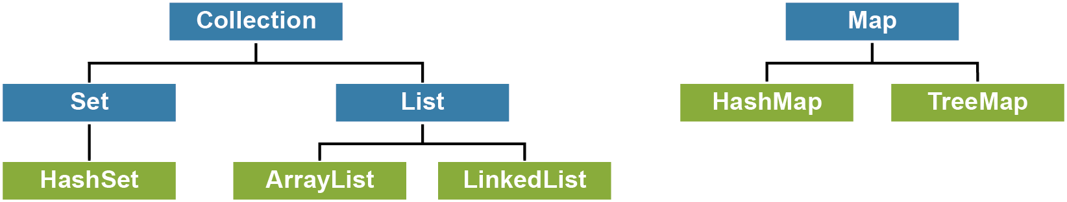
The collection framework
The blue boxes represent interfaces, green boxes are classes
ArrayList in Java is similar to List in C#
HashMap – similar to Dictionary in C#?
Notes:
p. 383

Slide 40
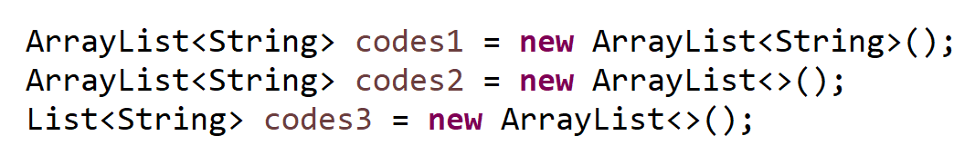
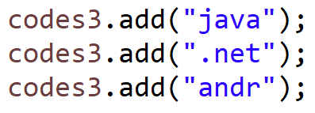

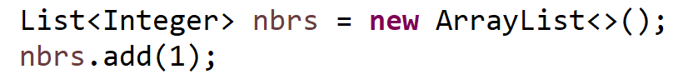
arraylist in java
3 ways to declare an ArrayList
Adding to the List
Removing from the list
Primitive types in Lists -> autoboxing

Slide 41
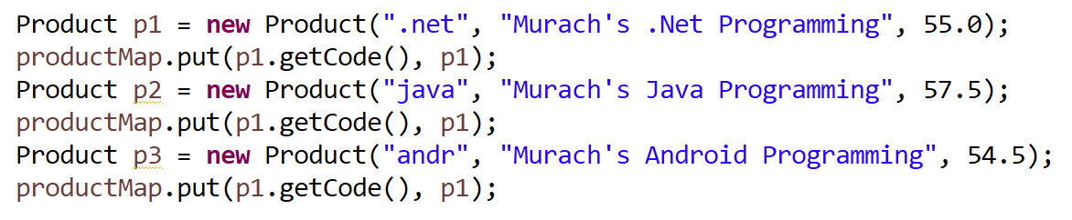
hashmaps in java
Stored by Key, Value pair
Defining a HashMap
Adding entries
Removing entries

Slide 42
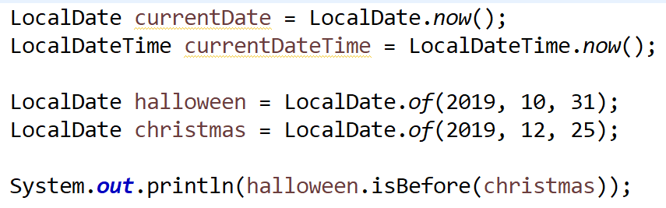
Strings, Dates, Times in java
StringBuilder class
Necessary because String is inherently inefficent
Dates and Times are difficult
Examples

Slide 43
Oh, if we only had more time…
File I/O
Advanced Exception Handling
JDBC – connecting console apps to a database
ORM / JPA – simplifying object to table mapping
The Web – creating RESTful web services with the Spring Framework

