Slide 1

Financial Data Analysis
Top S&P500 Companies

Slide 2
Project Team
Adams Lamin
Deepika Rapeti
Justin Blake
Michael Pond
Ryan Denniger
Suhasini Varma

Slide 3
Project Details
Scope
Explore the processes involved in data engineering to create an effective database system
Collect and store performance data for four key companies in the consumer discretionary sector: Amazon, Home Depot, McDonald’s, and Tesla
Approach
Data Engineering:
Extract information from different sources
Transform the data to make it usable
Load the transformed data into SQLite DB
Datasets
Yahoo Finance
(yfinance python package)

Slide 4
Project Deliverables
Jupyter Notebooks or Python scripts detailing the data cleaning, exploration, and analysis steps.
01
Visualizations (charts, graphs) supporting the findings for each research question. (If we want to)
02
A written report summarizing the insights gained from the analysis
03

Slide 5



Project Plan
Collected data from one or multiple sources
Load data to permanent storage system
TRANSFORM
EXTRACT
LOAD
Transform data into structural format

Slide 6
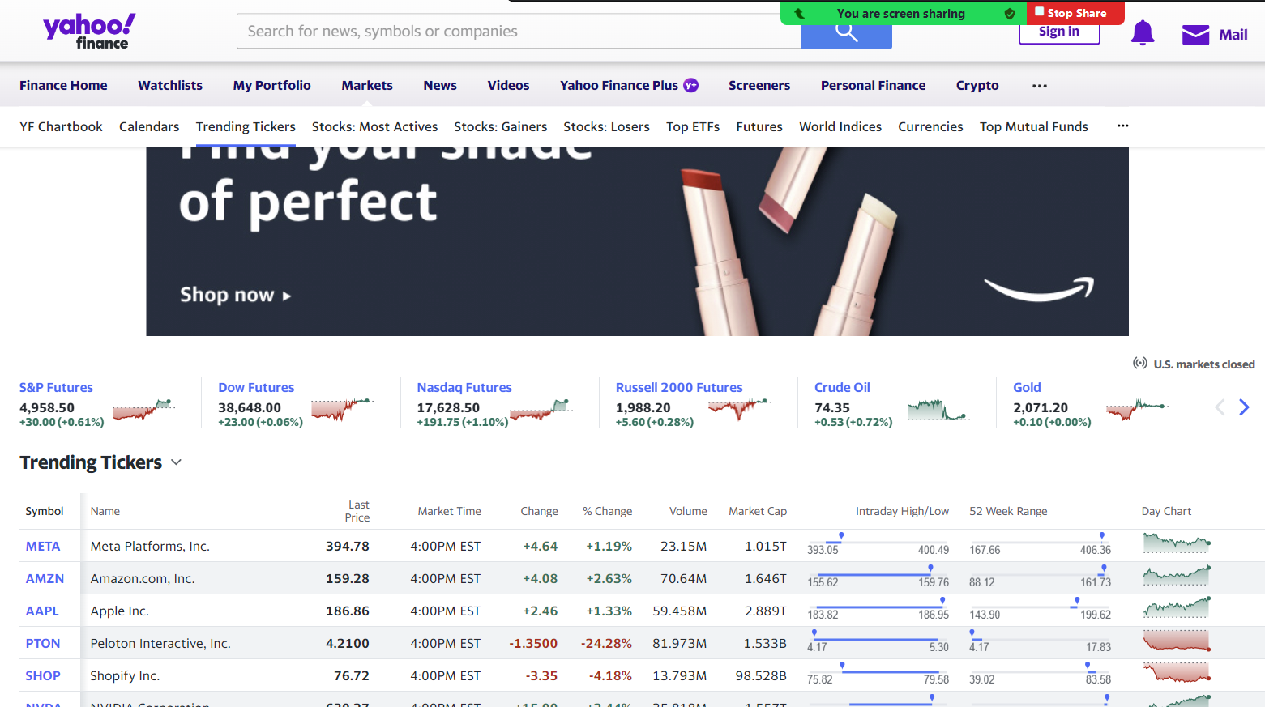
Extract
Collect data using the yahoo finance python library in visual studio code/jupyter notebooks
Finnhub - Free APIs for realtime stock, forex, and cryptocurrency. Company fundamentals, Economic data, and Alternative data.
Streamlit is an open-source Python framework for machine learning and data science
Find appropriate data for company finance sheets, balance sheets, and stocks

Slide 7
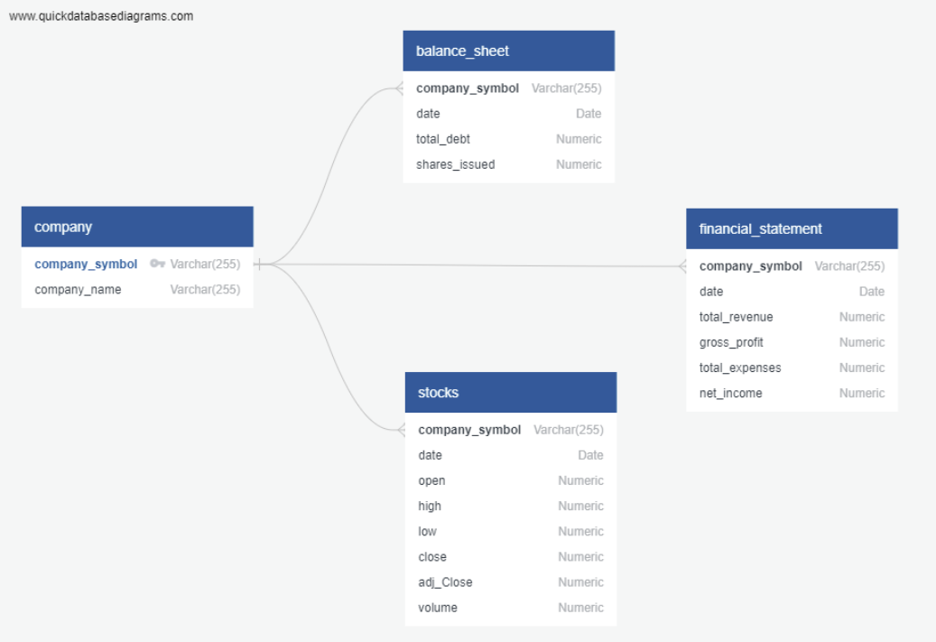
Entity Relationship Diagram
Entities
Relationships
Attributes
Cardinality

Slide 8

Transform
Converted data to data frames
Clean the data by means of removal of irrelevant information
Transposed data frame for normalization
Condensed the data frame making it suitable for end users
Align the data to show up on a csv in a manner that is easily accessible and transferrable

Slide 9

Load
Created data warehouse
Indexing data
Database maintenance

Slide 10
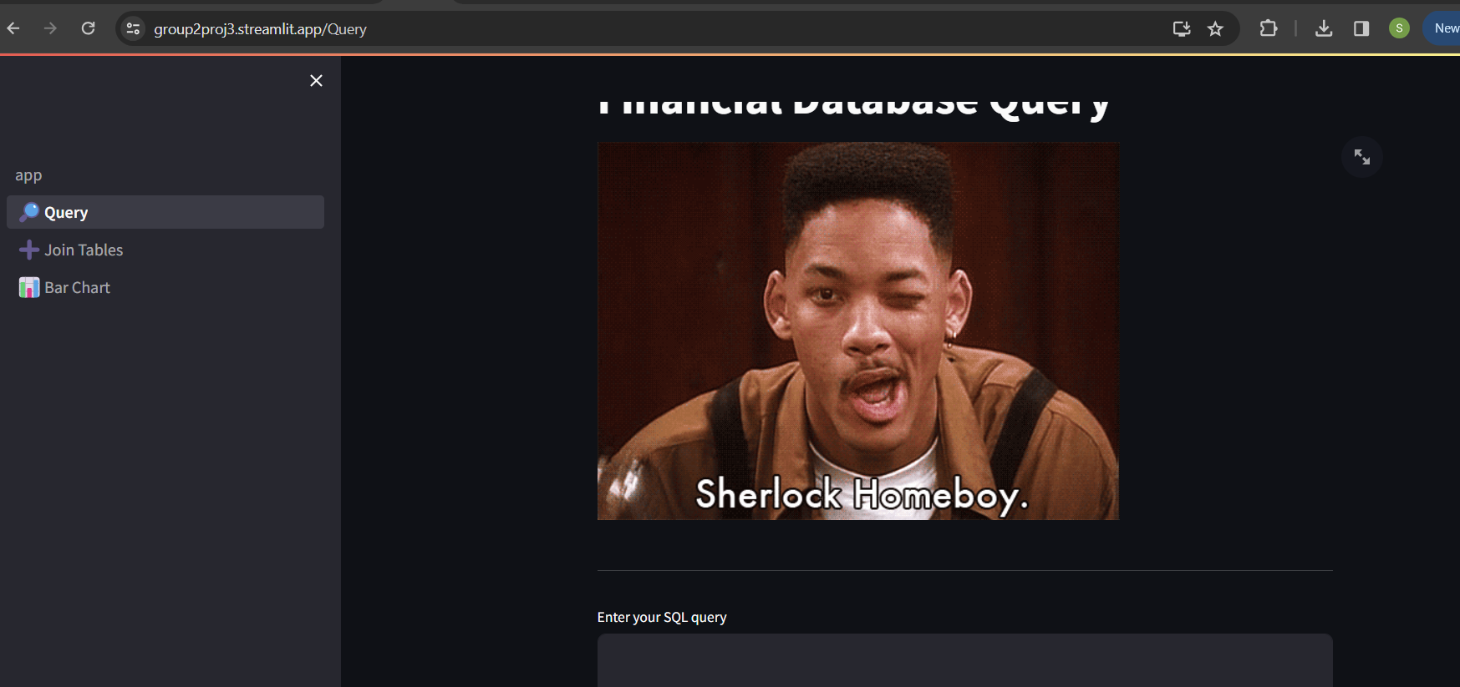
Project demonstration
App allows user interaction with following:
Query
Join tables
Creating chart
Demonstration

Slide 11


