Slide 1
Choose Devices
Finish
Main Screen
Master Login
Distributed ISS
Choose Devices
Login
Protect
Un-Protect
Device List
Login
Submit
Keyboard
Choose File Dialog
Choose File:
Cancel OK
File View Dialog
Finished
Master Login
Un Protected Documents
Login
Submit
Keyboard
Master Login
Login
Submit
Keyboard
Master GUI System
Choose Device Flow
Protect Flow
Login Flow
Un-Protect Flow

Slide 2
Master GUI System (Main Screen)
--Protect
User chooses a file inputs a password and the file is encrypted and split across the user defined devices
User’s password need not be the same as the login password
Main Screen
--Login
User is prompted to login to the system as an added precaution
Distributed ISS
Protect**
Un-Protect**
Login*
Choose Devices
Help
--Un Protect
User inputs the password used to previously protect a file
Upon correct password the user’s file is un-protected and the user is taken to a file viewing screen
--Choose Devices
User must first specify the devices to use during this session of protection
--Help
Will show user the steps to follow to protect/Un-protect a file
Other helpful stuff
*will enable after devices are chosen
**will enable after login succeeds

Slide 3
Master GUI System (Choose Devices)
Main Screen
Distributed ISS
Choose Devices
Choose Devices
Finish
--In background:
Master Generates and distributes seeds for next session
On acknowledgement from slaves will update the device list to show which devices are active and connected (Generate the “AddressBook”)
The user will only be able to select devices that the Master has received acknowledgements from
Device List
--In background:
Store the user specified “Session Host List”
Enable the login button
Master sends user defined session host list to server to update and waits for server’s acknowledgement
Enable Login Button

Slide 4
GUI System (Login)
--In background:
On click of Submit Master calls for all devices to send their characters with timestamps to the server
--In background:
Generate random seeds
Master then sends a command for the devices to open the keyboards along with the seed package
Main Screen
Distributed ISS
Login
Master Login
Login
Submit
Keyboard
To Server
--In background:
Devices generate character tables from stored seeds
Then opens their respective keyboards
Slave Login
Character Stream/
Character Pack
Login
Keyboard

Slide 5
Master GUI System (Protect)
Choose File Dialog
Choose File:
File Group Nick Name:
Cancel OK
Main Screen
--In background:
On click of Submit Master calls for all devices to send their characters with timestamps to be used to generate protection Key
Distributed ISS
Protect
Master Login
Start Protection
Login
Submit
--In background:
Master sends request to slaves to open their respective keyboards
Keyboard
Use To Generate Key
--In background:
Devices generate character tables from stored seeds
Then opens their respective keyboards
Slave Login
Character Stream
Login
Keyboard

Slide 6
Master GUI System (Un-Protect)
Choose File Dialog
Choose File Group:
Cancel OK
Main Screen
--In background:
On click of Submit Master calls for all devices to send their characters with timestamps to be used to un-protect the file
Distributed ISS
Un-Protect
Master Login
Login
Submit
--In background:
Master sends request to slaves to open their respective keyboards
Keyboard
Use To Un-Protect
Then Open File Viewer
--In background:
Devices generate character tables from stored seeds
Then opens their respective keyboards
Slave Login
Character Stream
Login
Keyboard

Slide 7
Master GUI System (File Viewer)
**Read only part of file**
File View Dialog
Finished
Un Protected Documents
Successful Un-Protection
Re-Protect or Destroy Un-Protected Files
Main Screen
Distributed ISS
Protect
Un-Protect
Login
Choose Devices
Help

Slide 8
Slave GUI System
Main Screen
--Wait For Master Commands
Waits until master gives commands
Distributed ISS
>>Waiting for master instructions
Help
--Help
Will show user the steps to follow to protect/Un-protect a file
Other helpful stuff

Slide 9
GUI Software Model
MainScreen : Activity
Private
-isEncDecEnabled
: boolean
SetupScreen : Activity
+pressSetup()
+pressProtect()
+pressUnProtect()
+pressHelp()
+startListener()
+pressAddDevice()
+diplayDevices()
+pressRemoveDevice()
+pressFinish
AddDeviceScreen: Activity
+pressOK()
+pressCancel()
ProtectScreen: Activity
+pressStart()
DiscoveryScreen : Activity
+displayDevices()
+displayWarning()
UnProtectScreen: Activity
+pressStart()
HelpScreen : Activity
KeyboardScreen : Activity
+pressBack()
Private
-isMaster: boolean
+pressKey()
+pressReset()
+pressSubmit()

Slide 10
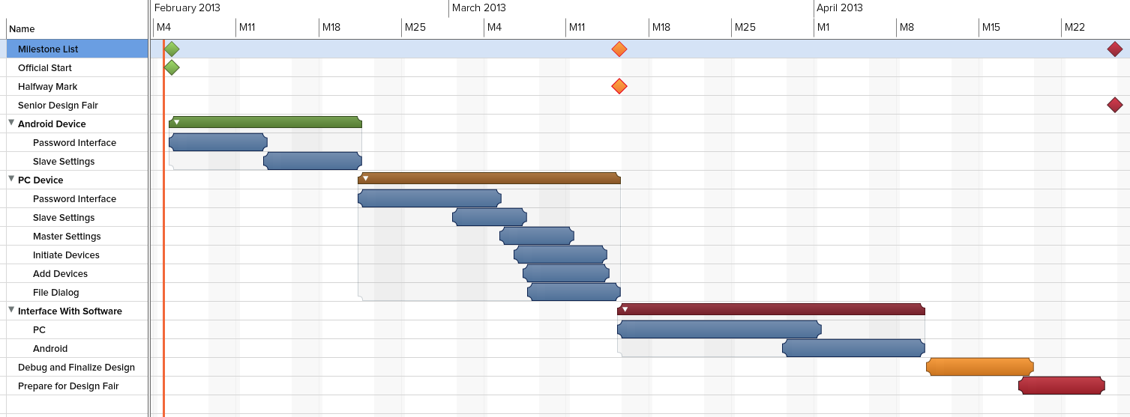
GUI Design Timeline

