Slide 1

DATA DRIFT OBSERVATION
IN A STOCK PREDICTION MODEL
MLOPS PROJECT
CARDOSO RAFAEL, DA SILVA LUCA, FERRARA JUSTIN, MAKSIMOUS THOMAS
TSM-MachLeData
Bertil Chapuis
Beat Wolf

Slide 2

Project Overview
Goal: Predict 5-day stock returns from the past 30 days of price variations.
Dataset
Challenges
20 tech stocks, 5 years of historical NASDAQ data
High volatility (daily swings up to ±3%)
Concept drift & data drift
Need for reproducible MLOps pipeline

Slide 3
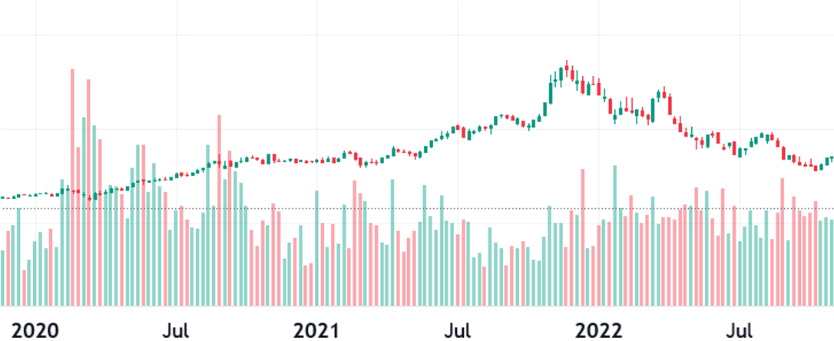
Concept Drift and Data Drift
1
2
3
Concept Drift
The relationship between X and Y transforms
New macroeconomic effects
New regulations
Data Drift - Feature Drift
Input variables change
Market volatility increases
Stock Volume change
Data Drift - Label Drift
Consequences
Gradual performance degradation and risk of erroneous financial decisions.
The target changes
New price dynamics
Prices increase overall (inflation)

Slide 4
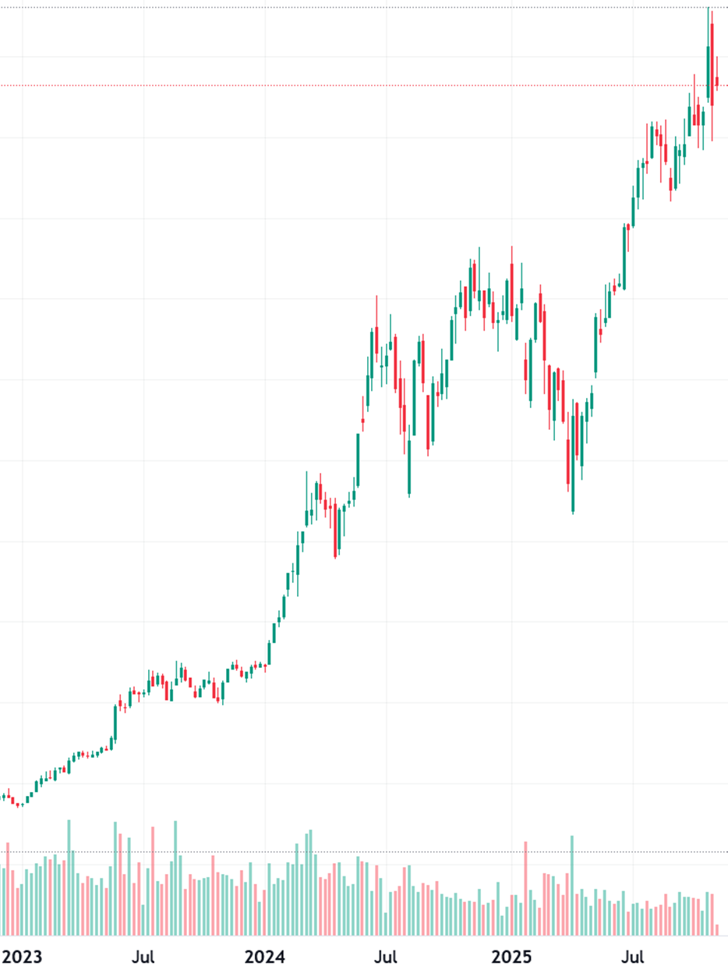
Concept Drift Example

Slide 5





OUR PROJECT ARCHITECTURE
5 - Model evaluation
and comparaison
1 - Data Acquisition
2 - Data Preprocessing
3 - Data Storage
4 - Model training
Collection of historical data (5 years) of 20 stocks in the NASDAQ index. Data in CSV format.
Data cleaning and transformation in a format suitable for modeling.
Datasets and intermediate artifacts stored and versioned using DVC on an S3 bucket.
Training LSTM-based forecasting model 30-day -> 5 days.
Training fully automated through the CI pipeline (DVC + GitHub Actions).
Evaluation with RMSE, MAE, and R², plus automatic comparison across model generations via CML reports.

Slide 6
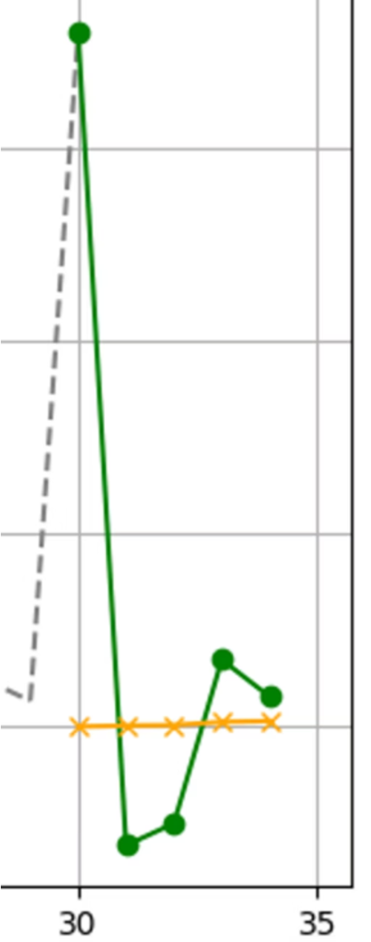

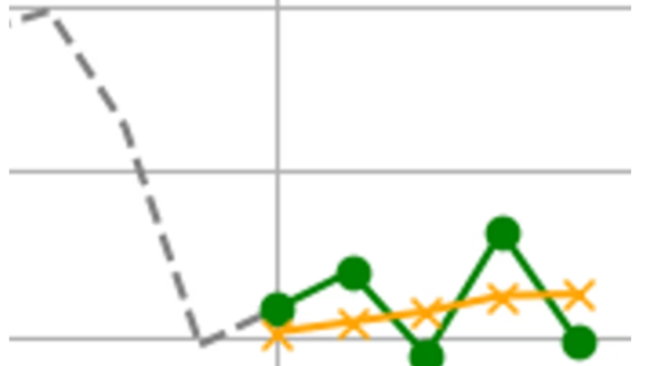
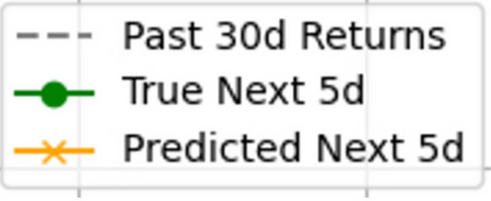
The "Flatline" Challenge
Where We Left Off
Working Pipeline
Infrastructure was in place
Failing Model
Unable to capture market volatility.
Problem: "Flatline Predictions" — merely predicting the mean.
MAE 1.87 ; RMSE: 2.87 ; R2: 0.014

Slide 7
Key Improvements
Since Last Presentation
1
2
3
4
5
6
Extended input
Added new features
Implemented drift detection
from 30 days to 60 days
SMA, EMA, spreads, ratios, volume signals
with Evidently
Created candidate dataset
Automatic performance comparison
Deployment
with BentoML + Docker + GKE
& candidate model evaluation flow
through CML reports

Slide 8

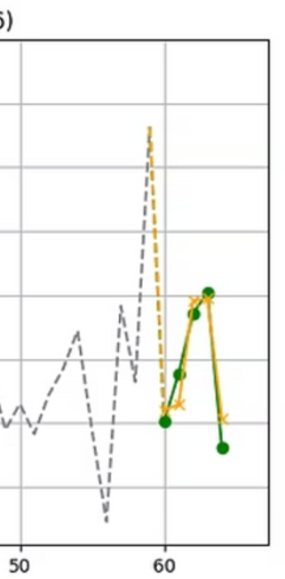
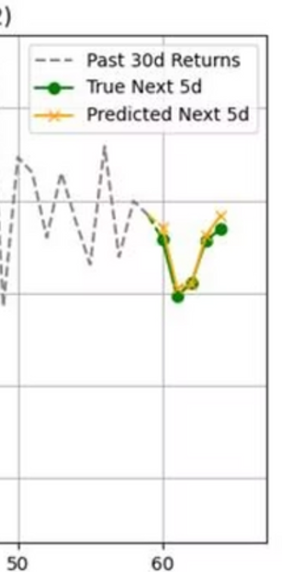
Final Results: Visual Performance
RMSE: 0.10
Predicted curve closely matches true 5-day trend
RMSE: 0.08
Model captures drop + recovery pattern
Global Results:
MAE: 0.65 → 65% better (old 1.86)
RMSE: 2.87 → 70% better (old 0.84)
R²: -1.19 → Worse (old 0.01)

Slide 9
How to create the candidate dataset
1
2
3
Ingestion Strategy (The "Append" Policy)
We add the latest week's data to the existing history instead of replacing it
Dual-Dataset Structure
To enable Drift Detection, we maintain two distinct versions:
Reference Data : The fixed dataset of the active model
Candidate Data : Reference + New Week's data.
3. Comparison Logic
Check: Evidently compares Reference vs. Candidate distributions
Result: We detect drift before any training happens.

Slide 10



How We Measure Data Drift
We measure data drift in two ways:
Evently Package :
Model Performance:
Compare reference vs candidate dataset
Drift detected if Wasserstein distance > 0.5
Compare baseline model vs candidate model
Performance improvement indicates data drift
Notes:
comment mesure datadrift

Slide 11
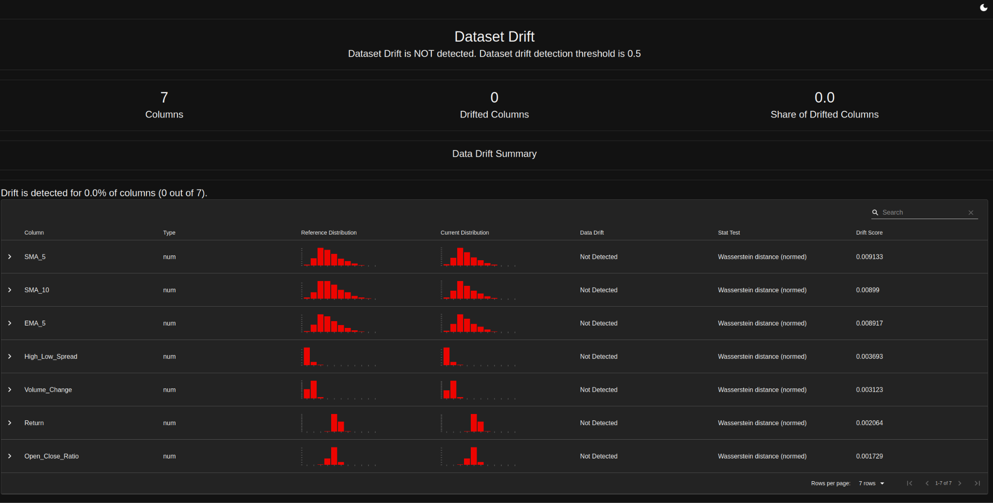
Real Data Drift Results
Observation
Scope: Analyzed 7 features (SMA, EMA, Volatility, etc.) on new data
Result: 0% Drift (0/7 columns)
Scores: Negligible (e.g., SMA_5 ~ 0.009$, far below 0.5)
Conclusion
Data distribution remains stable over the last month.
Current model remains valid without immediate retraining.

Slide 12
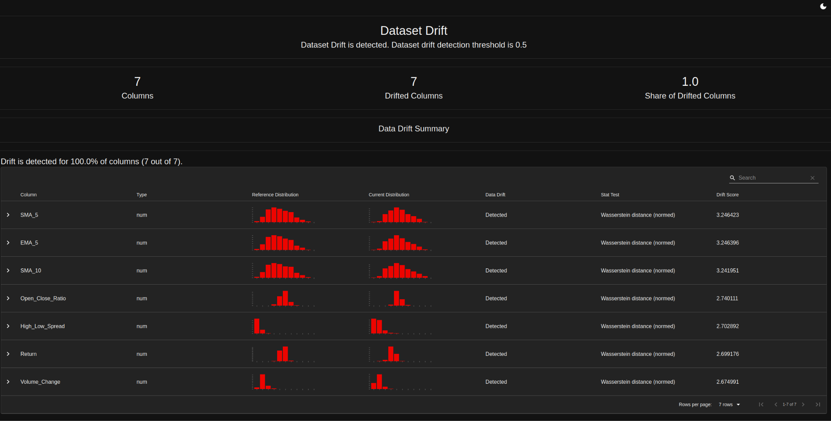
Artificial Drift Validation
Goal : Since no real drift occurred, we needed to validate the alert system.
𝐗new = 𝐗old ✕ 2.0 + 5.0
Injection Method : Modified candidate features in prepare.py:
Drift Detected : 100% (7/7 columns)
Scores: High impact ($> 2.0$)
Verdict: pipeline correctly flags significant statistical shifts

Slide 13

Deployment Strategy
Objective: Ensure updates improve the model, not just change it.
Method: Challenger vs. Champion
We evaluate two models in parallel on the latest data:
  Baseline: Current production model.
  Candidate: New model trained on fresh data.
The "Go/No-Go" Rule
Deploy Candidate ⟺ Candidate RMSE < Baseline RMSE.
  Result: We only deploy when performance actually increases.
Notes:
explique la règle (On ne déploie que si c'est mieux)
Transition: This logic is fully automated in our CI/CD pipeline, which we call the "Candidate Model Approach" (Next Slide).

Slide 14
Strategy Pivot:
Candidate Model Approach
New dataset added
Training time per run: <2 minutes
Inference time: ~20 ms
stored in DVC
Candidate model trained automatically
PR comment compares metrics & plots
Model deployed if accepted
Advantages: Scalable, Reproducible, Easy drift inspection, Avoids unnecessary retraining

Slide 15
Alternative Approaches
1
2
3
"Sliding Window" Dataset
Real-Time Observability
Macro-Economic Context
Keep a fixed history (e.g., 5 years) by dropping old data
Stream metrics via Prometheus/Grafana
Add VIX, Inflation, and Interest Rates features
Removes obsolete market behaviors & speeds up training
Instant alerts for crashes instead of weekly reports
Helps the model understand why prices move, not just how
Notes:
D’autre possibilité

Slide 16
Limitations & Next Steps
Current Limitations
Next Steps
Inject synthetic drift to validate detection and retraining
Add macro variables (VIX, inflation, interest rates)
Test a classification approach Target ≥ 70% directional accuracy
Very low R² → limited explanatory power
Poor performance during high volatility
Minimal drift observed (short time window)
No macroeconomic features integrated

Slide 17
Thanks!
Do you have any questions?

