Slide 1

Data Drift Observation
in a Stock Prediction Model
Project Stock-ML — MLOps Pipeline & Drift Analysis
Cardoso Rafael, Da Silva Luca, Ferrara Justin, Maksimous Thomas
Notes:
1

Slide 2

The Challenge: Predicting the Unpredictable
Input
Output
Data
Last 30 days of closing prices variation
Predict the variation for the next 5 days
20 tech stocks with 5 years of history
Understand how models degrade over time and study data drift across multiple generations.
Notes:
2

Slide 3
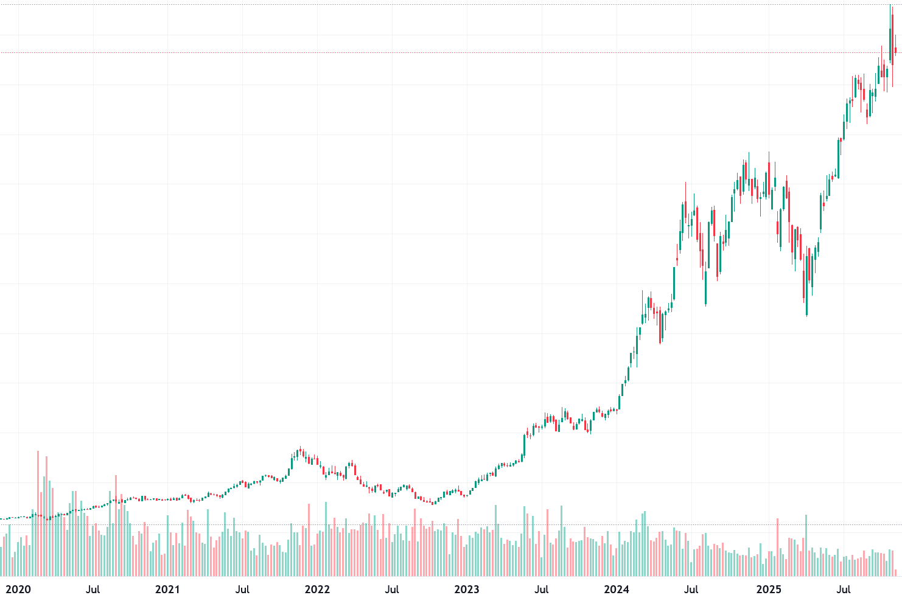
Concept Drift and Data Drift
Concept Drift
The relationship between X and Y transforms
  New macroeconomic effects
  New regulations
1
Data Drift - Feature Drift
2
Input variables change
  Market volatility increases
  Stock Volume change
Data Drift - Label Drift
The target changes
  New price dynamics
  Prices increase overall (inflation)
3
Consequences
Gradual performance degradation and risk of erroneous financial decisions.
Notes:
3

Slide 4





OUR PROJECT ARCHITECTURE
1 - Data Acquisition
2 - Data Preprocessing
3 - Data Storage
4 - Model training
5 - Model evaluation and comparaison
Collection of historical data (5 years) of 20 stocks in the NASDAQ index. Data in CSV format.
Data cleaning and transformation in a format suitable for modeling.
Data is stored in a S3 bucket.
Creation of a Long-short Term Memory (LSTM) neural network, trained with the preprocessed data.
Evaluation of the model using different metrics and comparing results with other models.

Slide 5
Our MLOps Architecture
CI/CD Pipeline Overview
GitHub Actions, DVC, CML Report, BentoML
Train & Report
  Setup environment
  Run model training via DVC
  Push updated artifacts and metrics to DVC remote
  Generate CML report with:
    Parameter & metric diffs
    Plot comparisons (training, predictions)
  Post report as PR comment
Publish & Deploy
  Build and package BentoML model
  Push Docker image
  Update & apply GKE deployment manifests
  Automatically deploy new model version to Kubernetes
Key Indicators
MAE / RMSE over time
Distribution comparison
Continuous monitoring of prediction error
Mean, variance, and data shape
Notes:
4

Slide 6
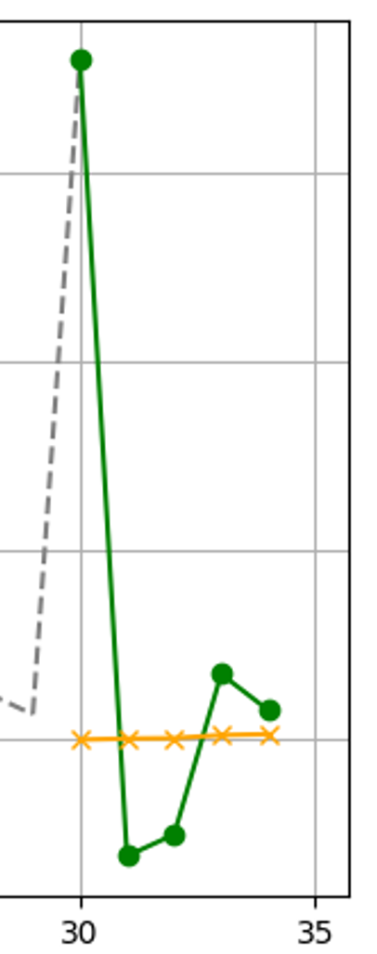
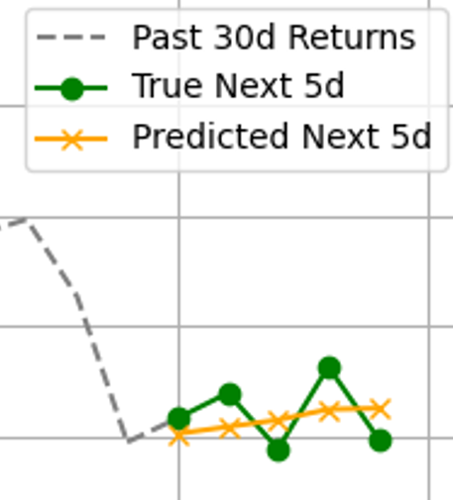
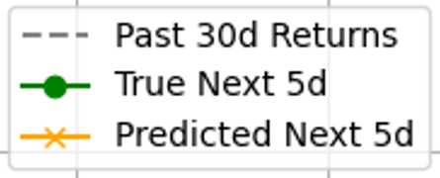
Current Results
  MAE: 1.87
  RMSE: 2.87
  R2: 0.004
The model’s predictions are equivalent to using the mean as the prediction
Notes:
3

Slide 7

Actual challenges & next steps
A breakthrought of actual challenges and steps that will be taken in the following weeks
Bad model predictions
Inaccurate predictions (due to volatility of financial markets)
Adaptation of our model target
Changes in our prediction goal (maybe predict trend direction (up/down) or percentage variation).
Data drift evaluation
Monitor our model’s performance over time with new weekly financial data added.
Notes:
3

Slide 8

Conclusions & Perspectives
A model that performs well today won't necessarily do so tomorrow. Drift monitoring is the key to sustainable MLOps.
Inevitability
Data drift is inevitable in financial data
Impact
It degrades models without periodic updates
Solution
DVC + versioning allows tracking this impact
Outlook
Automatic monitoring and weekly retraining
Notes:
5

Slide 9
Thank you for your attention!

