Slide 1

Stock Prediction Flask API
By Zihao Justin Huang

Slide 2
Why interested in stocks?
Market size:
The NYSE and Nasdaq exchanges are worth a collective $32 trillion in market capitalization, making up a sizable portion of the global equities market.
For May 30, 2019, the total dollar volume from all trading venues on which Nasdaq® Issues are traded is >$85 billions.
Due to its enormous market size, it might affect your employer as well as your work environment.
Investment potential:
US stocks have consistently earned more than investment-grade bonds over the long term, despite regular ups and downs in the market, returned an average of 10.01% annually (from 1926 to now).
Great option for retirement, since long-term stock ownership you can withstand the riskier investments and ride the ups and downs that are inevitable.

Slide 3
What methods are used?
Composed of a tight-knit community of researchers, engineers, and business professionals, Alpha Vantage Inc. is a leading provider of free APIs for realtime and historical data on stocks, forex (FX), and digital/crypto currencies
Data was collected in JSON format from Alpha Vantage API through Python
The prediction model uses auto.arima method in Python’s pmdarima package to fit a ARIMA model with the best (lowest) AIC score on the univariate time series stock data.

Slide 4
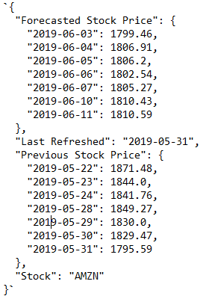
How is the result presented?
The model is written in Python, and it is wrapped in a docker container for reproduction purpose. Finally, it is hosted on an EC2 instance through Flask API that everyone can access it.
The detail direction on how to access the API and reproduce the model is posted on https://github.com/JustinFightOn/stat418_final_project.
Here is a sample of result for stock AMZN:

Slide 5
What is the purpose of the API?
User can use the tool to guide him/her when to invest/sell the stock
Finding potential stocks to invest:
Potential users can run the prediction API on all available stocks, and sort those stocks by % increase against last refreshed date, and invest in those stocks with high potential

Slide 6
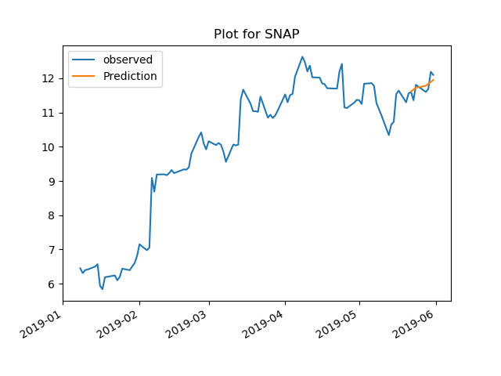
Future Improvements
Build user interface on an app to show plots of observed and predicted to improve user experience
Build long term prediction tool that utilize all historical stock data (>20 years) to predict stock price, which can be used for planning.

