Slide 1
From Prediction
to Causality
Prediction
Model explanation
Attribution
A practical guide to model explanation, attribution and causal modelling
Causal modelling
Notes:
Good morning, everyone.
Across many projects, we’re asked not just to predict an outcome but to understand what’s driving it. While prediction is a well-understood area where machine learning models tend to perform best, questions around attribution and causality are much less clear cut.
For those who I have yet to meet, my name is Justin, and I’m a third-year student of Data Science at the University of Stellenbosch. With a passion for econometrics, my interest is to bridge the gap between prediction and inference, moving from black-box models, where the intention is solely to increase predictive accuracy, to an approach which explores attribution and attempts to isolate causality. This requires a different way of thinking about a problem, one which requires a deeper understanding of the question we are trying to answer and the nature of the data we are dealing with.

Slide 2
One business question, four analytical tasks
Prediction
Model explanation
Attribution
Causal modelling
“Why are customers leaving?” can mean four very different things.
Analytical task
Core question
Churn example
Suitable methods
Prediction
Who is likely to churn?
Which customers should be prioritised for retention activity?
XGBoost, random forest,
logistic regression
Model explanation
Why did the model flag this customer?
Which features pushed this customer’s churn risk
up or down?
SHAP values, feature importance, partial dependence
Attribution
Which factors are associated
with churn?
Are month-to-month contracts related to churn,
controlling for tenure and services?
Logistic regression, GAMs, GAMMs,
mixed models
Causal effect estimation
What would happen if we
changed something?
Did a retention call or loyalty discount reduce churn?
SEM, propensity score matching,
difference-in-differences
The first step is not choosing the most sophisticated method — it is clarifying the question and whether the data can support the answer.
Notes:
In this presentation, I will show how one business question, “why customers churn?” can be split into four analytical tasks. We will see that “why customers are leaving”, can mean several things.
The first is prediction. Here the question is: “who is likely to churn?”. We want to identify high-risk customers so that the business can prioritise retention activity.
The second task is model explanation. Once we have a good prediction model, stakeholders naturally ask: “why did the model flag this customer?”. This can be answered using methods that explain the model’s prediction by showing which features pushed a customer’s predicted churn risk up or down.
The third task is attribution or association. Here we are asking: “which factors are related to churn, after accounting for other variables?”. For example, a are month-to-month contracts, high charges or lack of tech support associated with churn?
The fourth task is causal effect estimation. This is the strongest and most demanding question. Here we ask: “what would happen if we changed something?”. For example, did a retention call actually reduce churn? To answer this, we need causal thinking, not just predictive modelling.
For each task, the key question is not “which method is most sophisticated?” but rather “what question are we answering, and does the data support that answer?”.

Slide 3
Running example: customer churn data and extensions
Prediction
Model explanation
Attribution
Causal modelling
Base Telco churn dataset
Survey extension
Intervention extension
Customer profile, account, services and charges
Observed outcome: churn (Yes/No)
Useful for prediction, model explanation and association
Quantifies latent variables such as satisfaction, trust and value
Enables SEM-style measurement and structural modelling
Collects outcomes after a treatment has been applied
Enables causal inference around interventions
Base data gets us to patterns.
Extensions are needed for stronger causal claims.
Notes:
The base dataset I will be using for the worked examples in this presentation is the IBM Telco churn dataset. It contains data related to customer profile, services, charges, contract, and the binary churn outcome. This dataset allows us to predict churn, explain predictions, and identify associations. However, it cannot prove that a variable caused churn, alone.
Thus, I have proposed two hypothetical extensions that will allow us to estimate causality. The first is a survey extension, which aims to quantify unobserved variables such trust. The second is an intervention extension, where data is collected after some treatment, has been applied to a fraction of the customer base.

Slide 4
Prediction
Prediction
Model explanation
Attribution
Causal modelling
Who is likely to churn?
Illustrative model comparison
Predict the probability that a customer will churn
Prioritise retention activity for high-risk customers
Choose models based on predictive performance
Model | Accuracy | ROC AUC
Logistic Regression | 0.807 | 0.840
Support Vector Machine | 0.797 | 0.795
Random Forest | 0.800 | 0.838
XGBoost | 0.791 | 0.835
Prediction optimises accuracy; it does not, by itself, tell us why churn happens.
Notes:
We start with a brief overview of prediction. Here our goal is solely to determine “who is likely to churn?”, by accurately predicting each customer’s probability of churning. This will enable the business to conduct targeted intervention, that is, provide retention offers to those customers that are at highest risk of churning.
For problems of this nature, we can choose from a range of classification models such as logistic regression, random forests, XGBoost, or Support Vector Machines. Our choice of model will then be determined by the model’s performance on metrics such as accuracy and ROC AUC.

Slide 5
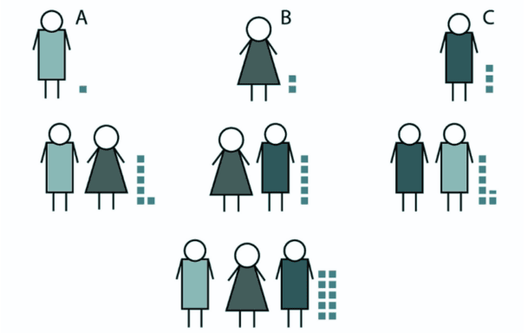
SHAP values for model explanation
Prediction
Model explanation
Attribution
Causal modelling
Why did the model make this prediction?
SHAP explains how features contribute to a model’s prediction
Each feature pushes the prediction higher or lower from a baseline
Works locally for one customer and globally across customers
Average
prediction
Feature
contributions
Fair
allocation
Final
prediction
Interpret the model’s reasoning — not the real-world cause.
Notes:
After our model has been fit and performance has been evaluated, stakeholders may ask “why the model flagged a given customer” or “how features impacted predictions across customers”. This is a question of model explanation, best answered using SHAP values.
SHAP values, or Shapley Additive exPlanations, are an explainable machine learning technique used to understand how different features contribute to a model’s predictions. Many machine learning models are considered “black boxes” because they can make accurate predictions without clearly showing how those predictions were produced. SHAP helps address this by showing how much each feature pushed a prediction higher or lower compared with the model’s average prediction.
It is based on cooperative game theory, treating the features in a model as “players” in a game, and the model’s prediction as the “reward” produced by those players working together. The SHAP value of a feature represents that feature’s fair contribution to the final prediction. This can be used at a local level, where we explain one specific prediction, or at a global level, where we understand which features are most important for prediction across the whole dataset.

Slide 6
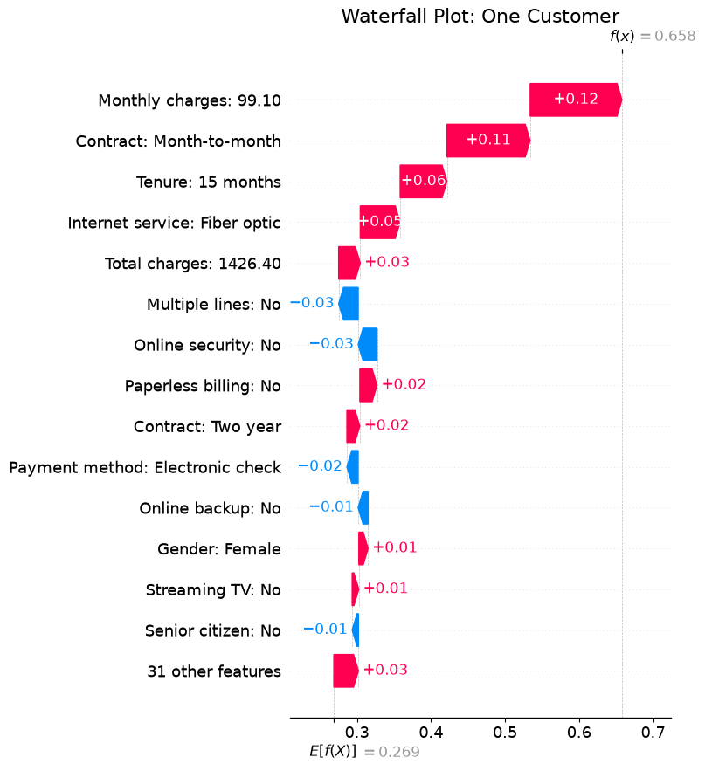
Explaining predictions at a local level
Prediction
Model explanation
Attribution
Causal modelling
From “high risk” to a stakeholder-ready explanation
Base value: average predicted churn probability
Features push the prediction up or down
This customer ends at a much higher predicted risk
“The model sees high charges, month-to-month contract and shorter tenure as a high-risk pattern.”
Notes:
To understand how much each feature contributed to an individual’s predicted probability of churn, we use a waterfall plot. In this case, the model starts with an average predicted churn probability of about 27%. This value is called the base value and is the average predicted probability of churn in a subset of the dataset called the background sample.
Each feature pushes the prediction up or down. For this customer, the final predicted churn probability is about 66%. The plot shows that the main features pushing this customer towards churn are: high monthly charges, a month-to-month contract, and a relatively short tenure of 15 months. We also notice that some features push the prediction down, lowering the predicted probability of churn, such as no multiple lines and no online security.
This develops our understanding of the model and enables us to move from saying “This customer is high risk”, to “This customer is high risk mainly because the model sees a pattern of high charges, a month-to-month contract, and a short tenure”, making prediction easier to discuss with business stakeholders.

Slide 7
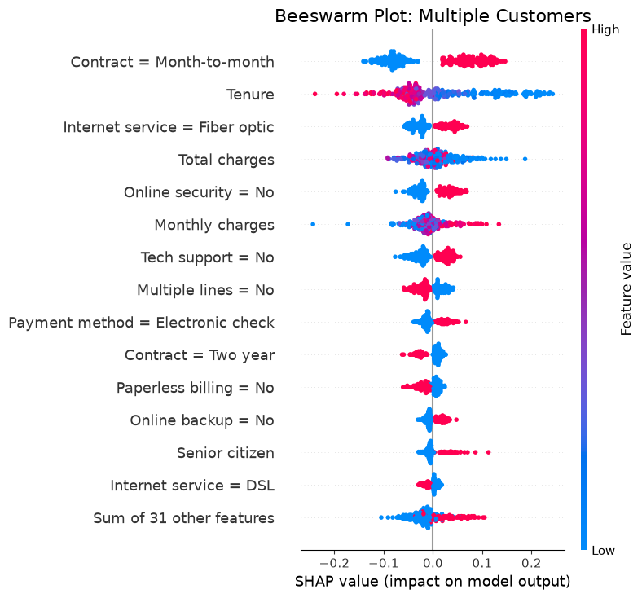
Explaining predictions at a global level
Prediction
Model explanation
Attribution
Causal modelling
What the model relies on across the dataset
Each dot is a customer
Position shows whether the feature increased or reduced churn risk
Colour shows whether the feature value is high or low
Influential predictors here include contract type, tenure and fiber optic service — but this is still predictive, not causal.
Notes:
Additionally, we can evaluate the impact of various features across different customers on prediction using a beeswarm plot. In this visual each dot is a customer, and its position on the x-axis shows whether that feature pushed the prediction towards churn or away from churn, compared the base value. The colour shows whether the feature value is high or low.
We can now see that across customers, the most influential features are whether contract type is month-to-month, the length of tenure and whether internet service is Fibre optic.
This is useful because it tells us what the model is relying on when it scores customers. However, we must remind ourselves that this does not necessarily mean that these features cause churn, it simply means that the model has learned that these features are useful for predicting churn.

Slide 8
Evaluating SHAP values
Prediction
Model explanation
Attribution
Causal modelling
Strengths
Weaknesses / limitations
Assumptions
Local and global explanation
Works with complex predictive models
Turns black-box predictions into business conversations
Not causal: explains the model, not the world
Depends on the quality of the model
Correlated features can distort importance
Model is worth explaining
Features are meaningful and consistently measured
Background sample is a reasonable reference group
Notes:
SHAP has three major strengths as it relates to explainable machine learning.
First, it gives both global and local explanation; second, it works well with complex predictive models like XGBoost, and third, it translates a black-box model into a more business friendly conversation. Instead of only showing accuracy or AUC, we can show why certain customers were flagged.
The main weakness is that SHAP is not causal; it explains the model, not the real world. If SHAP shows that month-to-month contracts increase predicted churn risk, that does not prove that changing the contract would reduce churn; since customers on month-to-month contracts may differ from other customers in many other ways.
Other limitations include the fact that SHAP explanations depend on the model. Therefore, if the model is biased, overfit, poorly validated or trained on weak data, SHAP will explain that flawed model. And finally, correlated features such as tenure and total charges can share or distort importance. This means we should avoid over-reading exact rankings.
The main assumptions are that the model being explained is good enough to be worth explaining; the features are meaningful and measured consistently, and the background sample used by SHAP is a reasonable reference group.

Slide 9
Logistic regression for controlled attribution
Prediction
Model explanation
Attribution
Causal modelling
Which factors are associated with churn, after accounting for other variables?
Churn is a yes/no outcome, so logistic regression is appropriate
Each coefficient estimates an association with the odds of churn
The model “holds constant” the other variables included in the model
Prediction asks: “Who?”
Attribution asks: “Which factors remain related after controls?”
The language changes from “causes” to “associated with”.
Notes:
Now we move to the third task: attribution. Here the question changes. We are no longer only asking, “Who is likely to churn?” or “Why did the model make this prediction?” We are asking, “Which factors are associated with churn after accounting for other variables?”.
This is where logistic regression becomes useful. Because churn is a yes/no outcome, we use logistic regression rather than ordinary linear regression, but the same logic applies for either model. Logistic regression estimates how each variable is associated with the odds of churn, while holding the other variables in the model constant.

Slide 10
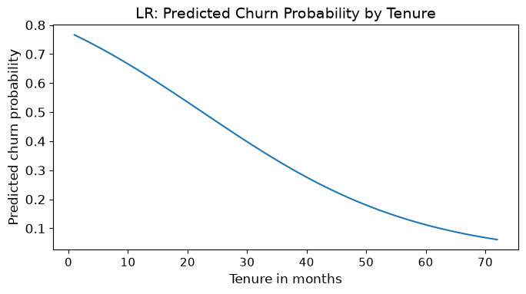
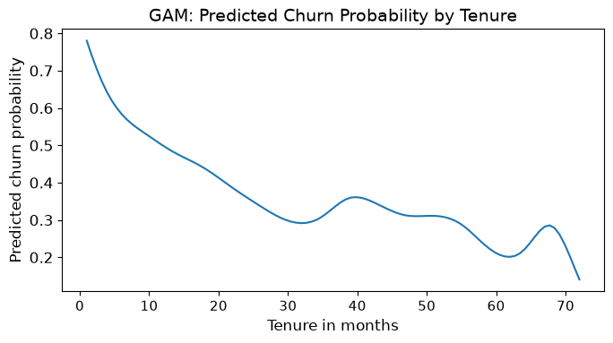
From logistic regression to GAMs
Prediction
Model explanation
Attribution
Causal modelling
Same question, more flexible shape
Notes:
A GAM keeps the same basic logic as logistic regression — we are still modelling a binary churn outcome and still controlling for other variables — but it relaxes the assumption of linearity for continuous predictors. Instead of forcing tenure into one simple effect, the GAM allows the data to estimate a smooth curve. The two visuals are both showing the relationship between tenure and predicted churn probability, but they are doing it in different ways. The chart on the left gives a very smooth, regular pattern. Implying that: “As tenure increases, predicted churn probability steadily decreases.” The chart on the right is the GAM version. It still shows the same overall story — churn risk is highest among newer customers and generally falls as tenure increases — but it allows the pattern to be more flexible. The curve drops sharply early on, then flattens, then shows smaller changes later in the customer lifecycle. So, the extra value of the GAM is not that it tells a completely different story. It tells a more detailed version of the story.

Slide 11
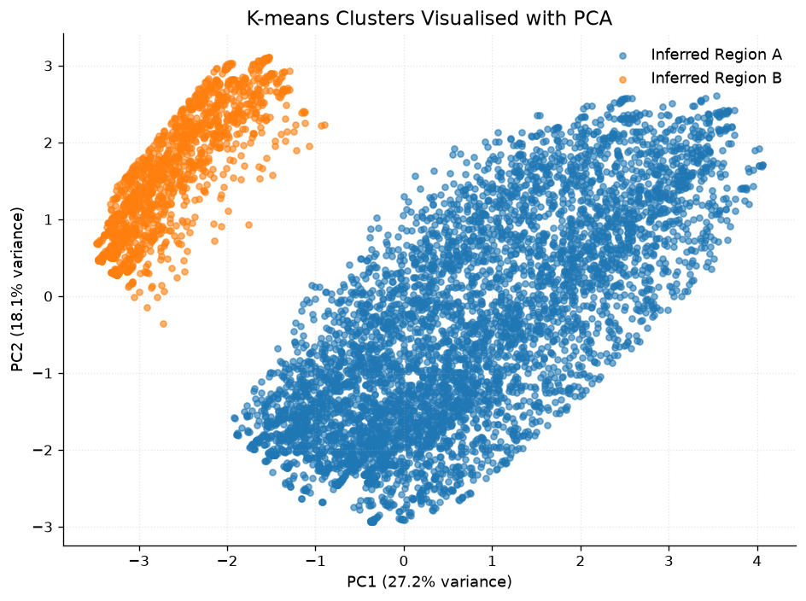
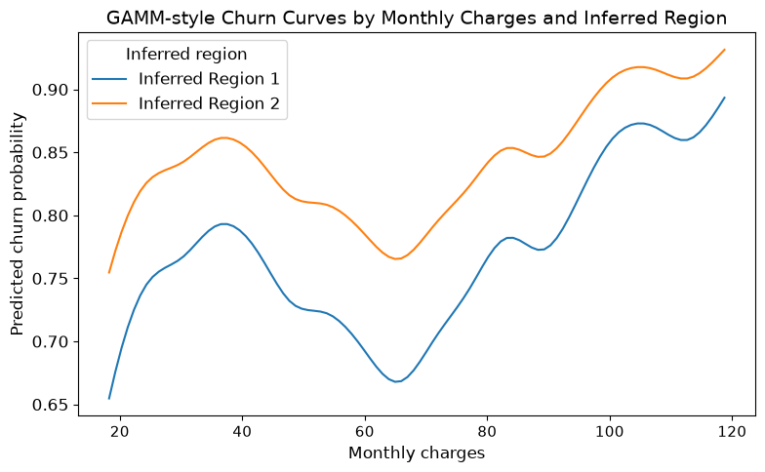

GAMMs for nonlinear and grouped attribution
Prediction
Model explanation
Attribution
Causal modelling
GAMM = flexible smooths + grouped data structure
Notes:
We can extend this idea one step further to Generalised Additive Mixed Models.
It combines two ideas: That a GAM allows flexible, nonlinear relationships and that a mixed model allows for grouped or clustered data.
So, a Generalised Additive Mixed Model is like a traditional GAM, but it also recognises that customers may belong to different groups.
In a real churn setting, those groups could be: regions, branches, stores, account managers, or sales teams.
The reason this matters is that customers are not always fully independent. Customers from the same region, branch or account manager may share common experiences. A standard GAM may ignore this grouping. However, its mixed model counterpart allows us to model it.
Since this dataset does not explicitly contain any features which imply grouping, I ran a k-means clustering algorithm to identify a latent class label. This resulted in two clusters that showed clear separation when visualised with a PCA plot. I then added a feature called inferred region to represent this artificial grouping.
The left-hand chart is a odds-ratio plot akin to the one discussed for logistic regression. It shows that the inferred Region A appears to have higher baseline churn risk, while Region B appears to have lower baseline churn risk.
This is powerful because it separates customer-level drivers from group-level patterns.
The right-hand chart shows churn curves by group. Which can be used to show how the relationship between response and predictor vary across different groups. In this case, it simply shows a baseline difference.

Slide 12
Evaluating GAMMs
Prediction
Model explanation
Attribution
Causal modelling
Strengths
Weaknesses / limitations
Assumptions
Handles nonlinear relationships
Produces interpretable curves
Separates customer-level and group-level variation
Harder to explain than logistic regression
Needs enough data within each group
Can overfit; still not necessarily causal
Grouping variable represents shared context or dependency
Smoothing choices are appropriate
Groups have enough observations to estimate meaningful variation
Notes:
Generalised Additive Mixed Models benefit from the strengths of traditional GAMs, since they can handle nonlinear relationships and are easily interpreted with odds-ratio plots and predicted probability curves. However, the mixed model component enables them to handle grouped data and help separate levels of variation, distinguishing between customer-level effects and group-level effects.
In terms of weaknesses and limitations:
The first weakness is complexity. The mixed component means that these models are harder to explain than logistic regression or a simple GAM, since you need to explain both the smooth functions and the grouped effects.
The second weakness is data requirements. You need enough data within each group. If some branches or regions have very few customers, the group estimates may be unstable.
The third weakness is overfitting. If the smooth curves are too flexible, the model can chase noise rather than capture a real pattern.
The final limitation, is that they are still not necessarily causal. Even if one region has higher churn, the model does not prove that the region caused the churn, since there may be unmeasured differences such as competitor activity.
The main assumption is that the grouping variable must represent a real source of shared context or dependency. If we group customers by something arbitrary, the random effect will not capture meaningful variation and may add complexity without improving the explanation.

Slide 13
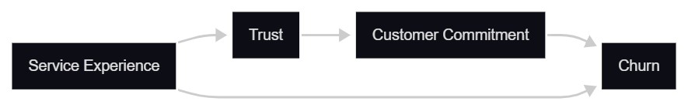
DAGs for causal reasoning
Prediction
Model explanation
Attribution
Causal modelling
Before causal modelling, draw the assumed real-world structure.
A DAG is not a model output; it is an assumption map
It forces clarity about what causes what and what must be controlled
It prepares the ground for SEM and causal effect estimation
Assumption map: service experience, trust, commitment and churn
Notes:
Now we begin to answer the long-awaited question of “what causes churn?”. We will see this requires a deeper understanding of the structure of observational data as well as methods to estimate the effects of unobserved data. A useful tool for understanding the structure of data and for modelling latent constructs is the DAG.
A DAG, or Directed Acyclic Graph, is a way of drawing out what we believe is happening in the real world before we start modelling. It is not a model output, and it is not something the data automatically gives us. Rather, it is an assumption map. It requires domain expertise and forces us to be clear about what we think causes what, which variables sit earlier in the process, and which variables are outcomes of other variables.
For example, we may assume that service experience impacts trust and churn, and that trust leads to customer commitment, which ultimately impacts churn as well.
Clarifying what we believe is the causal structure behind churn, and what would we need to assume before making a causal claim, prepares us for the next methods: SEM, Bayesian SEM, and causal effect estimation.

Slide 14
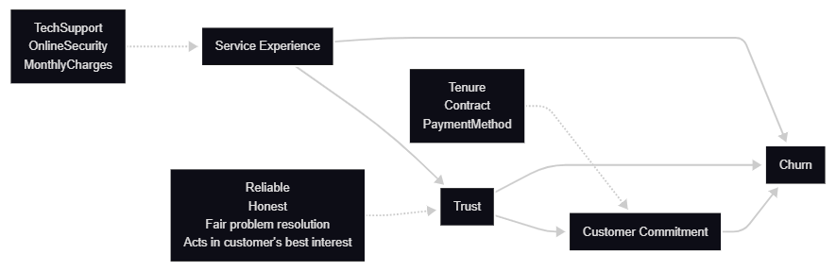
SEM for modelling relationships between constructs
Prediction
Model explanation
Attribution
Causal modelling
Observed indicators and latent constructs
SEM models a system of relationships, including latent constructs.
Notes:
Structural Equation Modelling, or SEM allows us to model relationships between variables that are directly observed, as well as broader concepts that are not directly observed. These broader concepts are called latent constructs. In this example, we are interested in ideas like service experience, trust and customer commitment. We cannot measure trust perfectly with one column in a dataset, but we can infer it from several indicators, such as whether customers believe the provider is reliable, honest, fair in resolving problems, and acting in their best interest. This is where engagement with customers through surveys can act as a useful extension to the dataset, where responses can be used to quantify trust.
The important difference between SEM and a standard regression model is that SEM allows us to model a system of relationships at the same time.
In this diagram, the dotted arrows show how observed indicators are used to measure latent constructs. For example, tech support, online security and monthly charges help represent service experience. The solid arrows then show the structural pathways between those constructs and churn.
This gives us a richer explanation of churn. Rather than saying, “contract type predicts churn,” we can say that contract type may be part of a broader commitment mechanism.
However, this approach requires caution. SEM can make a model look causal because it uses arrows, but the arrows are only as strong as the assumptions and data behind them. With proper survey measures, timing, and theory, SEM can help us test whether the proposed structure is plausible. But it does not automatically prove causality.

Slide 15
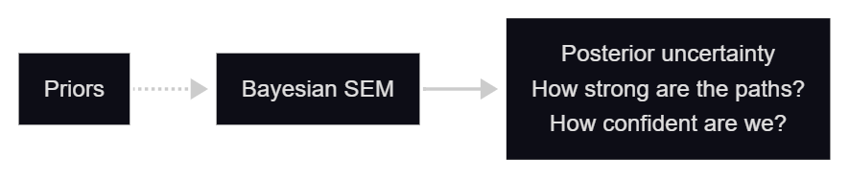
Bayesian SEM for uncertainty in structure
Prediction
Model explanation
Attribution
Causal modelling
Bayesian SEM:
Standard SEM estimates pathway strengths
Bayesian SEM estimates distributions of plausible values
Useful when theory, prior evidence and current data need to be combined
Pathways with uncertainty around estimates
Notes:
This leads naturally into Bayesian SEM. Standard SEM estimates the strength of each pathway in the model. Bayesian SEM does the same thing, but instead of giving us only a single best estimate, it gives us a distribution of plausible values for each relationship. It allows us to express uncertainty more directly, incorporate prior knowledge, and ask how confident we are about each relationship in the model.
This is useful because in real-world problems, we are often uncertain. We may not know exactly how strong a relationship is, have limited data or have prior knowledge we’d like to incorporate. Bayesian SEM gives us a formal way to combine what we already believe with what the current data is telling us.

Slide 16
Evaluating Bayesian SEM
Prediction
Model explanation
Attribution
Causal modelling
Strengths
Weaknesses / limitations
Assumptions
Represents uncertainty directly
Incorporates prior knowledge
Useful for complex or smaller-sample models
Technically demanding
Priors must be justified
Harder to explain to stakeholders than a single coefficient
Measurement model is meaningful
Structural pathways are theoretically justified
Priors are appropriate and sensitivity-checked
Notes:
Bayesian SEM has several strengths. First, it gives us a more honest way to talk about uncertainty. Instead of presenting each pathway as though there is one fixed answer, Bayesian SEM gives us a range of plausible values for each relationship. A second strength is that Bayesian SEM can incorporate prior knowledge, which is then updated using the data. This can be especially useful when sample sizes are smaller, the model is more complex, or we want to combine theory, previous evidence and current data.
However, Bayesian SEM also has weaknesses. It is more technically demanding than a standard SEM. The results can be influenced by the priors we choose, especially when the sample is small or the data is weak. This means we cannot simply choose priors that produce the story we want. The priors must be justified, and we should check whether the conclusions change when different reasonable priors are used. Bayesian SEM can also be harder to explain to stakeholders because the output is probabilistic rather than a single coefficient or p-value.
The main assumptions are that the measurement model is meaningful, the structural pathways are theoretically justified, and the priors are appropriate.

Slide 17
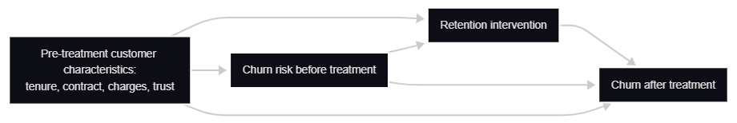
Causal inference: estimating intervention effects
Prediction
Model explanation
Attribution
Causal modelling
Estimating the counterfactual:
Cannot observe the same customer both receiving and not receiving treatment at the same time.
Hypothetical intervention extension.
Methods considered: propensity score matching and difference-in-differences.
Estimating the effect of intervention
Notes:
This leads naturally into Bayesian SEM. Standard SEM estimates the strength of each pathway in the model. Bayesian SEM does the same thing, but instead of giving us only a single best estimate, it gives us a distribution of plausible values for each relationship. It allows us to express uncertainty more directly, incorporate prior knowledge, and ask how confident we are about each relationship in the model.
This is useful because in real-world problems, we are often uncertain. We may not know exactly how strong a relationship is, have limited data or have prior knowledge we’d like to incorporate. Bayesian SEM gives us a formal way to combine what we already believe with what the current data is telling us.

Slide 18
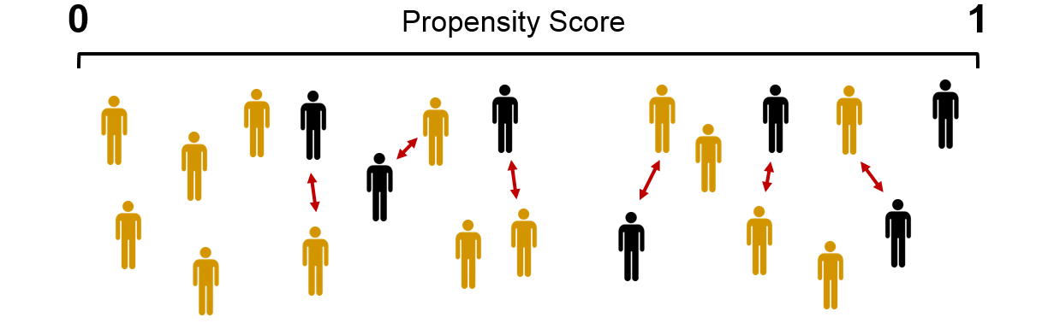
Causal inference: propensity score matching
Prediction
Model explanation
Attribution
Causal modelling
Using PSM to estimate intervention effects:
Estimate each customer’s probability of receiving a retention offer.
Match each recipient with a non-recipient who had a similar probability of receiving a retention offer.
Compare outcomes between the treated and untreated groups.
Notes:
This leads naturally into Bayesian SEM. Standard SEM estimates the strength of each pathway in the model. Bayesian SEM does the same thing, but instead of giving us only a single best estimate, it gives us a distribution of plausible values for each relationship. It allows us to express uncertainty more directly, incorporate prior knowledge, and ask how confident we are about each relationship in the model.
This is useful because in real-world problems, we are often uncertain. We may not know exactly how strong a relationship is, have limited data or have prior knowledge we’d like to incorporate. Bayesian SEM gives us a formal way to combine what we already believe with what the current data is telling us.

Slide 19
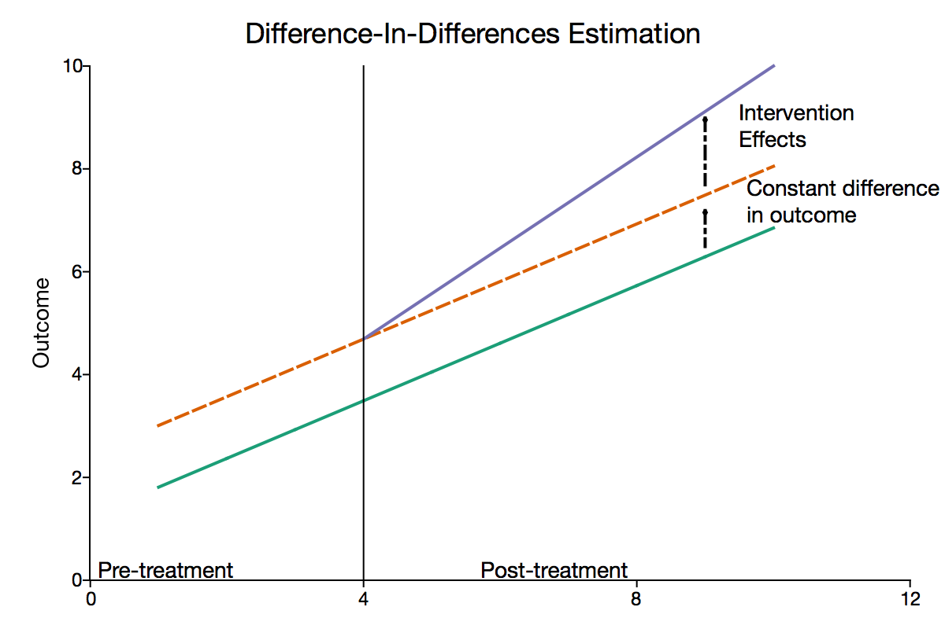
Causal inference: difference-in-differences
Prediction
Model explanation
Attribution
Causal modelling
Using DiD to estimate intervention effects:
Change in treated group = after treatment - before treatment
Change in comparison group = after same period - before same period
Difference-in-differences = change in treated group - change in comparison group
Notes:
This leads naturally into Bayesian SEM. Standard SEM estimates the strength of each pathway in the model. Bayesian SEM does the same thing, but instead of giving us only a single best estimate, it gives us a distribution of plausible values for each relationship. It allows us to express uncertainty more directly, incorporate prior knowledge, and ask how confident we are about each relationship in the model.
This is useful because in real-world problems, we are often uncertain. We may not know exactly how strong a relationship is, have limited data or have prior knowledge we’d like to incorporate. Bayesian SEM gives us a formal way to combine what we already believe with what the current data is telling us.

Slide 20
Closing: choose the tool by the question
Prediction
Model explanation
Attribution
Causal modelling
The same business question can require very different evidence.
Analytical task
Core question
Churn example
Suitable methods
Prediction
Who is likely to churn?
Which customers should be prioritised for retention activity?
XGBoost, random forest, logistic regression
Model explanation
Why did the model flag this customer?
Which features pushed this customer’s churn risk up or down?
SHAP values, feature importance, partial dependence
Attribution
Which factors are associated with churn?
Are month-to-month contracts related to churn, controlling for tenure and services?
Logistic regression, GAMs, GAMMs, mixed models
Causal effect estimation
What would happen if we changed something?
Did a retention call or loyalty discount reduce churn?
SEM, propensity score matching, difference-in-differences, instrumental variables
Practical decision rule
Use prediction for prioritisation, explanation for transparency, attribution for controlled associations, and causal inference when the decision is about changing the system.
Notes:
The main point of this presentation is to ask the right question. Once the question is clearly defined, the choice of approach is simplified. Use prediction for prioritisation, explanation for transparency, attribution for controlled associations and casual inference when the decision is about changing the system.
Thank you

