Slide 1
UP NEXT
Jordan Borean
Justin Grote

Slide 2
3
3

Slide 3
2

Slide 4
1

Slide 5
PowerShell Runspaces Deep Dive Follow Along Session
Jordan Borean
Justin Grote

Slide 6

Many thanks to our sponsors:

Slide 7
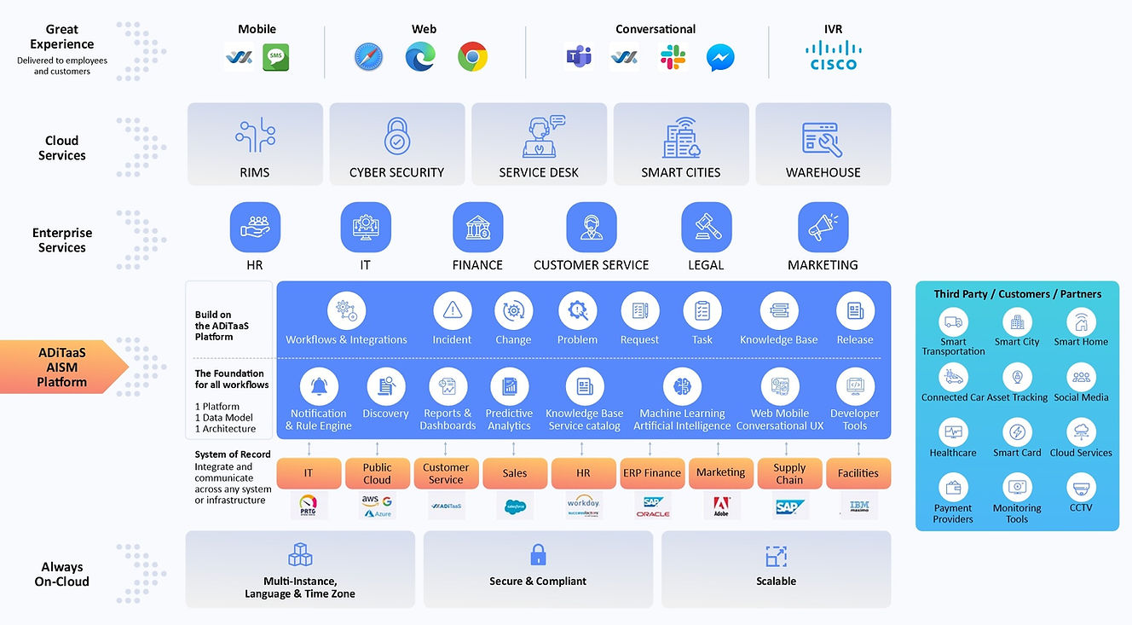

Thank You Allied Digital!

Slide 8
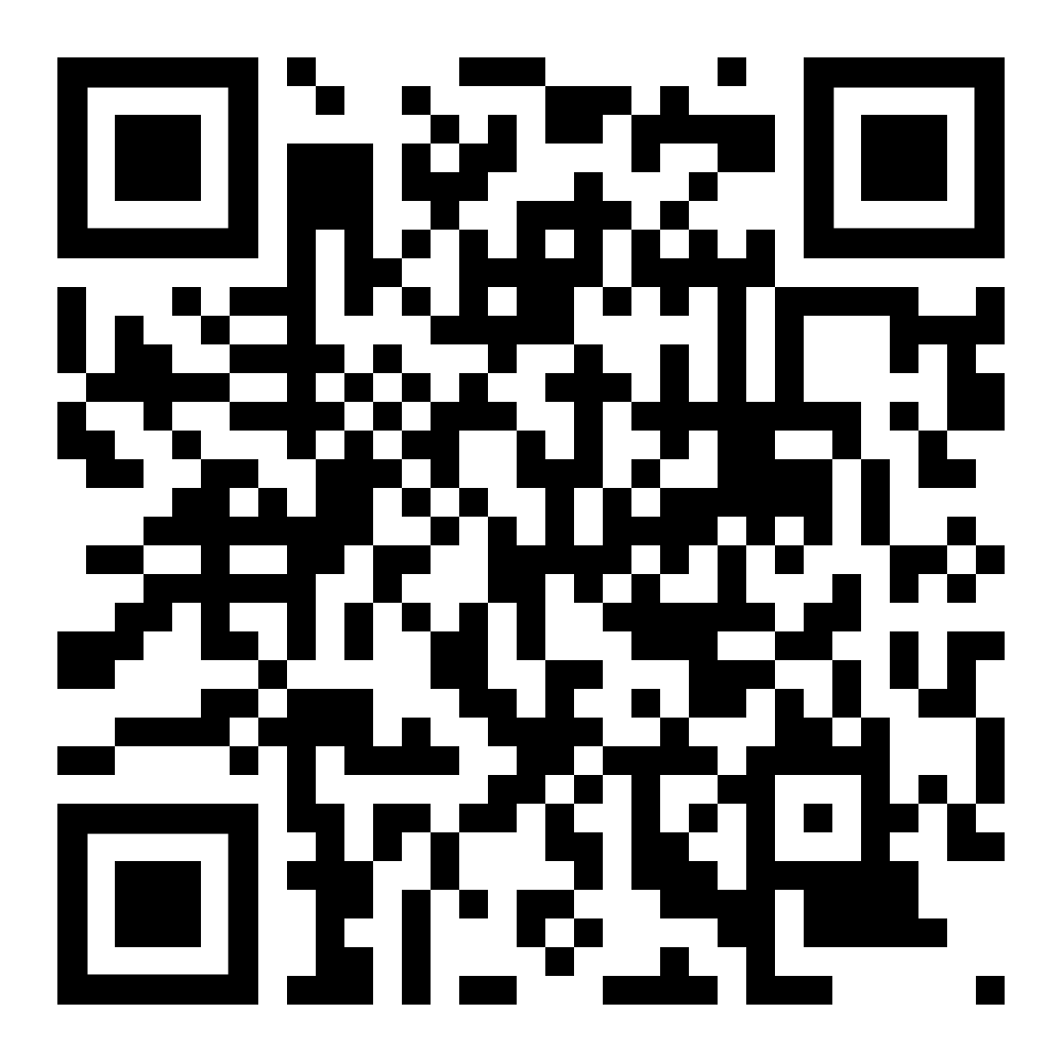
Codespaces Follow Along!

Slide 9


Process (pwsh.exe, powershell.exe, myDotnetProgram.exe)
🧵🧵🧵 ThreadPool
PowerShell Instance - {} Commands
- 📳 Streams
📗 Runspace
🏯Session State (Global) - Variables
- Modules
- Types - Formats
⏹️Session State (Module) - Variables
- Modules
- Types - Formats
👮SessionStateProxy
🧵Thread

Slide 10
Process (pwsh.exe, powershell.exe, myDotnetProgram.exe)
🧵🧵🧵 ThreadPool
PowerShell Instance - {} Commands
- 📳 Streams
PowerShell Instance - {} Commands
- 📳 Streams
📗 Runspace
📗 Runspace
🏯Session State (Global) - Variables
- Modules
- Types - Formats
⏹️Session State (Module) - Variables
- Modules
- Types - Formats
🏯Session State (Global) - Variables
- Modules
- Types - Formats
⏹️Session State (Module Again) - Variables
- Modules
- Types - Formats
👮SessionStateProxy
👮SessionStateProxy
🧵Thread

Slide 11
Process (pwsh.exe, powershell.exe, myDotnetProgram.exe)
🧵🧵🧵 ThreadPool
PowerShell Instance - {} Commands
- 📳 Streams
PowerShell Instance - {} Commands
- 📳 Streams
📚RunspacePool
📗 Runspace
📗 Runspace
📗 Runspace
🏯Session State (Global) - Variables
- Modules
- Types - Formats
⏹️Session State (Module) - Variables
- Modules
- Types - Formats
🏯Session State (Global) - Variables
- Modules
- Types - Formats
🏯Session State (Global) - Variables
- Modules
- Types - Formats
👮SessionStateProxy
👮SessionStateProxy
👮SessionStateProxy
⏹️Session State (Module Again) - Variables
- Modules
- Types - Formats
⏹️Session State (Module Again) - Variables
- Modules
- Types - Formats
🧵Thread

Slide 12
Process (pwsh.exe, powershell.exe, myDotnetProgram.exe)
Process (pwsh.exe, powershell.exe, myDotnetProgram.exe)
🧵🧵🧵 ThreadPool
🧵🧵🧵 ThreadPool
PowerShell Instance - {} Commands
- 📳 Streams
CLIXML REMOTING
PowerShell Instance - {} Commands
- 📳 Streams
📗 Runspace
📗 Runspace
🏯Session State (Global) - Variables
- Modules
- Types - Formats
⏹️Session State (Module) - Variables
- Modules
- Types - Formats
🏯Session State (Global) - Variables
- Modules
- Types - Formats
⏹️Session State (Module) - Variables
- Modules
- Types - Formats
👮SessionStateProxy
👮SessionStateProxy
🧵Thread
🧵Thread

Slide 13
Process (pwsh.exe, powershell.exe, myDotnetProgram.exe)
Process (pwsh.exe, powershell.exe, myDotnetProgram.exe)
🧵🧵🧵 ThreadPool
🧵🧵🧵 ThreadPool
PowerShell Instance - {} Commands
- 📳 Streams
CLIXML REMOTING
PowerShell Instance - {} Commands
- 📳 Streams
📗 Runspace
📗 Remote Runspace
📗 Runspace
Remoting
🏯Session State (Global) - Variables
- Modules
- Types - Formats
🏯Session State (Global) - Variables
- Modules
- Types - Formats
⏹️Session State (Module) - Variables
- Modules
- Types - Formats
👮SessionStateProxy
👮SessionStateProxy
⏹️Session State (Module) - Variables
- Modules
- Types - Formats
🧵Thread
🧵Thread

