Slide 1
Natural Computation
Optimizing AF Distribution
using Simulated Annealing
Task 2: Abstract and Introduction for the intermediate report
Justin Klein · Patrick Fan-Ming Lee · Ziri Moula . Negar Farahani
Task 2 · 01

Slide 2
Abstract
This project explores whether the performance of small neural networks can be improved by searching for better activation-function assignments.
In a normal neural network, training mainly changes the weights and biases. This training is done with gradient descent. However, the activation functions, such as ReLU, tanh, sigmoid, Swish, GELU, or identity, are usually selected manually before training starts and then remain fixed.
Our project separates these two processes clearly.
Gradient descent is used to train the weights and biases for a fixed activation layout.
Simulated Annealing is used to search over different activation-function layouts.
In each step, Simulated Annealing proposes a small change to the current layout, for example changing the activation function of one neuron. The proposed layout is then trained briefly and evaluated on validation data to estimate how well it works.
The aim is to compare Simulated-Annealing layouts with standard manually chosen layouts under identical training conditions, such as the same network structure, data split, training time, and random seeds. This allows us to fairly study whether optimizing activation-function distributions can improve neural network design.
Task 2 · 06

Slide 3
Project in one sentence
We optimize the distribution of activation functions in small neural networks.
Fixed topology
Activation layout
SA search
Validation score
Same network structure
Input → hidden layers → output
Activation functions assigned to hidden neurons
ReLU / tanh / sigmoid / Leaky ReLU
Small change → brief training → score → accept/reject
Lower validation loss or higher validation accuracy
In this project, We keep the network structure fixed, so the number of layers and neurons does not change.
What we change is the activation layout, meaning which activation function is assigned to each hidden neuron.
Simulated Annealing searches through different layouts by making small changes, briefly training the candidate, and checking the validation score.
The main distinction is that gradient descent trains the weights, while Simulated Annealing searches for better activation-function layouts.
Task 2 · 05

Slide 4
Introduction : Why this project matters
Neural networks are trained to make predictions from data.
During training, the network usually learns:
Weights
Biases
However, another important design choice is often fixed before training starts:
the activation functions
Main question:
Can we improve a neural network by searching for a better distribution of activation functions?
Task 2 · 08

Slide 5
Introduction: What is an Activation Function?
A neuron first computes a weighted input:
Then an activation function transforms this signal into the neuron’s output.
Examples:
ReLU
tanh
Sigmoid
Leaky ReLU
Swish
GELU
input values
weights + bias
internal signal
Simple explanation: Activation functions help the network learn non-linear patterns.
Task 2 · 07

Slide 6
Introduction: The Usual Problem
Activation functions are usually chosen manually
In many neural networks:
the architecture is fixed before training
activation functions are selected manually
the same activation is often used for a whole layer
training does not change the activation functions
Example:
Layer 1: ReLU, ReLU, ReLU, ReLU
Layer 2: ReLU, ReLU, ReLU, ReLU
Problem: This may not be the best activation-function distribution.
Task 2 · 10

Slide 7
Introduction: Our Project Idea
Turning activation-function choice into a search problem
Instead of using only one fixed activation setup, we treat activation-function assignment as a search problem.
A layout describes which activation function each hidden neuron uses.
Example layouts:
ReLU, ReLU, ReLU, ReLU
ReLU, tanh, ReLU, sigmoid
Leaky ReLU, ReLU, tanh, sigmoid
Goal: Find layouts that perform better on validation data.
Task 2 · 10

Slide 8
Introduction: Why Simulated Annealing?
Activation-function choices are discrete.
This means we cannot directly train them like weights.
Simulated Annealing is useful because it can:
search through many possible layouts
make small changes step by step
accept better layouts
sometimes accept worse layouts to avoid getting stuck
gradually become more conservative
Task 2 · 10

Slide 9



Introduction: Two Different Processes
Gradient Descent
Simulated Annealing
trains weights and biases
works inside one fixed activation layout
reduces prediction error
searches over activation-function layouts
proposes small layout changes
uses validation performance to guide the search
Key distinction:
Gradient descent trains the network parameters.
Simulated Annealing searches for better activation layouts.
Task 2 · 11

Slide 10
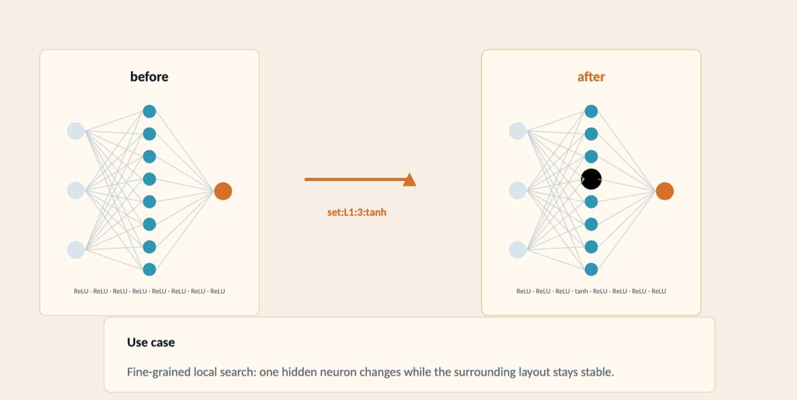
Introduction: How the Search Works
One Simulated Annealing step:
Start with a current activation layout.
Make a small change.
Train the candidate layout briefly.
Evaluate it on validation data.
Accept or reject the candidate.
Reduce the temperature over time.
Example small change:
ReLU, ReLU, ReLU, ReLU → ReLU, tanh, ReLU, ReLU
Task 2 · 10

Slide 11
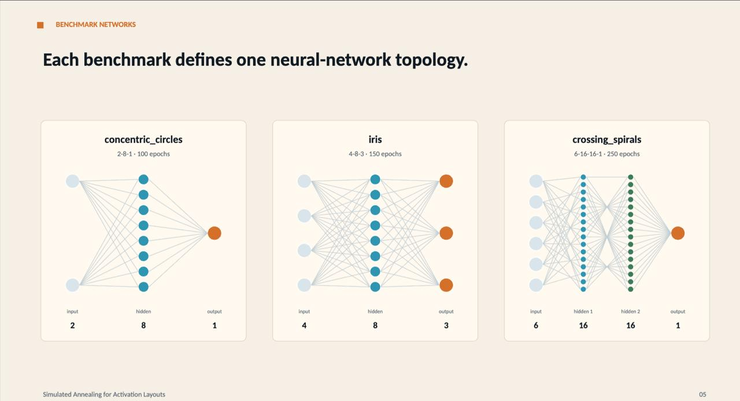
Introduction: Benchmark Setup
Where do we test the activation layouts?
We use benchmarks to test our method in a controlled way.
Each benchmark defines:
the prediction task
the input data
the neural-network topology
the train / validation / test setup
For a fair comparison, the benchmark and network structure stay fixed.
Only the activation-function layout changes.
Task 2 · 10

Slide 12
Introduction: Fair Evaluation
How do we compare layouts fairly?
To compare layouts fairly, we need identical conditions:
same benchmark
same network structure
same train/validation/test split
same training budget
same random seeds
We compare:
manually chosen layouts
fixed single-activation layouts
Simulated-Annealing-generated layouts
Task 2 · 10

Slide 13
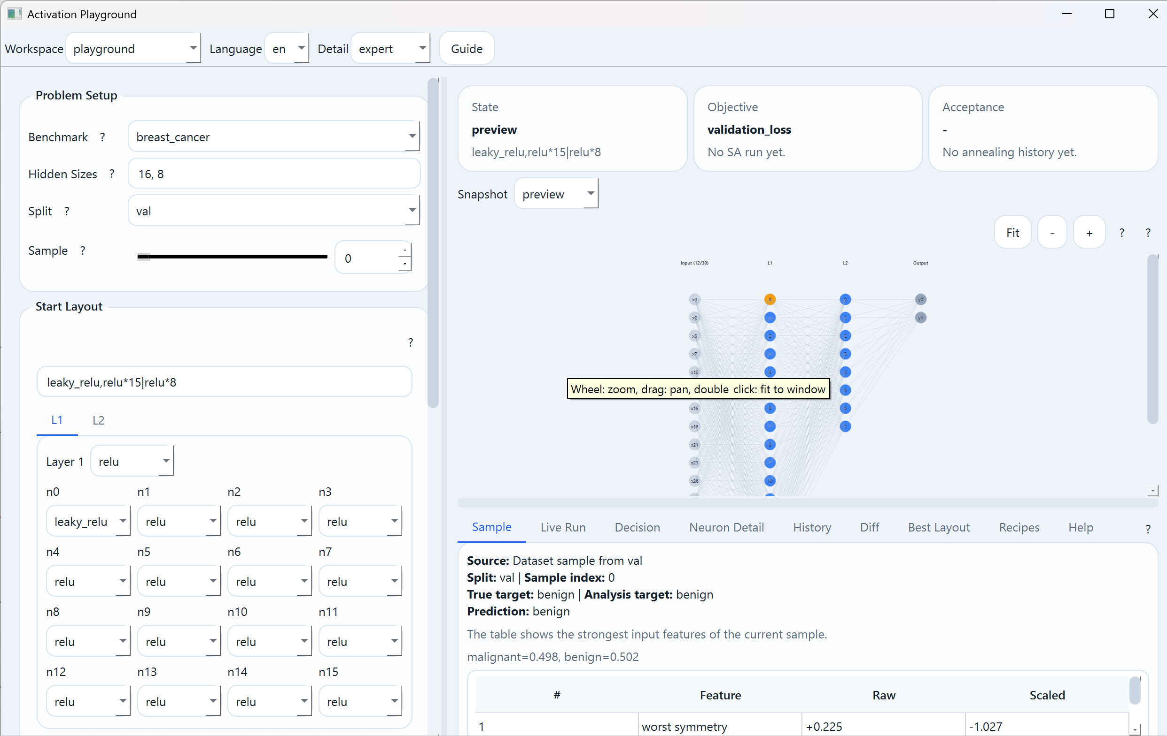
Activation Playground Implementation
We designed an activation playground: a small experimental tool for understanding and testing activation-function layouts.
It currently allows us to:
choose a benchmark, such as wine or breast_cancer
define the hidden-layer structure, for example 16, 8
assign activation functions per layer or per neuron
inspect how one sample moves through the network
run Simulated Annealing over activation layouts
compare start, current, candidate, and best layouts
observe validation score, acceptance rate, and temperature
Task 2 · 10

Slide 14
Thank You
Task 2 · 10

