Slide 1
Reading and Writing Skills
Prepared by:
Hannah Angela Ilarde
Khient Justin Grande

Slide 2
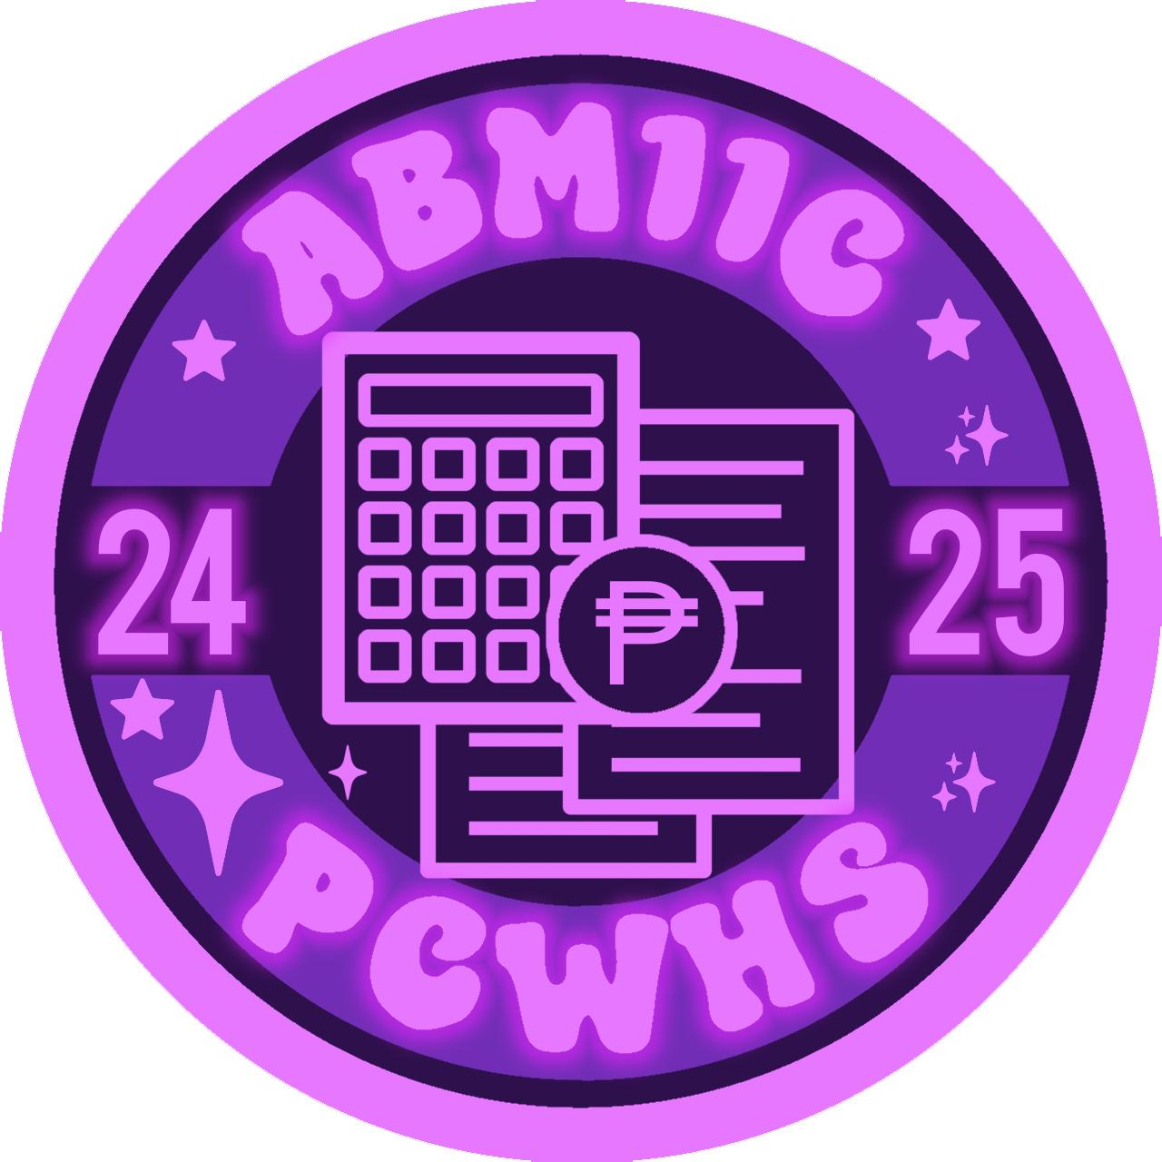
Are you ready

Slide 3
Games: Rules
Do not use electronic gadgets for searching.
Do not answer in chorus, otherwise you are been rejected for answering future questions.
Raise your hand if you want to answer.
If you don’t know the answer, we can give the clue but in morse code.
Rewards can claimed if you answered it correctly. Rewards are depending on the level of the game.

Slide 4
Games Level: I
The part of a book where the lists of definitions for technical, advanced, or confusing words.
GLOSSARY

Slide 5
Games Level: II
Fill the missing word correctly:
The ABM11C students ________ struggling with their schoolworks.
ARE

Slide 6
Games Level: III
Fill the missing letters:
_ C _ N _ _ L E _ G _
ACKNOWLEDGE

Slide 7
Games Level: IIII
A transparent thing that ability to see and interact with others using a cold and solidified liquid thing.
ICE

Slide 8
Games Level: IIIII
Fill and answer
What is a system of s__k_n and written symbols used by a community?
SPOKEN; LANGUAGE

Slide 9
Text and Context Connections
(Critical Reading)

Slide 10
Objective
Identifies the context in which a text was developed
Hypertext
Intertext

Slide 11
Identifying the Context of Text Development
Being a critical reader also involves understanding that texts are always developed with a certain context. A text is neither written or read in a vacuum; its meaning and interpretation are affected by a given set of circumstances. Thus, context is defined as the social, cultural, political, historical, and other related circumstances that surround the text and from the terms from which it can be better understood and evaluated. Knowledge od the text’s concept helps in appreciating the text’s message more deeply.

Slide 12
Identifying the Context of Text Development
In discovering a reading’s context, you may ask questions like:
When was the work written?
What were the circumstances that produced it?
What issues does it deal with?
Another important technique in analyzing the context of a text’s development is defining its intertextual link to another text.

Slide 13
Intertext
Are works which inform or help construct a text.
They can be from any medium but the main text relies on them to help construct meaning.
An intertext connects the studied text to media as a whole and stops the text from being an island.

Slide 14
Intertextuality
What they mean
Inter: a prefix from Latin, where it meant “between”, “among”, “in the midst of”, “mutually”, “reciprocally”, “together”, “during”.
Textuality: all of the attributes that distinguish the communicative content under analysis as an object of study.

Slide 15
Intertextuality
“Borrows” ideas and themes from other media forms.
Can be borrowed from text, audio files, movies, theatre etc.
Not to be associated with copyright, collusion.
Various movies use intertextual references.
Helps reader to better understand text.

Slide 16
Intertextuality
Is the modelling of a text’s meaning by another text.
It is defined as the connections between language, Images, characters, themes, or subjects depending on their similarities in language, genre, or discourse.
This is seen when an author borrows and transforms a prior text, or when you read one text and you reference another.
This view recognizes that the text is always influenced by previous texts and in turn anticipates future texts.

Slide 17
Intertextuality
A text contains many layers of accumulated cultural, historical, and social knowledge, which continually adds to and affects one another.
Thus, Intertextuality becomes a dialogue among different texts and interpretations of the writer, the audience, and the current and earlier cultural contexts.

Slide 18
Intertextuality Example
The local legend of folk hero Bernardo Carpio. Many versions of his tale exist, but local folklore says he is a giant who is the cause of earthquakes.
In Greek mythology, there is also Poseidon, who is the god of the sea and earthquakes. Many cultures also attribute natural disasters to legendary figures.

Slide 19
Intertextuality Example
The story of “Tall Story” by Candy Gourlay. This is the story of a British-Filipina teenager who meets Bemardo, her long-lost half-brother. Bernardo tums out to be eight feet tall and suffers from gigantism. However, the people from his village believe he is the legendary giant who has come to save everyone from earthquakes. The inspiration of the Bernardo Carpio myth is clear in this story and creatively updated to make it more appealing to modem and foreign audiences.

Slide 20
Intertextuality Example
Intertextuality – Simpsons
Almost every episode of the Simpsons contains at least one film reference to a famous film scene.
The Simpsons also contains intertextual references to politics, religion - nearly every aspect of social, political and cultural life.
The grabs on the following slides are from an episode where the Simpsons referenced Psycho.

Slide 21
Intertextuality
Meanwhile, hypertext is a relatively new way of reading a text online. Traditionally reading was viewed as a linear process, where you read from the beginning until the end. However, the advert of the internet and technology has created new ways of reading and processing a text, which includes hypertext.

Slide 22
Hypertext
Is a nonlinear way of showing information connects topics on a screen to related information, graphics, videos, and music information is not simply related to text.
This information appears as links and is usually accessed by clicking.
The reader can jump to more information about a topic, which in turn may have more links.
This opens up the reader to a wider horizon of information or to a new direction.

Slide 23
Hypertext
Non-Linear arrangements of textual material is called hypertext. The term hyper means extension to other dimensions.
Converting text into a multidimensional space.
The term was invented by Ted Nelson in 1965.
Hypertext “non-sequential writing” Nelson, T. 1987. Literary Machines.
Non-linear sequences of information (dictionary, encyclopedia, newspaper).

Slide 24
Hypertext
Hypertext are systems to manage collection of information that can be accessed non-sequentially.
A reader can skim through sections of a text, freely jumping from one part to another depending on what aspect of the text interests him/her.
Thus, in reading with hypertext, you are given more flexibility and personalization because you get to select the order in which you read the text and focus on information that is relevant to your background and interests. Therefore, you create your own meaning out of the material.

Slide 25
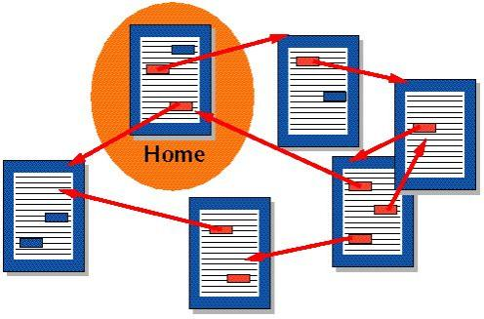
Hypertext Concept
What is hypertext?
“Merely and direct connection for a one position in a text to another.” (Aarseth, 1994)
“In hypertext, the component of the text by clicking on certain areas, the so-called hyperlinks, that bring to the screen or the segments of text.” (Ryan, 2001)

Slide 26
Hypertext Example
You are doing research about the Philippine eagle.
A quick Google search would lead you to a Wikipedia article on it.
Information on it would include a picture and a brief, written description.
While reading about the Philippine eagle, you will also encounter links to its conversation Status.
This may lead you to more information about conservation efforts.

Slide 27
Hypertext Example
However, if you were interested in the appearance of the Philippine eagle because you wanted to sketch it for your art class, the same page would provide its physical description and even give you links to pictures and videos of the Philippine eagle.
Thus, depending on your purpose and interests, the article on the Philippine eagle could lead you to a variety of different, detailed paths.

Slide 28
Do you have any questions?

Slide 29
Quiz: Rules
Cheat paper or kodigo, electronic gadgets, and other form of cheating are not allowed. Wired or wireless earphones should be removed.
Talking to your classmate is strictly prohibited. Keep it zero-noise during the quiz.
Looking to the paper of your classmate for answer is prohibited.
If one of these rules are violated, it may be subjected to score deduction.

Slide 30
Quiz
IDENTIFICATION
Write the correct word. Wrong answer and spelling will be deducted from the score.

Slide 31
Quiz
Who invented hypertext?
Is the modelling of a text’s meaning by another text.
Is a nonlinear way of showing information.
Who said this? “Merely and direct connection for a one position in a text to another”
All of the attributes that distinguish the communicative content under analysis as an object of study is called?

Slide 32
Quiz
DIRECTIONS: Write HYPERTEXT or INTERTEXT. Spell it correctly, otherwise it will be deducted from the score.

Slide 33
Quiz
6. EXPO - This site includes numerous on-line "tours” of history and society, including the Dead Sea Scrolls and the Vatican.
7. He’s asking her to the prom. It’s like a happy version of Romeo and Juliet.
8. Shakespeare On-Line - Every play the Bard ever wrote, interlinked with commentary throughout the site.
9. It’s hard being an adult! Peter Pan had the right idea.
10. He was lying so obviously, you could almost see his nose growing.

Slide 34
Quiz
11. Dissect a Frog! - UVA’s Curry School of Education maintains this innovative multimedia science experiment. If your Web browser has a form submission capability, there’s also another great frog dissection located at the Lawrence Berkeley Laboratory.
12. CS Lewis’ The Chronicle of Narnia: The Lion, the Witch, and the Wardrobe. It alludes to the Bible, and some of the parts parallel some scenes in the Bible (such as Edmund’s betrayal and Aslan’s sacrifice vis-à-vis Judas’ betrayal and the crucifixion of Jesus).
13. The Exploratorium - San Francisco’s famous interactive museum has an excellent on-line site as well.

Slide 35
Quiz
14. Taylor Swift – “Love story” music video. The lyrics of this song talk about Romeo and Juliet. This video is made to look like a modemized version of the story, relating more to the lyrics of the song.
15. Le WebLouvre – An Online tour of some of the most famous art exhibits in Paris.

Slide 36
Thank you for participating!

