Slide 1
GIGGLE GROUNDS
GROUP 1

Slide 2
Presented By
Arais, Macky Ashley Josh M.
Cazin, Lericka Gwayne D.
Grande, Khient Justin
Halim, Lianne Joyce B.
Ilarde, Hannah Angela S.
Labadia, Princess Mhine R.
Maliwat, Luis Andrei T.
Reyes, Janina Justin P.
Tabuzo, Hunter Hangello A.

Slide 3
Table of contents
I. Organizational Structure and Analysis
A. Business Name
B. Vision and Mission Statements
C. Organizational Structure
D. Organizational Theories and Analysis
II. Human Resource Management
A. Business Overview
B. Staffing Plan
C. Employee Benefits
D. Performance Appraisal System
E. Employee Relations Movements
III. Real-life Applications and Case Study
IV. References
V. Other attachments
A. Draft
B. Rubric

Slide 4
I. ORGANIZATIONAL STRUCTURE AND ANALYSIS

Slide 5
A. Business Name: Giggle Grounds
Giggle Grounds is a comedy bar and restaurant located in Pasay City. We specialize in providing funny entertainment and delicious food and drinks. By providing funny entertainment through our diverse comedians and delectable food and drinks curated by our chefs to our customers, we can create a warm, inviting, and hospitable atmosphere. Giggle Grounds's slogan is "Laughs Served Daily” that reflects the company's focus on providing laughter and exquisite cuisine to our customers.

Slide 6
B. Vision and Mission
Vision Statement: Our vision is to become the premier destination for entertainment, humor, and dining, fostering a vibrant community where people come together to celebrate connection and creativity. We aim to create an uplifting environment that goes beyond the traditional comedy club, offering a space that sparks joy and encourages meaningful interactions. Our goal is to be recognized as one of the nation's top comedy clubs, known for exceptional service and unforgettable culinary and entertainment experiences that attract repeat visitors.

Slide 7
B. Vision and Mission
Mission Statement: Our mission is to create an inclusive and inviting environment where laughter and exceptional dining come together for an unforgettable experience. We focus on delivering high-quality comedy performances that resonate with diverse audiences, fostering engagement and unity among guests, performers, and staff. By prioritizing quality entertainment, excellent service, and innovative events, we aim to cultivate joy, friendships, and a lasting sense of belonging, complemented by delicious cuisine and beverages.

Slide 8
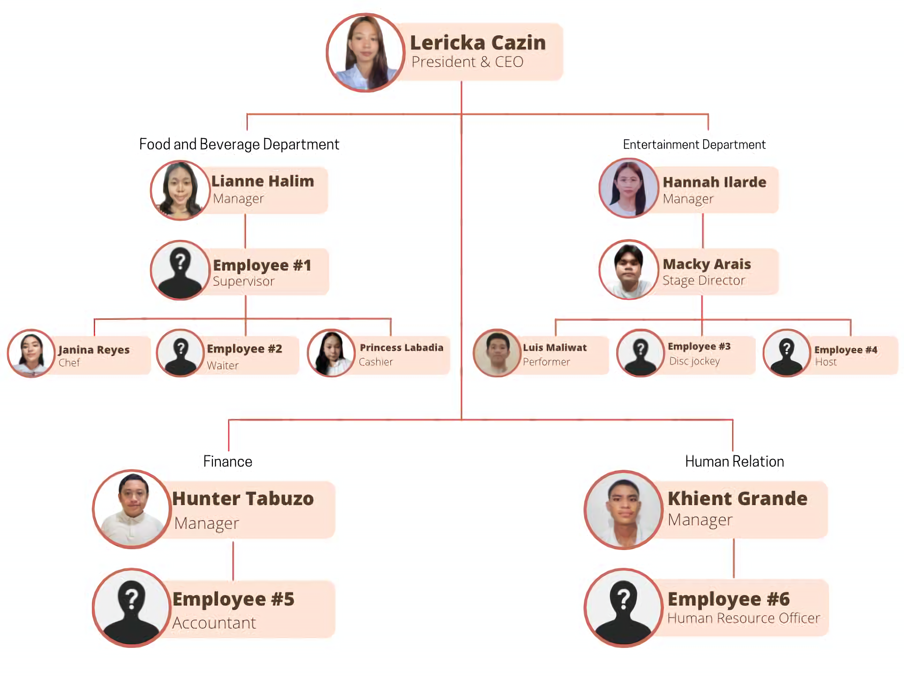
C. Organizational Structure

Slide 9
D. Organizational Structure Analysis
Giggle Grounds structures its employees by using Line Organizational Structure. This ensures the relationships between employees and managers are aligned and stable, and to create fast decision-making. Giggle Grounds is led by the President and CEO. Each department is overseen by a manager, who is also a member of the board of directors. Supervisors are responsible for guiding employees in their daily tasks to ensure smooth operations.

Slide 10
II. HUMAN RESOURCE MANAGEMENT

Slide 11
A. Business Overview
Type of Business: Giggle Grounds is a business that has a unique and exciting venture that also serves the best food and beverage combine with entertainment industry. It offers delicious foods like chicken tenders, mash potato, criss cross fries, pizza rolls, and tater tots. Giggle Grounds also sells cocktails since it’s also a comedy bar.
Type of Industry: As a comedy bar and restaurant, Giggle Grounds operates in both the entertainment industry and the food and beverage industry.

Slide 12
A. Business Overview
Workforce: Giggle Grounds is a medium business. This workforce includes bartenders, head chef, bar manager, general manager, host/hostess, line cooks, prep cooks, comedians, and servers. This restaurant is also for people looking for a night or day filled with laughter, with food that serves as well-prepared in a unique setting. This also includes social gatherings for people to celebrate at our restaurant such as birthday parties, wedding parties, and anniversaries.

Slide 13
B. Staffing
1. CEO and President
2. Stage Director
3. Manager, Human Relations
4. DJ
5. Manager, Entertainment Department
6. Performer
7. Chef
8. Accountant
9. Restaurant Supervisor
10. Manager, Food and Beverage Department
11. Manager, Finance Department
12. Human Resource Officer
13. Host
14. Cashier
15. Waitress/Waiter

Slide 14
1. CEO and President
Monthly Salary: ₱671,378
Job Description: The CEO and President, serving as the sole top executive, holds the responsibility of establishing the company's vision, making strategic decisions, overseeing daily operations, supervising management, and ensuring that all departments operate cohesively to support the organization's vision and culture.

Slide 15
1. CEO and President
Duties:
Set a budget within organizations
Give directions to the employees so that company vision can be fulfill
Setup the strategies in the organization
Stay informed about the current trends related to product & services offered by the organization
Negotiate and approve agreements and contracts
Evaluate the results of the organization
Set up long term & Short term goals for the organization
Oversee both dining and entertainment will guarantee an excellent customer experience, creating a memorable and pleasurable atmosphere at the facility.

Slide 16
2. Stage Director
Monthly Salary: ₱200,000
Job Description: In a comedy bar, a stage director is in charge of making sure the show runs smoothly, adjusting the comedy timing and tempo, increasing audience participation, controlling technical elements like lighting and sound, quickly resolving any technical or performance-related problems, and giving performers advice on how to improve their material and delivery for maximum impact.

Slide 17
2. Stage Director
Duties:
Arrange and organize rehearsals: Set up sessions with comedians to work on their delivery and hone their gags.
Technical aspects: Make sure that the stage design, lighting, and sound complement the performances' mood.
Analyze performances: Determine the caliber of each performance and offer suggestions for enhancements in the future.
Work with comedians: Engage comedians in close collaboration to refine their acts and incorporate input from past performances.
Promote smooth transitions: Make sure that the energy and flow of the show are maintained when an act changes.

Slide 18
3. Manager, Human Relations
Monthly Salary: ₱87,000 to ₱155,000
Job Description: The Manager of Human Relations is the head in charge of all HR activities to create an inclusive, productive work culture. He guides recruitment, employee relations, and strategic workforce planning and ensures that all work is done within the policy of HR and labor laws. I'm responsible for programs designed to increase employee engagement, managing performance evaluation processes, and supporting professional growth across the organization.

Slide 19
3. Manager, Human Relations
Duties:
Formulate and implement HR strategies to support organizational goals.
Manage recruitment and training to attract and retain talents.
Employee relations management and conflict resolution.
Obeying the law and representation of workers' interests.

Slide 20
4. DJ
Monthly Salary: ₱51,000 to ₱59,000
Job Description: The DJ at Giggle Grounds is responsible for creating an engaging and energetic atmosphere by selecting and mixing music for live events, performances, and parties. This role requires a deep understanding of various music genres, excellent technical skills, and the ability to read and engage an audience.

Slide 21
4. DJ
Duties:
Create a playlist or setlist tailored to the event type or audience.
Use mixers, controllers, and software to blend and transition between songs seamlessly.
Monitor sound levels and quality, adjusting as needed for the venue.
Engage the crowd, making announcements or encouraging participation if needed.
Take requests and adapt music selection based on crowd response.
Set up and break down equipment before and after the event.
Ensure all music selections are appropriate and meet event guidelines.
Collaborate with other staff or performers to coordinate the entertainment schedule.
Keep equipment in good condition and transport it as required.
Promote upcoming events or the DJ brand through social media and networking.

Slide 22
5. Manager, Entertainment Department
Monthly Salary: ₱49,000
Job Description: The Manager of the Entertainment Department at Giggle Grounds is responsible for overseeing and enhancing the entertainment offerings of our establishment. This role involves curating high-quality performances, managing talent, and ensuring an exceptional entertainment experience for our guests. The ideal candidate will have a keen eye for comedy, excellent leadership skills, and a passion for creating memorable experiences.

Slide 23
5. Manager, Entertainment Department
Duties:
Oversee entertainment strategy and direction
Lead entertainment staff and vendors.
Manage budgets and financial planning.
Develop and implement policies.
Analyze department performance.
Foster industry relationships and partnerships.
Identify new business opportunities.
Approve event concepts and programming.
Ensure compliance with regulations.
Represent the department in executive meetings.

Slide 24
6. Performer
Monthly Salary: ₱44,800
Job Description: A stage performer in a comedy bar is responsible for delivering engaging, well-timed comedic performances, connecting with the audience, adapting to the energy of the room, and maintaining the flow of the show. They must be able to handle unexpected audience reactions and respond with humor. Additionally, they collaborate with the director and other performers to adjust their material and delivery, ensuring each show is fresh and dynamic.

Slide 25
6. Performer
Duties:
Engage the audience: Use humor, timing, and improvisation to connect with the audience and create a lively atmosphere.
Practice and refine material: Regularly rehearse and adapt jokes, timing, and punchlines to ensure they resonate with different audiences.
Coordinate with the technical crew: Work with lighting and sound technicians to ensure the technical aspects support the performance and timing of jokes.
Adapt to audience feedback: Make adjustments during the performance based on audience reactions to keep the energy high.
Assist with transitions: Help ensure smooth transitions between different acts, keeping the show's momentum steady.

Slide 26
7. Chef
Monthly Salary: ₱44,800
Job Description: Chef responsibilities include studying recipes, setting up menus and preparing high-quality dishes. He/she should be able to delegate tasks to kitchen staff to ensure meals are prepared in a timely manner. Also, he/she should be familiar with sanitation regulations.

Slide 27
7. Chef
Duties:
Ensure that all food is of excellent quality and served in a timely manner.
Plan the menu, keeping in mind budget, and availability of seasonal ingredients.
Oversee all kitchen operations.
Coordinate kitchen staff, and assisting them as required.
Train staff to prepare and cook all the menu items.
Take the stock of ingredients and equipment, and placing orders to replenish stock.
Enforce safety and sanitation standards in the kitchen.
Create new recipes to keep the menu fresh.
Keep up to date with industry trends.
Receive feedback and making improvements where necessary.

Slide 28
8. Accountant
Monthly Salary: ₱44,187
Job Description: The Accountant at Giggle Grounds is responsible for managing financial records, preparing financial reports, and ensuring compliance with accounting regulations. This role plays a vital part in supporting the venue’s financial operations and strategic planning, contributing to overall business success.

Slide 29
8. Accountant
Duties:
Record all transactions, including sales, purchases, receipts, and payments.
Process invoices, reimbursements, and vendor payments accurately.
Reconcile bank statements and ledger accounts regularly.
Generate and review financial statements monthly, quarterly, and annually.
Calculate and deduct taxes and withholdings for payroll processing.
Prepare tax documents and ensure timely filing to avoid penalties.
Work with auditors to provide requested records and documents.
Track company assets and depreciation for accurate valuation.
Implement internal checks and controls to ensure accuracy and prevent fraud.
Update accounting systems and stay informed on industry best practices.

Slide 30
9. Restaurant Supervisor
Monthly Salary: ₱35,000
Job Description: A restaurant supervisor is tasked with ensuring that a restaurant runs smoothly. This can involve many different tasks, including hiring and training staff, managing schedules, and ensuring compliance with all food health and safety requirements. The role of the restaurant supervisor can also be a customer-facing one. Supervisors may need to support the broader restaurant staff by waiting tables or seating customers. They will also be in charge of both responding to customer complaints and resolving them.

Slide 31
9. Restaurant Supervisor
Duties:
Assist in the hiring and training of new employees as well as the continuous training of existing staff
Oversee both front and back of house operations, including wait staff, kitchen crew, and bussing staff
Maintain high-quality food standards
Oversee our kitchen staff’s compliance with all health code and sanitation requirements
Provide exceptional customer service and lead staff to do the same
Respond to customer complaints quickly and resolve them effectively
Develop strategies for improving our customers’ dining experience
Work with staff to project future needs for kitchen supplies, goods, and cleaning products.
Maintain inventory of all needed supplies
Identify methods our restaurant can use to cut waste, decrease costs, and improve profits
Manage the work schedules of our restaurant’s staff

Slide 32
10. Manager, Food & Beverage Department
Monthly Salary : ₱39,000
Job Description: The manager of food and beverage department is direct and oversee the financial success across all food & beverage operations by developing and executing revenue-driving marketing campaigns, setting and achieving food & beverage revenue goals.

Slide 33
10. Manager, Food & Beverage Department
Duties:
Plan and organizing the menu, costs, supply, as well as staffing;
Develop policies and procedures for the department’s operations and implementing them;
Collaborate with other hotel departments in ensuring seamless visits and dining experiences,
Keep track of the industry’s latest trends and working closely with related sub-departments to innovate menu and service offerings.

Slide 34
11. Manager, Finance Department
Monthly Salary: ₱33,333
Job Description: The Manager of Finance is the top executive tasked with overseeing the financial operations of the organization. Responsibilities of the Vice President of Finance include monitoring cash flow and financial planning, as well as evaluating the company's financial strengths and weaknesses and suggesting necessary changes. The responsibilities of the Finance Head are akin to those of a treasurer or controller, as they oversee the finance and accounting departments and ensure that the company’s financial statements are accurate and prepared promptly.

Slide 35
11. Manager, Finance Department
Duties:
Track the company's cash flow
Analyze the company's financial strengths and weaknesses
Prepare accurate forecasts to help management make decisions about investments and budget cuts
Identify and manage financial risks that could impact the company's stability and reputation
Prepare accurate and relevant financial reports for stakeholders, including management, shareholders, and regulatory bodies

Slide 36
12. Human Resource Officer
Monthly Salary: ₱29,750
Job Description: The Human Resource Officer at Giggle Grounds is responsible for managing various HR functions, including recruitment, employee relations, performance management, and compliance with labor laws. This role plays a critical part in supporting organizational objectives and promoting a positive workplace culture in a dynamic entertainment environment.

Slide 37
12. Human Resource Officer
Duties:
Conduct job analysis and write clear job descriptions for open positions.
Post job openings on various platforms and screen applications.
Conduct interviews and coordinate the selection process.
Facilitate new employee orientation sessions.
Develop and maintain employee handbooks outlining company policies.
Organize training sessions and workshops for employee development.
Assist in developing and administering employee benefits programs.
Mediate conflicts and assist in employee grievance procedures.
Ensure compliance with labor laws and regulations in all HR practices.
Generate HR reports and analyze metrics to inform strategic decisions.

Slide 38
13. Host
Monthly Salary: ₱20,583
Job Description: The Host at Giggle Grounds is responsible for creating a welcoming atmosphere for guests, managing reservations, and ensuring a smooth flow of service in a lively entertainment environment. This role involves excellent communication skills, customer service expertise, and the ability to multitask effectively.

Slide 39
13. Host
Duties:
Greet guests warmly upon arrival and bid farewell when they leave.
Confirm reservations and manage the waitlist during busy times.
Escort guests to their tables and present menus.
Communicate wait times to guests and offer alternatives if necessary.
Answer questions about menu items, hours, and policies.
Ensure guests with special needs or preferences are accommodated.
Coordinate with servers to manage seating flow and avoid overloading sections.
Observe the dining area and prepare tables for incoming guests.
Assist with handling guest complaints and reporting to a manager if needed.
Maintain a tidy, organized front-of-house area and a professional appearance.

Slide 40
14. Cashier
Monthly Salary: ₱13,000 to ₱17,000
Job Description: Cashier is responsible for processing cash, debit, credit and check transactions by using a cash or other point of sale in a retail environment. Cashier has one duty, which is interacting with customers, balancing the cash that customer's give and determining the change, recording things, food or anything that they purchase, processing the foods or things that they return and the foods or things that they cancel.

Slide 41
14. Cashier
Duties:
Process customer payments for goods by itemizing and totaling customer purchases.
Calculate total purchases by recording prices and item prizes on the cash register.
Process payments by accepting cash, checks, credit cards, vouchers, or automated debits.
Discount purchases by redeeming coupons or accepting senior citizen and PWD discounts.
Provide customers with change for cash for those paying cash.
Verifiy and accepts credit card payments by following all the necessary authorization requirements.
Balance cash payments by counting cash at the beginning and end of the work shift.
Complete payment processing by issuing receipts.
Process all payments using correct prices by referring to price sheets and other internal guidelines.
Generate sales reports by compiling and consolidating payments process daily.

Slide 42
15. Waitress/Waiter
Monthly Salary: ₱13,000 to ₱16,000
Job Description: The waiter at Giggle Grounds is responsible for providing exceptional customer service to guests, taking food and beverage orders, and ensuring a pleasant dining experience in a vibrant entertainment setting. This role requires excellent communication skills, a friendly demeanor, and the ability to thrive in a fast-paced environment.

Slide 43
15. Waitress/Waiter
Duties:
Welcome guests and escort them to tables.
Memorize menu details and keep up with specials.
Accurately record orders and communicate with the kitchen.
Serve food and drinks while adhering to presentation standards.
Clear tables, replace settings, and reset for new guests.
Check with guests during meals to ensure satisfaction.
Process payments, including cash, card, or digital transactions.
Keep dining and service areas clean and organized.
Collaborate with colleagues to ensure smooth service flow.
Report any guest issues or concerns to the supervisor.

Slide 44
C. Employee Benefits
1. Traditional Benefits
Health Insurance (₱100,000 anually) - This covers medical expenses, including hospitalization, doctor's visits, prescription drugs, and preventive care.
Dental Insurance (₱20,000 annually) - This provides coverage for dental care, such as cleanings, fillings, and extractions.
Life Insurance (₱100,000) - This provides death benefit to the employee's beneficiaries in the event of their passing.
Disability Insurance (₱20,000 anually) - This provides income replacement if the employee becomes disabled and unable to work due to long-term physical, mental, intellectual, or sensory impairments.

Slide 45
C. Employee Benefits
2. Retirement and Financial Benefits
Retirement Plans - These plans, such SSS pensions, allow employees to save for retirement and receive employer contributions. SSS contribution costs 5% of the employee's monthly salary, and the company will match another 5% contribution to the employee's pension.

Slide 46
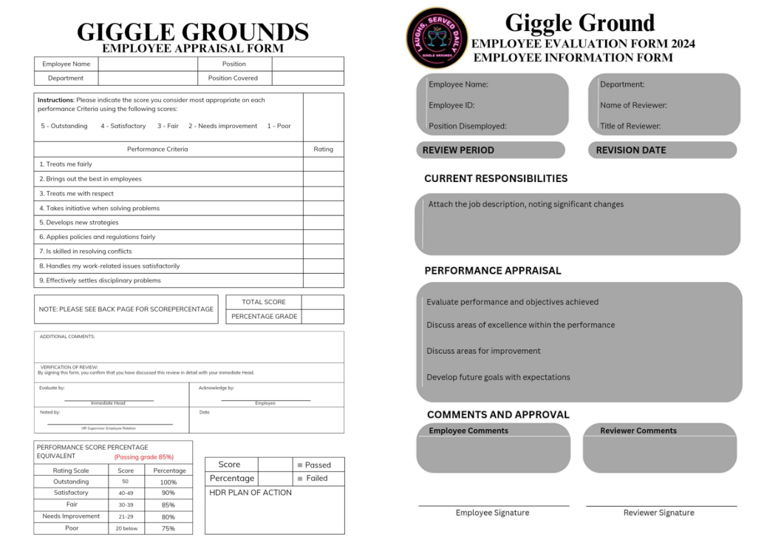
D. Performance Appraisal System
Employee’s Appraisal form:

Slide 47
D. Performance Appraisal System
Criteria:
Customer ratings and reviews
Sales growth and revenue
Employee turnover and satisfaction
Social media engagement
Mystery shopping reports
Customer retention rates
Online reservations and booking data
Inventory management and waste reduction
Regulatory inspection results

Slide 48
E. Employee Relations Movements
To maintain transparency and fairness within the organization, below is an outline of the clear policies for employee movements, including promotions, transfers, and separations:
1. Criteria for Promotion Decisions
2. Transfers
3. Separations
4. Retirements

Slide 49
1. Criteria for Promotion Decisions
Employees at a Comedy Bar and Resto can be promoted based on several criteria, including performance, tenure, skillset, and willingness to take on new responsibilities.
Promotions are typically considered during performance reviews, where employees who have consistently exceeded expectations and demonstrated leadership potential are identified.
The decision is usually made by HR managers, direct supervisors, or leadership/executives to ensure impartiality.

Slide 50
1. Criteria for Promotion Decisions
Promotion Process:
Performance Reviews: Regular performance evaluations help identify employees who have consistently exceeded expectations and shown leadership potential.
Criteria for Promotion: Clear, measurable criteria such as performance, tenure, skillset, and willingness to take on new responsibilities are essential.
Decision Makers: Promotions are typically decided by HR managers, direct supervisors, or leadership/executives to ensure impartiality.
Communication: Transparent communication of promotion policies and timelines helps employees understand the requirements and set realistic expectations.

Slide 51
2. Transfers
Employees may be transferred to other departments or locations within the organization to meet operational needs, such as organizational restructuring or filling essential positions.
The transfer process involves a review of the employee's skills and experience to ensure they are a good fit for the new role.
Employees must also consent to the transfer, and the process should be clearly communicated to avoid misunderstandings.
Transfers are managed by HR and departmental managers to ensure a smooth transition.

Slide 52
2. Transfers
Transfer Process:
Consent: Employees must consent to transfers; involuntary transfers without agreement are generally considered illegal.
Business Purpose: Transfers should serve a legitimate business purpose, such as organizational restructuring or filling essential positions.
Equivalence: Transfers should be to positions of equivalent rank, level, or salary without a break in service.
Communication: Clear communication about the reasons for the transfer, benefits, and impact on career paths is crucial.

Slide 53
3. Separations
These guidelines outline the procedures for handling employee separations, including resignations, retirements, and terminations. The goal is to ensure a fair and transparent process for all parties involved.
a. Voluntary Separations
(1) Resignations
b. Involuntary Separations
(1) Performance-Based Termination
(2) Terminations for Cause

Slide 54
3. Separations
a. Voluntary Separations
(1) Resignations
Notice Period: Employees are required to provide a written notice at least 30 days in advance.
Exit Interview: An exit interview will be conducted to gather feedback and address any concerns.
Final Pay: The final paycheck, including any unused leave and benefits, will be processed on the employee's last working day.
Return of Company Property: All company property (e.g., uniforms, equipment) must be returned before the final paycheck is issued.

Slide 55
3. Separations
b. Involuntary Separations
(1) Performance-Based Termination
Performance Reviews: Regular performance evaluations to identify any issues.
Improvement Plan: Implement a performance improvement plan (PIP) with clear goals and a timeline.
Final Decision: If the employee fails to meet the PIP requirements, termination may be considered.
Notice and Documentation: Provide written notice of termination, including reasons and effective date.

Slide 56
3. Separations
(2) Terminations for Cause
Immediate Termination: For serious misconduct (e.g., theft, violence), immediate termination may be necessary.
Documentation: Document the incident and provide written notice of termination.
Security Measures: Ensure the employee is escorted off the premises if necessary.

Slide 57
4. Retirements
The employee should provide written notice of their intention to retire due to Old Age or Illness at least 1 to 3 months in advance. The employer/employee must acknowledge the retirement notice in writing within a week of receiving it. A meeting should be scheduled with the employee to discuss their retirement plans, finalize their last working day, and explain the process.

Slide 58
4. Retirements
Ensure all necessary retirement forms and documents are completed and signed by both parties. Arrange for the retiring employee to pass on essential knowledge and responsibilities to a designated successor.
Process the final paycheck, including any outstanding payments, bonuses, or retirement benefits. Conduct an exit interview to gather feedback and insights from the retiring employee.

Slide 59
4. Retirements
Retirement Process:
Notification: Employees should notify HR of their intention to retire at least 3 months in advance.
Retirement Meeting: A meeting will be scheduled to discuss the retirement process, benefits, and last working day.
Retirement Benefits: Ensure all retirement benefits are calculated and processed.
Farewell Event: Organize a farewell event to celebrate the employee’s contributions.

Slide 60
III. REAL-LIFE APPLICATIONS AND CASE STUDY

Slide 61
A. Case in our group
Problem: A mid-sized retail company is experiencing high employee, turnover and low morale. The exit survey showed that employees feel unappreciated and dissatisfied with their work environment.

Slide 62
A. Case in our group
Resolutions:
Create team-building activities to improve social interactions between managers and employees.
Increase salaries of employees.
Provide open channels of communication through online and on-site to address concerns and suggestions.
Organize flexible work schedules and create rest days improve work- life balance of employees.
Establish employee intervention and mentorship to improve work performance.

Slide 63
A. Case in our group
Each of these resolutions are linked to behavioral management theory and Maslow’s Hierarchy of Needs. By providing employees with the benefits that they deserve, the managers are certain that their needs are met and that employee satisfaction will increase, leading to a decrease in employee turnover.

Slide 64
B. Incorporate in the same industry
Problem: On July 7, 2023, Crackhouse Comedy Club, located in Kuala Lumpur in Malaysia, faced problems as well as reputational loss when its owner was fined RM8,000 for posting racially offensive material on social media which offended some people and had a large public complaint which eventually turned into a case. This incident brings to the fore a challenge of comedy venues in striking an appropriate balance between edgy content and not crossing a line that is considered as offensive or inflammatory.

Slide 65
B. Incorporate in the same industry
Solutions:
Establish Crisis Communication Plan: A well-constructed crisis communication plan may help in mitigating negativity in publicity, maintaining stakeholder relationships, and reducing the damage to the company's reputation. (Crisis Management Theory)
Strict Content Guidelines: Clear guidelines on social media and live performances can prevent future incidents and ensure a good brand image. (Corporate Social Responsibility)
Implement Sensitivity Training: Train your employees on diversity, equity, and inclusion to help them understand how their words or actions can influence the other. (Human Resource Management)
Creating a Respectful and Inclusive Workplace Culture: The outcome of which will keep future incidents off the radar while also attracting and retaining talent. (Organizational Culture Theory)

Slide 66
B. Incorporate in the same industry
In our business, we can implement these as follows:
Crisis Management Plan: Define likely crisis situations and describes roles and responsibilities as well as communication lines
Code of Conduct for performers: Clearly indicates expected behavior and subject content.
Training staff on diversity, equity, and inclusion: Provide annual or bi-annual training sessions in the workplace to make the place of work respectful and inclusive.
Monitor social media and online reviews: Immediately respond to negative reviews, address concerns and act on them.

Slide 67
IV. REFERENCES

Slide 68
1. Bajrai, H. (2023, July 7). Comedy club owner fined for offensive online content sparking racial sensitivity. Marketing in Asia. https://www.marketinginasia.com/comedy-club-owner-fined-for-offensive-online-content-sparking-racial-sensitivity/
2. Barreiro, V., Jr. (2024, May 17). Comedy rules the PH podcast roost as over 17 million internet-connected Filipinos tune in. Rappler. https://www.rappler.com/technology/internet-culture/portrait-podcast-listener-filipino-study-findings/
3. Benefits. (n.d.). Washington and Lee University. https://my.wlu.edu/human-resources/benefits?need_sec_link=1&sec_link_scene=im
4. Best Restaurant Supervisor Job Description Template. (n.d.). Workstream. https://www.workstream.us/job-description/restaurant-supervisor.html#:~:text=A%20restaurant%20supervisor%20is%20tasked,be%20a%20customer%2Dfacing%20one
5. Bika, N. (2024, January 2). Employee resignation policy template. Recruiting Resources: How to Recruit and Hire Better. https://resources.workable.com/employee-resignation-policy?form=MG0AV3
6. Bika, N. (2024, January 4). Employee promotion policy template. Recruiting Resources: How to Recruit and Hire Better. https://resources.workable.com/promotion-policy?form=MG0AV3

Slide 69
7. C, A. (2023, September 13). What does a vice president of Human Resources Do?. Human Resource Careers. https://humanresourcecareers.com/what-does-a-vice-president-of-human-resources-do/
8. CEO and President duties and responsibilities. (n.d). Workable. https://resources.workable.com/hr-terms/ceo-vs-president
9. Charaba, C. (2023, July 19). HR Rules You Need to Know. PeopleKeep. https://www.peoplekeep.com/blog/hr-rules-you-need-to-know
10. Chief Executive Officer - Food & Beverage Restaurant Chain Job vacancy in Garden City, Cairo. (n.d.). Wuzzuf. https://wuzzuf.net/jobs/p/255103-Chief-Executive-Officer---Food--amp--Beverage-Restaurant-Chain-Cairo-Egypt
11. Comedian job description, career as a comedian, salary, employment - definition and nature of the work, education and training requirements, Getting the job. (n.d.). State University Careers. https://careers.stateuniversity.com/pages/7751/Comedian.html
12. Computation of Retirement Pay, Private Sector. (2024, July 13). Labor Law PH. https://laborlaw.ph/computation-of-retirement-pay-private-sector/?form=MG0AV3
13. Corporate Finance Institute (CFI). https://corporatefinanceinstitute.com

Slide 70
14. Director (Theater and opera). (n.d.). Berklee. https://www.berklee.edu/careers/roles/director
15. DOLE Labor Advisory 06 Series of 2020: GUIDELINES ON THE PAYMENT OF FINAL PAY AND ISSUANCE OF CERTIFICATE OF EMPLOYMENT. (n.d.). Platon Martinez. https://platonmartinez.com/articles/dole-labor-advisory-no-06-series-of-2020-guidelines-on-the-payment-of-final-pay-and-issuance-of-certificate-of-employment?form=MG0AV3
16. Farmiloe, B. (2023, May 26). What criteria should be used in promoting employees?. Best of HR. https://bestofhr.com/what-criteria-should-be-used-in-promoting-employees/?form=MG0AV3
17. Food and Beverage Department: Responsibilities, services, and Prospects. (2023, February 8). RMC Asia. https://www.educationaltravelasia.org/food-and-beverage-department-responsibilities-services-and-prospects/
18. Food & Beverage Supervisor. (2023, March 11). go2HR. https://www.go2hr.ca/career-summary/food-and-beverage-supervisor
19. Grant, M. (2024, February 1). What Is a Chief Financial Officer (CFO)? Role and Responsibilities. Investopedia. https://www.investopedia.com/terms/c/cfo.asp

Slide 71
20. Kumar, R. (2024, October 8). Roles and responsibilities of an accountant - Learn more! RegInsights. https://www.regenesys.net/reginsights/what-are-the-five-roles-and-responsibilities-of-an-accountant
21. Marinaki, A. (2023, September 21). CEO vs. President: How they differ. Recruiting Resources: How to Recruit and Hire Better. https://resources.workable.com/hr-terms/ceo-vs-president#:~:text=A%20CEO%20
22. Nguwi, M. (2024, October 23). Job description of cashier. Human Capital Hub. https://www.thehumancapitalhub.com/articles/job-description-of-cashier-#Job%20description%20of%C2%A0cashier:%20Main%20duties%C2%A0
23. Pantelakis, A. (2024, January 2). Employee retirement policy template. Recruiting Resources: How to Recruit and Hire Better. https://resources.workable.com/employee-retirement-policy?form=MG0AV3
24. Payscale - Salary comparison, salary Survey, Search Wages. (2024, October 17). Payscale. https://www.payscale.com/
25. Peters, P. (2022, March 7). Chef Job Description. Betterteam. https://www.betterteam.com/chef-job-description

Slide 72
26. President Job Description: Top Duties and Qualifications. (2024, October 28). Indeed. https://www.indeed.com/recruitment/job-description/president
27. Respicio, H. (2024, June 12). Employee transfers between companies: legal considerations in the Philippines. RESPICIO & CO. https://www.respicio.ph/commentaries/employee-transfers-between-companies-legal-considerations-in-the-philippines?form=MG0AV3
28. Splitters, S. (2023, April 17). Rules for Stand-Up Comedy – What you need to know. Sidesplitters. https://sidesplitterscomedy.com/rules-for-stand-up-comedy-what-you-need-to-know/
29. Suder, R. (2024, October 3). Waiter & Waitress Job Description. TopResume. https://topresume.com/career-advice/waiterwaitress-job-description
30. Supervisor Job Description Template. (2022, February 8). Monster. https://hiring.monster.com/resources/job-descriptions/management/supervisor/#:~:text=Supervisor%20Job%20Responsibilities%3A&text=Plans%2C%20monitors%2C%20and%20appraises%20job,and%20adhering%20to%20legal%20regulations
31. Tsonis, L. (2024, September 9). 6 Necessary restaurant employee rules and HR policies. Qwick. https://www.qwick.com/blog/necessary-restaurant-employee-rules-and-hr-policies?form=MG0AV3

Slide 73
32. Vice President Food & Beverage: What is it? and how to become one?. (n.d.). ZipRecruiter. https://www.ziprecruiter.com/career/Vice-President-Food-Beverage/What-Is-How-to-Become
33. VP Entertainment Jobs, employment. (2024, October 29). Indeed. https://www.indeed.com/q-VP-Entertainment-jobs.html
34. What are the most important rules a waiter/waitress must follow? (n.d.). Quora. https://www.quora.com/What-are-the-most-important-rules-a-waiter-waitress-must-follow
35. What does a Food Service Supervisor do? (Duties and Skills). (2024, May 28). Indeed Canada. https://ca.indeed.com/career-advice/finding-a-job/what-does-food-service-supervisor-do
36. What is Human Resources? (2016, March 22). University of Minnesota Libraries. https://open.lib.umn.edu/humanresourcemanagement/chapter/1-1-what-is-human-resources/

Slide 74
THAT'S ALL FOR TODAY THANK YOU FOR LISTENING!

