Slide 1
ShadowServe: Interference-Free KV Cache Fetching for Distributed Prefix Caching
Xingyu Xiang, Raj Joshi, Yuhan Liu, Jiayi Yao, Chenxingyu Zhao, Junchen Jiang, Yang Zhou, Eddie Kohler, Minlan Yu
Harvard University, University of Chicago, University of Washington, UC Davis
Jingbin Lin | June 1, 2026
Notes:
Today I will present ShadowServe. The paper asks a simple systems question: if many requests share a long prefix, can we reuse the KV cache without hurting model serving? The answer is yes, but only if cache fetching does not interfere with the GPU.

Slide 2
Authors
Xingyu Xiang: Second-year Ph.D. student in Computer Science, Harvard University
Raj joshi: Postdoctoral Fellow at Harvard SEAS
Yuhan Liu: Ph.D. Candidate, Computer Science, The University of Chicago
Minlan Yu: Gordon McKay Professor of Computer Science at Harvard SEAS
Notes:
This work is from researchers at Harvard, the University of Chicago, the University of Washington, and UC Davis. I will not spend much time here, but it helps place the paper in the systems and networking community.

Slide 3
Contents
1
Long-Context LLM Serving
2
KV Cache & Prefix Caching
3
The Bottleneck: GPU Interference
4
ShadowServe Design
5
Evaluation, Critique & Discussion
Notes:
I will first explain the serving background, then KV cache and prefix caching, then the bottleneck, then the ShadowServe design, and finally the evaluation, critique, and discussion.

Slide 4
Long-Context LLM Serving
Why long prompts make LLM inference expensive?
Notes:
Before I explain ShadowServe, I need to explain the serving problem it targets. The key issue is long-context inference, where the model must read many input tokens before it can generate even the first output token.

Slide 5
What makes a request “long-context”?
What makes a request “long-context”?
Input is not just a short user question
Examples:
RAG
Chatbots
Document QA
Legal/medical document analysis
Long Input Prompt
System Prompt
Retrieved Documents
Chat History
User Query
Notes:
In many real applications, the prompt is not only a short user question. It can include a system prompt, retrieved documents, chat history, tool output, and then the user query. When all of that is combined, the model has to read a very long context before generation begins.

Slide 6
LLM Serving - Two Phases
All prompt tokens are known, so prefill can run as a batch
The model computes an attention matrix for all prompt tokens at once
Each token can only attend to previous tokens and itself
Input prompt
x₁, x₂, …, xₙ
Long-context input tokens
Prefill
Read the entire prompt
Parallel over input tokens
First token
Generate y₁
TTFT ends here
Decode
y₂ → y₃ → y₄ → …
Sequential token generation
 | x₁ | x₂ | x₃ | x₄
x₁ | ✓ | X | X | X
x₂ | ✓ | ✓ | X | X
x₃ | ✓ | ✓ | ✓ | X
x₄ | ✓ | ✓ | ✓ | ✓
Notes:
LLM serving has two phases. In prefill, the model reads the whole prompt and builds the internal state. In decode, it generates output tokens one by one. Prefill can run in parallel because all prompt tokens are already known. But decode is sequential because each new token depends on earlier generated tokens. TTFT ends when the first output token appears.

Slide 7
Long context makes prefill expensive
Long context makes prefill expensive:
More input tokens: 1. More attention computation 2. Larger intermediate state 3. Slower first token (TTFT)
What does “faster serving” mean?
TTFT: wait until first token TPOT: time per generated token Throughput: requests per second
100 tokens
Medium Prompts
5K tokens
Slower Prefill
Long Prompts
80K tokens
Very Expensive
Short Prompts
Fast Prefill
Notes:
Long prompts make prefill expensive for two reasons. First, there is more attention computation. Second, the model creates more intermediate state that must be stored for later decode. In this talk, I will use three metrics: TTFT, TPOT, and throughput.

Slide 8
KV Cache & Prefix Caching
If long-context prefill is expensive, what computation can we reuse?
Notes:
Now that the serving cost is clear, I move to the reuse idea: KV cache and prefix caching.

Slide 9
Attention creates Q, K, and V
Prompt tokens: x₁ x₂ x₃ ... xₙ
Layer 1: K,V K,V K,V ... K,V
KV Cache
Layer 2: K,V K,V K,V ... K,V
Layer L: K,V K,V K,V ... K,V
Prefill computes K/V for every prompt token
Decode:
New token brings Q
Past tokens provide cached K/V
Query: what am I looking for? (Question)
Key: what do I match against? (Labels)
Value: what information do I retrieve? (Content)
New token y₁ with Q ---- Attends to cached K/V
Notes:
During prefill, the model computes keys and values for every prompt token and stores them as the KV cache. Later, each new token brings a new query and attends to those old keys and values. That is why the KV cache avoids recomputing old prompt tokens.

Slide 10
Prefix Caching: Reuse Shared Prompt Prefixes
Prefix Caching Reuses Shared Beginnings:
Same prefix, different requests → Reuse prefix KV cache
Shared prefix → cached KV → reused
Unique question → compute normally
Request A
System Prompt
Long Document
Request B
System Prompt
Long Document
Request C
System Prompt
Long Document
Question A
Question B
Question C
Notes:
Many requests share the same beginning of the prompt, such as the same system prompt or the same long document. Prefix caching stores the KV state for that shared prefix, so later requests can skip recomputing it and only process the unique suffix.

Slide 11
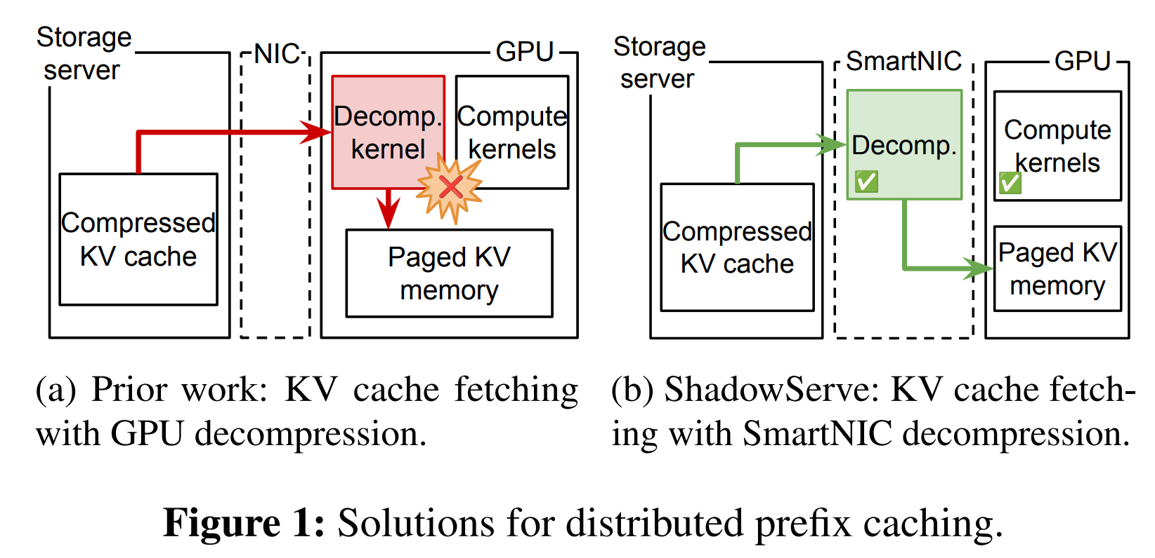
Why not keep all cache locally?
Remote KV Cache Store
Remote KV Fetch
GPU A
GPU B
GPU C
Distributed Prefix Caching:
KV cache can be huge
Many GPUs want to share it
Remote cache improves reuse
Fetch KV over the network
Key: Fetch must be faster than recomputing prefill.
Compression – Network – Decompression (Bottleneck)
Notes:
Local memory is too small for very large KV caches, and many GPUs may still want to reuse the same prefix. So systems move to distributed prefix caching, where the cache may be stored remotely. But then reuse is only worth it if remote fetch, decompression, and placement are still faster than recomputing prefill.

Slide 12
The Bottleneck: GPU Interference
Distributed caching saves prefill compute.
But cache fetching now competes with model serving.
Notes:
Now we reach the core problem. Distributed prefix caching saves prefill work, but the fetch path itself can start competing with model serving.

Slide 13
Remote KV cache fetch vs. recompute
Remote caching is only useful if fetching is faster.
Why Compression:
KV cache is large
Less network traffic
But extra decompression stage
Where should decompression happen?
Long Prompt
GPU Prefill
First Token
Remote KV Cache
Network Fetch
Decompression
First token
Notes:
Remote caching creates a tradeoff. Recompute uses expensive GPU prefill work. Fetching avoids that work, but adds network transfer, decompression, and memory-copy cost. Compression makes remote transfer practical, especially under limited bandwidth, but then the system must decide where decompression should happen.

Slide 14
But decompression competes with LLM decode
LLM decode and decompression share GPU resources
Result:
Decode slows down
Decompression slows down
Serving latency increases
Notes:
Prior systems often decompress on the GPU because the cache will finally be used by the GPU anyway. But the GPU is already busy running the model. So decompression and decode start competing for the same device resources, which increases latency.

Slide 15
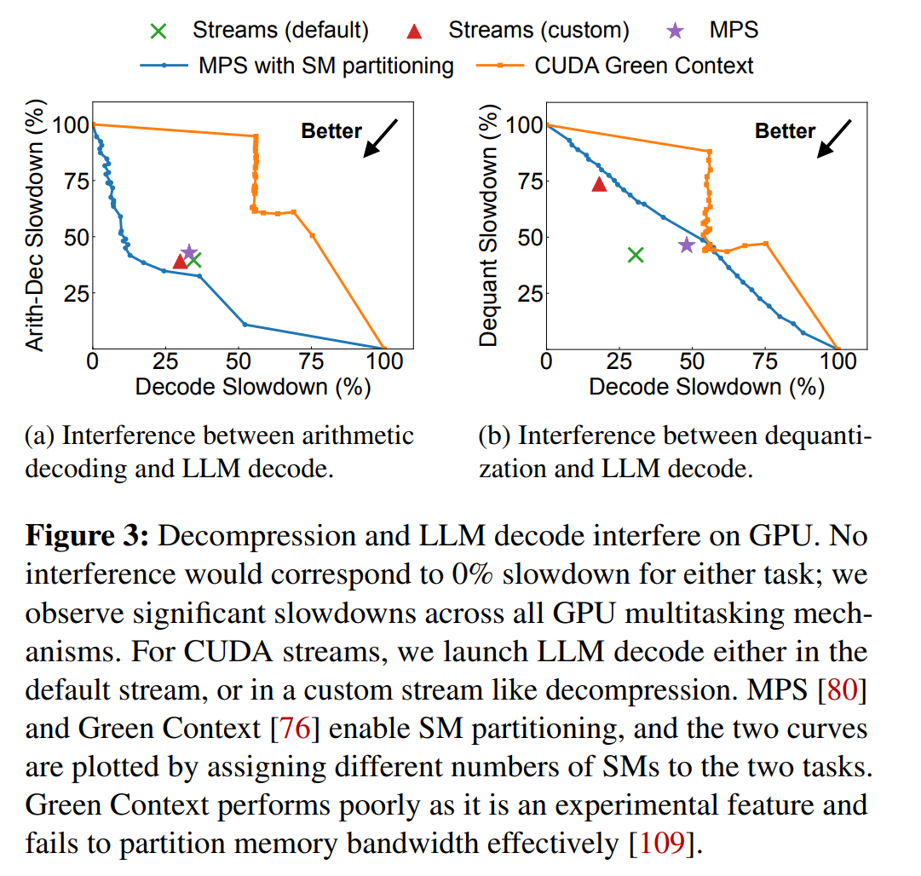
GPU decompression is not “free”
Same GPU:
LLM decode + KV decompression
Result:
Bidirectional slowdown
Notes:
The paper tests this directly. Across CUDA streams, MPS, and Green Context, there is still large slowdown. There is no clean setting where both decode and decompression stay fast at the same time. So GPU decompression is not a free optimization.

Slide 16
Discussion Questions
If even GPU multitasking tools still cause large slowdown, what does that tell us about the limit of same-device optimization?

Slide 17
Why not decompress on the CPU?
CPU avoids GPU interference,
but it is not a free resource.
Problems:
Limited decompression throughput
Busy with serving-side tasks
Extra data movement
GPU Decompression
Close to Model
Interference with Decode
CPU Decompression
Avoid GPU Kernel
Busy CPU
Extra Copies
Low Throughput
Notes:
A natural idea is to move decompression to the CPU. That avoids GPU interference, but it still has problems: CPU decompression throughput is limited, CPUs are already busy with serving-side work, and there may be extra data movement before the cache reaches GPU memory.

Slide 18
ShadowServe: Decompress on NIC
Move KV-cache preparation off the GPU
Notes:
So the paper’s main idea is: move KV-cache preparation off the GPU and onto the SmartNIC, which is the network interface card.

Slide 19
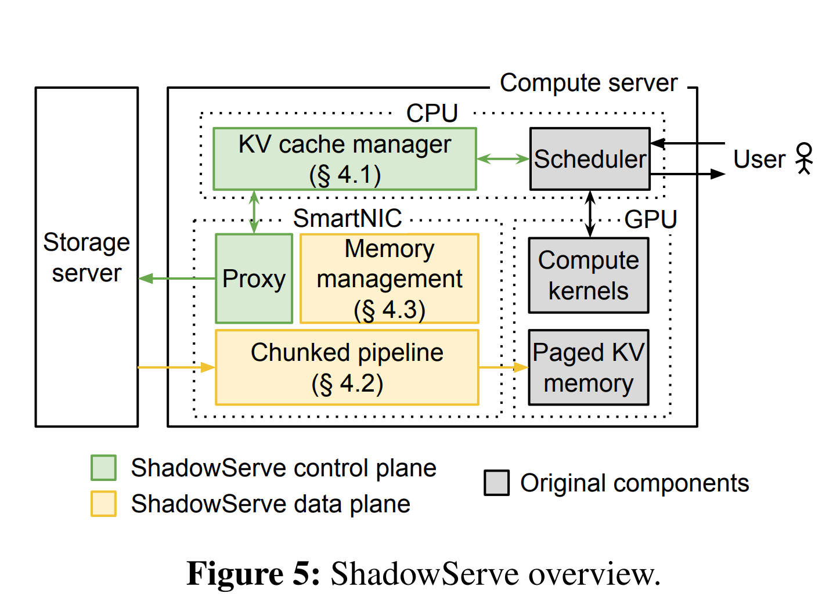
ShadowServe separates control and data
CPU control plane:
Schedule and coordinate fetches
SmartNIC data plane:
Fetch, Decompress, Dequantize, Transfer
GPU:
Model compute, Paged KV memory
Notes:
ShadowServe splits the system into two planes. The control plane stays on the host CPU and coordinates fetching with the serving scheduler. The data plane runs on the SmartNIC and does the heavy data operations: fetch, decompress, dequantize, and transfer. The GPU keeps model compute and paged KV memory.

Slide 20
SmartNIC offload is not automatically fast
SmartNIC constraints:
Limited compute
Limited memory subsystem
Need:
Pipeline + careful memory management
Offloads decompression and DMA to SmartNIC hardware accelerators
Partitions the Arm cores between network and dequantization work
Weak On-chip Cores
Chunked Pipeline
Resource Partitioning
Memory Bottleneck
Minimal-copy Pinned Buffers
Notes:
Offloading alone is not enough. SmartNICs have weaker cores and a more constrained memory subsystem than a host server. So a naive SmartNIC design can simply move the bottleneck from the GPU to the NIC. That is why the paper needs both a chunked pipeline and careful memory management

Slide 21
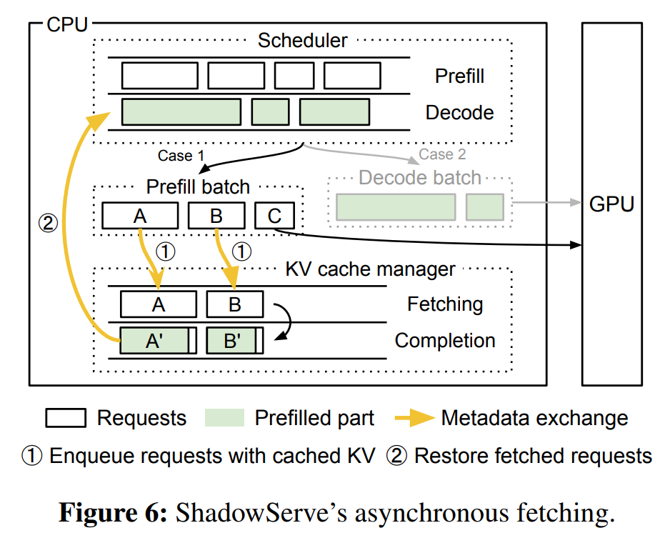
Control Plane: fetch in the background
1. Scheduler forms a prefill batch
2. KV cache manager intercepts requests with cached KV
3. Data plane fetches in background, then manager restores requests
Notes:
Remote fetching has I/O latency, so ShadowServe makes it asynchronous. The KV cache manager intercepts requests with remotely cached prefixes, sends them to the SmartNIC path, and later returns them to the scheduler when the fetch is done. That way, the GPU can keep working on other requests instead of waiting.

Slide 22
Control Plane: fetch in the background
Do not stall the GPU for remote I/O
Fetching queue:
Requests waiting for KV fetch
Completion queue:
Requests ready to resume
Notes:
Remote fetching has I/O latency, so ShadowServe makes it asynchronous. The KV cache manager intercepts requests with remotely cached prefixes, sends them to the SmartNIC path, and later returns them to the scheduler when the fetch is done. That way, the GPU can keep working on other requests instead of waiting.

Slide 23
Discussion Question
What could go wrong if remote fetching was synchronous?
GPU stalls
Lower throughput
Higher TPOT
Scheduler blocked by I/O
Notes:
Let me pause for a short question. If remote fetching were synchronous, the scheduler and GPU could stall on I/O, which would lower throughput and often raise TPOT.

Slide 24
Fetched KV cache is not a complete prefill
KV cache = intermediate attention state
Full prefill also produces:
The first output token
ShadowServe workaround:
Mark last token as not yet prefilled
Full Prefill
Prompt
KV Cache
Remote Fetch
Cached KV Only
Need One Final Model Setup
Hidden State
First Token
First Token
Notes:
A fetched KV cache is still not the same as a full prefill. Full prefill also produces the hidden state needed to sample the first output token. ShadowServe follows a workaround from CacheGen: it marks the last token as not yet prefilled, and the scheduler finishes that last step locally.

Slide 25
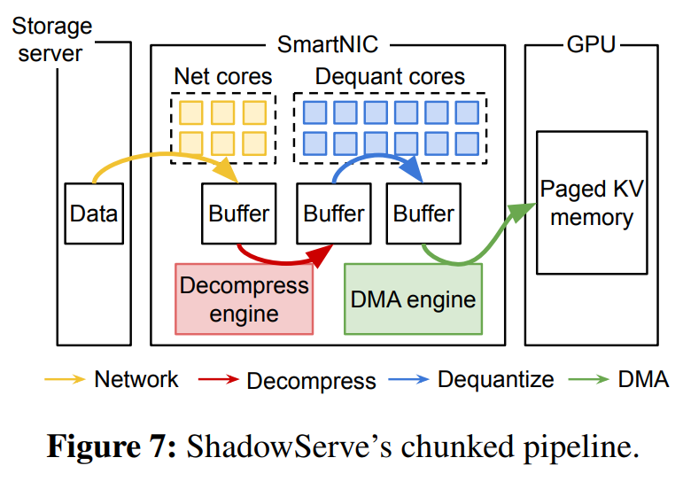
Data Plane: four-stage chunked pipeline
Network → Decompress → Dequantize → DMA
Split KV cache into chunks
Pipeline chunks across SmartNIC resources Smart NIC (Network Interface Card)
Notes:
The SmartNIC data plane has four stages: network fetch, decompression, dequantization, and DMA to the GPU. ShadowServe splits the KV cache into chunks, so different chunks can move through different stages at the same time. This pipeline improves hardware use and reduces end-to-end latency to the slowest stage.

Slide 26
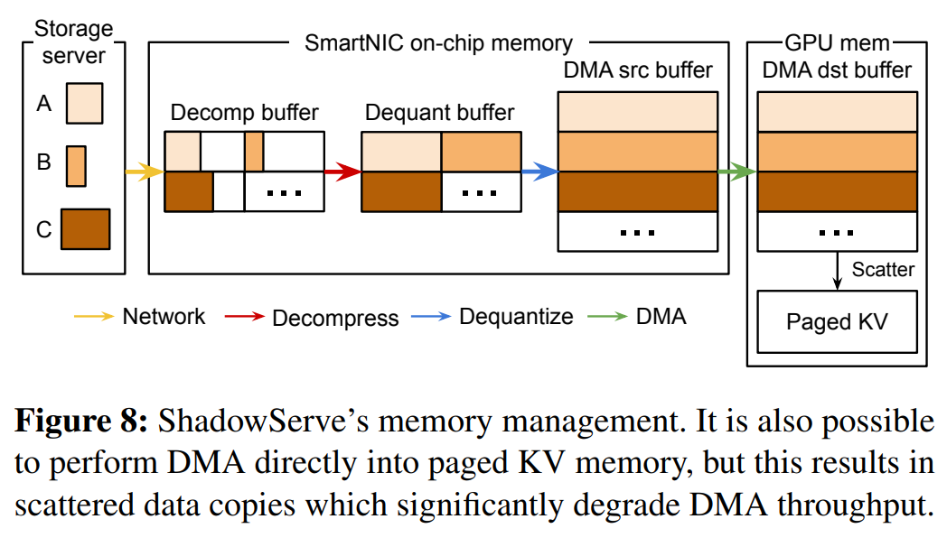
Memory Management: keep the data path tight
Pre-allocate and pin buffers
Avoid:
Runtime allocation
Memory registration overhead
Redundant copies
Notes:
The second design piece is memory management. ShadowServe pre-allocates and pins buffers, avoids runtime memory registration, and moves data through a minimal-copy path. It first DMA-transfers into a contiguous GPU buffer, and only then uses a lightweight scatter into paged KV memory.

Slide 27
Memory Management: keep the data path tight
1. Compressed chunks arrive from storage
2. Decompression writes into decompression/dequantization buffers
3. Dequantization writes into DMA source buffer
4. DMA copies contiguous data into GPU destination buffer
5. Lightweight scatter places data into paged KV memory
Notes:
The second design piece is memory management. ShadowServe pre-allocates and pins buffers, avoids runtime memory registration, and moves data through a minimal-copy path. It first DMA-transfers into a contiguous GPU buffer, and only then uses a lightweight scatter into paged KV memory.

Slide 28
What ShadowServe changes
Prior systems:
GPU decompresses compressed KV cache
ShadowServe:
SmartNIC fetches + decompresses + transfers KV cache
Result:
GPU focuses on model computation
Notes:
So the overall change is simple. Prior work fetches compressed KV data but still decompresses on the GPU. ShadowServe moves the data path off the GPU, so the GPU can spend more time on model compute.

Slide 29
Evaluation, Critique & Discussion
Did ShadowServe solve the bottleneck, where does it win, and where does it still fail?
Notes:
Now I will ask the most important question: does ShadowServe really solve the bottleneck, and where does it still fail?

Slide 30
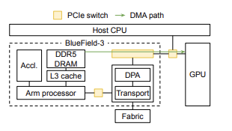
Evaluation setup
Baselines:
vLLM = recompute KV cache
CacheGen-Async = GPU decompression
ShadowServe = SmartNIC offload
Metrics:
TTFT, TPOT, throughput
NIC: NVIDIA BlueField-3 DPU
Decode: NVIDIA L40S GPU
Notes:
The paper compares three systems: vLLM as recomputation, CacheGen-Async as GPU-decompression prefix caching, and ShadowServe as SmartNIC offload. It measures TTFT, TPOT, and throughput. To isolate remote fetching, the authors disable local prefix caching and use a 100% remote cache hit rate.

Slide 31
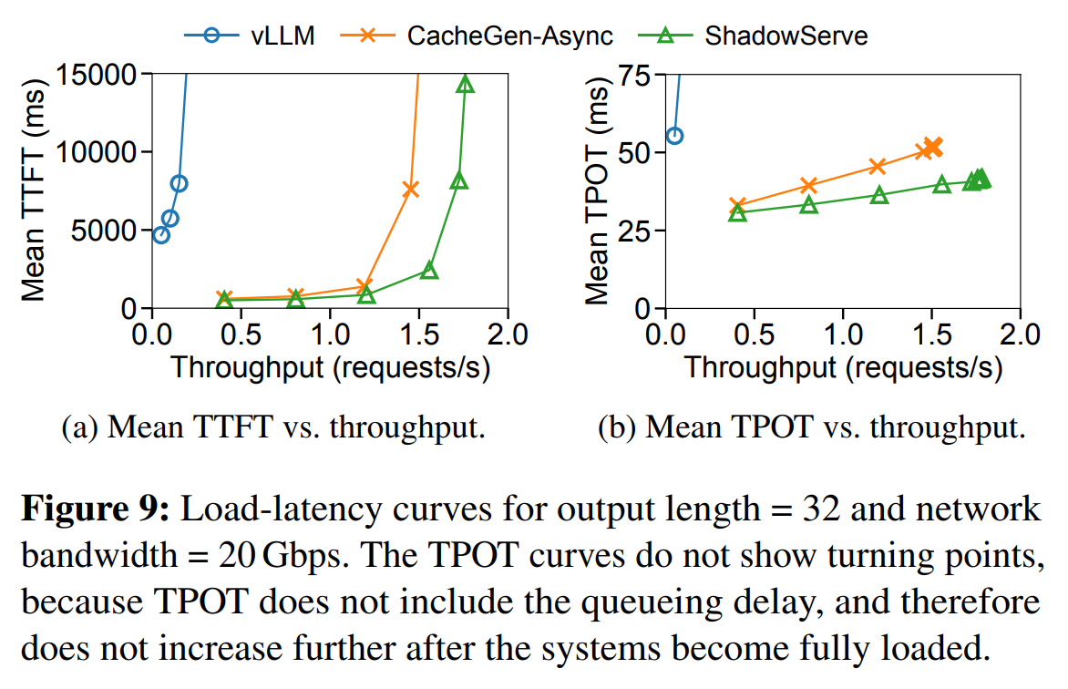
End-to-end: ShadowServe reduces latency under load
20 Gbps, output length = 32
vs. CacheGen-Async:
16% lower unloaded TTFT
20% lower loaded TPOT
18% higher max throughput
Notes:
This is the main end-to-end result. In the setting with 20 Gbps bandwidth and 32 output tokens, ShadowServe beats CacheGen-Async on all three reported numbers: about 16% lower unloaded TTFT, 20% lower loaded TPOT, and 18% higher maximum throughput.

Slide 32
Discussion Question
In a real product, would you care more about TTFT or TPOT, and would that change your decision to deploy ShadowServe?

Slide 33
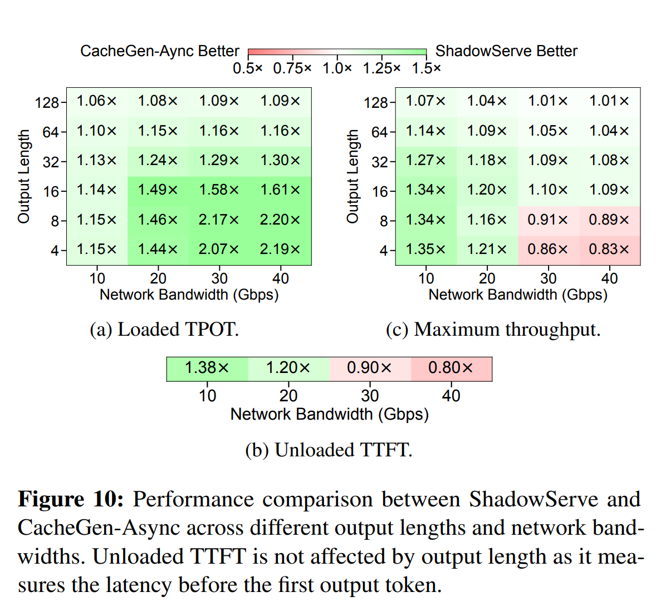
Where does ShadowServe win?
TPOT: better across all settings
TTFT: better at ≤ 20 Gbps,
Worse above 20 Gbps
Throughput:
Best for low bandwidth or longer outputs
Notes:
Across settings, ShadowServe is consistently better on loaded TPOT. But TTFT is better only in lower-bandwidth settings, especially at 20 Gbps or less. So throughput wins depend on the workload: ShadowServe is strongest when bandwidth is limited or outputs are long enough that TPOT matters more.

Slide 34
Why the results change by workload
Short output:
TTFT dominates
Longer output:
TPOT dominates
Low bandwidth:
Compression/offload helps
High bandwidth:
SmartNIC fetching becomes bottleneck
 | Short output | Longer output
Low bandwidth | ShadowServe often wins | ShadowServe wins
High bandwidth | CacheGen-Async can win | Mixed / ShadowServe often wins
Notes:
The reason is simple. For short outputs, users spend more of the total time waiting for the first token, so TTFT matters most. For longer outputs, streaming cost matters more, so TPOT matters more. That is why low bandwidth and longer outputs tend to favor ShadowServe.

Slide 35
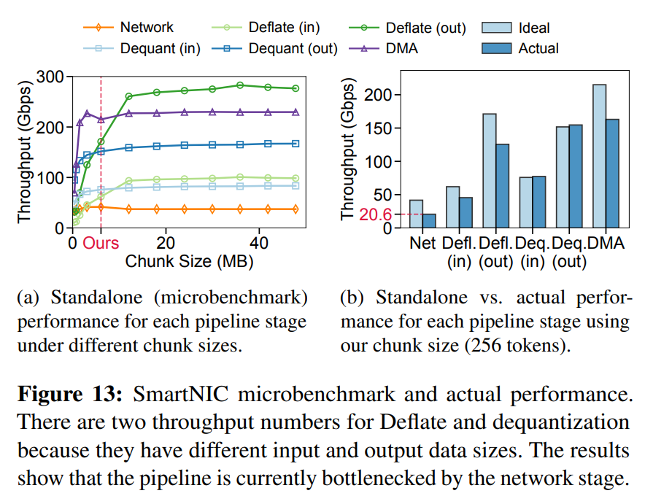
Offloading removes one bottleneck, but exposes another
Network stage becomes the bottleneck
Actual network throughput:
37.3 Gbps standalone → 20.6 Gbps in pipeline
Likely cause:
SmartNIC memory subsystem contention
Notes:
This is the paper’s most honest limitation slide. The network stage becomes the bottleneck on the SmartNIC, and the measured network throughput falls from about 37.3 Gbps alone to about 20.6 Gbps in the full pipeline. The likely reason is contention in the SmartNIC memory subsystem.

Slide 36
Final takeaway
ShadowServe is strongest when:
network bandwidth is limited
outputs are long enough for TPOT to matter
GPU decode interference is expensive
Main limitation:
SmartNIC memory/network bottleneck
Notes:
My final takeaway is balanced. ShadowServe is strongest in low-bandwidth, TPOT-sensitive settings and shows clearly that GPU decompression interference is real. But it is not a universal win, because at higher bandwidth the bottleneck moves to the SmartNIC.

Slide 37

Thank you!
Notes:
Thank you. I’m happy to discuss the design tradeoff, the evaluation assumptions, or where this system would matter in real deployment.

