Slide 1
AFM Visualization
By Justin Marbutt

Slide 2
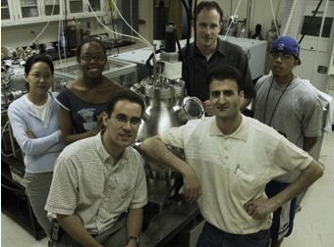
The Customer
Dr. Renato Camata
  associate professor of physics at UAB. Research in materials science
Research
  placement of peptides as bonding agents for cells on small surfaces (i.e. implants).

Slide 3
The Data
3D AFM Surface Data
[Header Section]
Version=v6.02
Date/Time=06/25/2010 11:40:24
Description=
Data Offset=3144
Stage Type=Explorer AFM
Probe Type=AFM
Scanner SerialNum=EX350511
Experiment Type=Plane Image
Data Type=Linearized Height
Calibration Type=System Calibration
Z Gain=High
Image Size=80 µm x 80 µm
Image Resolution=200 x 200 pixels
Data Range=32763, 32772
Scan Rate=179.93 µm/s
Scan Direction=Forward
Rotation=0 degrees
PID Settings=2.000 0.100 0.000
Relative Set Point=-1 nA
Sample Bias=0.00 mV
[Data Section]
Shade data: [a.u]
3.1217e+000 3.1217e+000 3.7460e+000 3.1217e+000 2.4973e+000 3.7460e+000 3.7460e+000

Slide 4
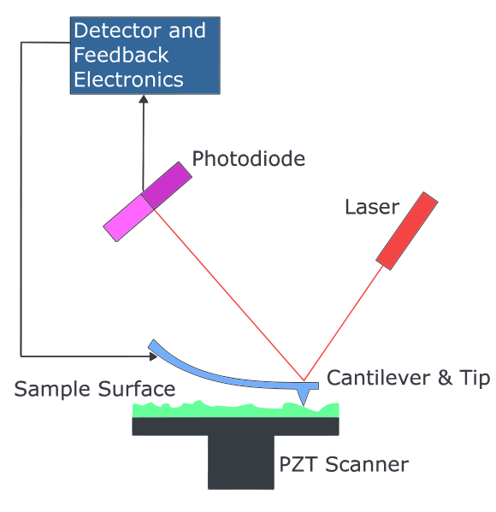
Atomic Force Microscopy
Mapping of a 2D- Surface with fundamental forces measured by a incident angle of a laser

Slide 5
Goals of Visualization
Visualize Manipulations to Data
    Visualize the manipulation of the data in real time
    to ensure correctness of manipulation
Visualize Surface
    Visualize surface accurately with open knowledge of algorithm
    Allow for resizing of the visualization with minimal
    information loss.

Slide 6
Visualizing Manipulations
Visualize the manipulation of the data to remove artifacts created by the machine
Visualize the application of a threshold to determine what is and is not a particle
Visualize the size distribution of the particles once identified

Slide 7
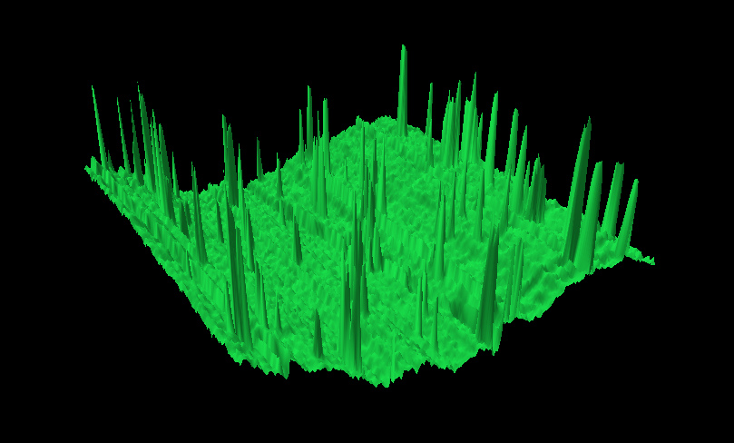
3-D height map visualization

Slide 8
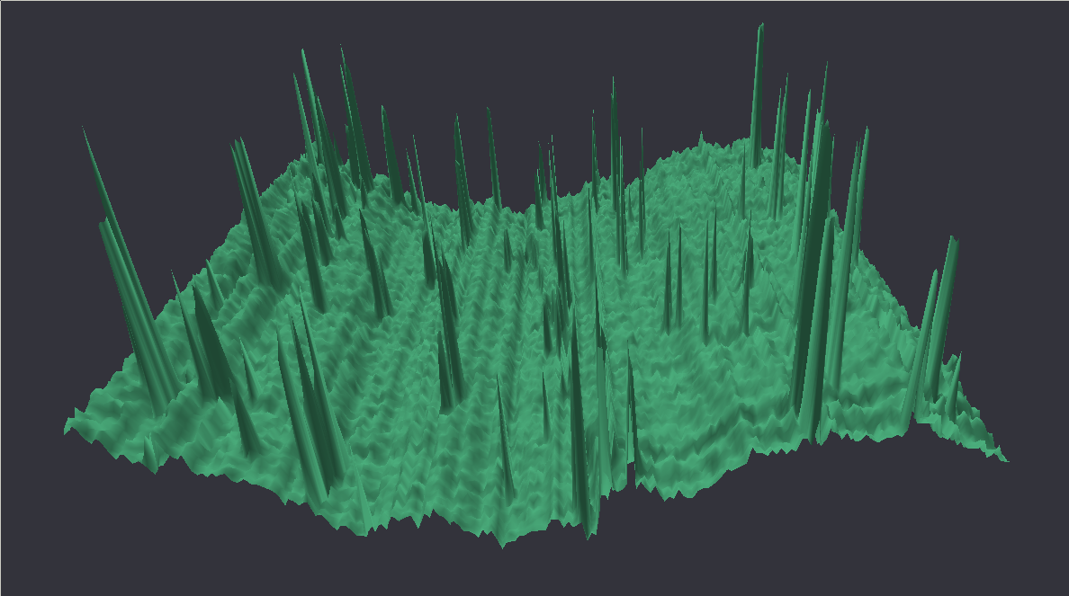
Curve in surface created by machine

Slide 9
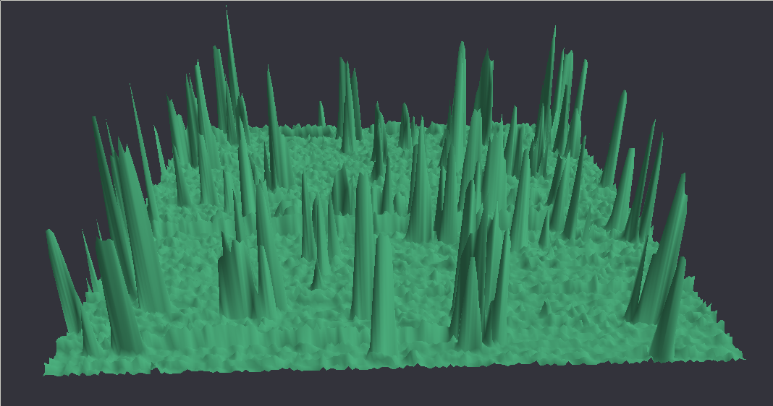
After curve removed

Slide 10
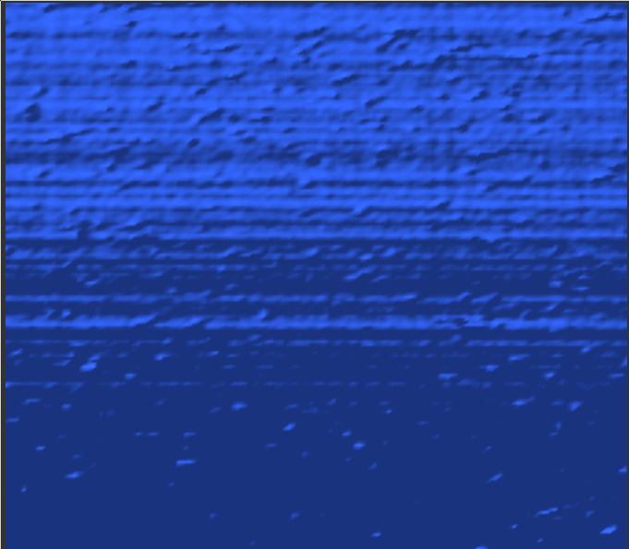
Top-down visualization
Pros
  Better view of the number of particles
Cons
  Loss of perspective on height

Slide 11
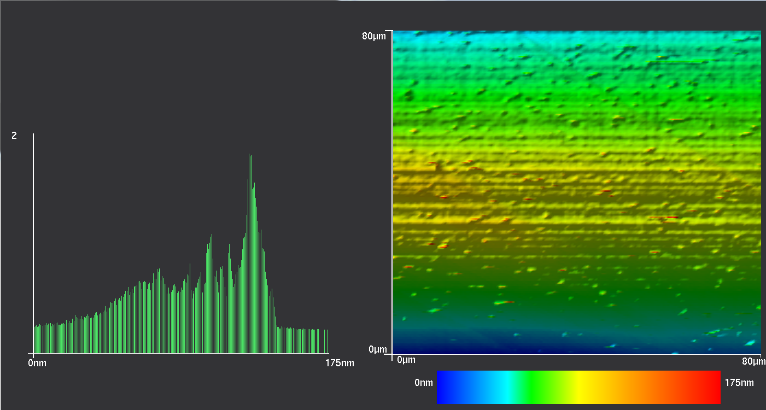
Third dimension of color & histogram

Slide 12
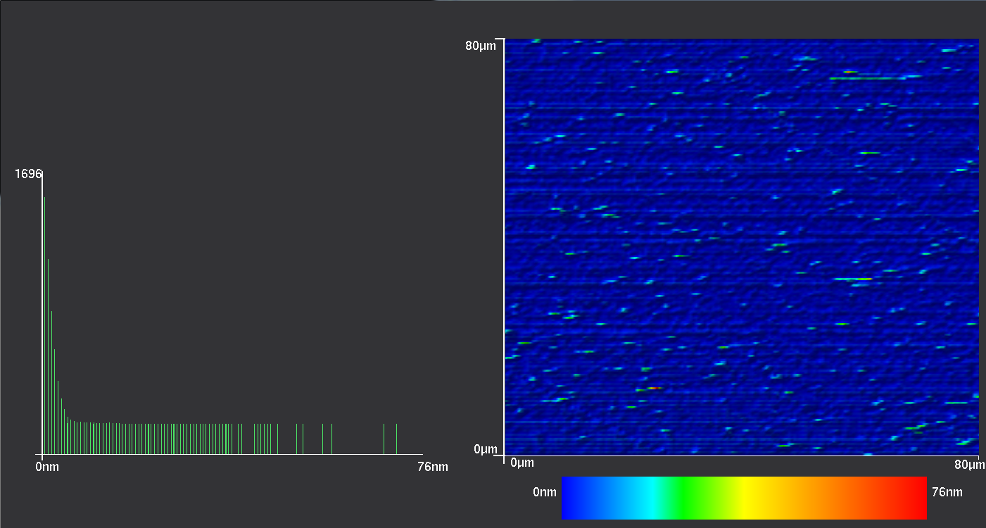
After removing curve

Slide 13
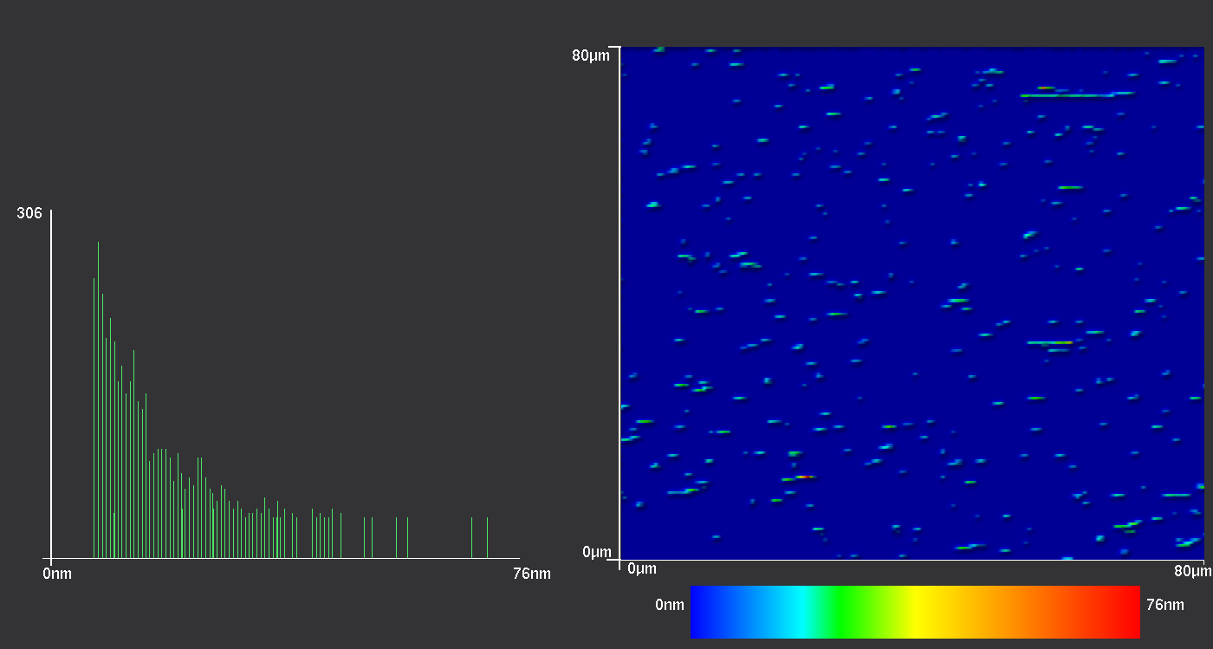
After threshold applied

Slide 14
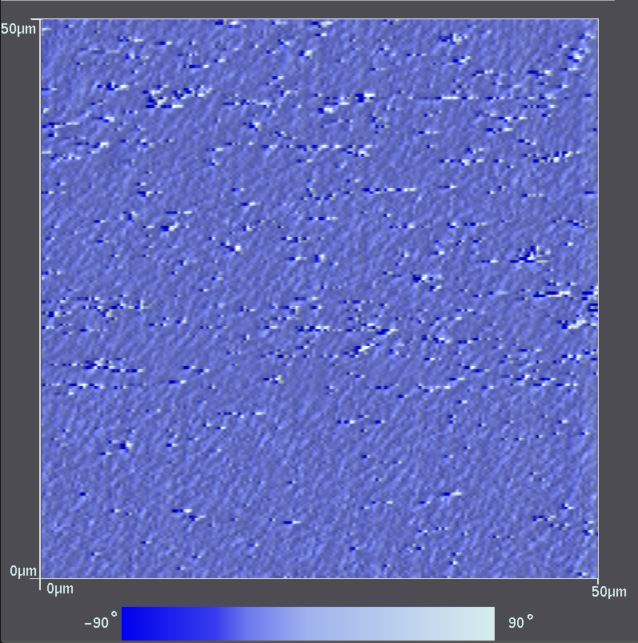
Visualization of the surface through an emulated light
An emulated light placed above and to the right of the surface
Color is mapped to the angle of reflection to visualize the surface as a human would see it

Slide 15
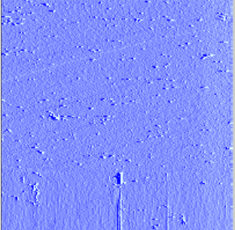
Fitted DPI and scaling using Gaussian blur and Bi-Cubic Interpolation

