Slide 1
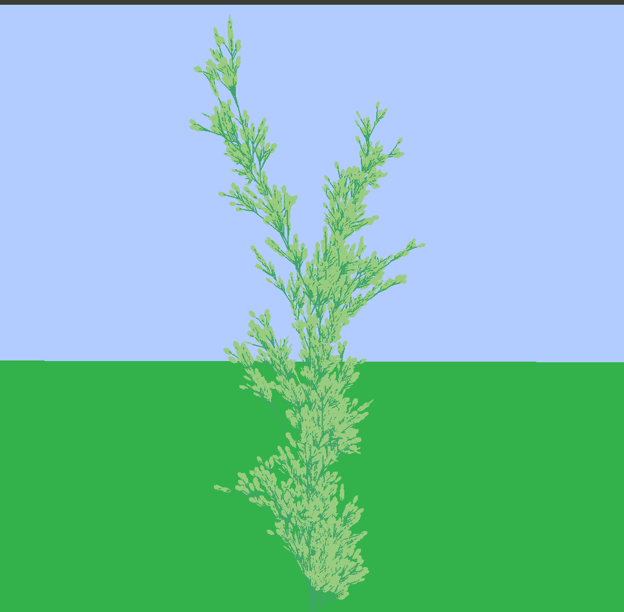
GABLE
(Graphical Algorithmic Breeding of L-Grammars in Environments)

Slide 2
Objectives
Correctly model plants, and environment.
  Have diverse and unique leaves and flowers that are generated in the same manor as plants.
Breed plants based on the set of current plants to create a constantly changing environment
Create the program in such a way that it can be modified to fit a wide array of applications

Slide 3
L-Grammars
Lindenmayer system, A type of formal grammar that begins with an axiom and produces a string with some number of iterations
Like most grammars, very powerful and
very sensitive.
Problem: finding grammars that
“look nice”
  Possible Solution: breeding from a set that does “look nice”
N=5, δ=22.5◦
X
X→F-[[X]+X]+F[+FX]-X
F→FF
X – variable
F – terminal (forward)
+/- - terminal (rotate)

Slide 4
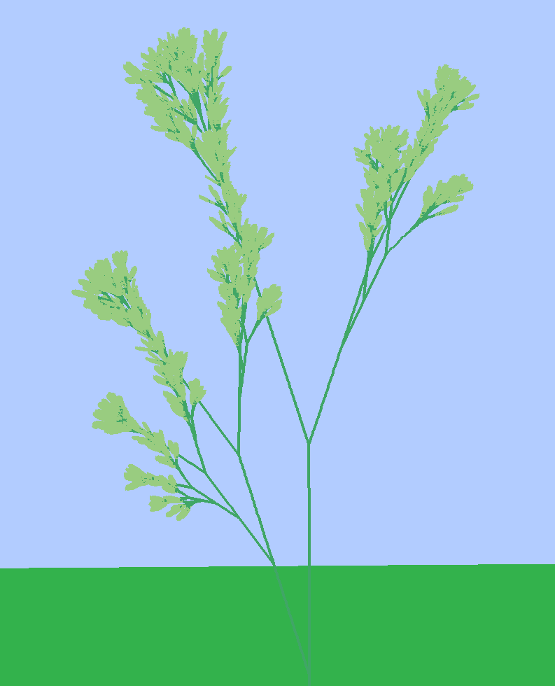
Current Progress

Slide 5
Future Goals
Dynamic leaf generation
More diverse grammars / classes of plants
Optional simplification of plants
Breeding of plant “DNA”
Exporting mesh of plant

Slide 6
Problems
Simplifying plants
Generating “pretty / correct” plant grammars

