Slide 1
NP-Complete Max KnapSack
Justin Newman, Jacob Shulman, Kyle Lacanna, Jackson Brantley

Slide 2
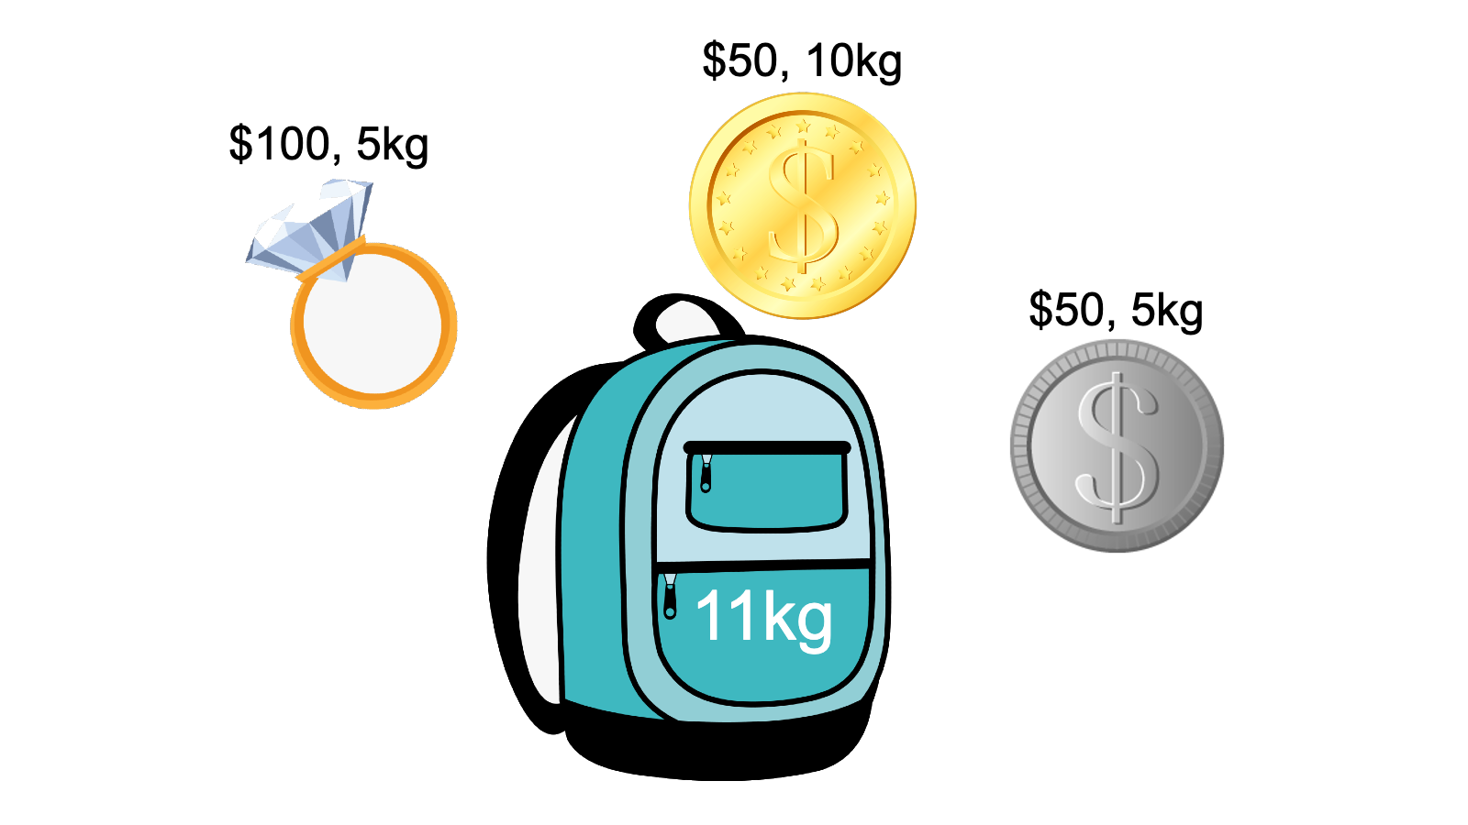
My Problem
My problem (phrase as a decision problem):
Can the maximum value V be achieved without exceeding the weight W?
Optimization Version:
What is the maximum value V achievable within a given weight W?

Slide 3
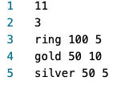
Problem Input
-- Maximum weight of knapsack
-- Number of available items
-- Items given in format: name,
value, weight

Slide 4
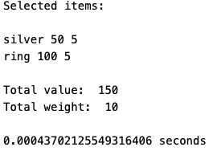
Problem Output

Slide 5
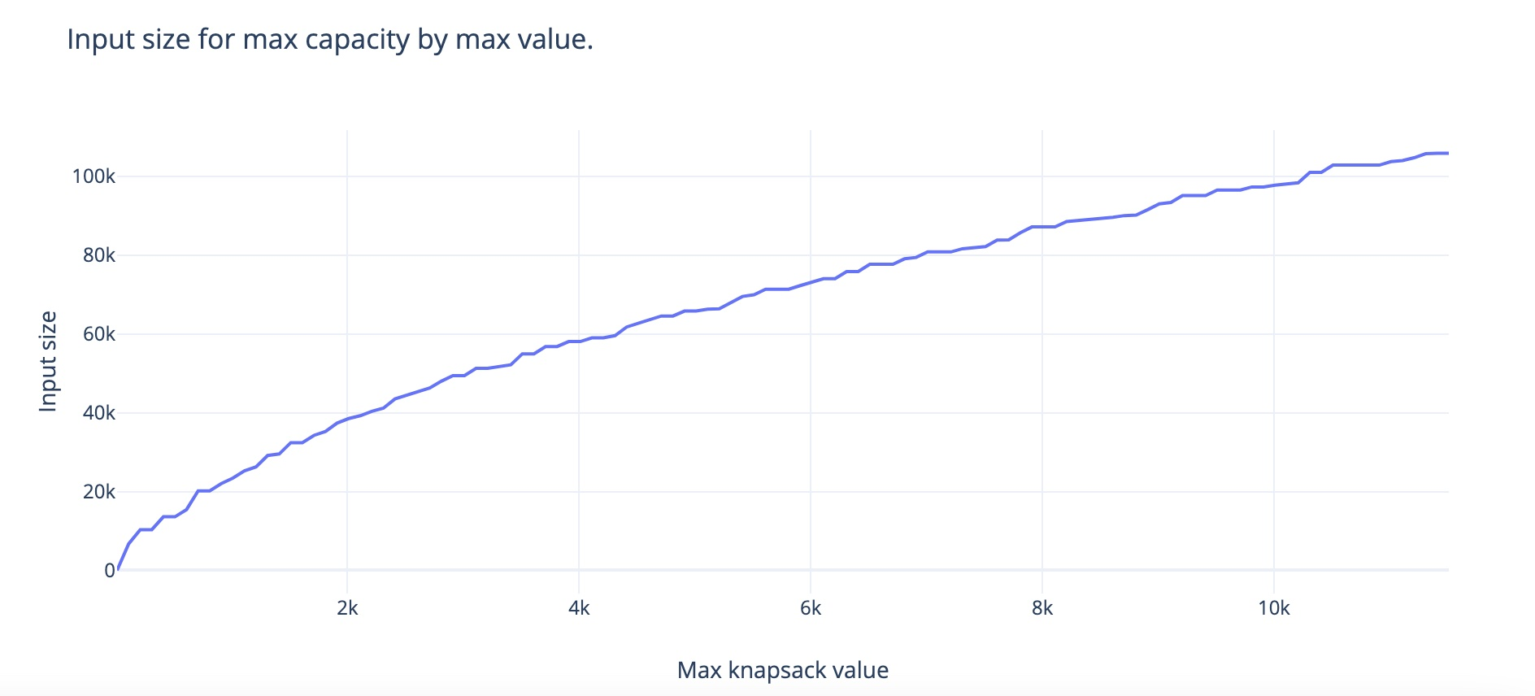
Problem Output

Slide 6
Applications
Packing for a trip (mars rover) – add image of mars rover
Eating lowest num of calories(weight) with hunger being max capacity fullness (value)
Cramming for test (textbook): knowledge (capacity), pages to read (weight), importance (value)

Slide 7
Reduction (justify its inclusion in NP-Complete)
Show the reduction that justifies the problem is in NP-Complete

Slide 8
Sketch of Exact Solution (pseudo-code)
knapSack(capacity, wts, vals, n)
if n = 0 or capacity = 0 then
return 0
if wts[n-1] > capacity then
return knapSack(capacity, wts, vals, n-1)
else
return max(vals[n-1] + knapSack(
capacity-wts[n-1], wts,
vals, n-1), knapSack(
capacity, wts, vals, n-1))
end
end
-- No items to select or max capacity is 0
-- Weight of nth item exceeds the capacity of the knapsack, cannot be included in optimal solution
-- Return the maximum of two cases: nth item included, nth item not included

Slide 9
Test Cases
How did you generate them? (hopefully with a python program)
Created Python script that used a stepped for loop to print integers from 10-100,000 in intervals of 100.
Generated a random integer from 1-100 to select that quantity of random ”items”.
Two more random integers were generated in each iteration to decide the item’s weight and value.
Test case Sizes?
- All test cases used the same randomly generated list of 63 items with each test increasing its maximum capacity.
Performance of test cases of different sizes?
- See graph
Plot of the run time of your program as you increase the input size. You MUST run your program on inputs that cause your program to run more than 20 minutes.

Slide 10
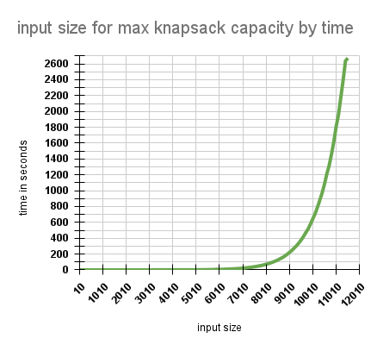
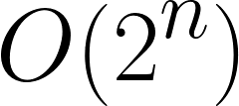
Runtime Analysis
Around input size 100, the runtime began to grow exponentially.
No real “worst case”. Performance decreases as maximum capacity increases
Items: 63

Slide 11
Approximation Portion

Slide 12
Approximation
Sketch algorithm choices (anytime algorithms, greedy algorithms, stochastic algorithms).
Bounds on its performance
Plot comparing difference in run time and solution quality using your test cases.

