Slide 1
Video Game Communication & Time Management
Chapter 1: Video Game Developer Communication

Slide 2
Overview
Why is communication & time management important?
  More difficult skills to develop
  Video game developers today are tasked with diverse projects and project components
  Video game developers communicate at all levels within a game studio today
  Employers will hire people with superior communication & time management abilities compared to others who only have technical knowledge
Notes:
Mention Visio & Powerpoint

Slide 3

The Geek Stereotype
Nerd/Geek (don’t have a life…
& can prove it mathematically)
Intolerant of non-technical people
Poor communication skills (too technical)
Rude & inconsiderate
Poorly dressed, messy
Male

Slide 4
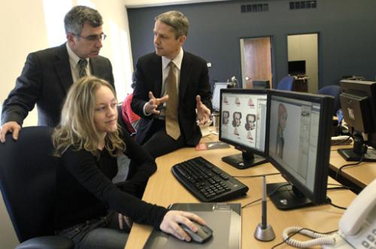
The “Real” World
Communication is key (promotion)
Business Casual
People skills a must (paraphrase/explain)
Well-organized
Can solve problems
Can work with others
Nice laptop

Slide 5
Developer Communication
Mostly written, some verbal & non-verbal
  Email & TM
  Reports & Forms
  Dress & body language
Should be geared towards the recipient
  Manager vs peer (coworker) vs client
  Cultural differences
    Eye contact & physical positioning
    Avoid idioms
Notes:
Written communication has “staying power” whereas verbal communication relies on memory

Slide 6
Email Etiquette
What is it?
Why is it important?
  Risk of informality
  Risk of being too aggressive
  Risk of being misunderstood (no body language to enhance interpretation
Notes:
Do sample email

Slide 7
How should I format email?
Use whitespace, shorter lines (pg 6)
Descriptive subject line
Salutation
Brief, properly punctuated
Prompt (this always impresses people!)
Plain text where possible
Notes:
Do sample email

Slide 8
Emailing a Manager or Group
Be direct & clearly organize concepts
Avoid acronyms(ROTFLOL)
Avoid emoticons :-)
Paraphrase all technologies (purpose)
Re-read all emails twice or more before sending
Leave white space & use proper grammar!
Notes:
Do sample email

Slide 9
Emailing a Peer or Coworker
Acronyms OK (provided they have the same knowledgebase)
Vary depending on rapport
Write as if anyone will read the email (they tend to get forwarded in the future)
pg 8 example (bad)
Notes:
Do sample email

Slide 10
Emailing a Client
Be direct & clearly organize concepts
Explain all technologies & include steps
Avoid all idioms & acronyms
Avoid long words (i.e. aforementioned)
Avoid humor
Include contact information
Notes:
Do sample email.
Review Email etiquette handout.

Slide 11
Attachments
Keep them as small as possible
Don’t add unless absolutely necessary!
Mention attachments in the email
  Prevents recipient from missing them
  If firewall/spam filters remove attachment, recipient can request you to resend it
Notes:
Do sample email.
Review Email etiquette handout.

Slide 12
Length of Email
Fit to the purpose of the email
For informational or important summary emails, include a structure:
  Table of Contents
  Summary
  Action items (what to do)
Notes:
Do sample email.
Review Email etiquette handout.

Slide 13
Flaming & Sensitive Emails
What is flaming?
Try to imagine what the recipient will think when they read the email
pg 10 example
Sensitive topics should always be discussed in person: disciplinary action, complaints, concerns, conflict
Notes:
Do sample email.
Review Email etiquette handout.

Slide 14
Verbal Communication (1)
Listen carefully
  Helps resolve heated issues
  Repeat what the other person said
  Pause (2 sec)
Notes:
Review Effective Verbal Communication Handout.

Slide 15
Verbal Communication (2)
Assess the listener’s technical knowledge
Don’t rush communication
Avoid blame (we need to find a solution…)
Explain all technologies
See tips on pg 12-13
Notes:
Review Effective Verbal Communication Handout.

Slide 16
Non-verbal communication
A.K.A. Body Language
Gun-pointing vs open hand
Nervous gestures
Hallway communication
Use for emphasis

