Slide 1
Video Game Communication & Time Management
Chapter 3: Reports & Presentations

Slide 2
Formal & Informal Reports
Formal reports
  Have predefined sections
  Typically for GDDs
Informal reports
  Most common (TDDs)
  Fit their purpose
  Typically have Visio diagrams
Notes:
See Informal Reports handout
See “10 Tips for creating a network analysis report” handout

Slide 3
Preparing Informal Reports (1)
Types
  Informational
  Analytical
Planning
  Assess audience
  Determine purpose & expected outcome
  Examine the scope of your report
Notes:
See Informal Reports handout
See “10 Tips for creating a network analysis report” handout

Slide 4
Preparing Informal Reports (2)
Choose a topic order
  Where should the most important information be in the report?
  Ensure that the order gives the desired reaction (i.e. introduce problems, discuss logistics, use conclusion to solve problems discussed earlier to impress readers)
Notes:
See Informal Reports handout
See “10 Tips for creating a network analysis report” handout

Slide 5
Preparing Informal Reports (3)
Organize report elements
  Statement of purpose
  Key points
  Body
    Present information (or comparisons) here in the easiest and most organized form to ensure reader comprehension
Notes:
See Informal Reports handout
See “10 Tips for creating a network analysis report” handout

Slide 6
Preparing Informal Reports (4)
  Rewrite your report 2-3 times!
    You will inherently organize topics better on each rewrite
    You will pick out logistical/grammar/spelling problems
  Avoid Writer’s Block
    Dictating
    Onscreen composing
    Free writing
  Write objectively
    Identify any assumptions
    Back up your opinions (references!)
    No subjective/ambiguous language – be specific!
Notes:
See Informal Reports handout
See “10 Tips for creating a network analysis report” handout

Slide 7
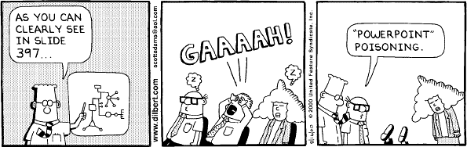
Preparing a Presentation
Use PowerPoint/OpenOffice/Keynote slides
  Keep a few key points per page (4-6)
  Simple = readable (no full sentences)
  No fancy colors or excessive graphics
  Print it out for audience (pg 65)
  Demo: Worst Presentation Ever (pg 65)

Slide 8
Giving a Presentation
Open with purpose
  Take your time
  Interact with the audience
Speak clearly/loudly/slowly, pause often
Use body language
Eye contact (questions)
Watch your time!

