Slide 1
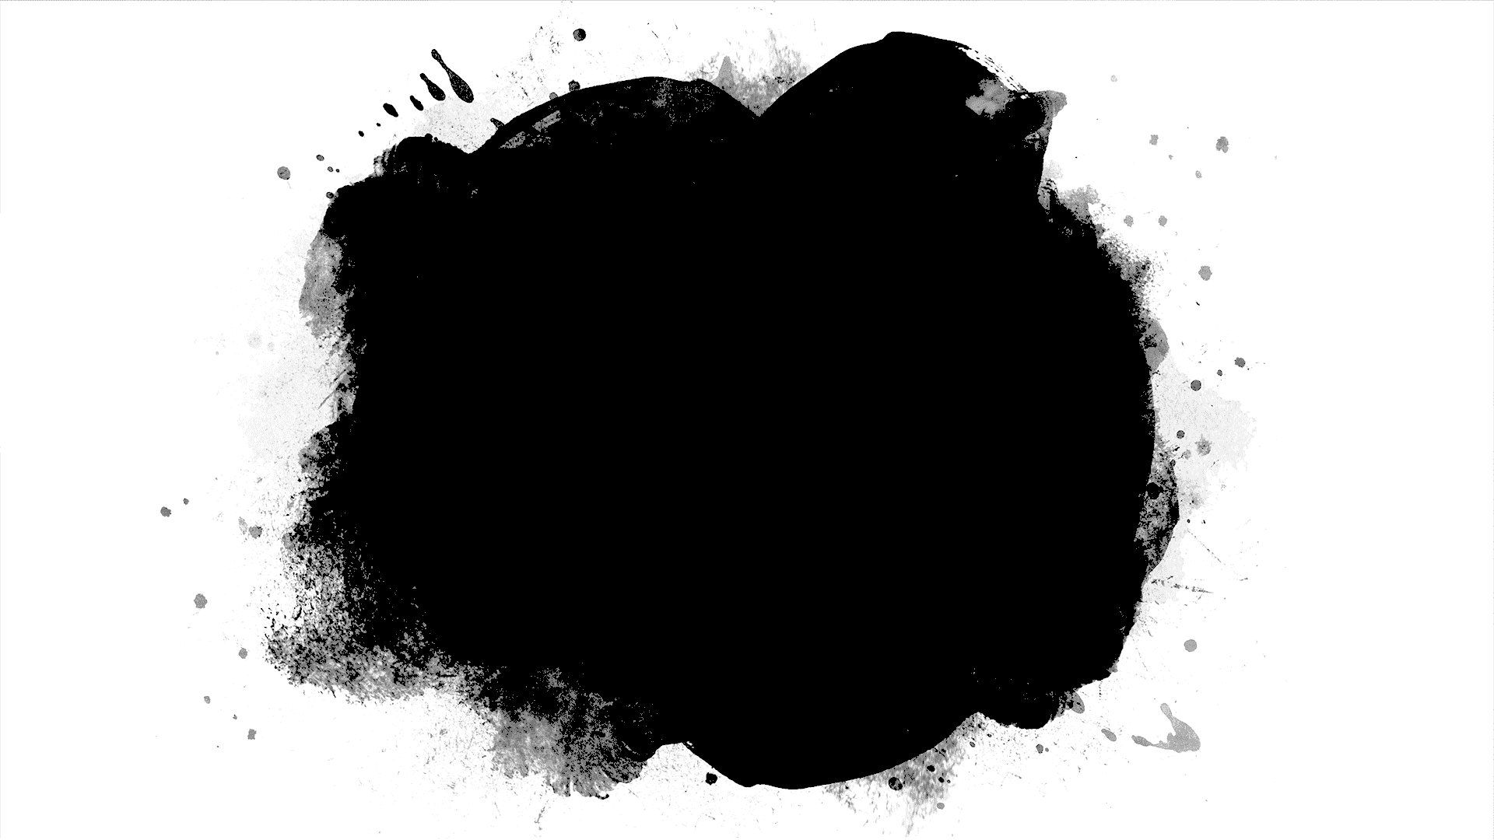
DriverPass System Analysis
Justin Phillips
Notes:
[No speaker notes required for this slide.]

Slide 2
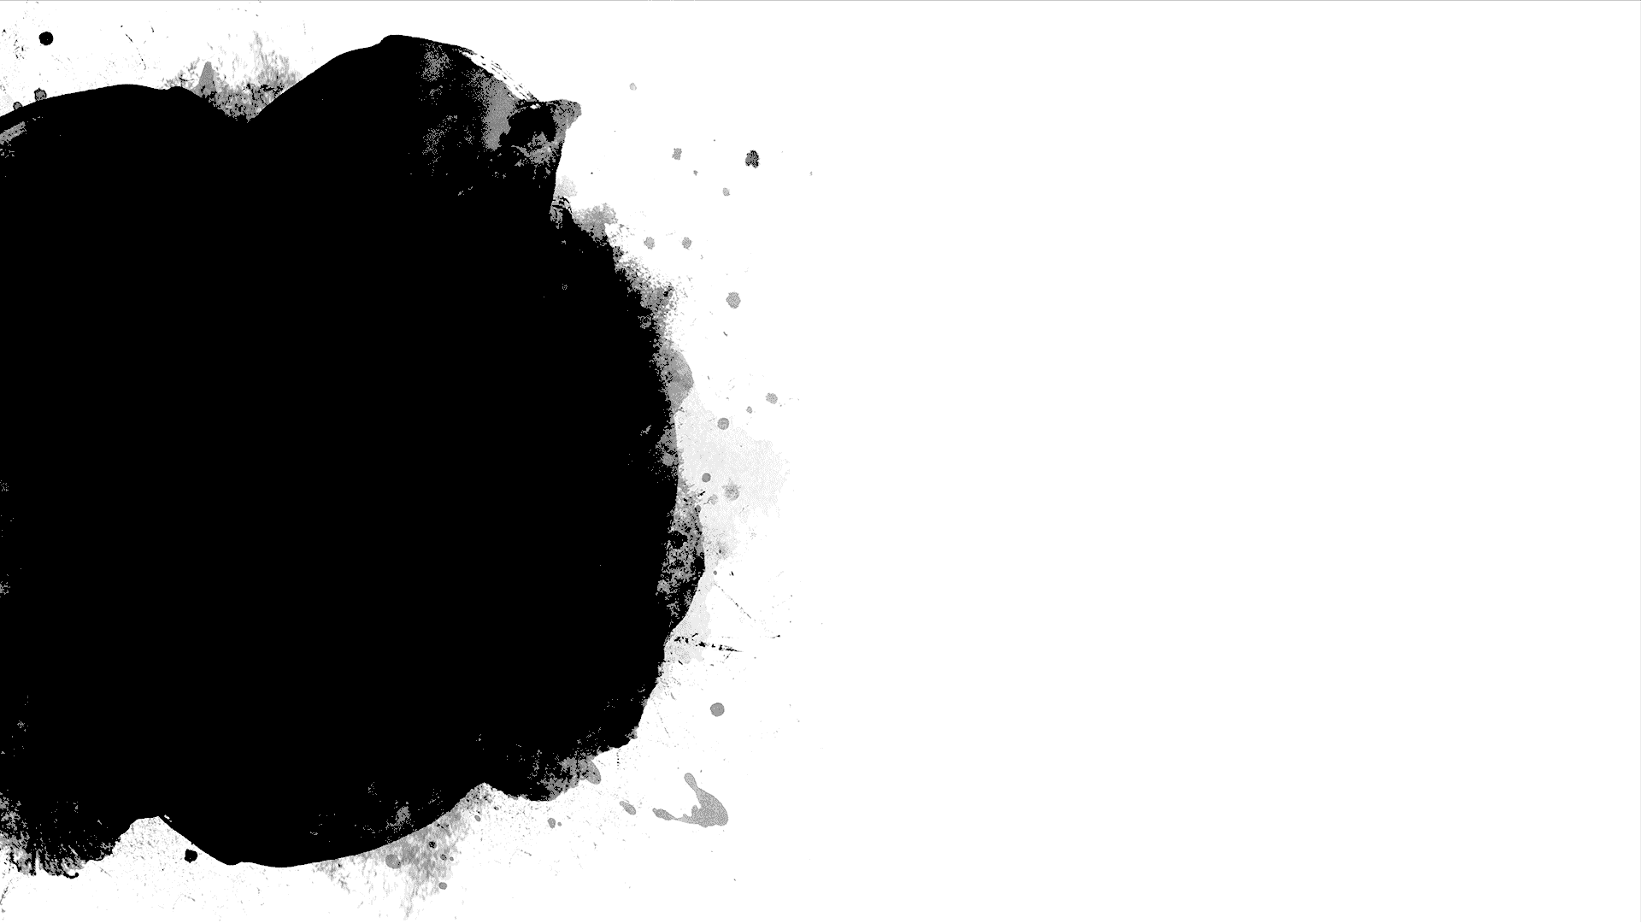
System Requirements
Functional Requirements:
The system shall allow users to create a new account or log into an existing one
The system shall allow customers to book appointments with instructors
Non-Functional Requirements:
The system will be platform-adaptable.
The system will be secure with user information and avenues of data communication.
Notes:
Hello, and welcome to my presentation.
To begin, here are the requirements our system needs. Functionally, it is critical that our users can create a new account or log into an existing one. The system also must allow customers to book driving lessons with our team of instructors.
There are other requirements that are important to the design of our system; our system still should be platform adaptable, and our system must be as secure as possible with our users’ information, and the avenues we use to send and receive data.

Slide 3
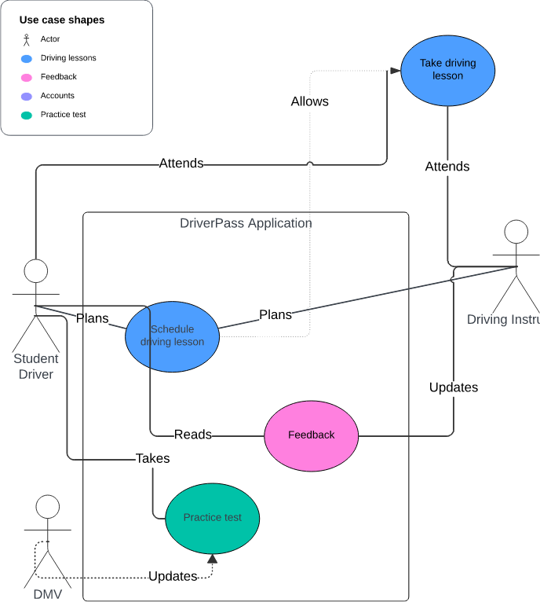
Use Case Diagram
[Insert your use case diagram here.]
Notes:
This diagram represents the journey of our end user, the Student Driver, and how they interact with our application and our Instructors. DriverPass enables the Student to take up-to-date practice tests sourced from the DMV’s example questions and latest guidelines. The Student also can plan driving lessons with the Instructor. Having a session planned allows both parties to meet up and make it happen; Afterwards, the Instructor can provide useful feedback for the Student. This cycle of studying and taking lessons is how the Student will become enabled through DriverPass to become a ready and safe-for-the-road driver.

Slide 4
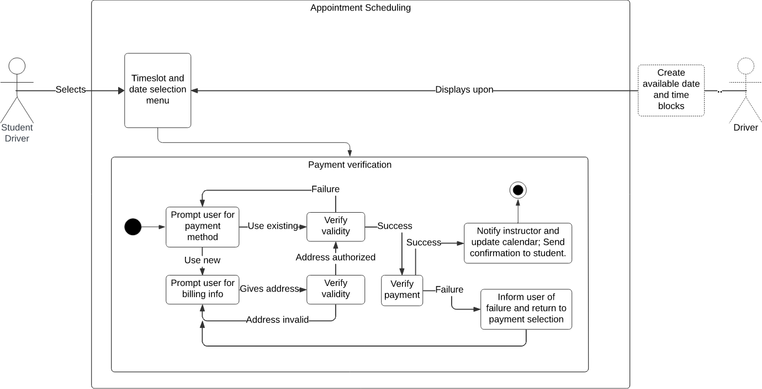
Activity Diagram
[Insert one of your activity diagrams here.]
Notes:
This diagram demonstrates the process of booking a driving lesson in greater detail. The Student is presented with an availability menu which offers all the time slots their instructor can make themselves available. Once a date and time is selected, the student can pay for their lesson. The payment verification process starts by prompting the Student for their payment method. If the user provides a new payment method, they also must input their billing information. Otherwise, they can select pre-existing payment information. Their payment information will be verified for validity and after they input valid information, the student and instructor are notified of the appointment, and their calendars are marked. The appointment is confirmed!

Slide 5
Security
Central server
Firewall
Secured encryption tunnels
Ubuntu Server
Instancing
Workplace
Authorized network access only
Account permissions
Hardware
Separate hard drives
BitLocker
Notes:
My design tackles security at three key points; The central server software. By controlling the data which reaches and leaves the server strictly by using a firewall, we can prevent harmful programs or intruders from ever touching our databases. To transmit data safely, we will use secured encryption tunnels by taking advantage of protocols such as HTTPS. We will host our server using the secure Ubuntu Server software, and we will instance interactions between our server and the outside world, sandboxing them so that no client interactions with our server have any overlap, preventing the risk of data leaks.
In the workplace, we will use a secured network able to be monitored by on-site administrators, and we will keep account permissions strictly regulated by role. Administrators will be able to administrate; Normal users and employees will only be able to do what they need for their job. It is principle of least privilege!
As for hardware, we will keep hard drives on the server separated depending on the data they store. Databases for payment methods, user log-in information, and our services will be physically separate, backed up daily, and encrypted with BitLocker. That means no one can walk out the door with one of the server hard drives and plug it into their own computer. It will not allow them access to sensitive information!

Slide 6
System Limitations
Power Loss
Internet Loss
Unsupported Devices
Notes:
The system does have a few drawbacks. Unlike a cloud hosted app with power redundancy and remote servers able to pick up the slack, if our system loses power, it becomes inaccessible. If the system loses internet, it also becomes inaccessible to online users. Finally, some devices without up-to-date browser capabilities or the power to have apps will not be able to have access to our system. Unsupported devices will often be older or more niche devices – Our system is perfectly accessible on modern smartphones rocking Android, iOS, or Google; Our system is accessible on Windows, MAC, Linux, or other mainstream operating systems; And our system is accessible on the latest versions of Google Chrome, Microsoft Edge, and Firefox. Thank you all for your time!

