Slide 1
BAR – Inflatable Blade
Nicole Mendoza, Ph.D.

Slide 2
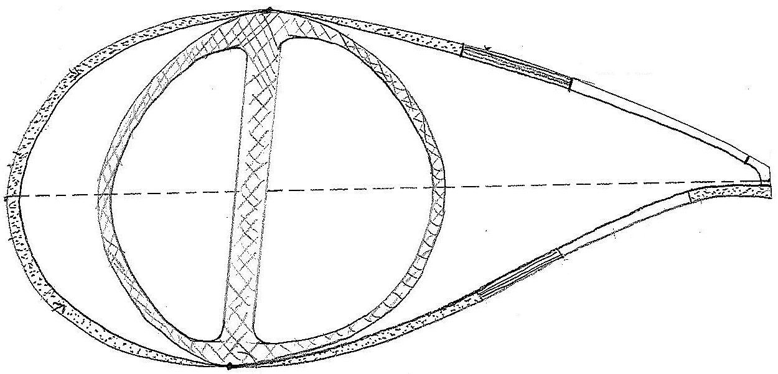
Inflatable Blade Concept
Materials
Kevlar – reliable (military, re-entry grade), non-conducting (lightening), flame resistant (seams and thread done same as parachutes)
Teflon – protects Kevlar from UV, mitigates icing and soiling, white (soaked)
Foam – lightweight, rigid → maintains aerodynamic shape
Uniaxial CF – provides strength for buckling
foam-filled section
(hard, rigid)
pre-made pultruded uniaxial CF pre-inserted into pocket
exterior Kevlar only
soaked with Teflon
design can support both rounded and sharp SSTE
traditionally-constructed
primary structure (box beam, double web, etc.)
PSTE must be rigid (foam)
to attach TE devices
air-filled sections allow for shape control &
pneumatic actuation (can also sew in air tubes)
*** could have spanwise compartments to pneumatically actuate to stall! ***
Aero shell created with 2 layers of Kevlar with filler in between
pre-sewn compartment structure
Legend
Foam filler
Uniaxial CF
Air

Slide 3
Inflatable Blade Concept
Factory
Fabric/textile manufacturing executed in parallel with primary structure manufacturing (traditional), then joined during curing phase, then shipped
Transportation
Transport by train, deflated and attached (smaller in chord, lighter)
On-site Manufacturing
Inflate mandrels
Inject foam → let harden
Deflate & remove mandrels
Glue on LEP, passive aero devices
Smooth/putty over injection ports (no need to paint blade)
could insert mandrels here
foam-filled section
(hard, rigid)
pre-made pultruded uniaxial CF pre-inserted into pocket
exterior Kevlar only
soaked with Teflon
design can support both rounded and sharp SSTE
traditionally-constructed
primary structure (box beam, double web, etc.)
PSTE must be rigid (foam)
to attach TE devices
air-filled sections allow for shape control &
pneumatic actuation (can also sew in air tubes)
*** could have spanwise compartments to pneumatically actuate to stall! ***
Aero shell created with 2 layers of Kevlar with filler in between
pre-sewn compartment structure
Legend
Foam filler
Uniaxial CF
Air

Slide 4
Inflatable Blade Concept
Unknowns/Issues
How thin can get outboard TE? ( → minimum thickness of 2 Kevlar layers)
How to glue add-ons to Teflon? ( → avoid soaking those areas, use seams)
Possible failure mode is delamination of Teflon-coated Kevlar to foam
Flap/edge/torsional stiffnesses?
foam-filled section
(hard, rigid)
pre-made pultruded uniaxial CF pre-inserted into pocket
exterior Kevlar only
soaked with Teflon
design can support both rounded and sharp SSTE
traditionally-constructed
primary structure (box beam, double web, etc.)
PSTE must be rigid (foam)
to attach TE devices
air-filled sections allow for shape control &
pneumatic actuation (can also sew in air tubes)
*** could have spanwise compartments to pneumatically actuate to stall! ***
Aero shell created with 2 layers of Kevlar with filler in between
pre-sewn compartment structure
Features
Re-usable primary structure facilitates derivative blade products (within 2 aero-structural constraints)
Air-filled compartments yield pneumatic aero shape control (airfoil shape and pitch/stall control)
No pressurized air (unless have pneumatically actuated compartments), so won't “burst” under extreme conditions
Compartmental design can easily be segmented/compartmentalized spanwise and chordwise via sewing seams – any size, any #
This concept does not consider structural spanwise segmenting (joints) → other BAR task
Legend
Foam filler
Uniaxial CF
Air

Slide 5
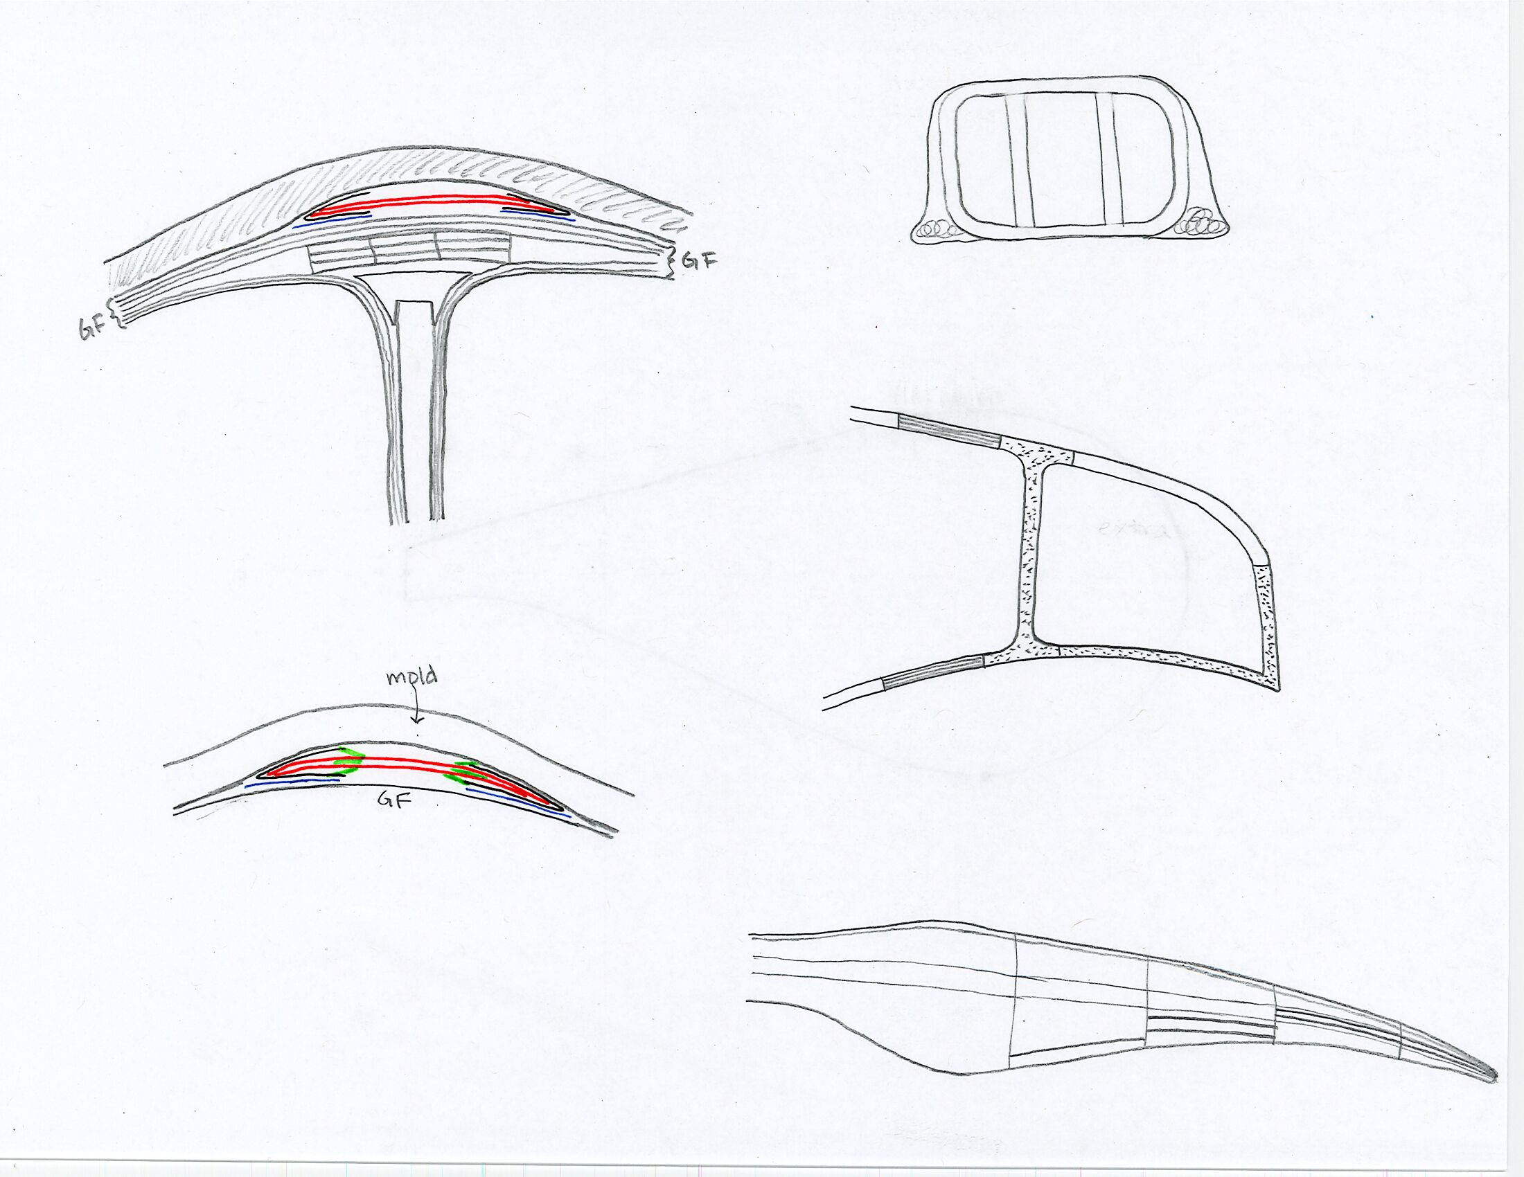
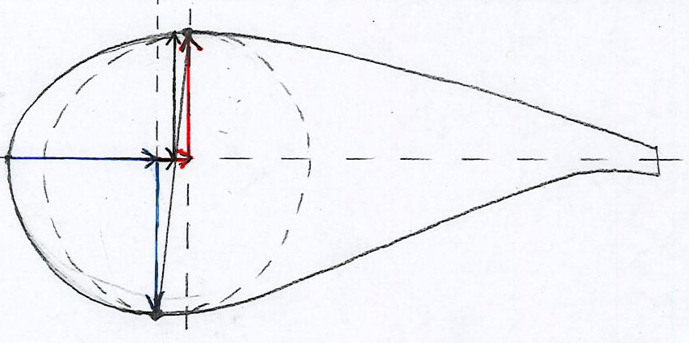
Design Considerations
Attachment Mechanism (Shell to Structure)
Include 2 Kevlar layers (minimum) in top and bottom of primary structure inside mold @ SS/PS max thk pos before curing
would need new molds anyways (smaller, lighter)
Cure primary structure + Kevlar layers, remove from molds
Sew/join Kevlar shell to dry Kevlar on primary structure
Design supports both traditional and filament-wound primary structures
Aft Panel Spar Caps / Side Beam
Designs fully supports addition with no restrictions
Simply create compartment and fill with rigid foam
Will need another mandrel for internal aft section
mold
CF spar cap/beam
shear web
Peel Ply
Vacuum Bag
Kevlar
Tacky Tape
Aero-Structure Coupling
Reusability of primary structure to create derivative blades is subject to two design restrictions/constraints
Airfoil families (geometry)
Blade absolute thickness spanwise distribution
Most likely structure will constrain aero (will have some wiggle room)
Note: Drawings NOT TO SCALE
PS max thk pos & value
SS max thk pos & value
Airfoil max thk pos & value
Example of Chordwise and Spanwise Compartmentalization

Slide 6
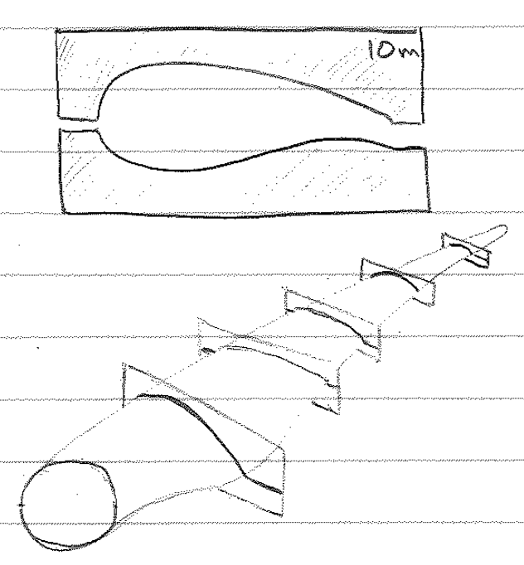
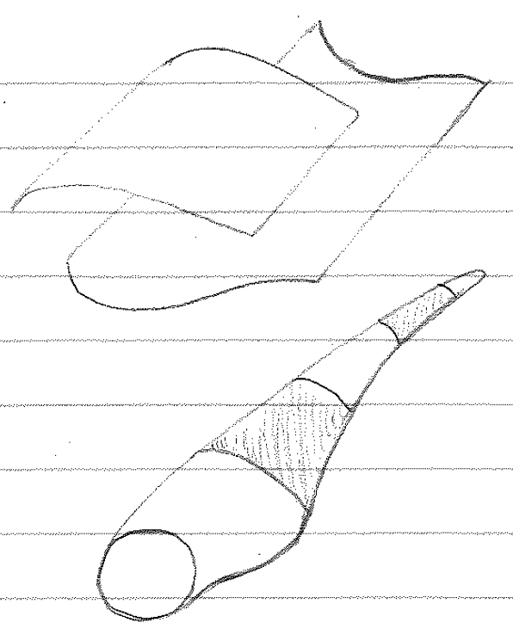
Design Considerations
Exterior Shape Control
Option # 1 Option # 2 Option # 3
Station Templates Traditional Mold 3D-Printed Segments
Price: $ (or less)
Can be made in parallel to or before blade manufacturing (laser cut)
Easily storable (low space required)
Recyclable
Any # along span (20-25?)
Split @ LE, TE mold release lines
Least/smallest amount of shape control
Most likely wood or recycled plastic
On-site usage (easily transported)
Interchangeable for new blades
Price: $$
Create traditional mold using standard methods
Need to transport to site (large, lighter)
Make prior to blade manufacturing
Must have injection ports
Most/highest amount of shape control
Not reusable/recyclable
Split @ LE, TE mold release lines
Need supporting equipment (cranes, etc.)
?
Price: ? = OPEX (segments) + CAPEX (machine)
Any # of variably-sized spanwise blade segments → variable amount of shape control
Depends on University of Maine printer: 30m X 6.7m X 3m (L X W X H)
Easily segmentable and transportable
Use recyclable materials (wood cellulose and/or recycled plastic)
Split @ LE, TE mold release lines
Can be made in parallel to or before blade manufacturing

Slide 7
Design Challenges
Primary design benefits:
Reduced mass/weight
Reduced chord during transportation → no maximum chord constraint!
Design supports all structural and aerodynamic needs of all OEMs
Problem/Challenge | Proposed Solution
Flap/edge/torsional stiffness | ?
Attachment/loads transfer | Include Kevlar layers in primary structure curing process
Buckling | Pre-made, pre-inserted uniaxial CF
Material reliability / O&M costs | Kevlar, Teflon coating
Aero shape/performance/airfoils | Rigid foam
Aeroelasticity/aeroacoustics/wake | Rigid foam
Controls | Neutral; Would simplify pitch system & give more control authority if use active air devices
Transport/logistics/installation | Easier due to reduced chord and weight
Rest of turbine design | Minimally affected (easier due to reduced weight)

Slide 8
Project Plan
Resources:
Roland: ~20% time
Nicole: ~12 hrs/month
Industry AB Mtg
AIAA SciTech abstracts due
Industry AB Mtg
Sandia Blade Workshop
FY20 Reports Due
| Mar | Apr | May | Jun | Jul | Aug | Sept | Oct | Nov | Dec
Go/No-Go
Steps 0, ½, 1a)-1x)
1 cross-section
1 Cross-section:
Steps 2,3
Multiple stations (blade)
openFAST (& LCOE) calcs
New blade designs
Tech Reports & documentation
Journal & conference papers

