Slide 1
Natural variation of root exudates in Arabidopsis thailiana linking metabolomic and genomic data
Susann Mönchgesang*, Nadine Strehmel*, Stephan Schmidt*, Lore Westphal,
Franziska Taruttis†, Erik Müller, Siska Herklotz, Steffen Neumann & Dierk Scheel
Begelson Lab Meeting
Justin Rigby
12/04/17

Slide 2
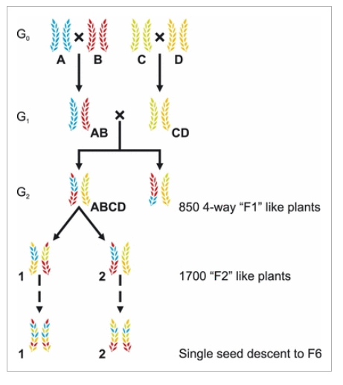
General Overview
19 separate lab accessions were used in the paper [e.g. Col-0, Pol-0, ect]
MAGIC lines [Multiparent advanced generation inter-cross] were constructed from the accessions (Huang et al. 2012)
A generic workflow including metabolomics and sequencing was used
Fold change in metabolite presence and mutated abrupt stop codons were measured and correlated to determine a relationship
Fig 1. Definition of a MAGIC line
Huang et al. 2012

Slide 3
Hypotheses
To determine if the root exudates are genetically determined, and if they can be found by a mixture of identifying dis-regulated metabolites and presence of SNP’s in the genome which lead to premature stop codons

Slide 4
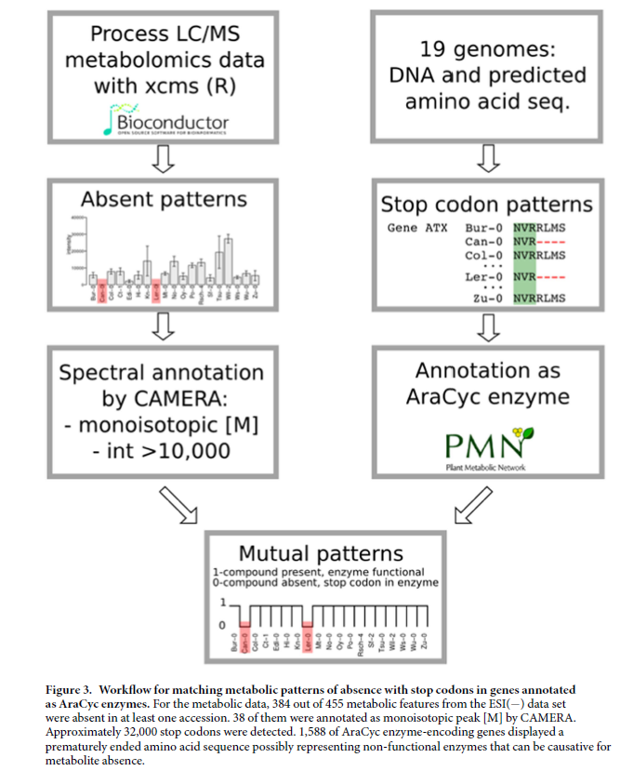
Workflow for matching metabolic patterns of absence with mutation of a premature stop codon

Slide 5
Workflow for matching metabolic patterns of absence with mutation of a premature stop codon
Plants wished to be sampled must have both their metabolome and their genome sequenced to a degree.

Slide 6
Workflow for matching metabolic patterns of absence with mutation of a premature stop codon
De convolution of data and creation of a peak table
Looking the absence of chemicals generally seen / assumed to be present

Slide 7
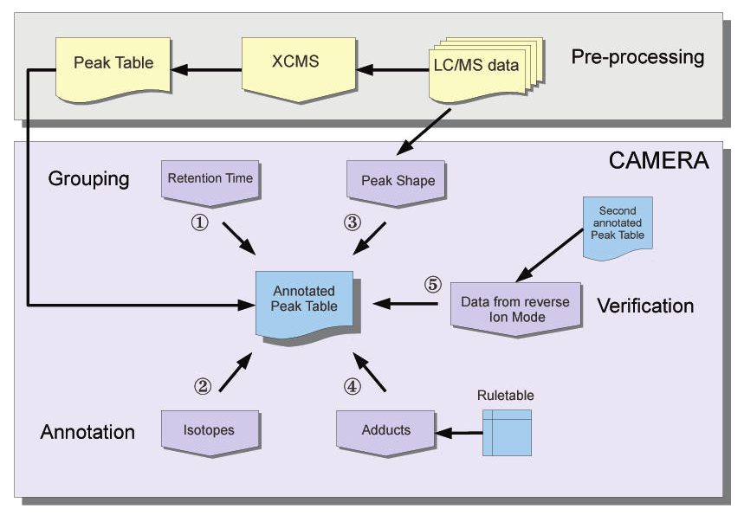
Workflow for matching metabolic patterns of absence with mutation of a premature stop codon
R package designed to analyse LC-MS peaks in order to determine the isotopes and accurate compound mass. (Kuhl et al. 2011)

Slide 8
Workflow for matching metabolic patterns of absence with mutation of a premature stop codon
Large assumption that mutations in genes that encode enzymes are always negatively correlated with chemical abundances

Slide 9
Workflow for matching metabolic patterns of absence with mutation of a premature stop codon

Slide 10
Results
Looking for clustering of metabolome compositions in the 19 accessions.

Slide 11
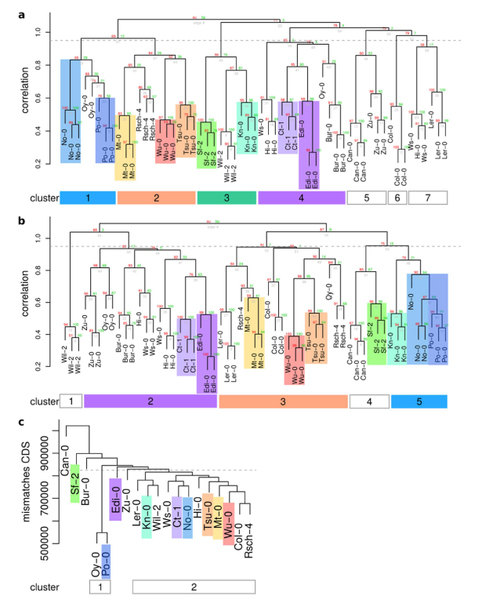
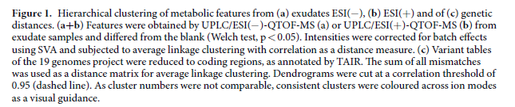
Negative Ion Mode
Clusters of similar metabolomes in the 19 accessions
Clusters of genotypes which typically resides next to one another are labelled with colour highlights
The clustering of some colours is more apparent than others, and does not guarantee that the clustering is significant across all figures
Positive Ion Mode
Mismatch in Genetic Code

Slide 12
Negative Ion Mode
Here three clusters of accessions tend to cluster next to one another in similar fashion
Possible indication of genetic abnormalities causing differential expression of metabolites
Positive Ion Mode
Mismatch in Genetic Code

Slide 13
Negative Ion Mode
Here two clusters of accessions tend to cluster next to one another in dissimilar fashion
The Po-0 genotype (along with Oy-0) tend to have the least amount of mismatches in their coding genome than the rest of the accessions
Interstingly, the level of mismatch CDS (Sequence polymorhpisms in coding sequences) does not seem to be similar between the Po-0 and Ct-1/No-0 genotypes
Positive Ion Mode
Mismatch in Genetic Code

Slide 14
Results
Looking at the fold changes of metabolites across the 19 accessions

Slide 15
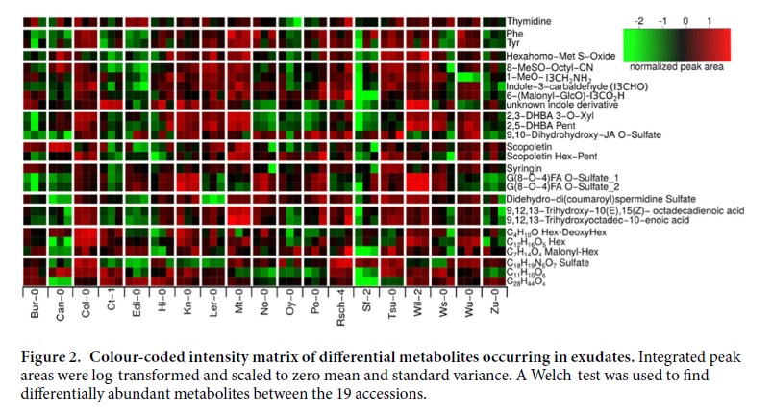
Black: No difference
Green: Down-regulation
Red: Up-regulation
Three biological replicates for each genotype

Slide 16
Significant negative fold changes in metabolite presence dependant on the genotype
Significant positive fold changes is hard to determine since the ‘2’ for the normalize peak area is not present

Slide 17
Raises question as to why this is;
Could be an artefact finding influenced by accidental relaxed selection in a lab setting
Or maybe
Difference in population metabolite composition

Slide 18
Results
Identifying a possible
cyclic didehydro-di(coumaroyl)spermidine sulfate
gene

Slide 19
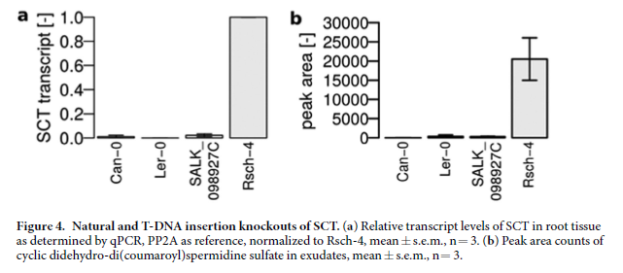
Looking at the level of transcription (a) and the level of metabolites in question (b) in this figure
Just because a single gene knock-out causes the same phenotype is not grounds for assumption of a relationship and the biological relevance of the chemical is still unknown

Slide 20
Results
Identifying a possible Robinin gene

Slide 21
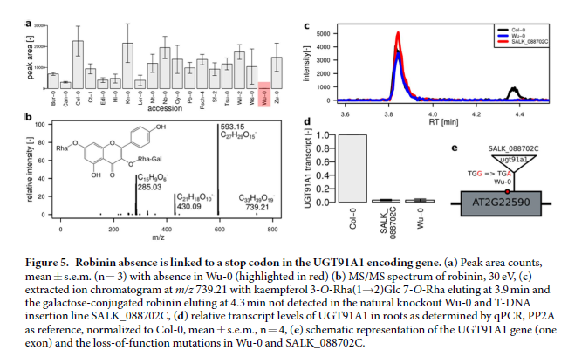
Results

Slide 22
Conclusion
The new protocols introduced in this paper pave the path for new high-throughput techniques and analysis between genes and metabolites
The chance of a type I error is high due to the methods implored (no empirical data on the gene transcription or purpose is shown or accounted for)

Slide 23
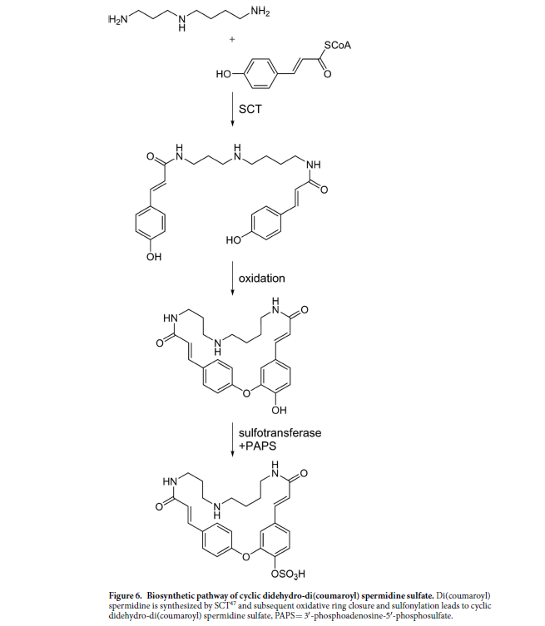
Supplemental Images

Slide 24
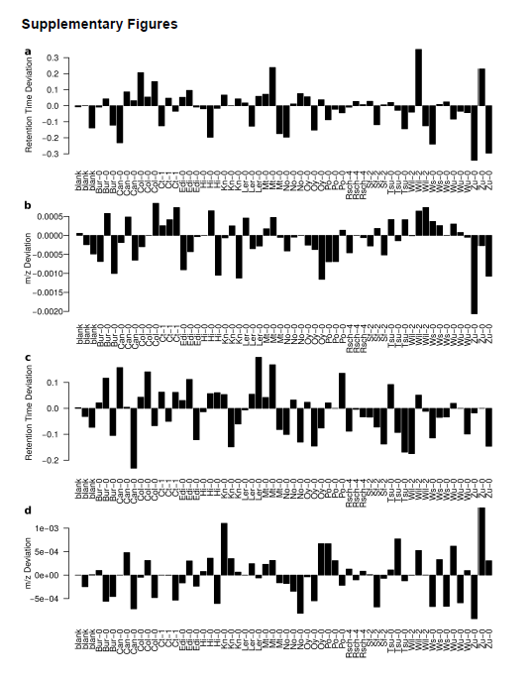
Supplemental Images

Slide 25
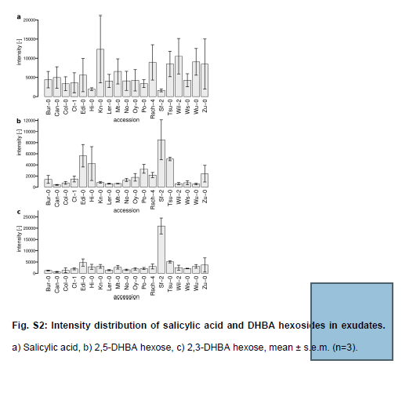
Supplemental Images

Slide 26
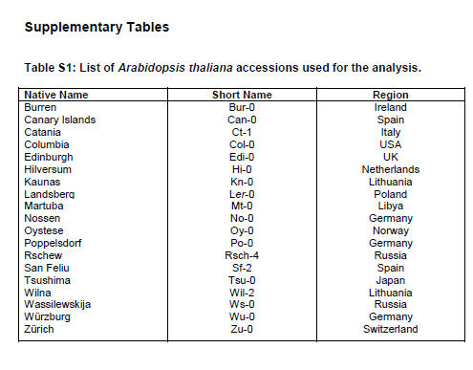
Supplemental Images

Slide 27
Supplemental Images

