Slide 1
Multilayer Networks

Slide 2
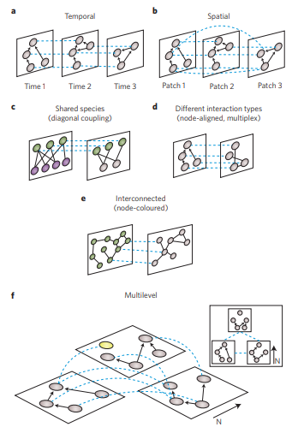
Multilayer Networks
- Synthesis Paper on Multilayer Networks
- Interested in this due to data set I have from field floral visitation data (3 Summers)
- Relatively new technique which can be applied to some of my previous and future work with herbivore and metabolite networks
Pilosof, Shai, Mason A. Porter, Mercedes Pascual, and Sonia Kéfi. "The multilayer nature of ecological networks." Nature ecology & evolution 1 (2017): 0101.

Slide 3
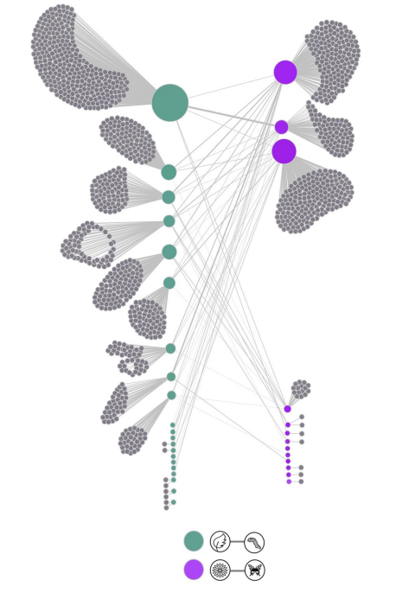
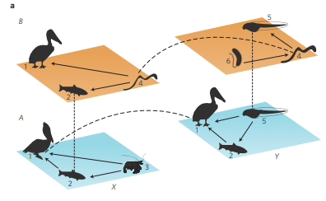
- The goal of this paper is to summarize the current knowledge and to posit new hypotheses pertaining to multilayer networks
- Looking at research within biology, but also outside of it.
Pilosof, Shai, Mason A. Porter, Mercedes Pascual, and Sonia Kéfi. "The multilayer nature of ecological networks." Nature ecology & evolution 1 (2017): 0101.
Astegiano, Julia, Florian Altermatt, and François Massol. "Disentangling the co-structure of multilayer interaction networks: degree distribution and module composition in two-layer bipartite networks." Scientific reports 7, no. 1 (2017): 15465.

Slide 4
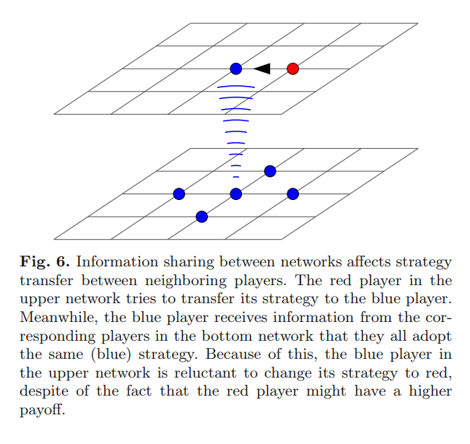
- There are interesting applications of multilayer networks outside of biology and mathematics
- This paper is an application of multilayer networks to evolutionary games – particularly the evolution of human cooperation through transfer of information
Wang, Zhen, Lin Wang, Attila Szolnoki, and Matjaž Perc. "Evolutionary games on multilayer networks: a colloquium." The European physical journal B 88, no. 5 (2015): 124.

