Slide 1
Multilayer Metabolomic Networks
Networks in Ecology and Evolution
Justin Ryan Rigby
05/30/18

Slide 2
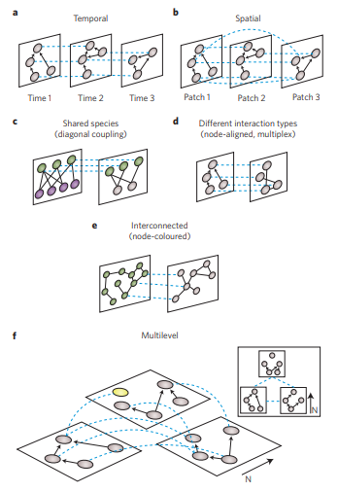
Multilayer Networks
Multilayered networks are a unique reductionist network which allows nodes to be connected between adjacency matrices
I.E. Node Y in Matrix A is connected to Node Z in Matrix B
Multilayer networks can be unweighted and weighted networks where;
- Un-weighted: G = (V, E, D) | Triplet
- Weighted: E = (V, E, D, W) | Quadruplet
A famous implementation is the Google Page Rank system which utilizes multilayer networks and Markov Chain random walks.
1. Pilosof, Shai, Mason A. Porter, Mercedes Pascual, and Sonia Kéfi. "The multilayer nature of ecological networks." Nature ecology & evolution 1 (2017): 0101.

Slide 3
Multilayer Networks
Recent developments in multilayered networks has allowed for these connected matrices to span temporal, spatial, and multilevel layers (1)
The focus of this presentation however will be on shared species multilayered networks where the nodes of the same species are connected to one another under the assumption that they reside in the same temporal space.
1. Pilosof, Shai, Mason A. Porter, Mercedes Pascual, and Sonia Kéfi. "The multilayer nature of ecological networks." Nature ecology & evolution 1 (2017): 0101.

Slide 4
Implementing Multilayer Networks to a System of Herbivores and Host Plants
Previous research has looked at herbivore and host plant networks (1)
Other researchers have looked at metabolic networks (2)
However, there is no current research on the secondary metabolite networks of host plants and herbivores
1. Villa-Galaviz, Edith, Karina Boege, and Ek del-Val. "Resilience in plant-herbivore networks during secondary succession." PloS one 7, no. 12 (2012): e53009.
2. Fiehn, Oliver. "Combining genomics, metabolome analysis, and biochemical modelling to understand metabolic networks." Comparative and functional genomics 2, no. 3 (2001): 155-168.

Slide 5
Key Idea
The purpose of this synthesis paper and presentation is to look at the interactions of host plants, herbivores, and secondary metabolites in a multilayer context in order to gain insight on how these complex interaction can affect one another.
While this is just a toy example, it showcases the possible interactions that can occur within an ecosystem.

Slide 6
Network of Plants and Herbivores
Generalist Herbivore
High Connectivity
Plant
Plant
Herb
Herb
Plant
Plant
Herb
Herb
Herb
Herb
Herb
Plant
Plant
Plant
Plant
Herb
Herb
Herb
Most Predated Plant
High Connectivity
Specialist Herbivore

Slide 7
Network of Plants and Secondary Metabolites
General Defense Compound
High level of centrality
Plant
Plant
Met
Herb
Plant
Plant
Met
Met
Met
Plant
Plant
Plant
Plant
Met
Unique Metabolite
Possibly a specialized chemical
Met
Met

Slide 8
Network of Herbivores and Secondary Metabolites
General Defense Compound
High level of centrality
Met
Herb
Herb
Herb
Herb
Herb
Herb
Met
Met
Met
Herb
Herb
Herb
Met
Herb
Met
Met

Slide 9
Transforming into a
Multilayer Network

Slide 10
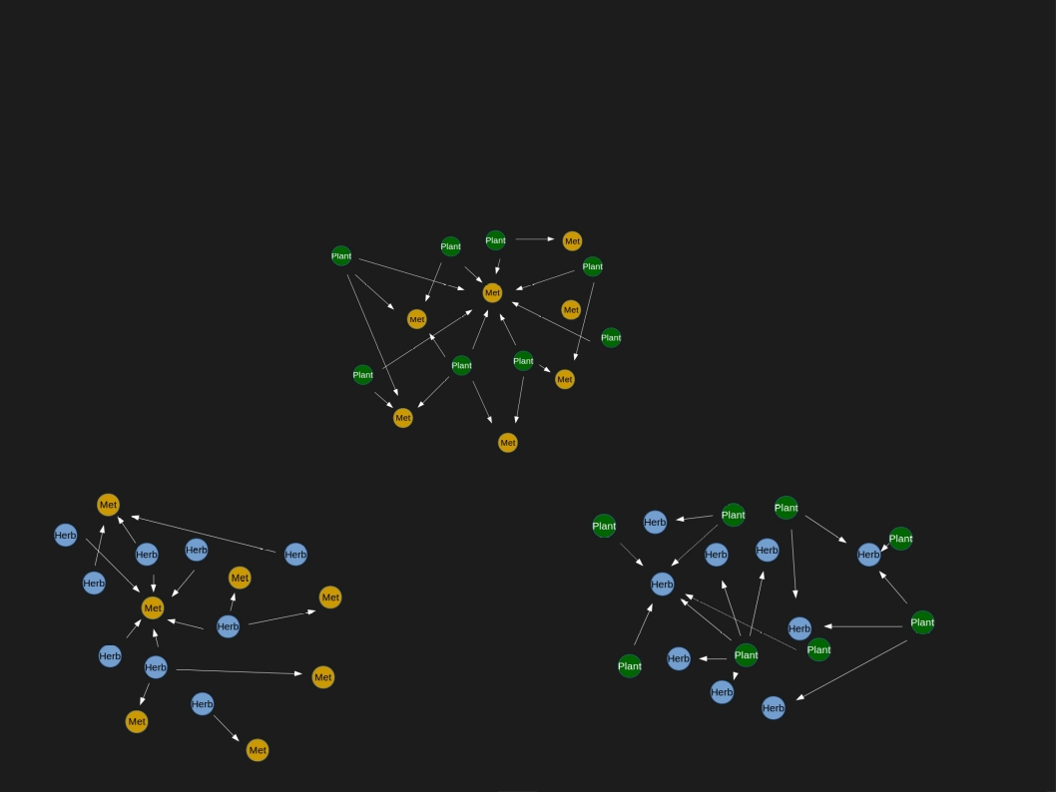
Multilayer Network of Secondary Metabolites, Host Plants, and Herbivores

Slide 11
Multilayer Network of Secondary Metabolites, Host Plants, and Herbivores
Removal of a plant with unique metabolites has a downstream effect which cause the herbivores to feed without worry
Removal of Highly Connected Herbivore Leads to plant nodes with no edges.
Removal of a sparsely connected herbivore has little effect on the network

Slide 12
Conclusion
The purpose of this paper was to investigate a possible application of multilayer network theory to a complex interaction.
While this is just a toy example, it showcases the possible interactions that can occur within an ecosystem.

Slide 13
Conclusion
Thank you!
Questions?

