Slide 1
Time-Dependent Two-Term Boltzmann Solver for Non-Equilibrium Gas Discharge Studies
Justin R Angus
6-29-16

Slide 2
Outline
Need for time-dependent Boltzmann solver
Governing equation
Some code details
Verification tests done using N2 cross sections at P=1Torr and driving to steady state
Elastic-momentum exchange only
E/N = 100Td (excitations dominant process)
E/N = 1000Td (ionization dominant process)
Equal energy sharing
Zero energy sharing
Example input file
Summary and future
1 Td = 10⁻¹⁷ V-cm²

Slide 3
Two-Term and Maxwellian Reaction rates in nitrogen at P=1Torr
Solid lines are computed using a Maxwellian EEDF
Dashed lines are computed using the Two-Term EEDF
Rates scale linearly with pressure
Energy relaxation rate is on the order of 100ns for 100mTorr and T_{e} order unity
Momentum relaxation rate is on the order of 1ns for 100mTorr

Slide 4
A time dependent equation for the EEDF is needed for time scales comparable to or shorter than the energy relaxation time and when multiple species are affecting the shape of the EEDF
Equation above is obtained by expanding the distribution function in Legendre polynomials, assuming the electric field is weak enough that the distribution function is weakly anisotropic, and that momentum relaxation is fast
W, D, and S are the energy space advection, diffusion, and source coefficients, respectively
Steady state solvers obtain F₀ (EEDF) from above equation by setting ∂F₀/∂t=0

Slide 5
Time-dependent solver details
Writing code using C++
JSON format is used for input files
h5 format used for writing to output files
All reactions and cross sections vs energy are specified in a text file
Elastic momentum
Excitation
Ionization
Cross sections are interpolated to energy grid using a linear interpolation on a log log scale
Cross sections are extrapolated to higher energy assuming ln(ε)/ε scaling for allowed transitions and 1/ε³ for forbidden transitions
Governing equation is discretized in energy space using a 2nd order finite volume algorithm and is solved in time implicitly using a 2nd order Crank-Nicolson method with predictor-corrector algorithm for nonlocal source terms.
Simulation time step computed based upon energy dependent rate of change of EEDF and is adaptable (runs faster as the solution approaches equilibrium)

Slide 6
Test 1: N₂ EEDF evolution with only elastic collision
Initial EEDF is Maxwellian with T_{e}=10 eV
P_{g}=1Torr, T_{g}=300K, E=300V/m
Cross section set for N2 includes elastic momentum exchange only.
Steady state solution obtained analytically

Slide 7
Test 2: N₂ EEDF evolution for E/N = 100 Td
Initial EEDF is Maxwellian with Te = 4 eV
P_{g}=1Torr, T_{g}=300K, E=3.22kV/m
Cross section set for N2 includes elastic momentum, 10 vibrational excitations, 11 electronic excitations, 1 ionization, and 1 dissociative ionization.
Steady state solution obtained from COMSOL (BOLSIG)

Slide 8
Test 3: N₂ EEDF evolution for E/N = 1000 Td with equal energy sharing for ionization
Initial EEDF is Maxwellian with Te = 4 eV
P_{g}=1Torr, T_{g}=300K, E=32.2kV/m, equal energy sharing
Cross section set for N2 includes elastic momentum, 10 vibrational excitations, 11 electronic excitations, 1 ionization, and 1 dissociative ionization.
Steady state solution obtained from COMSOL (BOLSIG)

Slide 9
Test 4: N₂ EEDF evolution for E/N = 1000 Td with zero energy sharing for ionization
Initial EEDF is Maxwellian with Te = 4 eV
P_{g}=1Torr, T_{g}=300K, E=32.2kV/m, zero energy sharing
Cross section set for N2 includes elastic momentum, 10 vibrational excitations, 11 electronic excitations, 1 ionization, and 1 dissociative ionization.
Steady state solution obtained from COMSOL (BOLSIG)

Slide 10
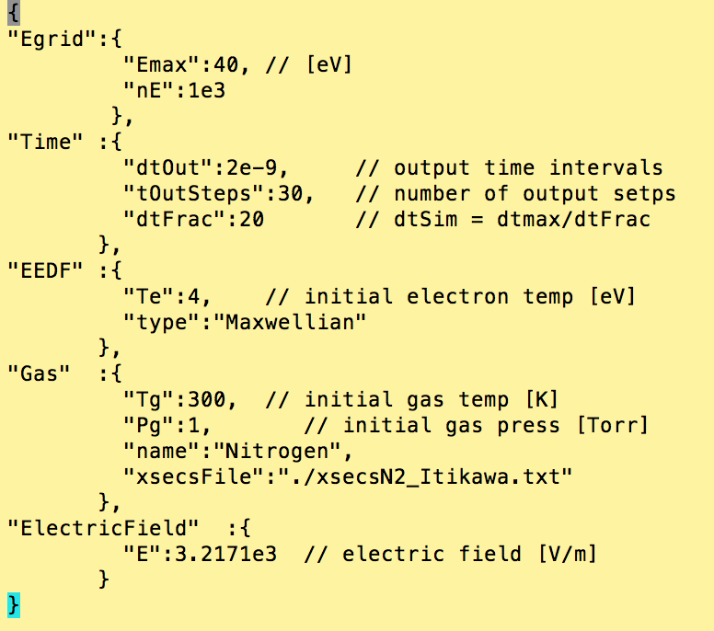
Example Input File (input.json)
Code uses json format for input files (JavaScript Object Notation)
Easy to read and write
Easy to parse and generate

Slide 11
HDF5 class for writing to output
class HDF5dataFile
{
public:
void setOutputFile(const string&);
void add(double &sclVar, const char *varName, int grow = 0);
void add(vector<double> &vecVar, const char *varName, int grow = 0);
void add(vector<vector<double>> &vecVar, const char *varName, int grow = 0);
void writeAll(); // appends all growing variables in output file
private:
string outputFile;
bool varExists(const H5File&, const char*); // probably obsolete now
bool varAdded(const string &name);
void writeScl(const double&, const char*, const bool&);
void writeVec(const vector<double>&, const char*, const bool&);
void writeVecVec(const vector<vector<double>>&, const char*, const bool&);
void appendVecInOutput(vector<double>*, const char*);
void appendSclInOutput(double*, const char*);
template<class T>
struct VarStr {
T *ptr;
string name;
bool grow;
};
vector< VarStr<double> > sclVar_arr;
vector< VarStr< vector<double> > > vecVar_arr;
vector< VarStr< vector<vector<double>> > > vecvecVar_arr;
};
void HDF5dataFile::add(double &varData, const char *varName, int grow)
{
if(varAdded(string(varName))) {
cout << "ERROR: Output variable " << string(varName) << " already added to datafile " << endl;
exit (EXIT_FAILURE);
}
VarStr<double> scl;
scl.ptr = &varData;
scl.name = string(varName);
scl.grow = (grow>0) ? true:false;
sclVar_arr.push_back(scl); // add variable to the list
writeScl(varData, varName, grow); // add variable to the output file
}
void HDF5dataFile::writeAll()
{
for(vector< VarStr<double> >::iterator it = sclVar_arr.begin(); it != sclVar_arr.end(); it++) {
if(it->grow==1) {
appendSclInOutput(it->ptr, it->name.c_str());
}
}
for(vector< VarStr< vector<double> > >::iterator it = vecVar_arr.begin(); it != vecVar_arr.end(); it++) {
if(it->grow==1) {
appendVecInOutput(it->ptr, it->name.c_str());
}
}
}
All variables added to output file during initialization
All growing variables are written to output file at specified output times using writeAll() function

Slide 12
Now and Later of Model
Now
Later
Developed 2nd order finite volume, 2nd order implicit time algorithm for two-term Boltzmann equation
Can perform time-dependent EEDF studies for a single gas species with elastic, excitation, and ionization reactions
Ionization reactions can have equal or zero energy sharing
Benchmark current model with McSwarm
Include beam source and use Opal for energy sharing during ionization
electron-electron collision operator
superelastic reactions
Allow for multiple species
Couple to system of rate equations (ABC model) and circuit model for electric field
Nonuniform energy grid?

