Slide 1
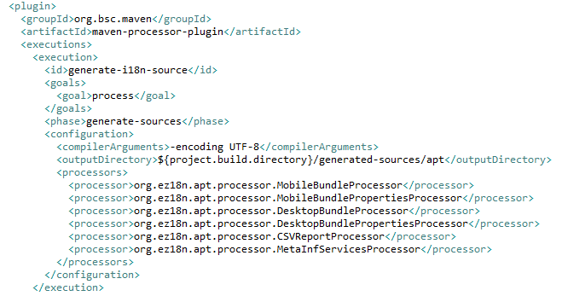
APT chaining
5 APT processors to obtain the default pattern
Optional CSV file for analysis/tooling

Slide 2
Big picture

Slide 3
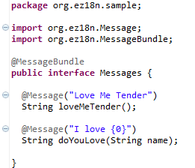
Generate the DesktopBundle
@MessageBundle is triggering each processor
@Message is supporting the default localization

Slide 4
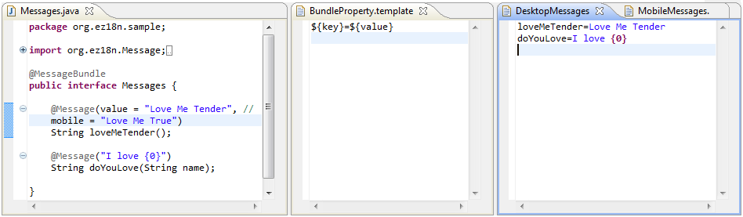
DesktopBundlePropertiesProcessor
One property file per interface with @MessageBundle
One property entry per method with @Message

Slide 5
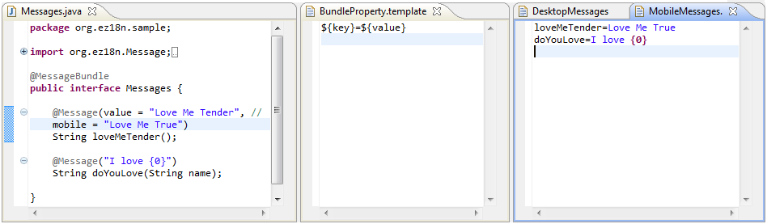
MobileBundlePropertiesProcessor
Another property file is generated for the mobile content
If @Message#mobile is empty, the @Message#value is used as fallback

Slide 6
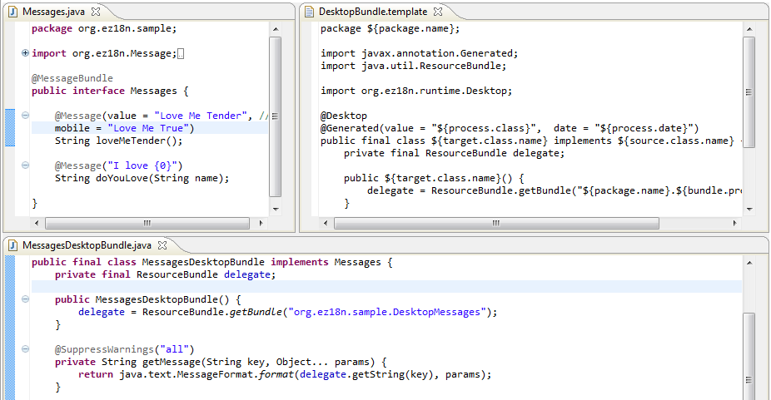
DesktopBundleProcessor (1/2)

Slide 7
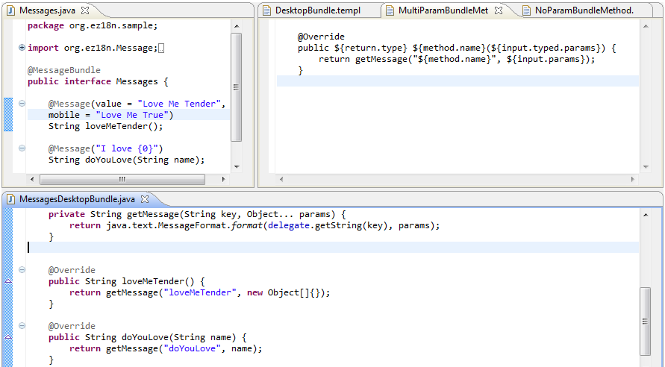
DesktopBundleProcessor (2/2)

Slide 8
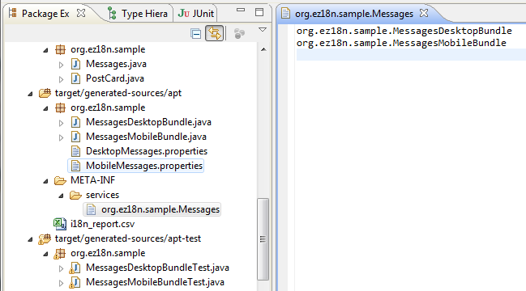
Bundle injection
Using META-INF/services to inject the mobile & desktop implementation
The two implementation could be filtered at runtime using annotations and ServiceLoader
@Mobile
@Desktop

Slide 9
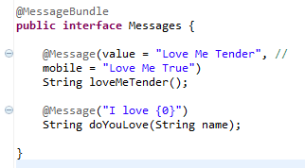


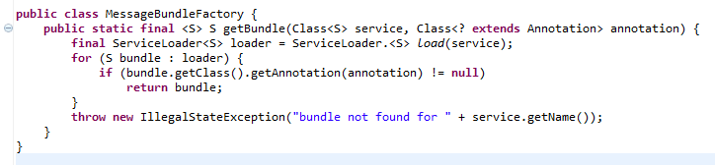
Client code sample (1/2)
Using java.util.ServiceLoader to inject the interface with @MessageBundle
@Desktop and @Mobile used to filter the injection result

Slide 10
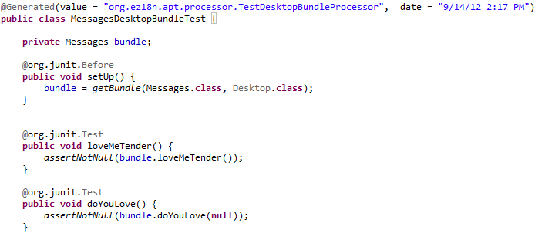
Client code sample (2/2)
Some basic JUnit test using the API
The unit tests are generated using APT too ☺
MessageBundleFactory.getBundle(…) usage in the test @Before to retrieve the bundle implementation

