Slide 1
Multi-device Content Display & Smart Use of Annotation Processing
@gdigugli
@dbaeli

Slide 2
Speakers
@dbaeli
@gdigugli
Java developer since 1999
R&D Team Mentor at
Coder, DevOps, Agile Coach
From idea to production
eXo Platform
VP Quality
Java developer since 1999
Software architect at
ILOG - IBM
2D graphic toolkit
Rule engine
Prima-Solutions
Services platform for J2EE
Domain models code generators

Slide 3
Let’s talk about visible quality
Effective Content Display

Slide 4


The case
Effective Content Display
Multi device & languages
Labels
Layout & images
Clean code
Strong Quality
Easy Maintenance
with APT Tooling
APT Engine
APT Processors
Generate technical code
Generate reports
Generate Helpers
based on i18n
Message
@MessageBundle
https://github.com/dbaeli/ez18n

Slide 5
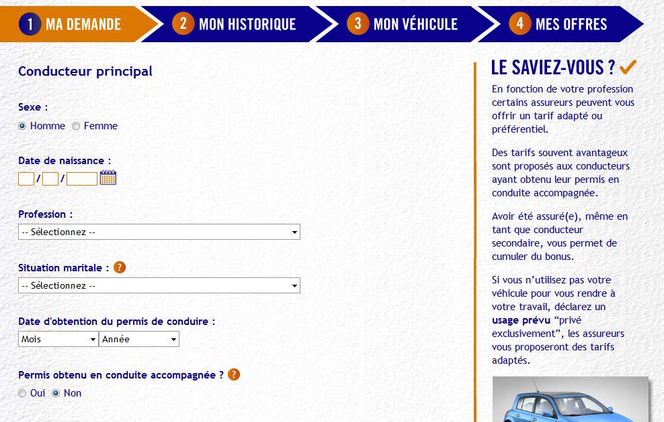
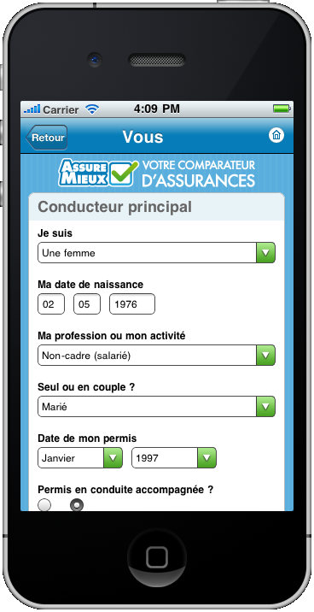
mobile et desktop

Slide 6
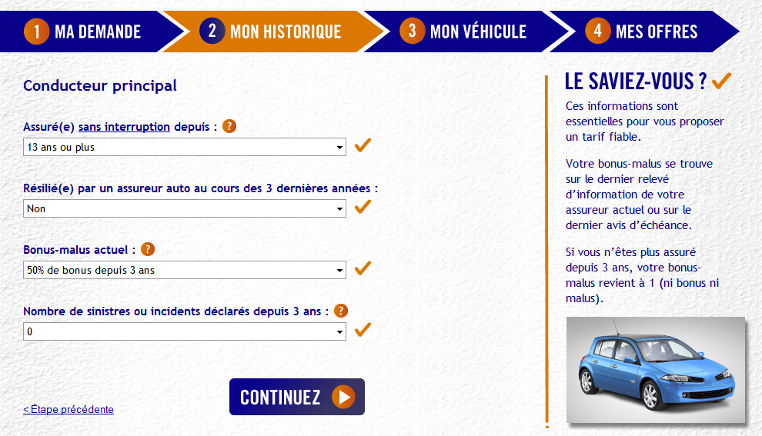
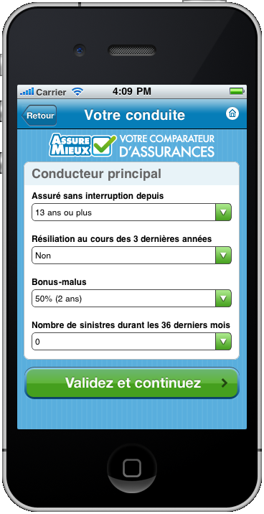
mobile et desktop

Slide 7
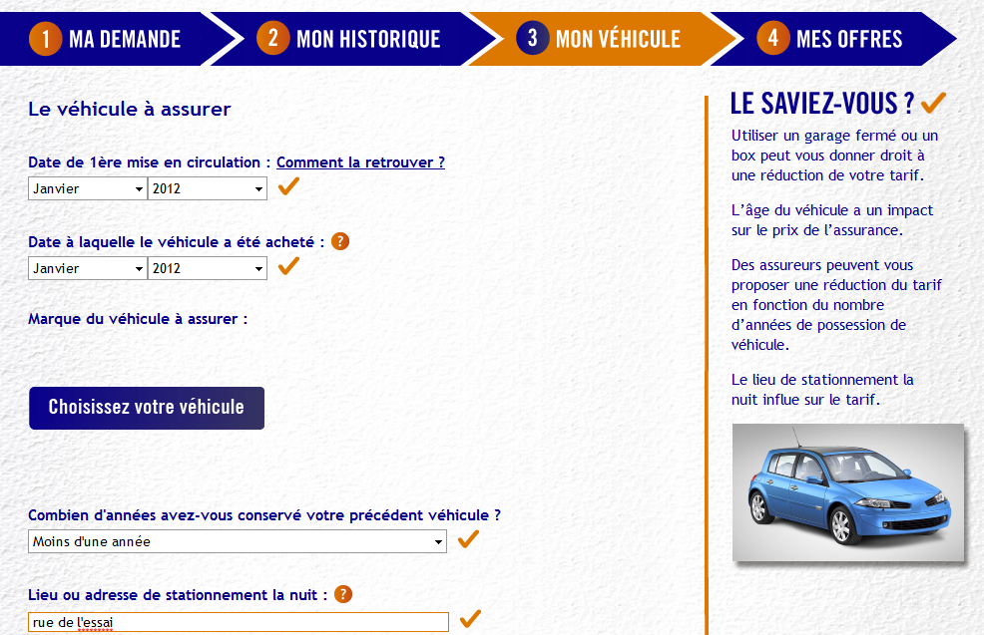
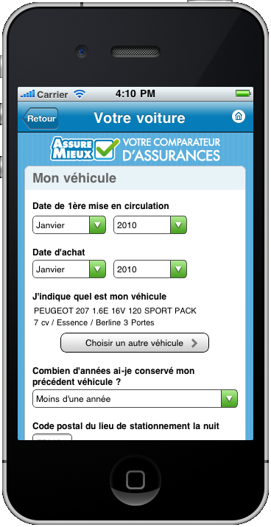
mobile et desktop

Slide 8
How to manage text display ?

Slide 9
Java i18n pattern
The provided tooling for :
Dynamically bind the content (ResourceBundle)
Texts obviously
But also CSS and images
Implementation :
java.util.ResourceBundle : for .properties reading
java.util.MessageFormat : tiny templating

Slide 10
java.util.ResourceBundle
The .properties loader for a given Locale
Key / Value in .properties
Naming convention for the storage
Messages_en_EN.properties
Language
Country

Slide 11


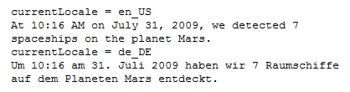
java.util.MessageFormat
Tiny templating
format(“<pattern>”, args)
Date, numbers are formatted according to the Locale
Options, conditional values easy to use

Slide 12
.properties issues
Low quality control
Keys are strings in the code
Poor IDE support
No idea of unused keys
No clue of wrong keys
Forces you to maintain two files in sync
key declaration / value in .properties
Key usage in the .java files

Slide 13
Improved i18n

Slide 14
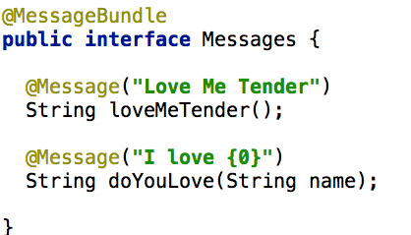
Improved i18n
An interface represents one .properties
The methods represents the keys

Slide 15
Annotations and Code generation
Same pattern as in GWT, but for J2SE
Annotate your code :
@MessageBundle to mark interfaces
represents a ResourceBundle
@Message to mark methods
represents a localisation key
Generate :
.properties file (for ‘en’)
A ResourceBundle for each .properties
Manage other languages out-side your code

Slide 16
Improved i18n benefits
Now you can
Refactor your keys
Maintain the ‘en’ in Java
Never change a .properties file for default locale
And use it with other libs:
GWT (done on github)
Even JQuery, Dojo, CoffeeScript (planned)

Slide 17
Extend this pattern for Multi-display

Slide 18
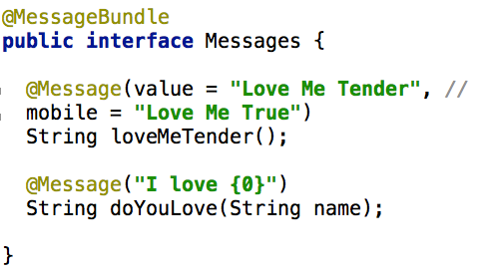
Extended to displays
Add a mobile support in the @Message annotation

Slide 19
Extended to displays
We extend this pattern for displays
One ResourceBundle by display
All driven by @MessageBundle annotation
Keep the rest generated

Slide 20
APT to generate .properties and ResourceBundle classes from annotations

Slide 21
Behind the scene How APT works

Slide 22
APT basics
APT (Annotation Processing Tool)
Kind of old-school pre-processing
But not on the file it-self
No runtime overload
Based on annotations in source code

Slide 23
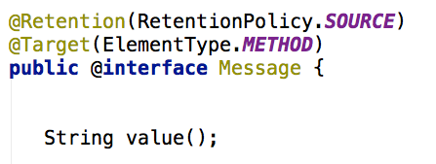

APT annotations
Use @Retention, @Target

Slide 24
APT Processors
javax.annotation.processing.Processor
Code parsing similar to Reflection
No need for compiled code
Some limitations
2 key elements :
@SupportedAnnotationTypes to declare the matching annotations
FileObject : the future generated file

Slide 25
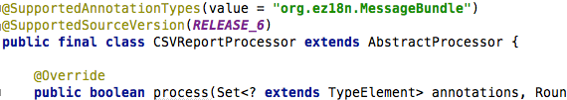
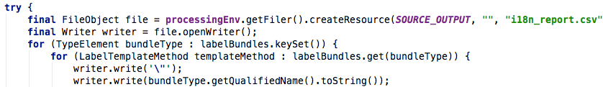
Processor code sample
Processor declaration
Use a FileObject to generate the content

Slide 26
Similarities with java.lang.reflect
Java.lang.reflect | Javax.annotation.processing
java.lang.Class | TypeElement
Constructor | ExecutableElement
Field, Parameter | VariableElement
Method | ExecutableElement
java.lang.Package | PackageElement
NO Class.newInstance()
NO instanceOf, NO isAssignable()
NO getConstructor, getMethod, …
Weak inhritance management

Slide 27
APT Usage
Command line
javac
-cp $CLASSPATH
-proc:only
-encoding UTF-8
-processor $PROCESSOR
-d $PROJECT_HOME\target\classes
-s $PROJECT_HOME\target\generated-sources\apt
-sourcepath $SOURCE_PATH
-verbose
$FILES
-proc:none
Processors fqcn list
Optional

Slide 28
APT Usage
Maven integration
Maven-processor-plugin
Ant integration
javac
IDE integration
Extend the J2SE compilation options

Slide 29
APT usages
Generate required repetitive code :
Not always possible at runtime
Unit tests, JMX declarations
Utility code with coverage and debug
Build your reports on your code
Your Metrics without runtime overload
Even fail the build if you want !

Slide 30
One or Two phase compilation
One phase
APT runs during the compilation
Genarated code is directly produced as bytecode (.class)
Harder to debug (no .java created)
Two phases
javac with proc:only then with proc:none
Creates .java files in the sourcepath
Not really supported by IDEs, ok with maven.

Slide 31
Caveats of APT
Beware of the “Generate” golden hammer
generate needed code
APT Processors can be tricky:
hard to test / maintain
bad error management (hidden errors !)
Not really (well) documented
No built in templating mechanism
Enforced file path creation
Beware of maven // builds
javac is not thread safe

Slide 32
Sample
Slides Gilles

Slide 33
Summary
Effective Content Display
Multi device & languages
Labels
Layout & images
Clean code
Strong Quality
Easy Maintenance
with APT Tooling
APT Engine
APT Processors
Generate technical code
Generate reports
Generate Helpers
based on i18n
@Message
@MessageBundle
https://github.com/dbaeli/ez18n

Slide 34
How to sell APT
APT parses the source code to generate
Java Files & .class, Reports (.csv, …)
Build log informations or even build failures
It allows you to have a source level DSL
Annotate your code
Generate the plumbing
Compile / Debug the real code

Slide 35
Modern i18n future
ez18n project on GitHub
Sample of i18n with annotations
Real life usage of APT
If you think there is room for a JSR
Please tell us.

Slide 36


Ez18n is on GitHub. Just fork it !
Thank you !
https://github.com/dbaeli/ez18n

