Slide 1
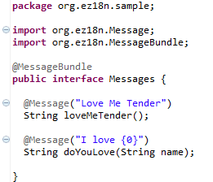
Ez18n - Getting started
@MessageBundle is triggering each processor
@Message is supporting the default localization

Slide 2
Ez18n - Big picture

Slide 3
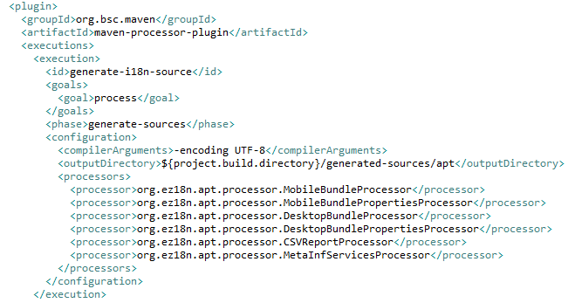
Ez18n - APT chaining
5 APT processors to obtain the default pattern
Optional CSV file for analysis/tooling

Slide 4
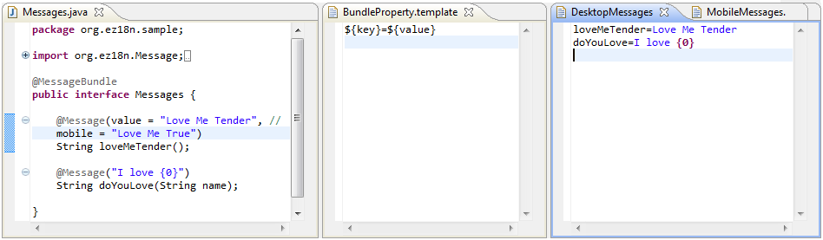
From Messages to DesktopMessages.properties
One property file per interface with @MessageBundle
One property entry per method with @Message

Slide 5
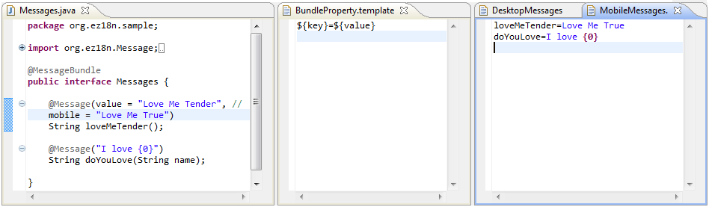
From Messages to MobileMessages.properties
Another property file is generated for the mobile content
If @Message#mobile is empty, the @Message#value is used as fallback

Slide 6
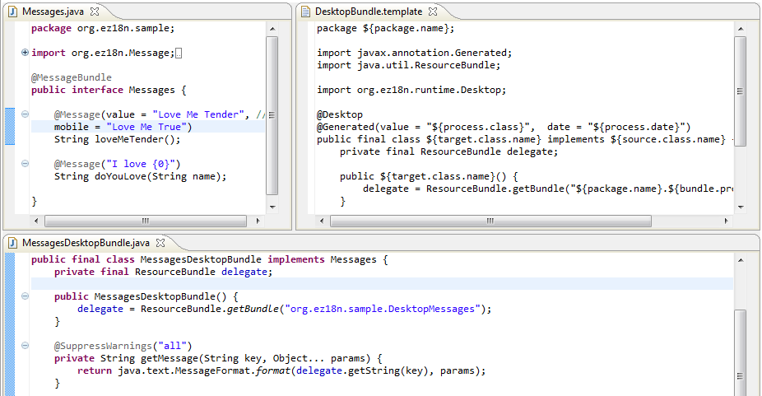
From Messages to MessagesDesktopBundle.java (1/2)

Slide 7
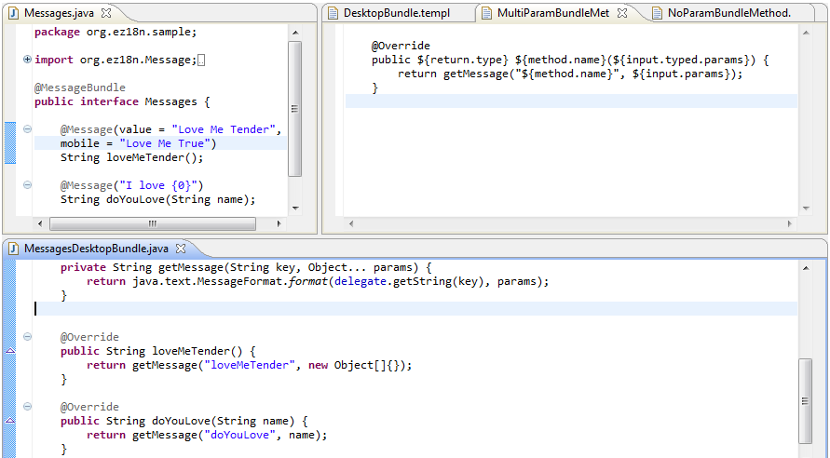
From Messages to MessagesDesktopBundle.java (2/2)

Slide 8
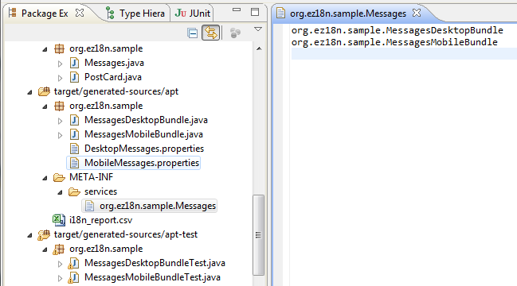
From Messages to META-INF/services/org.ez18n.sample.Messages
Using META-INF/services to inject the mobile & desktop implementation
The two implementation could be filtered at runtime using annotations and ServiceLoader
@Mobile
@Desktop

Slide 9
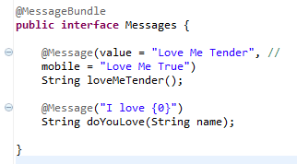


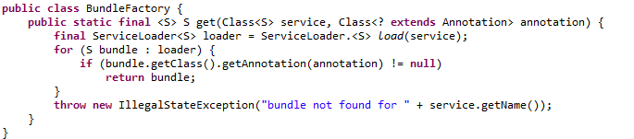
A factory for the Messages implementations
Using java.util.ServiceLoader to inject the interface with @MessageBundle
@Desktop and @Mobile used to filter the injection result

Slide 10
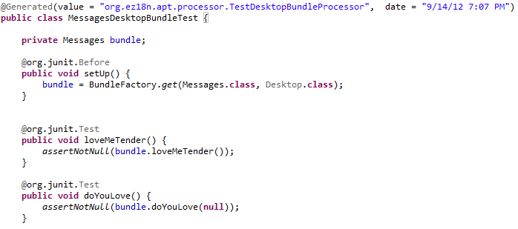
Client code sample with JUnit
Some basic JUnit test using the API
The unit tests are generated using APT too ☺
BundleFactory.get(…) usage in the test @Before to retrieve the bundle implementation

Slide 11


Ez18n - Summary
Maven
Javac & APT

