Slide 1
Multi-device Content Display & Smart Use of Annotation Processing
@gdigugli
@dbaeli

Slide 2
Speakers
@dbaeli
@gdigugli
Java developer since 1999
R&D Team Mentor at
Coder, DevOps, Agile Coach
From idea to production
eXo Platform
VP Quality
Java developer since 1999
Software architect at
ILOG - IBM
2D graphic toolkit
Rule engine
Prima-Solutions
Services platform for J2EE
Domain models code generators

Slide 3
Let’s talk about visible quality
Effective Content Display

Slide 4


The case
Effective Content Display
Multi device & languages
Labels
Layout & images
Clean code
Strong Quality
Easy Maintenance
with APT Tooling
APT Engine
APT Processors
Generate technical code
Generate reports
Generate Helpers
based on i18n
Message
@MessageBundle
https://github.com/dbaeli/ez18n

Slide 5
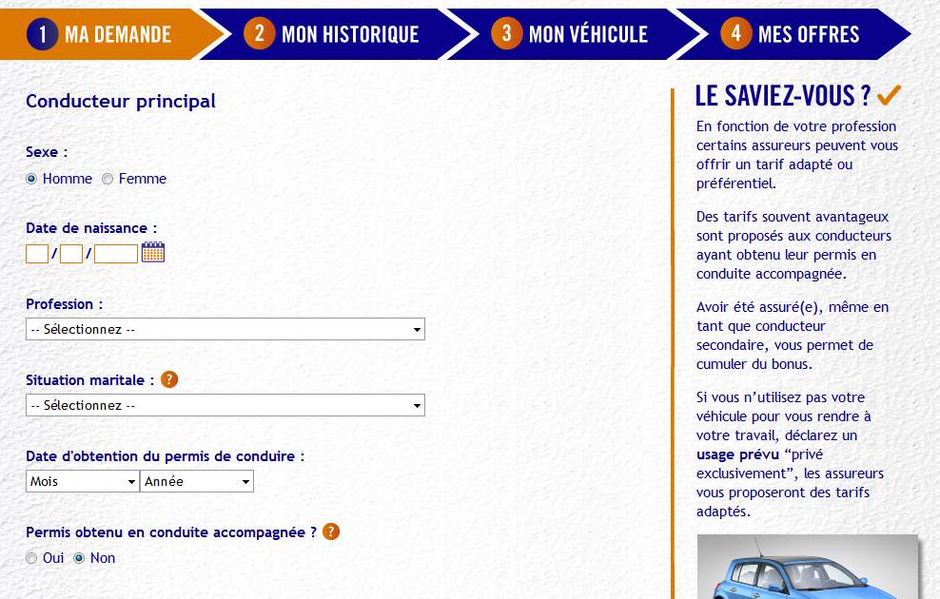
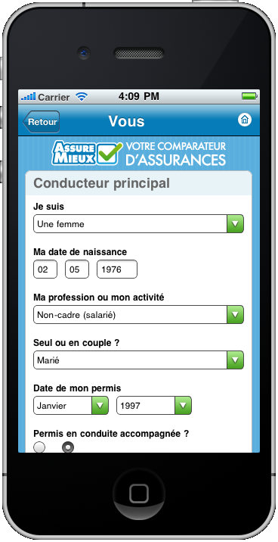
mobile et desktop

Slide 6
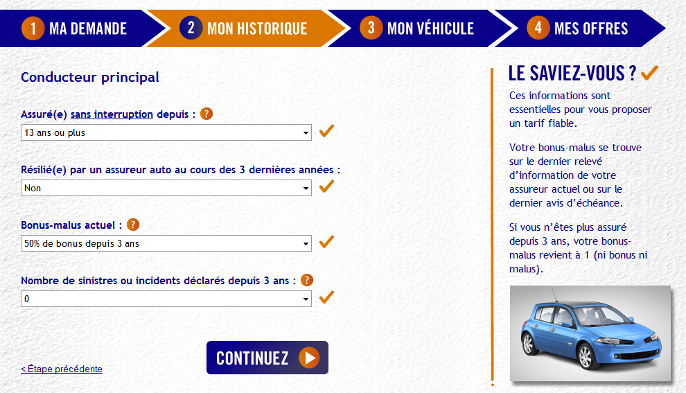

mobile et desktop

Slide 7
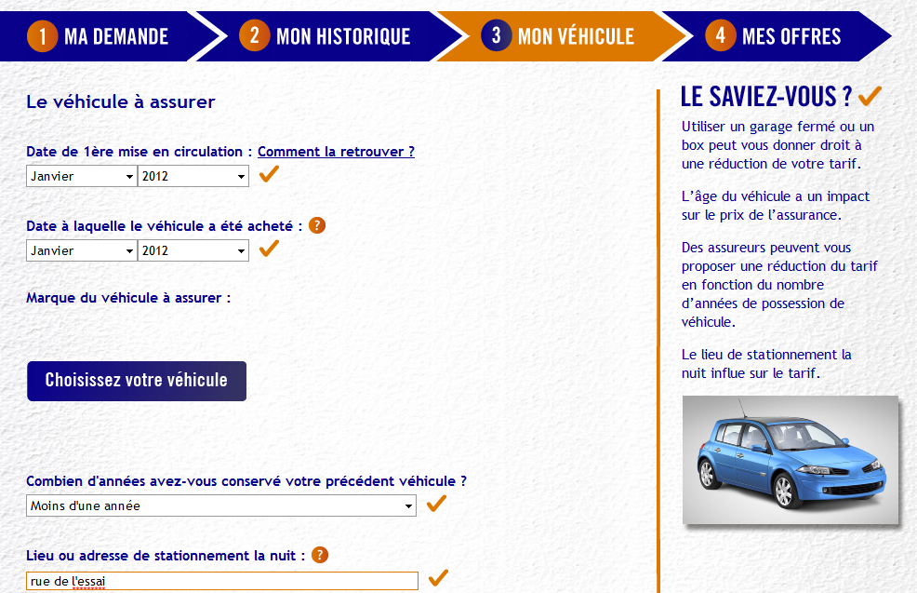
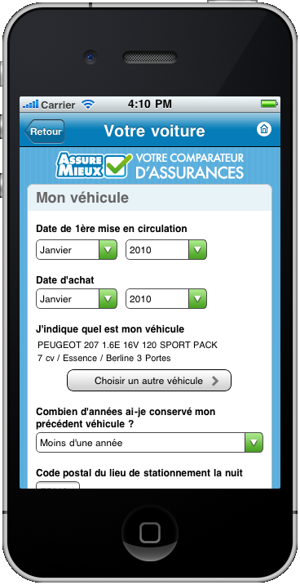
mobile et desktop

Slide 8
Java i18n pattern
Can help to :
Dynamically bind the content (ResourceBundle)
Texts obviously
But also CSS and images
The keys :
java.util.ResourceBundle : for .properties reading
java.util.MessageFormat : tiny templating

Slide 9
ResourceBundle
java.util.ResourceBundle
The .properties loader for a given Locale
java.util.Locale
Object representing the language to use
Naming convention for the storage
Messages_en_EN.properties
Language
Country

Slide 10


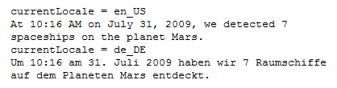
Java.util.MessageFormat
Tiny templating
Processes a list of parameters
Date, numbers are formatted according to the Locale
Options, conditionnal values easy to use
http://docs.oracle.com/javase/tutorial/i18n/format/messageFormat.html

Slide 11
.properties management
Low quality control
Keys are strings in the code
Poor IDE support
No idea of unused keys
No clue of wrong keys
Forces you to maintain two files in sync
key declaration / value in .properties
Key usage in the .java files

Slide 12
Modernized i18n
With interfaces and methods
The interface represent one .properties
The methods the keys (with params)
An annotation on methods for the ‘en’ value
Then code generation
Generate .properties
Generate the ResourceBundle

Slide 13
Modernized i18n
Now you can
Refactor your keys
Maintain the ‘en’ in Java
Never change a .properties file for default locale
And use it in your JavaScript :
Support for GWT (done on github)
JQuery, Dojo, CoffeeScript planned

Slide 14
Two annotations
Two annotations to mark the content to generate :
@MessageBundle to mark interfaces
represents a ResourceBundle
@Message to mark methods
➔ represents a localisation key

Slide 15
Extended to displays
We extend this pattern for displays
Here we need Desktop / Mobile
One ResourceBundle by display
All driven by @MessageBundle annotation
All the rest is generated

Slide 16
Behind the scene : How APT works Ideas of when to use it

Slide 17
APT basics :
APT (Annotation Processing Tool)
Kind of old-school pre-processing
But not on the file it-self
No runtime overload
Annotations in source code
@Retention(RetentionPolicy.SOURCE)

Slide 18
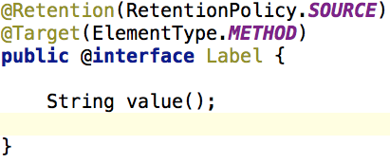
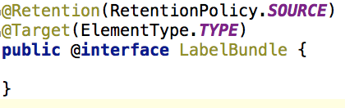
Annotation code samples
Declare Annotations on elements to parse.

Slide 19
APT Processors
javax.annotation.processing.Processor
Code parsing similar to Reflection
No need for compiled code
Some limitations
2 key elements :
@SupportedAnnotationTypes to declare the matching annotations
FileObject : the future generated file

Slide 20
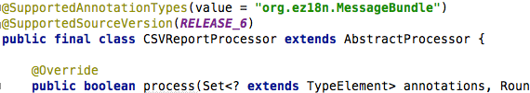
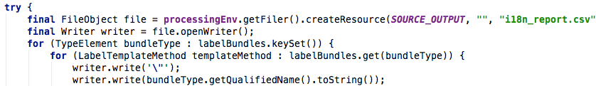
Processor code sample
Processor declaration
Use a FileObject to generate the content

Slide 21
Similarities with java.lang.reflect
Java.lang.reflect | Javax.annotation.processing
java.lang.Class | TypeElement
Constructor | ExecutableElement
Field, Parameter | VariableElement
Method | ExecutableElement
java.lang.Package | PackageElement
NO Class.newInstance()
NO instanceOf, NO isAssignable()
NO getConstructor, getMethod, …
Weak inhritance management

Slide 22
APT Usage
Command line
javac
-cp $CLASSPATH
-proc:only
-encoding UTF-8
-processor $PROCESSOR
-d $PROJECT_HOME\target\classes
-s $PROJECT_HOME\target\generated-sources\apt
-sourcepath $SOURCE_PATH
-verbose
$FILES
-proc:none
Processors fqcn list
Optional

Slide 23
APT Usage
Maven integration
Maven-processor-plugin
Ant integration
javac
IDE integration
Extend the J2SE compilation options

Slide 24
APT works better with:
Dependency Injection
java.util.ServiceLoader (META-INF/services)
JEE injection, Spring, Guice, …
Templating engine
Generate java files (or others)
A single class one borrowed from ant
Your Imagination !

Slide 25
One or Two phase compilation
One phase
APT runs during the compilation
Genarated code is directly produced as bytecode (.class)
Harder to debug
Two phases
javac with proc:only then with proc:none
Adding generated files in the sourcepath
Not really standard for maven, IDEs

Slide 26
Interesting APT usages :
Generate required repetitive code :
Not always possible at runtime
Unit tests, JMX declarations
Utility code with coverage and debug
Build your reports on your code
Your Metrics without runtime overload
Even fail the build if you want !

Slide 27
Caveats of APT
Beware of the “Generate” golden hammer
generate needed code
APT Processors can be tricky:
hard to test / maintain
bad error management (hidden errors !)
Not really (well) documented
No built in templating mechanism
Enforced file path creation
Beware of maven // builds
javac is not thread safe

Slide 28
Sample
Slides Gilles

Slide 29
Summary
Effective Content Display
Multi device & languages
Labels
Layout & images
Clean code
Strong Quality
Easy Maintenance
with APT Tooling
APT Engine
APT Processors
Generate technical code
Generate reports
Generate Helpers
based on i18n
Message
@MessageBundle
https://github.com/dbaeli/ez18n

Slide 30
Modern i18n : ez18n
@Message annotation to declare a message !
The rest is provided
Just use it
Room for a JSR ?

Slide 31
APT summary
APT parses the source code to generate
Java Files & .class
Reports (.csv, …)
Build log informations or even build failures
Do not hesitate to use it !
Explain it to your team

Slide 32
Build a DSL with annotations
Annotation to describe a complex pattern
For example : MBeans en ajoutant des méthodes de moyenne ou de dérivée en fonction du temps sur les sondes primitives
Le code client référence directement le code généré
????

Slide 33
Ez18n is on GitHub. Just fork it !
https://github.com/dbaeli/ez18n

