Slide 1
Multi-device Content Display & Smart Use of Annotation Processing
@gdigugli
@dbaeli

Slide 2
Speakers
@dbaeli
@gdigugli
Java developer since 1999
R&D Team Mentor at
Coder, DevOps, Agile Coach
From idea to production
eXo Platform
VP Quality
Java developer since 1999
Software architect at
ILOG - IBM
2D graphic toolkit
Rule engine
Prima-Solutions
Services platform for J2EE
Domain models code generators

Slide 3
Let’s talk about visible quality
Effective Content Display

Slide 4


The case
Effective Content Display
Multi device & languages
Labels
Layout & images
Clean code
Strong Quality
Easy Maintenance
with APT Tooling
APT Engine
APT Processors
Generate technical code
Generate reports
Generate Helpers
based on i18n
Message
@MessageBundle
https://github.com/dbaeli/ez18n

Slide 5
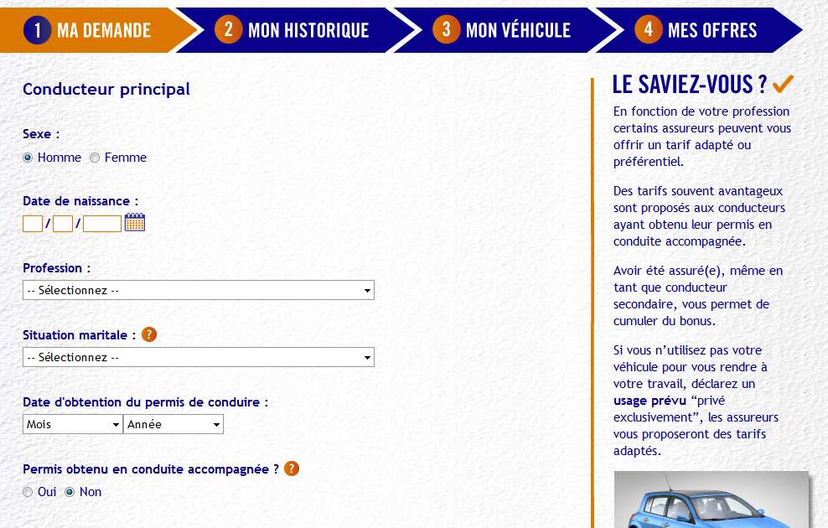
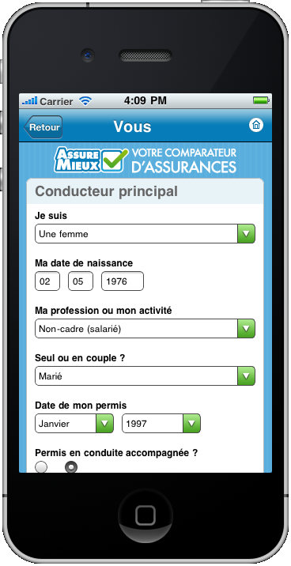
mobile et desktop

Slide 6
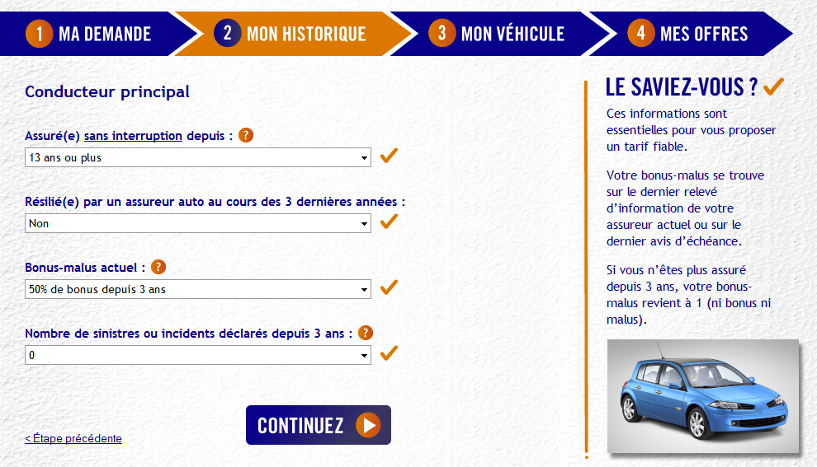
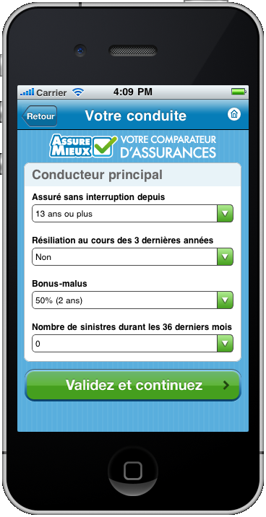
mobile et desktop

Slide 7
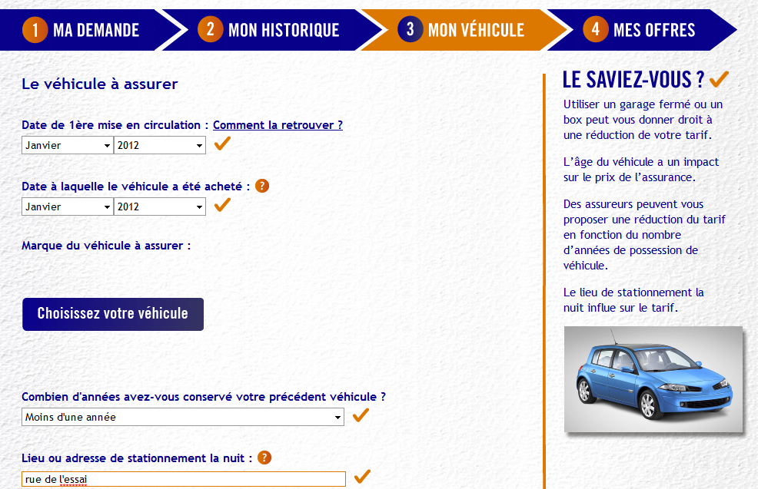
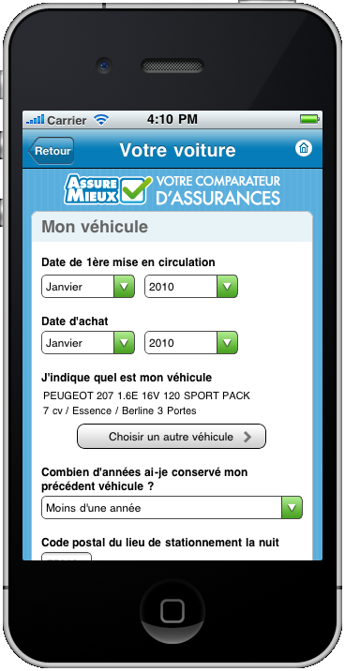
mobile et desktop

Slide 8
Java i18n pattern
Java provides:
java.util.ResourceBundle : for .properties reading
java.util.MessageFormat : for small templating
Let’s use that for :
Dynamically bind the content (ResourceBundle)
For labels obviously
But also CSS and images binding

Slide 9
ResourceBundle
java.util.ResourceBundle
La classe qui charge les fichiers properties en fonction de la locale (par défaut ou en paramètre)
java.util.Locale
Object to declare
Naming convention for the storage
Messages_en_EN.properties
Language
Country

Slide 10


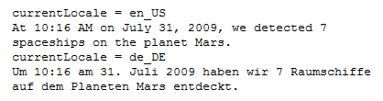
Java.util.MessageFormat
Inclure les « formats » dans le ResourceBundle
Oblige à manipuler un MessageFormat pour évaluer l’expression en passant ses paramètres via un tableau
Gère automatiquement le formatage des paramètres en fonction de la locale (nombre, date)
Pluralisation, paramètre optionnels …
http://docs.oracle.com/javase/tutorial/i18n/format/messageFormat.html

Slide 11
.properties Hell !
Keys are strings in the code
No IDE control
Absolutely no quality control
Non used keys
Wrong binding
Two files for key declaration / default value

Slide 12
Modern i18n
One class Messages.java
Each Label with @Message annotation
Interact only with Java
Refactoring, Usage are now built in
Other .properties
Generate the .properties and the ResourceBundle

Slide 13
And then …
Let’s extend this pattern for display
Here we need Desktop / Mobile
One ResourceBundle by display
All driven by Messages.java
Generate all the rest

Slide 14
Smart use of APT
Annotate i18n keys in Java
Work in your main language
Generate the reference files
No more .properties managed in source code
Integrate new versions at runtime
New languages and layouts are likes plugins

Slide 15
Behind the scene : How APT works Ideas of when to use it

Slide 16
APT basics :
APT (Annotation Processing Tool)
Kind of old-school pre-processing
But not on the file it-self
No runtime overload
Annotations in source code
@Retention(RetentionPolicy.SOURCE)

Slide 17
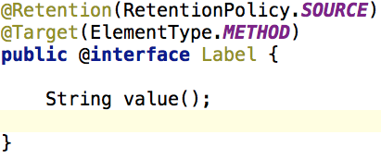
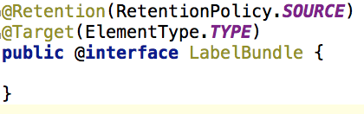
Annotation code samples
Declare Annotations on elements to parse.

Slide 18
APT Processors
javax.annotation.processing.Processor
Code parsing similar to Reflection
No need for compiled code
Some limitations
2 key elements :
@SupportedAnnotationTypes to declare the matching annotations
FileObject : the future generated file

Slide 19

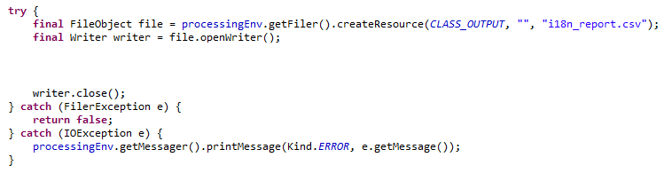
Processor code sample
Processor declaration
Use a FileObject to generate the content

Slide 20
Similarities with java.lang.reflect
Java.lang.reflect | Javax.annotation.processing
java.lang.Class | TypeElement
Constructor | ExecutableElement
Field, Parameter | VariableElement
Method | ExecutableElement
java.lang.Package | PackageElement
NO Class.newInstance()
NO instanceOf, NO isAssignable()
NO getConstructor, getMethod, …
Weak inhritance management

Slide 21
APT Usage
Command line
javac
-cp $CLASSPATH
-proc:only
-encoding UTF-8
-processor $PROCESSOR
-d $PROJECT_HOME\target\classes
-s $PROJECT_HOME\target\generated-sources\apt
-sourcepath $SOURCE_PATH
-verbose
$FILES
-proc:none
Processors fqcn list
Optional

Slide 22
APT Usage
Maven integration
Maven-processor-plugin
Ant integration
javac
IDE integration
Extend the J2SE compilation options
Dedicated builder (example eclipse ?)

Slide 23
APT works better with:
Dependency Injection
java.util.ServiceLoader (META-INF/services)
JEE injection, Spring, Guice, …
Templating engine
Generate java files (or others)
A single class one borrowed from ant
Your Imagination !

Slide 24
One or Two phase compilation
One phase
APT runs during the compilation
Genarated code is directly produced as bytecode (.class)
Harder to debug
Two phases
javac with proc:only then with proc:none
Adding generated files in the sourcepath
Not really standard for maven, IDEs

Slide 25
Interesting APT usages :
Generate required repetitive code :
Not always possible at runtime
Unit tests, JMX declarations
Utility code with coverage and debug
Build your reports on your code
Your Metrics without runtime overload
Even fail the build if you want !

Slide 26
Caveats of APT
Beware of the “Generate” golden hammer
generate needed code
APT Processors can be tricky:
hard to test / maintain
bad error management (hidden errors !)
Not really (well) documented
No built in templating mechanism
Enforced file path creation
Beware of // builds with maven

Slide 27
Sample
Slides Gilles

Slide 28
The case
Effective Content Display
Multi device & languages
Labels
Layout & images
Clean code
Strong Quality
Easy Maintenance
with APT Tooling
APT Engine
APT Processors
Generate technical code
Generate reports
Generate Helpers
based on i18n
Message
@MessageBundle
https://github.com/dbaeli/ez18n

Slide 29
!!! APT rocks !!!!
APT parses the source code
APT generates :
Java Files & .class
Reports (.csv, …)
Build log informations or even build failures

Slide 30
!!! ez18n !!!!
@Message annotation to declare a message !
The rest is provided
Just use it
Room for a JSR ?

Slide 31
Ez18n is on GitHub. Just fork it !
https://github.com/dbaeli/ez18n

Slide 32
Pattern avec injection – je fais un framework
Annoter des beans ou des interfaces
Générer les implémentations ou les proxy
Injecter les implémentations
Générer les descripteurs pour le framework d’injection ou utiliser un classpath scanneur
Le code client ne doit pas avoir de références sur le code généré
Possibilité de mixer le code généré avec des annotation interprétées à runtime
Utiliser les conventions de nommage des classes cibles et la réflection

Slide 33
Analyse et transformation de code vers des fichiers plats
Générer des fichiers pour le tableurs
Cartographie des @Deprecated dans une base de code volumineuse
Données métiers pour de la documentation : les constantes de toutes les énumérations d’un modèle métier
Générer des fichiers properties
Configuration de l’application pour le staging (développement/recette/production)

Slide 34
Build a DSL with annotations
Ajouter des annotations qui paramètrent un pattern complexe
Par exemple: le pattern pour des MBeans en ajoutant des méthodes de moyenne ou de dérivée en fonction du temps sur les sondes primitives
Le code client référence directement le code généré
Le code généré ne peut pas être utilisé dans le même module
requière une modularisation soigneuse

