Slide 1
Multi-device Content Display & Smart Use of Annotation Processing
@gdigugli
@dbaeli

Slide 2
Speakers
@dbaeli
@gdigugli
Java developer since 1999
R&D Team Mentor at
Coder, DevOps, Agile Coach
From idea to production
eXo Platform
VP Quality
Java developer since 1999
Software architect at
ILOG - IBM
2D graphic toolkit
Rule engine
Prima-Solutions
Services platform for J2EE
Domain models code generators

Slide 3
Let’s talk about visible quality
Effective Content Display

Slide 4


The case
Effective Content Display
Multi device & languages
Labels
Layout & images
Clean code
Strong Quality
Easy Maintenance
with APT Tooling
APT Engine
APT Processors
Generate technical code
Generate reports
Generate Helpers
based on i18n
Message
@MessageBundle
https://github.com/dbaeli/ez18n

Slide 5
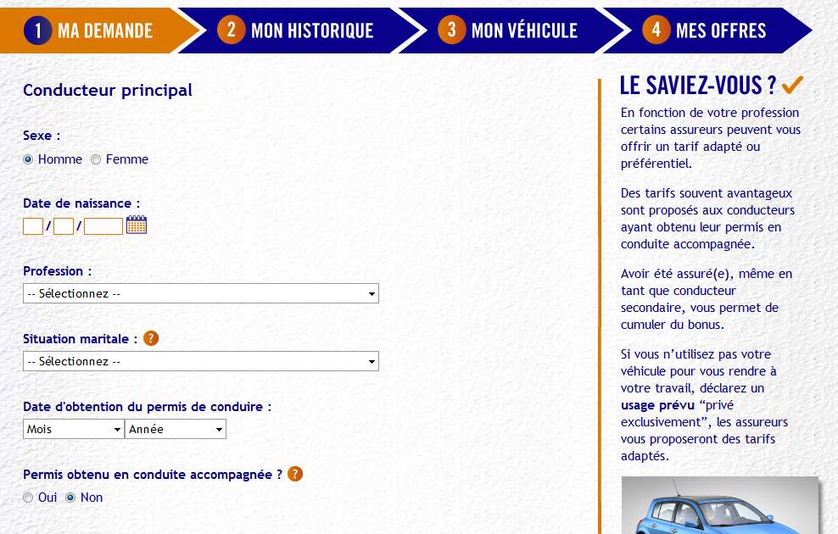
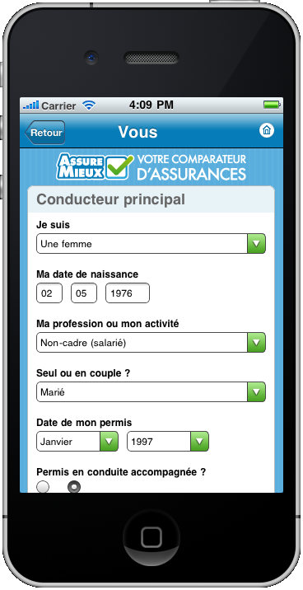
mobile et desktop

Slide 6
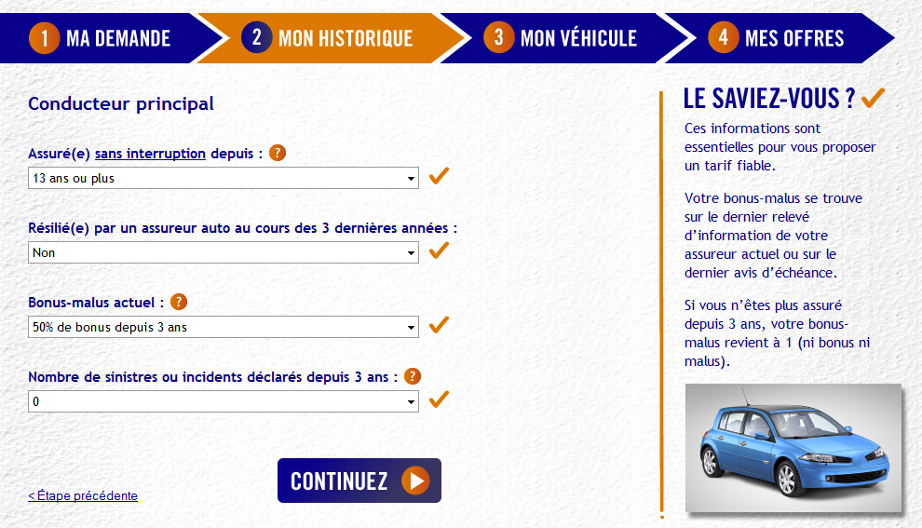
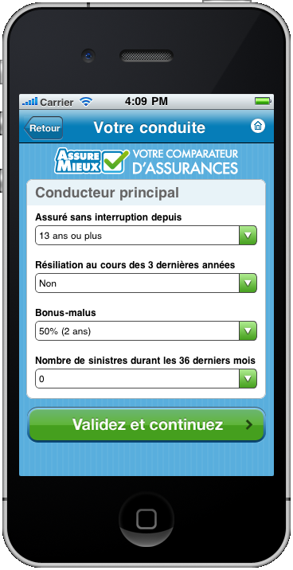
mobile et desktop

Slide 7
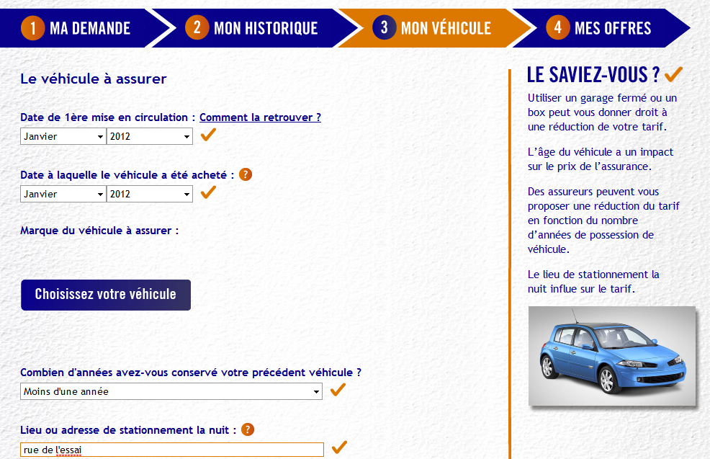
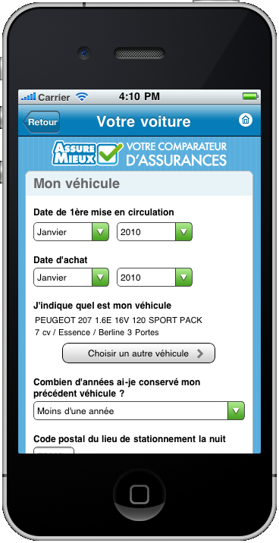
mobile et desktop

Slide 8
How to manage text display ?

Slide 9
Java i18n pattern
The provided tooling for :
Dynamically bind the content (ResourceBundle)
Texts obviously
But also CSS and images
Implementation :
java.util.ResourceBundle : for .properties reading
java.util.MessageFormat : tiny templating

Slide 10
Java.util.ResourceBundle
The .properties loader for a given Locale
Key / Value in .properties
Naming convention for the storage
Messages_en_EN.properties
Language
Country

Slide 11


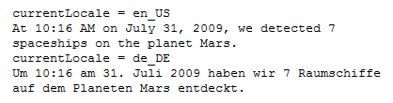
java.util.MessageFormat
Tiny templating
format(“<pattern>”, args)
Date, numbers are formatted according to the Locale
Options, conditional values easy to use

Slide 12
.properties management
Low quality control
Keys are strings in the code
Poor IDE support
No idea of unused keys
No clue of wrong keys
Forces you to maintain two files in sync
key declaration / value in .properties
Key usage in the .java files

Slide 13
Improved i18n

Slide 14
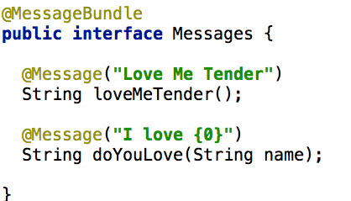
Improved i18n
An interface represents one .properties
The methods represents the keys

Slide 15
Annotations and Code generation
Same pattern as in GWT, but for J2SE
Annotate your code :
@MessageBundle to mark interfaces
represents a ResourceBundle
@Message to mark methods
represents a localisation key
Generate :
.properties file (for ‘en’)
A ResourceBundle for each .properties
Manage other languages out-side your code

Slide 16
Improved i18n benefits
Now you can
Refactor your keys
Maintain the ‘en’ in Java
Never change a .properties file for default locale
And use it with other libs:
GWT (done on github)
Even JQuery, Dojo, CoffeeScript (planned)

Slide 17
And extend this for multi-display

Slide 18
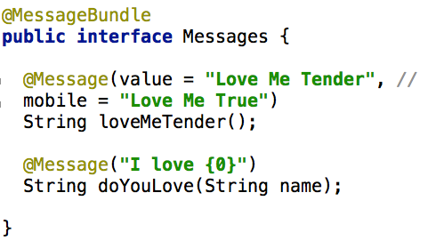
Extended to displays
Add a mobile support in the @Message annotation

Slide 19
Extended to displays
We extend this pattern for displays
One ResourceBundle by display
All driven by @MessageBundle annotation
Keep the rest generated

Slide 20
How to generate .properties and ResourceBundle class from annotations ?

Slide 21
Behind the scene How APT works

Slide 22
APT basics
APT (Annotation Processing Tool)
Kind of old-school pre-processing
But not on the file it-self
No runtime overload
Annotations in source code
@Retention(RetentionPolicy.SOURCE)

Slide 23
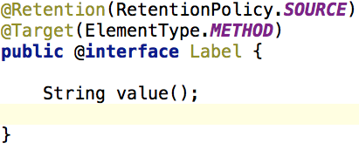
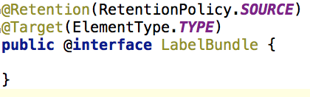
Annotation code samples
Declare Annotations on elements to parse.

Slide 24
APT Processors
javax.annotation.processing.Processor
Code parsing similar to Reflection
No need for compiled code
Some limitations
2 key elements :
@SupportedAnnotationTypes to declare the matching annotations
FileObject : the future generated file

Slide 25
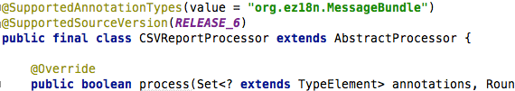
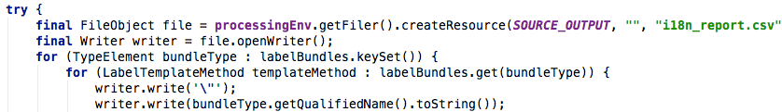
Processor code sample
Processor declaration
Use a FileObject to generate the content

Slide 26
Similarities with java.lang.reflect
Java.lang.reflect | Javax.annotation.processing
java.lang.Class | TypeElement
Constructor | ExecutableElement
Field, Parameter | VariableElement
Method | ExecutableElement
java.lang.Package | PackageElement
NO Class.newInstance()
NO instanceOf, NO isAssignable()
NO getConstructor, getMethod, …
Weak inhritance management

Slide 27
APT Usage
Command line
javac
-cp $CLASSPATH
-proc:only
-encoding UTF-8
-processor $PROCESSOR
-d $PROJECT_HOME\target\classes
-s $PROJECT_HOME\target\generated-sources\apt
-sourcepath $SOURCE_PATH
-verbose
$FILES
-proc:none
Processors fqcn list
Optional

Slide 28
APT Usage
Maven integration
Maven-processor-plugin
Ant integration
javac
IDE integration
Extend the J2SE compilation options

Slide 29
APT works better with:
Dependency Injection
java.util.ServiceLoader (META-INF/services)
JEE injection, Spring, Guice, …
Templating engine
Generate java files (or others)
A single class one borrowed from ant
Your Imagination !

Slide 30
One or Two phase compilation
One phase
APT runs during the compilation
Genarated code is directly produced as bytecode (.class)
Harder to debug
Two phases
javac with proc:only then with proc:none
Adding generated files in the sourcepath
Not really standard for maven, IDEs

Slide 31
Interesting APT usages :
Generate required repetitive code :
Not always possible at runtime
Unit tests, JMX declarations
Utility code with coverage and debug
Build your reports on your code
Your Metrics without runtime overload
Even fail the build if you want !

Slide 32
Caveats of APT
Beware of the “Generate” golden hammer
generate needed code
APT Processors can be tricky:
hard to test / maintain
bad error management (hidden errors !)
Not really (well) documented
No built in templating mechanism
Enforced file path creation
Beware of maven // builds
javac is not thread safe

Slide 33
Sample
Slides Gilles

Slide 34
Summary
Effective Content Display
Multi device & languages
Labels
Layout & images
Clean code
Strong Quality
Easy Maintenance
with APT Tooling
APT Engine
APT Processors
Generate technical code
Generate reports
Generate Helpers
based on i18n
@Message
@MessageBundle
https://github.com/dbaeli/ez18n

Slide 35
Modern i18n : ez18n
@Message annotation to declare a message !
The rest is provided
Just use it
Room for a JSR ?

Slide 36
APT Summary
APT parses the source code to generate
Java Files & .class
Reports (.csv, …)
Build log informations or even build failures
Do not hesitate to use it !
Explain it to your team

Slide 37
Build a DSL with annotations
Annotation to describe a complex pattern
For example : MBeans en ajoutant des méthodes de moyenne ou de dérivée en fonction du temps sur les sondes primitives
Le code client référence directement le code généré
????

Slide 38
Ez18n is on GitHub. Just fork it !
https://github.com/dbaeli/ez18n

