Slide 1
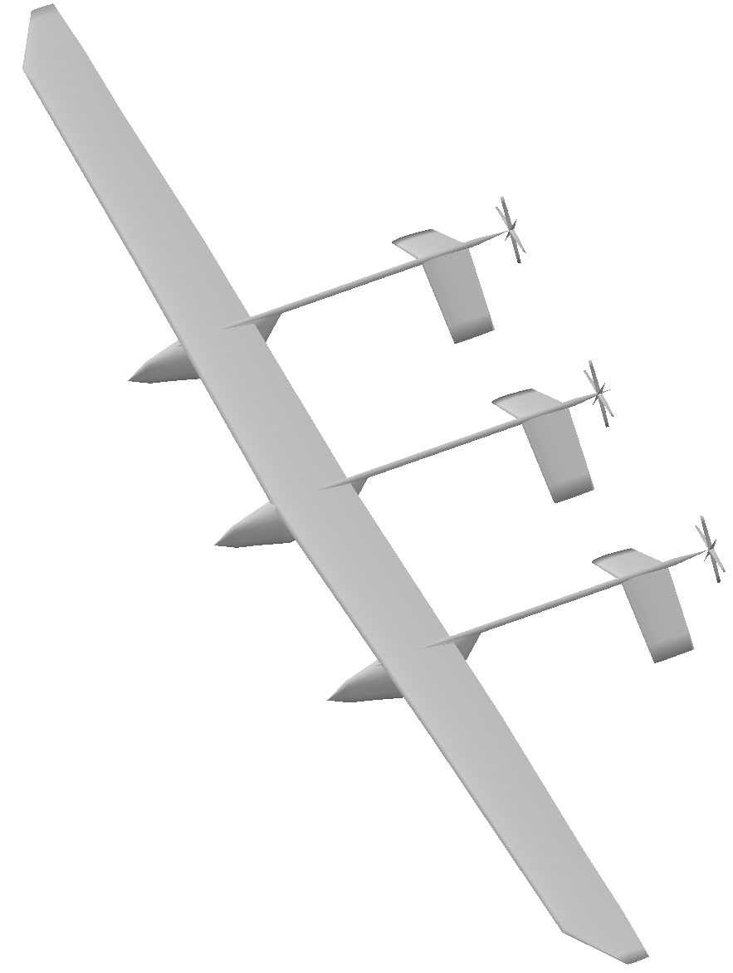
Coupled Aero­-Structural-Propulsive­ Design of an Ultra­Light, Highly Flexible, Human Powered Aircraft
PI: Justin Gray
9/3/14
Team Members/Org
Jeff Chin, GRC
Partner Name and Sector:
Kevin Reynolds, NASA Ames
Starr Ginn, NASA Armstrong
Juan Alonso, Stanford
Graeme Kennedy, Georgia Tech
Todd Reichert, AeroVelo Inc.
(Aircraft Design, Structural Optimization, Human Powered Vehicles)
Notes:
Tailor red text to your pursuit. It is suggested that blue text be left as is (unless it is not applicable to your pursuit).

Slide 2



Project Snapshot
Core competency: Propulsion Systems analysis, Multidisciplinary Design Analysis and Optimization
Description of proposed partnership
NASA will team up with AeroVelo Inc, Stanford, and Georgia Tech to design a human powered aircraft for the Kremer Marathon Challenge. The design will be done using OpenMDAO to couple high-fidelity CFD and FEA tools into a non-linear aerostructural aircraft model. This model will be used by AeroVelo to complete the detailed design and the build and fly the actual aircraft.
Proposal due by: September 8th, 2014. Partners need an answer ASAP.
Duration: 10/30/2014 – 10/30/2015
Total Dollar Value: 750k
Reimbursement Type: ARMD Seedling Fund

Slide 3

Partnership Responsibilities
GRC contributions
1 FTE, .25 WYE
LTA: Justin Gray and Jeff Chin. Propulsion Systems Analysis and MDAO.
Partner contributions
NASA Ames will handle the propeller design
Stanford will handle the aerodynamic modeling
Georgia Tech will handle the structural modeling
AeroVelo will perform the detailed design, construction, and actual flight testing for the aircraft. They will be providing ~250k of cost sharing to cover all testing and construction costs.

Slide 4
Benefit to NASA Glenn and/or Agency
Describe why GRC should pursue this work. Examples below.
In 2013 AeroVelo win the Sikorski Prize with their Atlas Human Powered Helicopter. They would like to partner with NASA to design their next human powered aircraft. Successful completion of a major Kremer avaition challenge will bring tremendous positive publicity to NASA and NASA’s MDAO capabilities.
Participation in this effort will give NASA Glenn huge amounts of hands on experience applying MDAO to a real aircraft design effort. This will position us to take the lead in MDAO research going forward.
High altitude, long endurance aircraft are of large commercial interest right now. This proposal will dramatically enhance NASA’s ability to analyze and design these kinds of aircraft, positioning us well to lead research in this emerging field moving forward.
Notes:
AeroVelo won the Sikorski Prize in 2013 for the Atlas Human Powered Helicopter. They have a huge public profile and are want to partner with NASA on their next project. NASA will receive a lot of publicity via this high profile project. Designing a human powered aircraft will give NASA real hands on experience for highly flexible aircraft structures, and an opportunity to participate in a low cost and rapid design process led by experienced engineers at AeroVelo.

Slide 5
Workforce, Facility, or Program Impacts
What, if any, impact is there on existing programs and projects, or other pursuits? If yes, how are they being mitigated?
Program Impact: Justin Gray and Jeff Chin are currently supporting TTT. They will reduce their assignment there during the seedling effort.
Have already discussed potential delaying of low level milestones with Jim Heidemann.
Will look for additional FTE support on lab to backfill the TTT efforts.
Facility Impact: N/A
Workforce Impact: N/A
Other impacts/risks? N/A

Slide 6
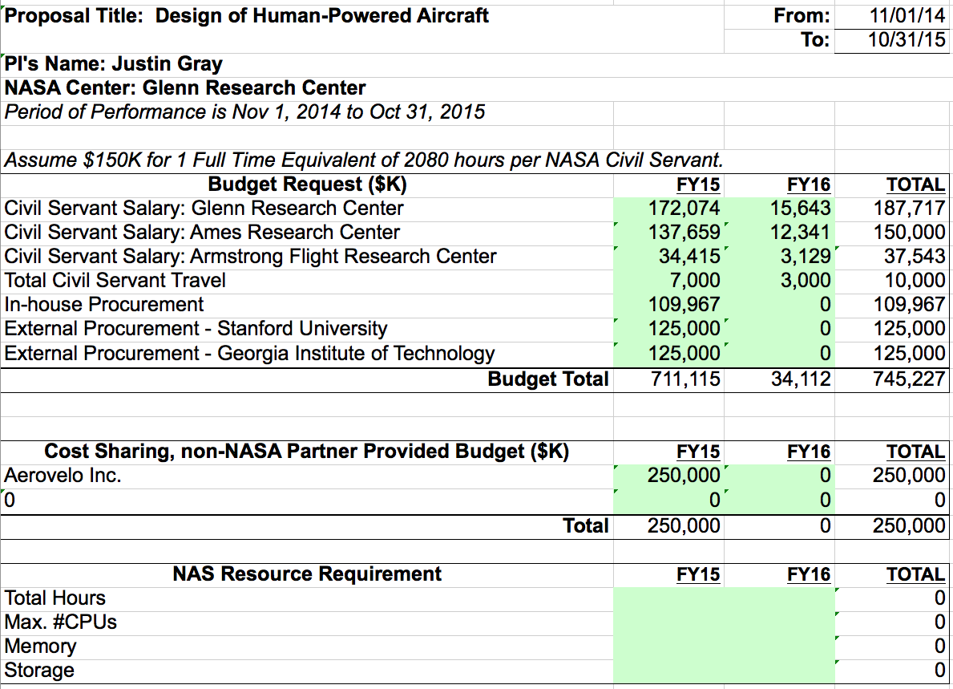

Resource Requirements
AeroVelo is assuming all construction costs for any test articles and for the final aircraft as well.

Slide 7

Nuts and Bolts
Reimbursement Type: ARMD Seedling Award
Proposed Agreement Type: Space Act Award with AeroVelo
EPR: Complted; % Reserves: 10%
SAA abstract required: No. Space Act abstract is required unless proposal is approved
Org/WBS will backing the agreement: LTA. WBS is TBD
Orgs that this has been coordinated with: N/A

Slide 8


Nuts and Bolts
Any feedback informal or formal from HQ? No Feedback from HQ yet. Will go through ARMD seedling award process.
Describe waivers, if any, to CMO: N/A
What IP is involved (both current and expected)? How is the IP protected? All models and data will be released open source. The goal is to gain as wide a dissemination as possible of the results. There is no IP that need to be protected, other than the design of the aircraft. AeroVelo has already elected to release that publically.
Comparison Against Eligibility and Prioritization Criteria:

Slide 9

Other Considerations
Similar efforts in private industry:
There are no similar efforts for human powered aircraft. But there are lots of companies working on HALE aircraft. This work will be directly relevant to them.
Relevant capabilities overlap with other NASA centers:
NASA Ames has an aero-propulsion capability, but they are part of the proposal.
NASA Langley has some aero-structural expertise, but is not heavily working with aero structural optimization.
Is there anything that might be considered newsworthy, controversial, unorthodox or precedent-setting in this proposal partnership? Please describe
Successful completion of a Kremer aviation challenge will bring large amounts of positive publicity to NASA. It will be newsworthy.
Status of Pre-existing or Ongoing Agreements with this Partner: N/A

Slide 10
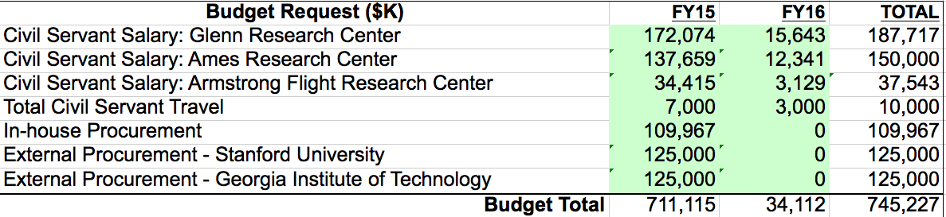
Basic question to be resolved / decision needed by NBB: Should NASA/Center pursue agreement with XX partner under XX conditions described below?
Project Snapshot
Nuts and Bolts
Proposed Project Title: Coupled Aero­-Structural-Propulsive­ Design of an Ultra­Light, Highly Flexible, Human Powered Aircraft
Core Competency: Propulsions Systems Analysis, Multidisciplinary Design Optimziation
Partner: Partner Name, POC and Title
GRC Org/POC/PI: LTA, Justin Gray
Total $: 750k Duration: 10/30/2014 – 10/30/2015
Time Sensitivity: Proposal due by 9/8/2014
Description of proposed partnership: ARMD Seedling fund award to a partnership between NASA Glenn, NASA Ames, NASA Armstrong, Stanford, Georgia Tech, and AeroVelo Inc.
Reimbursement Type: Reimbursable, Partial, Non-reimbursable
Type of Proposed Agreement: (SAA, CRADA, MOU, other) N/A
Has an EPR been completed/validated? N/A What % are the reserves? N/A
Org/WBS backing or funding the agreement: ARMD Seedling Fund
With which orgs has this been coordinated: LTA
Describe waivers, if any, to CMO N/A
Is an SAA abstract required? Why? The proposal will outline all responsibilities of partners. If ARMD award is made, contracts will be signed. No SAA is needed unless award is made.
What IP is involved (both current and expected)? How is the IP protected? If not protected, why? All results released under open source license.
Partnership Responsibilities
Other Considerations
GRC Contributions:
1 FTE, .25 WYE, 100k Procurement
Justin Gray, Jeff Chin. Propulsion systems analysis and MDAO
Partner Contributions:
Ames: 1FTE, Armstrong .25FTE, Stanford 125k, GaTECH 125k.
Nature of feedback received (informal, formal), if any, from HQ: No feedback yet. Will undergo ARMD Seedling review
Is the activity unorthodox, potentially controversial, newsworthy, or precedent setting? Successful completion of the goals of the proposal will result in achieving a major aviation Mileston, the Kremer Marathon Challenge.
Status of Pre-Existing or Ongoing Agreements with this Partner: N/A
Other Factors? N/A
Benefits to GRC and/or Agency: AeroVelo won the Sikorski Prize in 2013 for the Atlas Human Powered Helicopter. They have a huge public profile and are want to partner with NASA on their next project. NASA will receive a lot of publicity via this high profile project. Designing a human powered aircraft will give NASA real hands on experience for highly flexible aircraft structures, and an opportunity to participate in a low cost and rapid design process led by experienced engineers at AeroVelo.
Impacts, Risks, and Mitigation Strategy
Potential risk factors to GRC
TTT project has some low level milestones that will slip if personnel are reassigned to this project.
Mitigation Strategy
Have already discussed with Jim Heidemann, and secured his support

