Slide 1

DriverPass System Analysis
Justin Starr

Slide 2

System Requirements
Schedule Appointments
Take Online Practice Tests
Securely Store Customer Information
System Updates Occur With Minimal User Impact
Notes:
As seen here, we have identified four of the DriverPass System’s Requirements. Because your system seeks to improve student drivers’ scores when they take them for the first time, we incorporated a way for students to access materials from anywhere through a web browser so that they can take practice tests that will help improve their scores when they take their actual driving tests. Ultimately, this will also help build the business and generate a solid revenue stream. We have also incorporated a way for customers to schedule appointments with the DriverPass Office to make it more convenient than having to pick up a telephone and call. The system will also notify the office when any scheduling changes occur.
An essential aspect of the DriverPass System is that it stores information about employees, customers, and drivers. We have ensured that this information is stored in a database with only specific people who will be provided access when necessary.
Another critical function of the system is to perform system updates, including security updates, to ensure the system stays up-to-date and well-protected. We have made sure to schedule these updates during low peak hours so that if users are impacted and unable to access the system during these updates, it will affect the smallest number of users, if any, during these times.

Slide 3
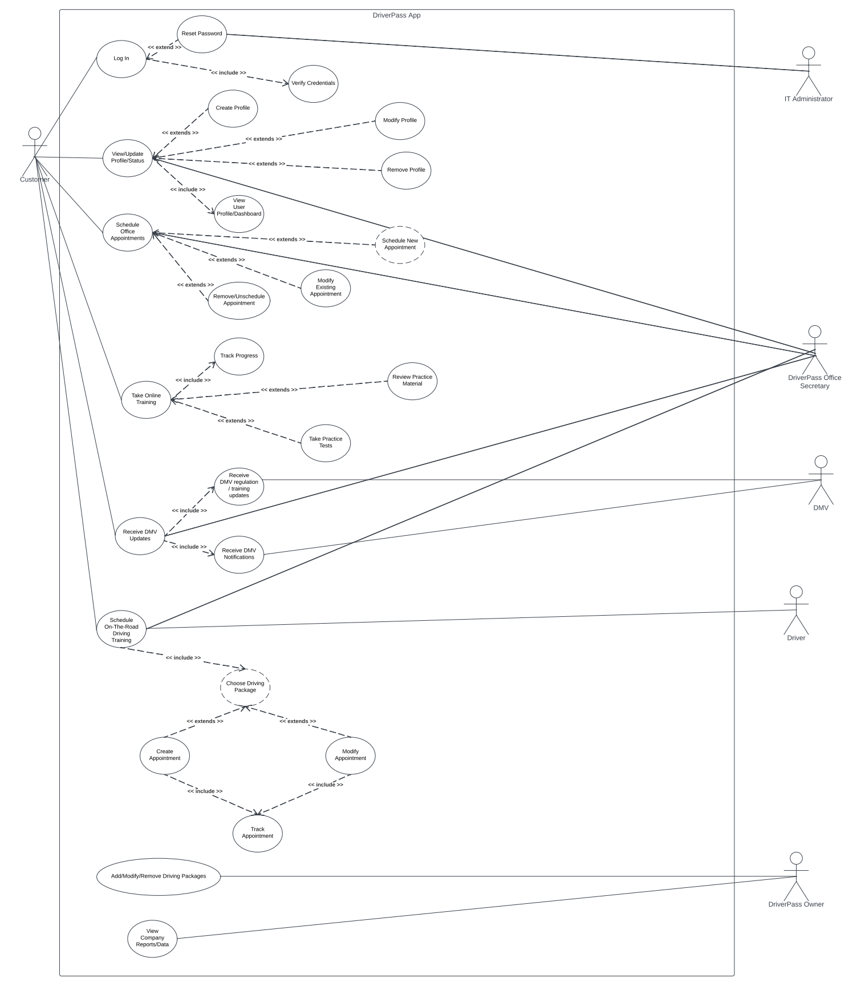
Use Case Diagram
[Insert your use case diagram here.]
Notes:
First, we must identify the DriverPass system as everything within the rectangle. Outside of the rectangle, we see the various users and external systems that interact with the DriverPass system. The different types of users that interact with the system are a Customer, IT Administrator, DriverPass Office Secretary, Drivers, and the Owner of DriverPass. The outside system that also interacts with our system is the DMV (Department of Motored Vehicles).
By identifying all the people/systems who will interact with the DriverPass system, we can ensure that we capture all the requirements of the system’s functionality. This includes a user’s ability to Log In, Verify/Update Profile/Status, Schedule Office Appointments, Take Online Training, Receive DMV Updates, Schedule On-The-Road Training, Add/Modify/Remove Driving Packages, and View Company Reports/Data.
Each of these system capabilities has additional or secondary functionality based on what the user tries to accomplish. For example, when a user Logs In, the system will always verify their credentials; however, it will not always reset the password. Reset passwords will only happen if the user chooses to reset their password. The same principle applies as you move forward through the diagram, where we then see that all system functionality is accounted for.

Slide 4
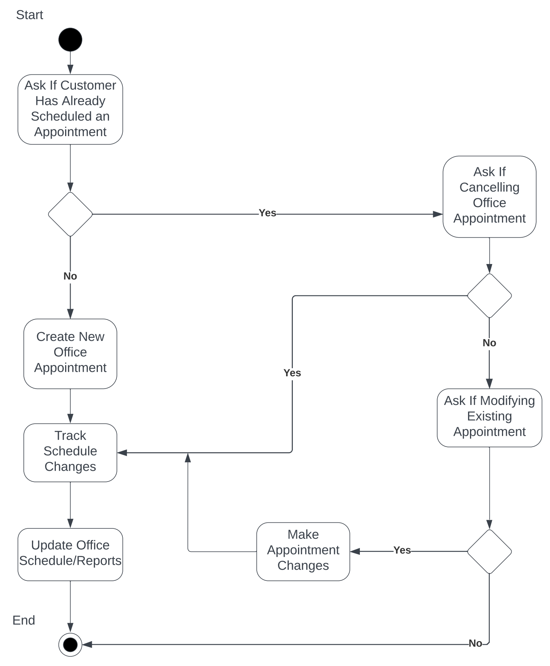
Activity Diagram
[Insert one of your activity diagrams here.]
Notes:
On this slide, we are breaking down one of the system’s previously shown functions that a user is able to perform when and if they choose to.
What we are seeing here is the activity of a user creating, modifying, or canceling an office appointment. Basically, we can see what actions will occur, from start to end, when a user decides they want to take any of these actions. Just as significant, we can see what actions the system is taking, the decisions it makes based on what the user tells the system, and how it should continue to operate until the entire process finishes.
When a customer chooses to Create/Modify/Remove an office appointment, the system will ask the user or check if they already have an office appointment. If they do not already have a scheduled office appointment, they will create a new appointment, the system will track the changes made to the office schedule and update the office schedule associated reports. If the user does have an existing office appointment, the system asks the user if they are canceling their existing appointment. If the user is canceling, the system tracks the schedule changes and updates the office schedule and reports. If the user is not canceling the existing appointment, the system then asks the user if they would like to modify the existing appointment. If they want to, the system makes the appropriate schedule change, tracks the change, and updates the schedule and reports. If the user makes it through the entire process without canceling or modifying the appointment, there is no need to track changes and update the schedule or reports. The system simply finishes the activity.

Slide 5
Security
Role-Based Access
Strict Credentials
Implementation of RESTful API
Continuous Integration with Software/Security Updates
“Brute Force” Notifications
Account Locking
Notes:
First, the entire system is designed to operate based on the type of user that will interact with the system and how much access should be given to each of these different types of users. A customer would not have the same level of access that the DriverPass office secretary will have and so forth.
Secondly, the use of strong passwords, which must be typed precisely as when created, helps minimize the ability of an attacker to gain access to the system. The system will detect how strong a password is when the user creates one and suggest changes to ensure that only strong passwords are created.
Next, the system makes use of additional tools that help ensure that the communication and exchanges of information between a user and the DriverPass system happen securely.
The system has also been designed to receive regularly scheduled software and security updates continuously.
In the event that someone tries to compromise any user account, the system will immediately notify the appropriate DriverPass staff so that they can take the necessary action(s) to prevent unauthorized access.
Similarly, such attempts to gain unauthorized access over a small amount of time will automatically lock the account to prevent unauthorized access. When this happens, the user will be required to contact DriverPass to have their password reset and account unlocked.

Slide 6
System Limitations
Budget
Automation
Hardware Capabilities
Size of Team
Time
Notes:
A primary limitation of the system is its budget. The budget has not been discussed up to this point, and we should address its limitations. It is assumed that DriverPass, based on your requirements, can afford or has budgeted enough money to implement the exact needs of this system design (which is based on your requirements).
Specifically, utilizing resources/tools/software, such as making the system cloud-based, will increase expenditures.
We also want to address the fact that the more automatic the system is, which does make it so that DriverPass does not have to be hands-on with the system all of the time, especially as it concerns security and updates or system maintenance, the higher the budget will need to be.
Similarly, the system design is taking into account that DriverPass affords the system design the opportunity to make use of modern and sophisticated technology capable of enabling the system to run seamlessly.
Additionally, the size of the team needed to complete the project with respect to the desired amount of time to complete the project is highly dependent on DriverPass’s budget. How fast the project needs to be completed is highly dependent on the budget that will be given to this system design.

