Slide 1
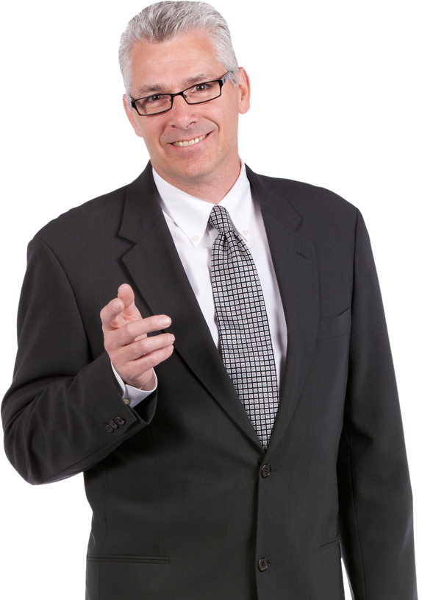

Sample 8
Demographics
Frankie Fit
Age: 50
Location: Fort Worth, Texas
Job Title: Dark Sky Observatory Manager
Education: Associates Degree
Family Status: Married with grown children
“The more we learn about the food we consume, the better choices we can make as consumers to achieve longevity.”
Goals and Tasks
I want to be able to know how healthy the ingredients are in the products I might decide to purchase for consumption
I would like to know if there are alternative products that are healthier compared to the products I scan that are not healthy choices.
I want to like to know more information about where ingredients come from and in what other forms they may be used as in the products I consume.
I would like the app to remember products I like and dislike
Physical, Social, and Technological Environments the App Is Used
Home
Grocery Store
Mobile App Usage
Health Conscious
Exercises

