Slide 1
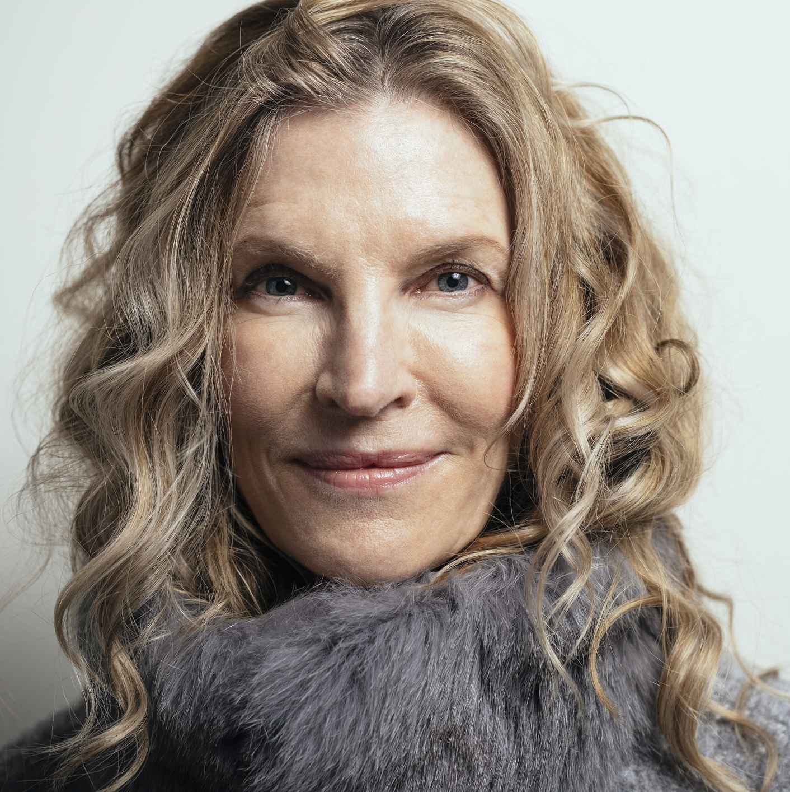

Sample 8
Demographics
Age: 65
Location: Seattle, Washington
Job Title: Retired Educator
Education: BA in Education
Family Status: Married with grown children
Vickie Vegan
Goals and Tasks
While I grocery shop, I would like to be able to scan a product’s barcode and receive information about the product’s ingredients and how healthy they are, also decreasing the amount of time I spend researching products I like or might want to try.
I would like to mark items I have scanned as products I like or dislike for future reference.
I would like to be notified if the product does not fit within a selected diet I or my family is restricted from.
I would like to be able to learn more about the ingredients used in products.
“A healthy family is sacred territory.”
Physical, Social, and Technological Environments the App Is Used
Home
Grocery Store
Mobile App Usage
Health Conscious
Exercises

