Slide 1



Airport Traffic Analytics
Sponsored by: Ruth Contino-Northrop Grumman
Team Planning Presentation
Notes:
Justin - 15 sec

Slide 2
Overview
Conceptual Architecture
System Runtime Diagram
Project Dependencies
Work Completed To Date
Project Priorities
Current Work
Next Steps
Risks
Demo
Notes:
Mitch - 30s

Slide 3
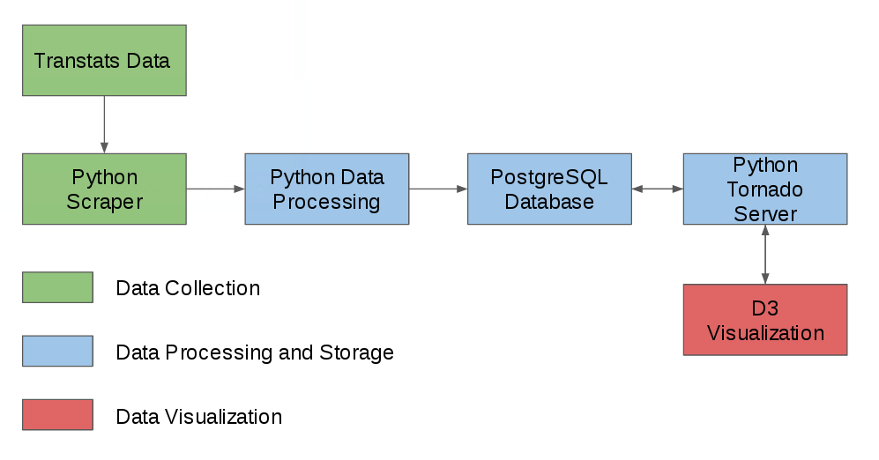
Conceptual Architecture
Pipeline Architecture
Notes:
Justin 1m

Slide 4
System Runtime Diagram
Database
PostgreSQL
Database
Data Processing
UI
Server
Scripts
Query Generation
Dropdown
Lists for UI
Visualization
D3.js/Viz
Prep
Visualization
Client
Notes:
Matt 1m

Slide 5
Project Dependencies
Physical Hardware
Front End Server
D3 Visualization
Data Ingestion
Running Database
DataCollection
Processing /storage
Visualization
Other
Source indicates dependency
Geopy Lat/Long
Predictive Methods
Google Maps API
Notes:
Client access depends on having a running server
Client needs map Data from Google

Slide 6


Work Completed to Date
Research
Visualization (Plotly, D3.js, Tableau, Google Maps API)
Database (PostgreSQL, Cassandra)
Back-End (Tornado)
Development
Python scripts for data acquisition and normalization
Creation and implementation of Tornado web-server
Deployment of remote machine cluster
Creation and implementation of PostgreSQL database
Airport visualization using D3.js
Notes:
Kristen 1m

Slide 7


Project Priorities
High Priority
Create functional API endpoints that the client can access
Serving relevant and requested data to the API endpoints
Low Priority
Expanding model flight data on the client side
Create a permanent server and database running
Notes:
Kristen 30s

Slide 8
Current Work
Research
Further learning of front-end/back-end development
Further learning of D3.js
Further finalization of requirements
Development
Implementing hardware/servers
Unit testing
Further addition of use-cases on project tracker (waffle.io)
Expanding web-application’s HTML/CSS
Adding functionality in addition to airport visualization
Explicit transition from Extreme to Agile methodology
Notes:
Matt 45s

Slide 9



Next Steps
Fall | Focus: Development
Finalize foundational web-application
Add additional functionality (delay colorization, specific airlines, taxiing, routing)
Winter | Focus: Research
Research machine learning
Consider ways of implementation
Spring | Focus: Development
Implement predictive data analysis
Finalize web-application
Create and finalize white-paper report
Notes:
Mitch 20s

Slide 10
Next Steps
Fall | Focus: Development
Finalize foundational web-application
Add additional functionality (delay colorization, specific airlines, taxiing, routing)
Winter | Focus: Research
Research machine learning
Consider ways of implementation
Spring | Focus: Development
Implement predictive data analysis
Finalize web-application
Create and finalize white-paper report
Notes:
Mitch 20s

Slide 11
Next Steps
Fall | Focus: Development
Finalize foundational web-application
Add additional functionality (delay colorization, specific airlines, taxiing, routing)
Winter | Focus: Research
Research machine learning
Consider ways of implementation
Spring | Focus: Development
Implement predictive data analysis
Finalize web-application
Create and finalize white-paper report
Notes:
Mitch 20s

Slide 12
Next Steps
Fall | Focus: Development
Finalize foundational web-application
Add visualization functionality (delay colorization, specific airlines, taxiing, routing)
Winter | Focus: Research
Research machine learning
Consider ways of implementation
Spring | Focus: Development
Implement predictive data analysis
Finalize web-application
Create and finalize white-paper report
Notes:
Mitch 20s

Slide 13


Risks
Managerial Risks
Effective communication
Further refining of requirements
Technical Risks
Learning and research
Use of unknown ML tools and algorithms
Python 2 vs Python 3
External Risks
Finances
Server space
Servers going down
Notes:
Mike 1m

Slide 14
Demo
Notes:
Led by Justin 1m

Slide 15
Questions?
Thank you for listening!
Resources
[1] Icons made by Madebyoliver from www.flaticon.com

