Slide 1
FOSSology: License Analysis
Part I: Why do we need to look at licenses?

Slide 2
What is Open Source Software Licensing?
Basics about Licensing
Obligations
Restrictions
Rights
Example for GPL version 2.0 (selection)
Obligations
Include original source, copyrights
Include license
Restrictions
Cannot be held liable
Rights
Modify
Distribute
Further reading:
The Linux Foundation provides a public training including basics about licensing https://training.linuxfoundation.org/linux-courses/open-source-compliance-courses/compliance-basics-for-developers
The TLDR Legal pages at https://tldrlegal.com/ provide OUTLINES about license obligations, restrictions, rights

Slide 3
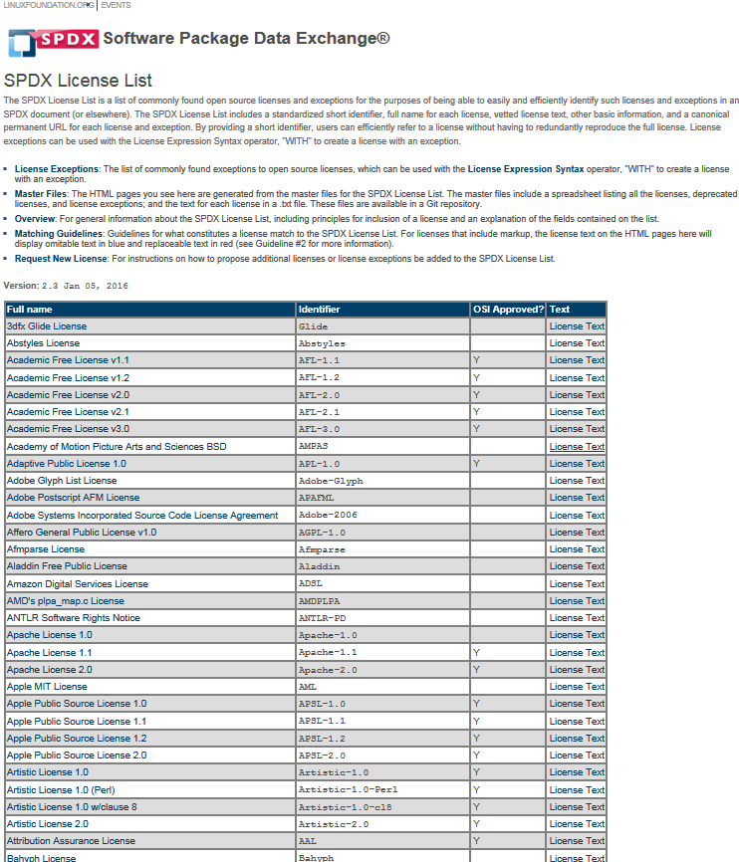
Open Source Software Licenses
Open Source Licenses
There are many of them
“License proliferation”
They can be categorized, but requires effort and assessment
Copyleft vs. permissive licenses
GPL version 2 compatibility
Patent left effect
… a lot more possible.
Further reading:
See the SPDX License List pages at http://spdx.org/licenses/ to see a selection of popular open source licenses

Slide 4
Analysis – Not Only Scanning but also Concluding
What are the goals?
It is about telling the software developers what to care for:
Identify obligations to fulfill, including providing for example
Credits (copyrights, prominent notice)
Information about licensing
Source code
Check for license compatibility
Simple example: GPL version 2 and CC-BY-SA (copyleft effect examples)
Be able to check desired usage
Does you business case match the licensing?
Is the context of usage envisaged from the OSS publishers
Further reading:
On obligations there is the OSADL association
They have published a set of obligation data for various licenses: https://www.osadl.org/Access-to-raw-data.oss-compliance-raw-data-access.0.html

Slide 5
FOSSology: Component Analysis
Part II: Motivating Examples

Slide 6
Examples for Licensing – Clarification Needed
(all examples from the same package zlib-1.2.8.tar.gz)
* gzlog.c Copyright (C) 2004, 2008, 2012 Mark Adler, all rights reserved
* For conditions of distribution and use, * see copyright notice in gzlog.h
* version 2.2, 14 Aug 2012
/* gzclose.c -- zlib gzclose() function
* Copyright (C) 2004, 2010 Mark Adler
* For conditions of distribution and use, * see copyright notice in zlib.h
* Copyright (C) 2003, 2012 Mark Adler
* For conditions of distribution and use,
* see copyright notice in blast.h
* version 1.2, 24 Oct 2012
* Copyright (C) 2002-2013 Mark Adler
* For conditions of distribution and use, * see copyright notice in puff.h
* version 2.3, 21 Jan 2013
* Copyright (C) 2003 Cosmin Truta.
* Derived from original sources by Bob Dellaca.
* For conditions of distribution and use,
* see copyright notice in readme.txt
These real world examples show references to a licensing statement, which is elsewhere
A scanner for text cannot generally determine the licensing from these files without capturing the particular occurrence and context
A person is required to clarify the licensing

Slide 7
Examples for Licensing – Clarification Needed 2
(from zlib-1.2.8.tar/ zlib-1.2.8/ contrib/ amd64/ amd64-match.S)
/*
* match.S -- optimized version of longest_match()
* based on the similar work by Gilles Vollant,
* and Brian Raiter, written 1998
*
* This is free software; you can redistribute it and/or modify it
* under the terms of the BSD License. * Use by owners of Che Guevarra
* parafernalia is prohibited, where possible, * and highly discouraged
* elsewhere.
*/
…
Another real world example:
What was meant to be fun (or a political statement), is difficult for license analysis
Question: Can this be ignored or shall the origination check for ownership of referred parafernalia?

Slide 8
Examples for Licensing – Clarification Needed 3
(TrueCrypt 7.1a Source.zip/ Common/ Cache.c)
Legal Notice: Some portions of the source code contained in this file were derived from the source code of Encryption for the Masses 2.02a, which is Copyright (c) 1998-2000 Paul Le Roux and which is governed by the 'License Agreement for Encryption for the Masses'. Modifications and additions to the original source code (contained in this file) and all other portions of this file are Copyright (c) 2003-2008 TrueCrypt Developers Association and are governed by the TrueCrypt License 3.0 the full text of which is contained in the file License.txt included in TrueCrypt binary and source code distribution packages. */
…
Another real world example:
The text is actually occurs with this formatting in file
Very special occurrence in fact that requires review

Slide 9
Examples for Licensing – Clarification Needed 4
(TrueCrypt 7.1a Source.zip/ Crypto/ AesSmall.h)
The free distribution and use of this software in both source and binary
form is allowed (with or without changes) provided that:
1. distributions of this source code include the above copyright
notice, this list of conditions and the following disclaimer;
2. distributions in binary form include the above copyright
notice, this list of conditions and the following disclaimer
in the documentation and/or other associated materials;
3. the copyright holder's name is not used to endorse products
built using this software without specific written permission.
ALTERNATIVELY, provided that this notice is retained in full, this product
may be distributed under the terms of the GNU General Public License (GPL),
in which case the provisions of the GPL apply INSTEAD OF those given above.
DISCLAIMER
This software is provided 'as is' with no explicit or implied warranties
in respect of its properties, including, but not limited to, correctness
and/or fitness for purpose.
Another real world example:
How does the organization decide which license to choose
There may be an external reason for choosing either one or the another

Slide 10
Examples for Licensing – Attention Needed 5
/******************************************************************************
* Copyright (C) 2008 - 2015 ***, Inc. All rights reserved.
*
* Permission is hereby granted, free of charge, to any person obtaining a copy
* of this software and associated documentation files (the "Software"), to deal
* in the Software without restriction, including without limitation the rights
* to use, copy, modify, merge, publish, distribute, sublicense, and/or sell
* copies of the Software, and to permit persons to whom the Software is
* furnished to do so, subject to the following conditions:
*
* The above copyright notice and this permission notice shall be included in
* all copies or substantial portions of the Software.
*
* Use of the Software is limited solely to applications:
* (a) running on a *** device, or
* (b) that interact with a *** device through a bus or interconnect.
*
* THE SOFTWARE IS PROVIDED "AS IS", WITHOUT WARRANTY OF ANY KIND, EXPRESS OR
* IMPLIED, INCLUDING BUT NOT LIMITED TO THE WARRANTIES OF MERCHANTABILITY,
* FITNESS FOR A PARTICULAR PURPOSE AND NONINFRINGEMENT. IN NO EVENT SHALL THE
* *** CONSORTIUM BE LIABLE FOR ANY CLAIM, DAMAGES OR OTHER LIABILITY,
* WHETHER IN AN ACTION OF CONTRACT, TORT OR OTHERWISE, ARISING FROM, OUT OF
* OR IN CONNECTION WITH THE SOFTWARE OR THE USE OR OTHER DEALINGS IN THE
* SOFTWARE.
*
******************************************************************************/
Another real world example:
It is actually based on an MIT license text
MIT license: very popular and permissive
Added two conditions inside the original license text
(not so permissive)
Very hard to identify with regular expression matching

Slide 11
Some Example from out in the wild (1)
icu4j-3.4.4-sources.jar/src/com/ibm/icu/dev/demo/translit/DemoApplet.java
private static final String COPYRIGHT =
"\u00A9 IBM Corporation 1999. All rights reserved.";
icu4j-3.4.4-sources.jar/src/com/ibm/icu/dev/test/perf/data/collation/TestNames_Latin.txt
Almeida JÃºnior, JosÃ© Ferraz de
Alpern, Rami
Als, Peder
icu4j-3.4.4-sources.jar/src/com/ibm/richtext/uiimpl/resources/FrameResources.java
*******************************************************************************
* Copyright (C) 2002-2004, International Business Machines Corporation and
*
* others. All Rights Reserved.
*
*****************************************************************************

Slide 12
Some Example from out in the wild (2)
/icu4j-3.4.4-sources.jar/src/com/ibm/icu/dev/tool/translit/dumpICUrules.bat
//--------------------------------------------------------------------
// Copyright (c) 1999-$THIS_YEAR, International Business Machines
// Corporation and others. All Rights Reserved.
//--------------------------------------------------------------------
// THIS IS A MACHINE-GENERATED FILE
spring-web-4.1.5.RELEASE-sources.jar/org/springframework/web/method/support/UriComponentsContributor.java
/*
* Copyright 2013 the original author or authors.
*
* Licensed under the Apache License, Version 2.0 (the "License");
… (authors given later with javadoc @author tag)
jena-2.6.4-sources.jar/com/hp/hpl/jena/vocabulary/OWL2.java
/*
(c) Copyright 2010
[See end of file]
$Id: OWL2.java,v 1.1 2010/01/11 09:17:04 chris-dollin Exp $
*/

Slide 13
Examples for Copyrights – Clarification Needed
Examples of incomplete statements
Year missing
Individual or organization missing
Copyright notice missing
Again: What about orphaned files? Who wrote them?
Ambiguous copyright information for every file
Copyright or copyright sign, year or years, individual or organization
Common understanding is covered by the Berne convention
How about authored, thanks to, contributed?
They do not express copyright, consult your legal counsel for guidance in these cases
The Wikipedia article on the Berne convention presents the basics and origin about copyright law https://en.wikipedia.org/wiki/Berne_Convention

Slide 14
FOSSology: Component Analysis
Part III: Scope and Terminology

Slide 15
Analyzing the License Situation of a Component
Analysis & Clarification of Compliance Issues
Analyzing Component vs. Usage Analysis
On a per component basis
Shall not consider a particular usage case – enabling reuse of license analysis
Opposed the usage clearing: considers all involved components
As previous licensing examples have shown, expert knowledge is required
As such, available tools, such as FOSSology will need experts to clarify ambiguous licensing situations
A license analysis tool does not replace the expert

Slide 16
Misconceptions: Other Terms and Analysis
Component Analysis & Clarification of Component License Condition
License Analysis
How to call what: license analysis vs. component analysis?
There is also clarifying license terms required, for example: new licenses, rare licenses, licenses written for the US law, used in Europe, etc.
Looking at OSS components or your own product?
For re-using license analysis: going OSS component by OSS component
An analysis on product level considers incompatible licensing or business case compatibility

Slide 17
License Analysis of a Component - Summary
Overall goals
Comply with OSS community and mitigate risk
Help the engineering with definitive instructions
Building a list of reusable assets, requires usage independent clearing of component
How to perform a component analysis for licensing
Reviewing file notices
Reviewing license texts
Determining the exact text for obligations (rights, restrictions)
Identify new licenses
License clarification required?
OSS Expert group available in organisation
Legal advice required
The FOSSology project enables the tool-based identification of licenses:
Finding license relevant texts
Aggregation in a hierarchy
Highlighting text occurrences
Identifying wording differences compared with reference texts
Searching for licensing phrases
Reporting of found licenses

Slide 18
Thank you for your attention
© 2016-2018 Siemens AG, The Linux Foundation
CC-BY-SA 4.0 https://creativecommons.org/licenses/by-sa/4.0/
Internet https://www.fossology.org
Github https://github.com/fossology/fossology
Further Links https://www.spdx.org
https://www.openchainproject.org
https://github.com/sw360/sw360portal

