Slide 1
FOSSology: Introduction and Basic Workflow

Slide 2
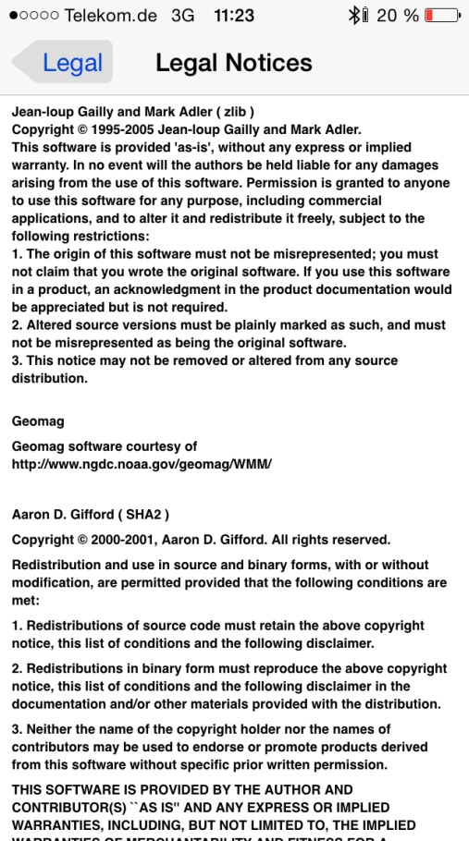
The Problem Actually
You know these examples
Distributing open source software requires to
Provide licenses of involved software
Provide copyright statements of involved authors
Provide disclaimers
… and much more

Slide 3
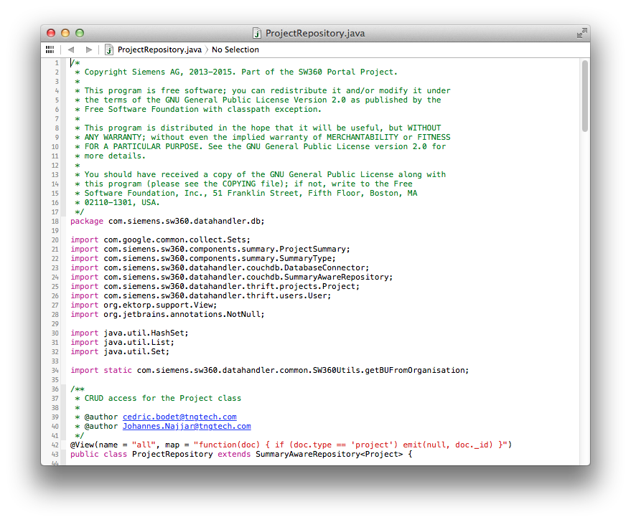
It is about finding licenses
Finding Licenses
License texts
References to licenses
Written texts explaining licensing
License relevant statements

Slide 4
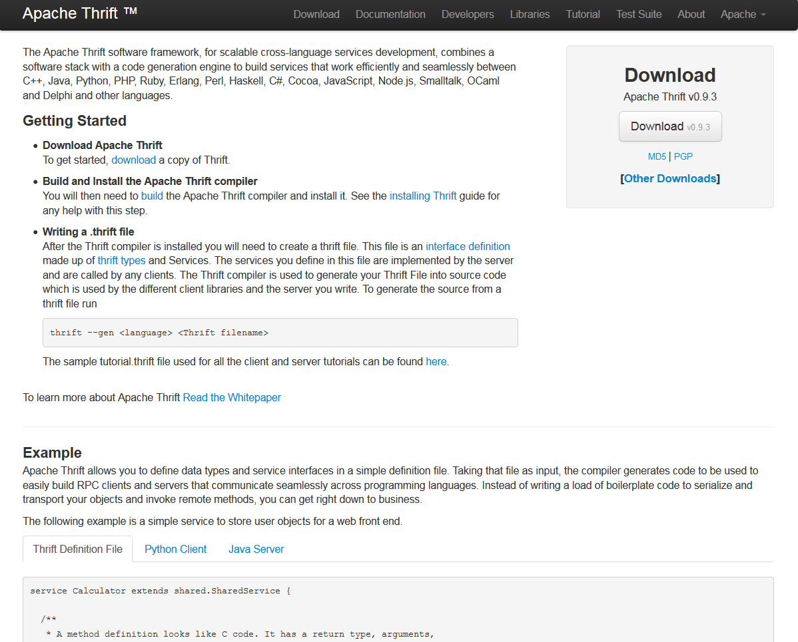
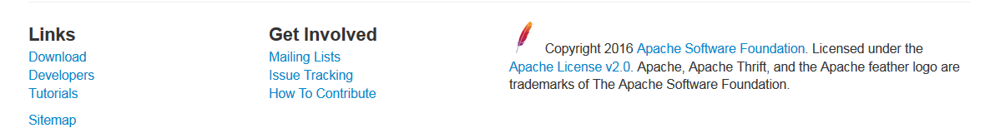
An Example – What do we find?
The Example
(Apache projects are known for homogenous licensing)
Such a project declares its licensing on its Website
However, Open Source implies using other open source
As such, a projects can contain also parts from other open source projects

Slide 5
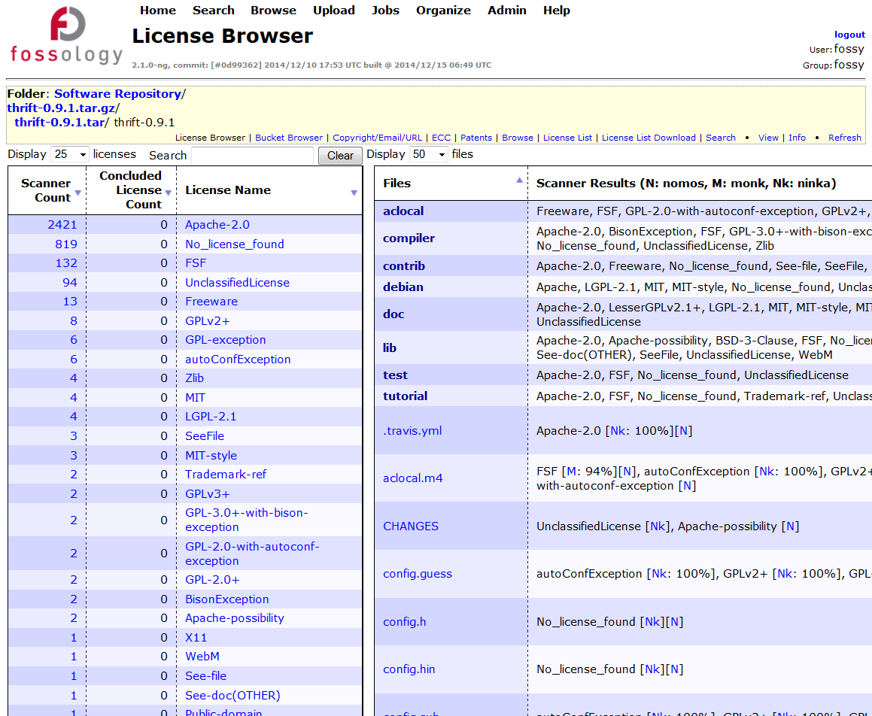
Using FOSSology with this Example
Open Source and Reuse
It is natural that an OSS project reuses available https://github.com/fossology/fossology
Likely OSS from other projects is found
For example, FOSSology will find 25 other licensing relevant text occurrences in Apache thrift

Slide 6
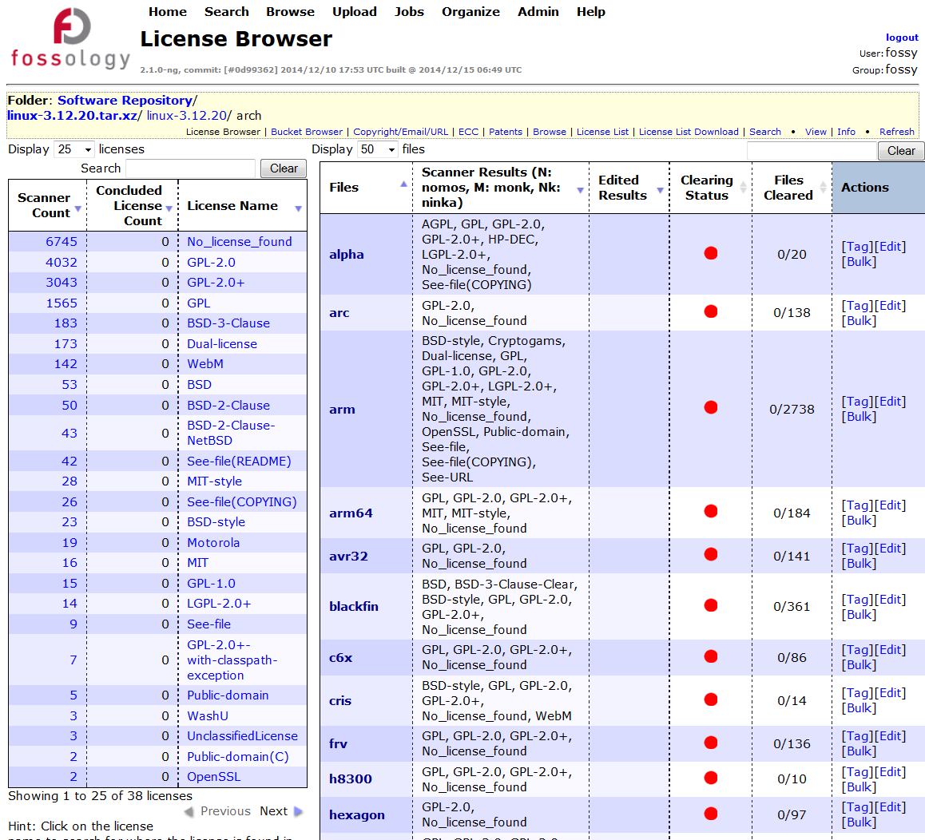
Using FOSSology with this Example
Another Example: Linux Kernel Project
Looking at the Linux kernel will result in thousands of files containing license relevant information
Analyzing them yields about 30 distinctive licensing statements

Slide 7
What is FOSSology?
A Web server application for license and copyright compliance of software components.
FOSSology Project
https://www.fossology.org/
FOSSology Development
https://www.github.com/fossology/fossology
Published first in 2008, GPL-2.0
2015: Linux Foundation collaboration project
Web server based and command line interfaces
Scanning agents searching for license and copyright relevant hits (and more …)
A multi-user / multi-tenant Web UI for review organizing clearing job
Standard Web application stack:
Linux, Apache 2, PostgreSQL, PHP,
Web-based UI in PHP, but scanners written in C / C++
Two ways to interact:
Web user interface
Command line utilities
Notes:
Memo

Slide 8
How does FOSSology work? – Overview 1 of 2
See more details the Basic Workflow Description: https://www.fossology.org/get-started/basic-workflow
Upload OSS Package
Upload an open source package to the server
Select scan agents that analyze the software
Review and Adjust (“Clearing”)
Review what scanners have found
Review license occurrences and correct findings if necessary
Generate
Generate report output
For example list of licenses or SPDX
Notes:
Memo

Slide 9
Hands-On: Basic End-to-End Workflow
Functionality
Example
Using FOSSology End-to-End
From uploading …
… to generating report: SPDX
Uploading - offers a variety of selections
Review the uploaded file in the license browser
Review the found licenses in the aggregated view
Do the clearing work
Review the copyrights
Review the Export Control and Customs (ECC)
Generate desired report output
Upload ionicons-3.0.0
Go to license browser by clicking upload name or selecting clearing from the action menu
Select “go to all …. with licenses”
Review licenses and apply decisions
Select the copyright, e-mail, url section from the yellow menu bar area
Review copyright statements and correct in case
Select ECC from the yellow area and review
Go to Browse main view
Select the pop-up menu of the ionicons upload

Slide 10
How does FOSSology work? – Overview 2 of 2
Upload
Component
Uploading source code archive (*.zip, *.tar.gz, etc)
Agents scan for license relevant text
Copyrights, Export Control (ECC), your keywords to look for etc.
Agents Scanning
Review scanner results for wrong license classification
Review other scanner findings (copyrights, ECC)
Review Results
Generate Reporting
Result of the “clearing”
SPDX reporting
Generated notice or readme file
debian-copyright
Pass Report to Client
Notes:
Memo

Slide 11
FOSSology Feature Overview
A Web server application for license and copyright compliance of software components.
License Scan features
Other features
Regular expression scanner
Text similarity scanner
License (text) management
Aggregation of licenses in hierarchical view
License histogram
Supporting concluded vs. found license
Bulk processing of files with same licensing
Reusing of license conclusions
Copyright, authorship statements scanner
Export control and customs scanner
Command line interfaces
Reporting
SPDX RDF and tag-value
Debian-copyright
Plain text output
Files sorting in buckets
User, group and upload management
Notes:
Memo

Slide 12
Features: Two License Scanners: Nomos and Monk
Nomos Keywords
Nomos Reg. Expressions
Bulk Phrase Matches
Monk Full text Matches
Finds all kind of license relevant texts
Finds unknown Licenses
Finds most license relevant texts
Identifies also derivatives of licenses
Good for finding actual licenses
Identifies also derivatives of licenses
Certainty that known license text is actually found and wording is exactly reproduced
Flexibility
Very imprecise
Does not identify license
High number of false positives
Only limited precision for identifying actual licenses
False positives
Limited to known phrases only
Does not provide certainty about original or derivative
Works only on known license texts
Actual occurrences are minority
Precision
Notes:
Memo

Slide 13
More Features in FOSSology
Workflow integration with command line interfaces
Do uploads and scans from the command line, right from your scripts
Or just run individual agents (e.g. for licenses) from command line
Schedule activities / integrate them into automated workflows
ECC (Export Control and Customs)
Regular expressions searching for export control and customs
License data sets import and export
Regular expressions searching for export control and customs
Buckets
Define rules for files with license results for collecting them in dedicated lists / buckets

Slide 14



FOSSology is Open Source
What happens actually?
As an organization distributing software there is responsibility for license compliance
This work must be actually provided by 3rd parties as well!
With FOSSology, a tool is freely available supporting all kind of organizations with their license compliance efforts
GPL-2.0 licensed
3rd parties
Organization
Distributing
Customer / Organization

Slide 15
Overview: FOSSology Hands On
Basic End-to-End Workflow Overview: What do I need to do actually to get the SPDX / Readme / DEP5
Accelerate the File Handling Using bulk scanning to correct scan results
Reuse of Clearing Decisions Process only differences for newer versions of a scanned component
Management of Licenses See the licenses and where to edit Export and import more licenses
Organizing the Uploads Getting started with folders, uploads and access rights Creating users and groups

Slide 16
Thank you for your attention!
© 2016-2018 Siemens AG, The Linux Foundation
CC-BY-SA 4.0 https://creativecommons.org/licenses/by-sa/4.0/
Internet https://www.fossology.org
Github https://github.com/fossology/fossology
Further Links https://www.spdx.org
https://www.openchainproject.org
https://github.com/sw360/sw360portal
Notes:
Notes

