Slide 1
FOSSology & SPDX

Slide 2
How does FOSSology work?
Upload Component
Uploading source code archive (*.zip, *.tar.gz, etc)
Agent Scanning
Agents scan for license relevant text
Copyrights, ECC, your keywords to look for etc.
Review Result
Review scanner results for wrong license classification
Review other scanner findings (copyrights, ECC)
Generate Reporting
Result of the “clearing”
SPDX reporting
Generated notice or readme file
debian-copyright
Pass Report to Client
Page
Notes:
Memo

Slide 3
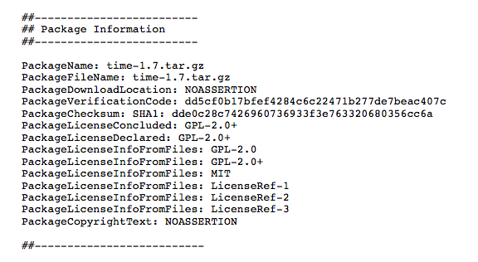
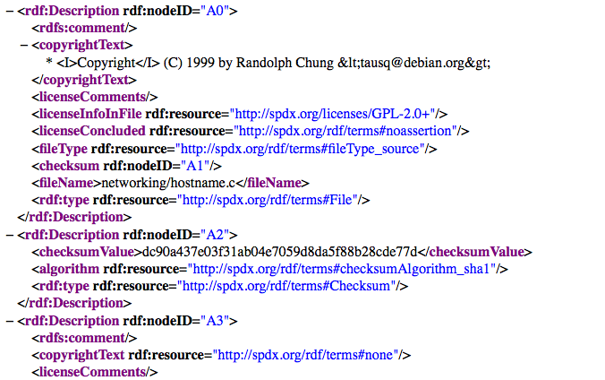
Supported SPDX Document Formats
tag:value
Tool consumable RDF/XML
Page

Slide 4
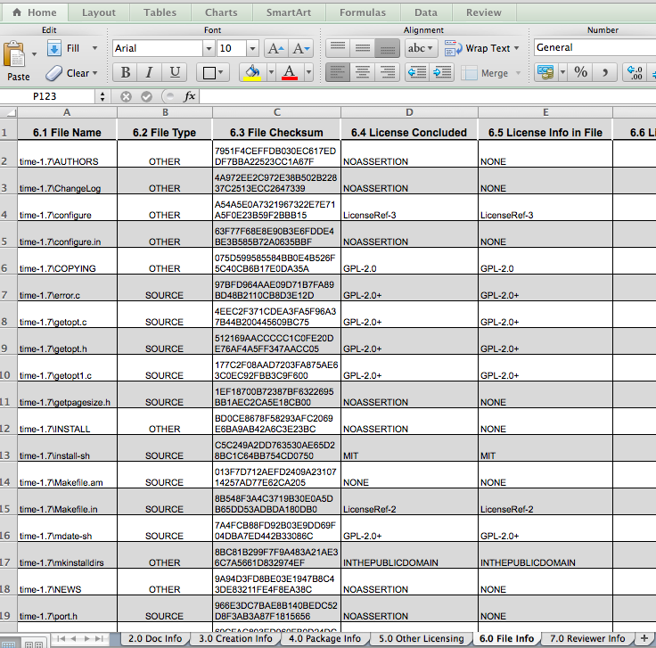
… and can translate to spreadsheets
tag:value
Tool consumable RDFa
spreadsheets
Page

Slide 5
What makes up an SPDX Document?
SPDX v2.1 Document contains:
Document Creation Information
Package Information
Package Information
Other Licensing Information
File Information
Other Licensing Information
Snippet Information
Other Licensing Information
Other Licensing Information
Other Licensing Information
Relationships
Other Licensing Information
Annotations
Page

Slide 6
Only subset of fields are mandatory
Document Creation Information
2.1 SPDX Version.
2.2 Data License
2.3 SPDX Identifier
2.4 Document Name
2.5 SPDX Document Namespace
2.8 Creator
2.9 Created
1 per document
File Information
4.1 File Name
4.2 File SPDX Identifier
4.4 File Checksum
4.5 Concluded License
4.6 License Information in File
4.8 Copyright Text
1 per package in document
Package Information
3.1 Package Name
3.2 Package SPDX Identifier
3.7 Package Download Location
3.9 Package Verification Code
3.13 Concluded License
3.14 All Licenses Information from Files
3.15 Declared License
3.17 Copyright Text
1 per file in each package
Notes:
The SPEC is just over 100 pages, but not all the fields are needed and relevant.
72 use cases identified for SPDX 2.0 – many requiring fields that really or only applicable to that use case
here are required fields – if look at, it’s what you’d want to know...
(walk through this)

Slide 7
Document Creation Information
Mandatory | Added | Field Name | FOSSology output
✓ | 1.0 | 2.1 SPDX Version | which version of SPDX?
✓ | 1.0 | 2.2 Data License | data in document: CC0-1.0
✓ | 2.0 | 2.3 SPDX Identifier | generates
✓ | 2.0 | 2.4 Document Name | takes from upload
✓ | 2.0 | 2.5 SPDX Document Namespace | generates
 | 2.0 | 2.6 External Document Reference | generates
 | 1.2 | 2.7 License List Version | when document created.
Notes:
This is section 2 of the Specification

Slide 8
Document Creation Information (cont’d)
Mandatory | Added | Field Name | FOSSology output
✓ | 1.0 | 2.8 Creator | Tool (id, version, when) ⇒ Version of FOSSology May want to add person who did scan (from userid)
✓ | 1.0 | 2.9 Created | date file created
 | 1.0 | 2.10 Creator Comment
 | 1.1 | 2.11 Document Comment

Slide 9
Package Information
Mandatory | Added | Field Name | FOSSology output
✓ | 1.0 | 3.1 Package Name | from uploaded
✓ | 2.0 | 3.2 Package SPDX Identifier | generated
 | 1.0 | 3.3 Package Version | from uploaded
 | 1.0 | 3.4 Package File Name | actual file name for package
 | 1.0 | 3.5 Package Supplier
 | 1.0 | 3.6 Package Originator
✓ | 1.0 | 3.7 Package Download Location | from upload information
 | 2.1 | 3.8 Files Analyzed | “yes”

Slide 10
Package Information (cont’d)
Mandatory | Added | Field Name | FOSSology Output
✓ | 1.0 | 3.9 Package Verification Code | generated
 | 1.0 | 3.10 Package Checksum | generated
 | 1.2 | 3.11 Package Home Page
 | 1.0 | 3.12 Source Information
✓ | 1.0 | 3.13 Concluded License | from cleared data
✓ | 1.0 | 3.14 All Licenses Information from Package | from scanned data
✓ | 1.0 | 3.15 Declared License | from scanned data
 | 1.0 | 3.16 Comments on License
Notes:
Section 2 of the Specification

Slide 11
Package Information (cont’d)
Mandatory | Added | Field Name | FOSSology output
✓ | 1.0 | 3.17 Copyright Text | from scanned data
 | 1.0 | 3.18 Package Summary Description
 | 1.0 | 3.11 Package Detailed Description
 | 2.0 | 3.12 Package Comment
 | 2.1 | 3.13 External Reference
 | 2.1 | 3.14 External Reference Comment
Notes:
Section 2 of the Specification

Slide 12
File Information
Mandatory | Added | Field Name | Comment
✓ | 1.0 | 4.1 File Name | what is name of file
✓ | 2.0 | 4.2 File SPDX Identifier | generated
 | 1.0 | 4.3 File Type | source, binary, ...
✓ | 1.0 | 4.4 File Checksum | SHA1
✓ | 1.0 | 4.5 Concluded License | Concluded by FOSSology
✓ | 1.0 | 4.6 License Information in File | detected by scanning file
 | 1.0 | 4.7 Comments on License
✓ | 1.0 | 4.8 Copyright Text | detected by scanning file
Notes:
File Types: source, binary, archive,application,audio,image,text,video,documentation,spdx

Slide 13
File Information (cont’d)
Mandatory | Added | Field Name | Comment
 | 1.0 | 4.9 Artifact of Project Name | deprecated
 | 1.0 | 4.10 Artifact of Project Homepage | deprecated
 | 1.0 | 4.11 Artifact of Project URI | deprecated
 | 1.1 | 4.12 File Comment
 | 1.2 | 4.13 File Notice | if Notice found in file
 | 1.2 | 4.14 File Contributor | if Contributor info in file
 | 1.2 | 4.15 File Dependencies | deprecated
Notes:
Section 2 of the Specification

Slide 14
Other Licensing Information (Optional*)
Mandatory | Added | Field Name | Comment
✓ | 1.0 | 6.1 License Identifier | unique ID
✓ | 1.0 | 6.2 Extracted Text | text found during scans
 | 1.1 | 6.3 License Name | formal name
 | 1.1 | 6.4 License Cross Reference | text found during scans
 | 1.1 | 6.5 License Comment
* NOTES:
Provides a way to identify licenses not on the SPDX License List.
SPDX aims for ~90% coverage with short forms license identifiers - NOT exhaustive
Although there are a lot of licenses “in the wild,” a smaller number covers most projects
Notes:
Black Duck identifies >2000 licenses in use , however ~20 licenses responsible for nearly all licensed open source projects
http://www.blackducksoftware.com/oss/licenses#top20
and, OSI currently recognizes 69 licenses as “open source”
http://www.opensource.org/licenses

Slide 15
Credits:
© 2016-2018 Linux Foundation, Parts Copyrights Siemens AG
CC-BY-SA 4.0 https://creativecommons.org/licenses/by-sa/4.0/
Project https://www.spdx.org
License List https://www.spdx.org/licenses
Tool Source https://github.com/spdx
Page
Notes:
Notes

