Slide 1
FOSSology: Hands On - Becoming Efficient

Slide 2
What is FOSSology?
A Web server application for license and copyright compliance of software components.
FOSSology Project
https://www.fossology.org/
FOSSology Development
https://www.github.com/fossology/fossology
Published first in 2008, GPL-2.0
2015: Linux Foundation collaboration project
Web server based and command line interfaces
Scanning agents searching for license and copyright relevant hits (and more …)
A multi-user / multi-tenant Web UI for review organizing clearing job
Standard Web application stack:
Linux, Apache 2, PostgreSQL, PHP,
Web-based UI in PHP, but scanners written in C / C++
Besides Web UI:
Command line utilities
Notes:
Memo

Slide 3
How does FOSSology work?
Upload
Component
Uploading source code archive (*.zip, *.tar.gz, etc)
Agents scan for license relevant text
Copyrights, ECC, your keywords to look for etc.
Agents Scanning
Review scanner results for wrong license classification
Review other scanner findings (copyrights, ECC)
Review Results
Generate Reporting
Result of the “clearing”
SPDX reporting
Generated notice or readme file
debian-copyright
Pass Report to Client
Notes:
Memo

Slide 4
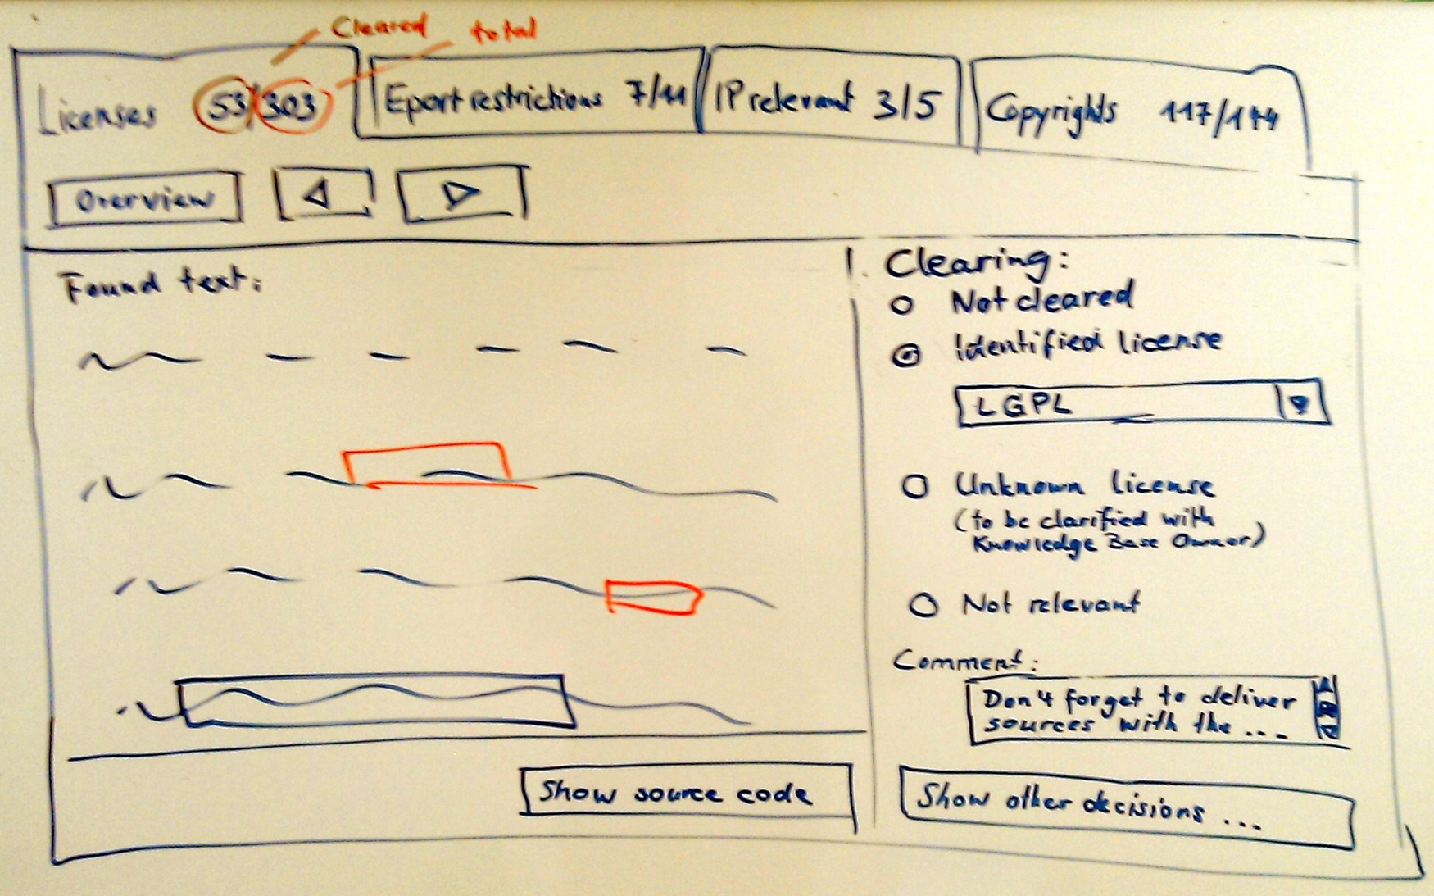
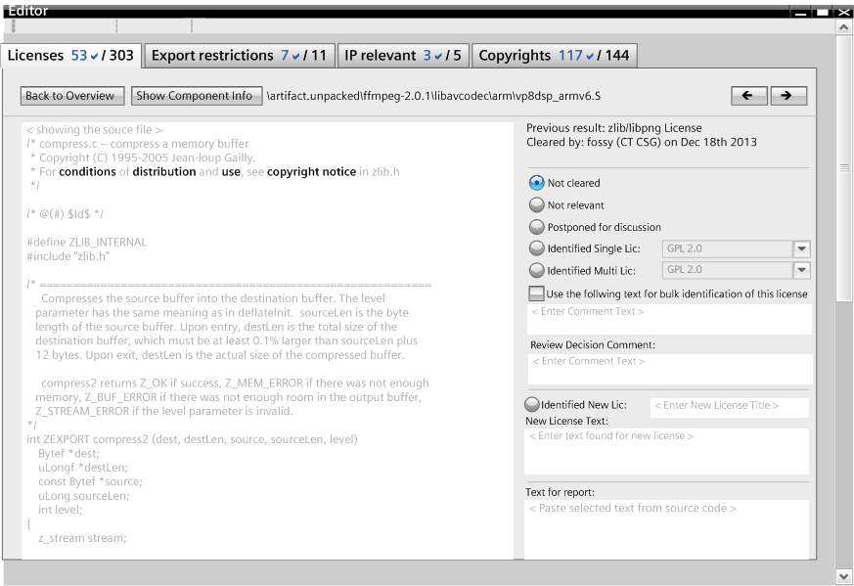
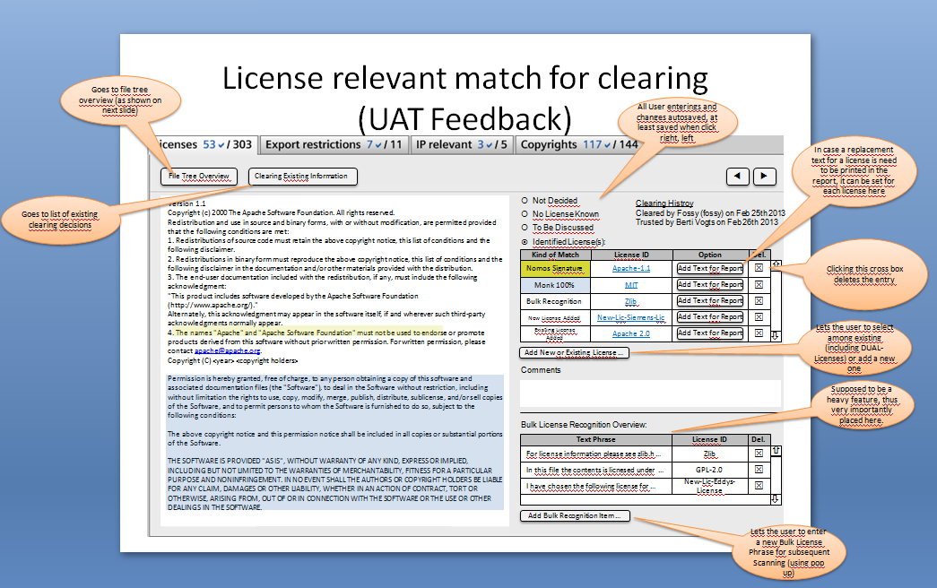
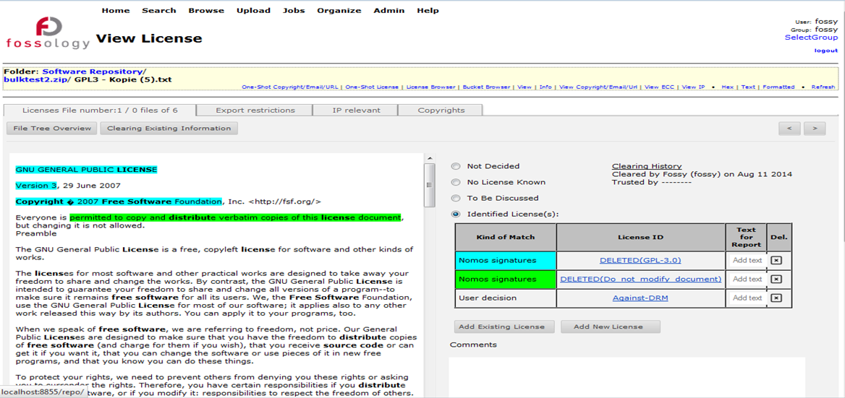
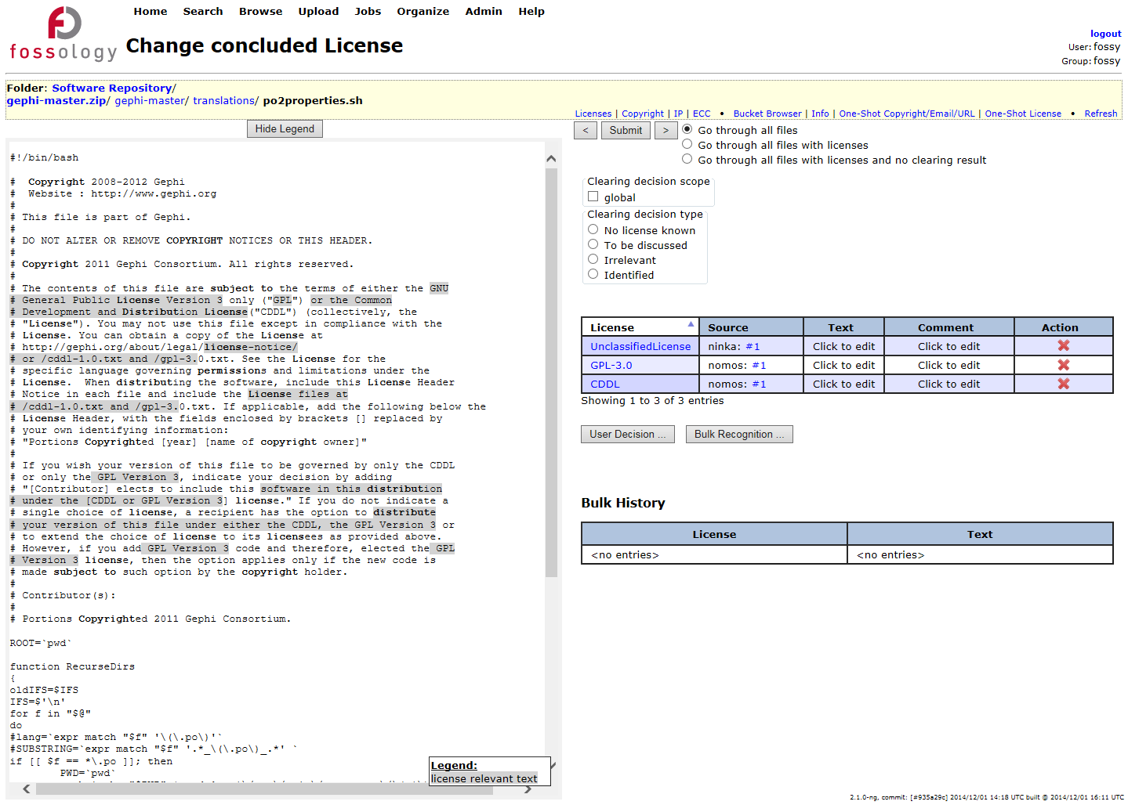
Features: Efficient User Interface
Evolution
Most work intensive part: review and correction
User interface went over many iterations the past years
Support for large packages (> 10.000 files, such as Boost, Linux Kernel,…)

Slide 5
Hands-On: Basic End-to-End Workflow (Again)
Functionality
Example
Using FOSSology End-to-End
From uploading …
… to generating report: SPDX
Uploading - offers a variety of selections
Review the uploaded file in the license browser
Review the found licenses in the aggregated view
Do the clearing work
Review the copyrights
Review the Export Control and Customs (ECC)
Generate desired SPDX report output
Upload an example file, jakarta-oro-2.0.7
Select the options in the upload menu
Go to browse and review the UI there
Select licenses from drop-down menu at upload
See the aggregated views and single file view: create decisions
First use of the bulk
Go to copyrights and correct found matches
ECC will be the same
Select SPDX output from drop-down

Slide 6
Feature: Reviewing Many Files at Once, Bulk Scan

Slide 7
Feature: Reviewing Many Files at Once: Bulk Scan
The FOSSology software cannot know all possible license relevant text phrases
Use Case
Solution
Finding standard and known license texts is straightforward
Do I need to create a clearing decision for every file?
If the scanner yields wrong results, do I need to go into every file and correct then?
FOSSology allows the user to define text phases …
For confirmation …
… or correction
And assign license confirmations or corrections to it
Every time a file is found with this text phrase (100%) …
… the confirmation or correction is applied to it.
No need to go through every file again.
Does not apply with scan result conflicts
Notes:
Memo

Slide 8
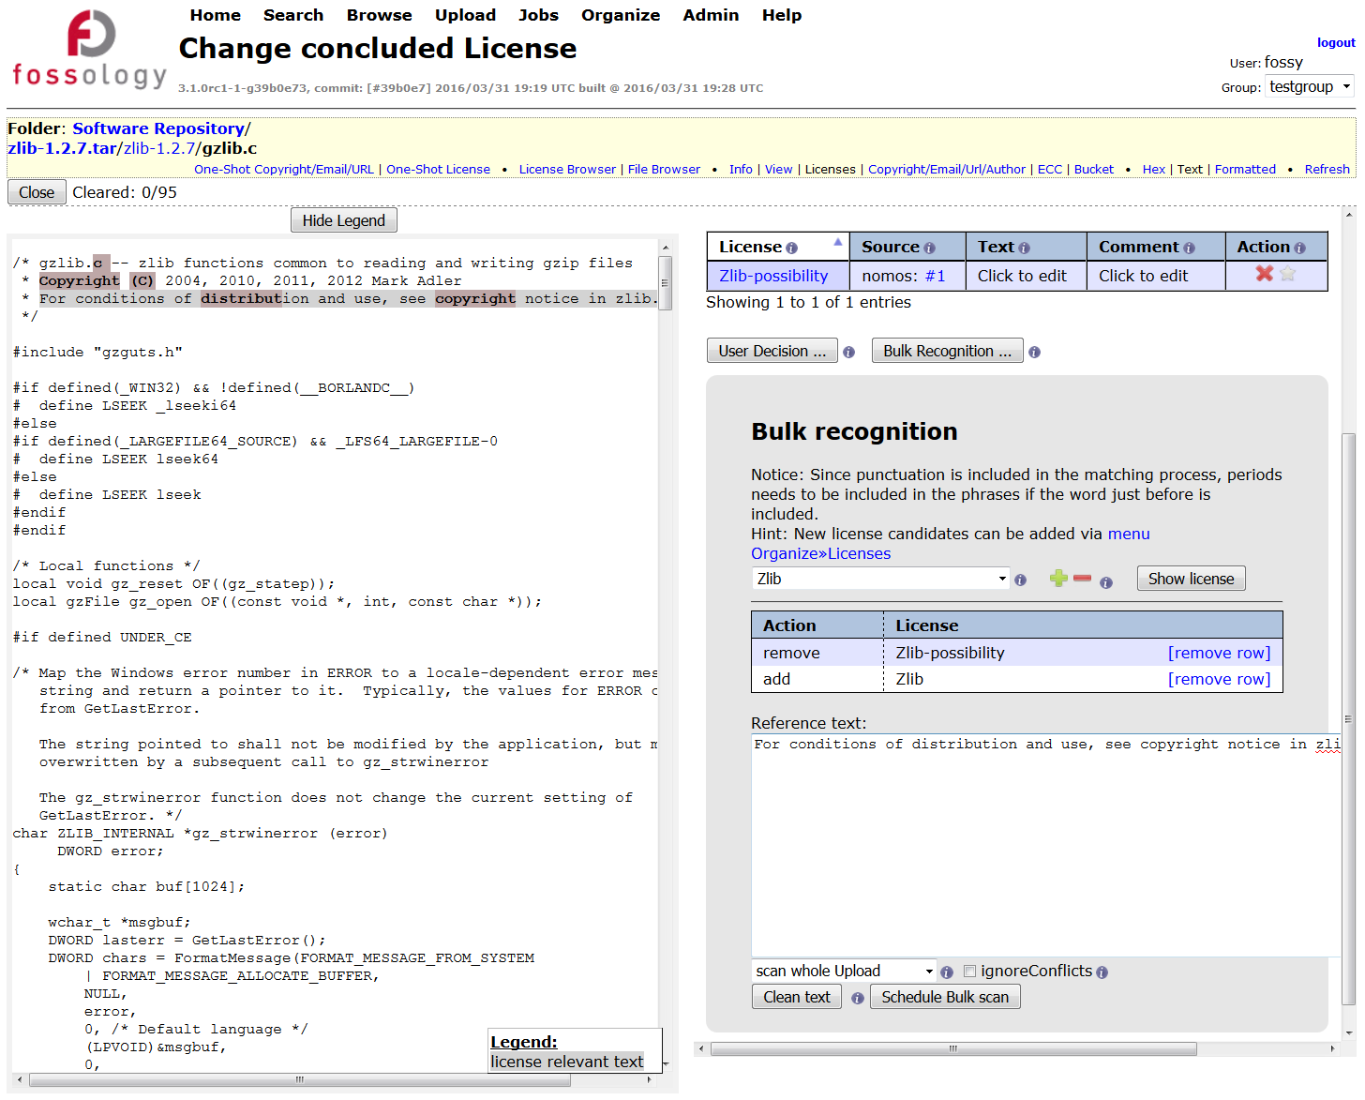
Feature: Using Bulk Scan
User Interface
Copy a characteristic text phrase from file view left (1)
Paste into the bulk scan text field (2)
The application will search for file with this text
Define scanner license findings (3)
For correction / removal
For confirmation, creating a clearing decision
Bulk scan will run over all files of the package and apply clearing decisions or scanner corrections where matching (4)
1
3
2
4

Slide 9
Hands-On: Accelerate File Handling: Bulk Scan
Functionality
Example
Upload open source package
Based on scan results: what the scanner found
Scanner found a license: either conform or correct
Going file by file: select, identify, next
Good, but not feasible for larger packages
Use bulk scan to accelerate it
Within an upload: select the text phrase
Assumption: using text phrases within an upload appears safe
Define a license for the text phrase – or a removal
For every finding where scanner found the same license confirmation
More edits on files at once
Edit and bulk from aggregated view
Edit is for irrelevant
Upload zlib sources 1.2.7
Go to first file in list
(some zlib-possibility)
Select zlib, remove zlib possibility, go next
Go to another file
Select zlib possibility
Define bulk item: removing zlib possibility
Define bulk item adding zlib
See that decision is created
Again
Same story, another example: BSL-case in contrib of zlib

Slide 10
Feature: Bulk Scan – A few Things to Consider
Scoping Bulk Scan
Bulk scan can be applied on folders but also an entire uploads
Larger bulk scan sections
Prefer larger text portion instead of smaller ones, this increases the precision
However, do not consider copyright statements for example, as they usually vary within an upload
Comment characters
Comment characters such as #, //, * , /* are filtered out anyway, copying them in does not matter
But other characters are not filtered out („%“). They will make a difference
No characteristic text phrase
Consider correcting license scan results directly using the edit feature
With the edit feature available in the license browser view, no text phrase is defined

Slide 11
Features: Processing Copyright Statements

Slide 12
Feature: Processing Copyright Statements
Edit is about a short cut at license review
Use Case
Solution
Many license obligations ask for listing the copyrights at distribution.
Example form BSD: “Redistributions in binary form must reproduce the above copyright notice,…”
How do I find out all relevant copyright statements of an upload?
FOSSology scans based on regular expressions
Copyright statements (yes, also © in UTF-8, 1152, …)
Authored by, contributed by, e-mail addresses
E-Mail addresses and http/https URLs
Stored on file level!
Maintained by hashes of the file
Editing the copyright of a file, edits it also for future uploads
Recovery of deleted copyright statements possible
Table-sheet editing up to come
Notes:
Memo

Slide 13
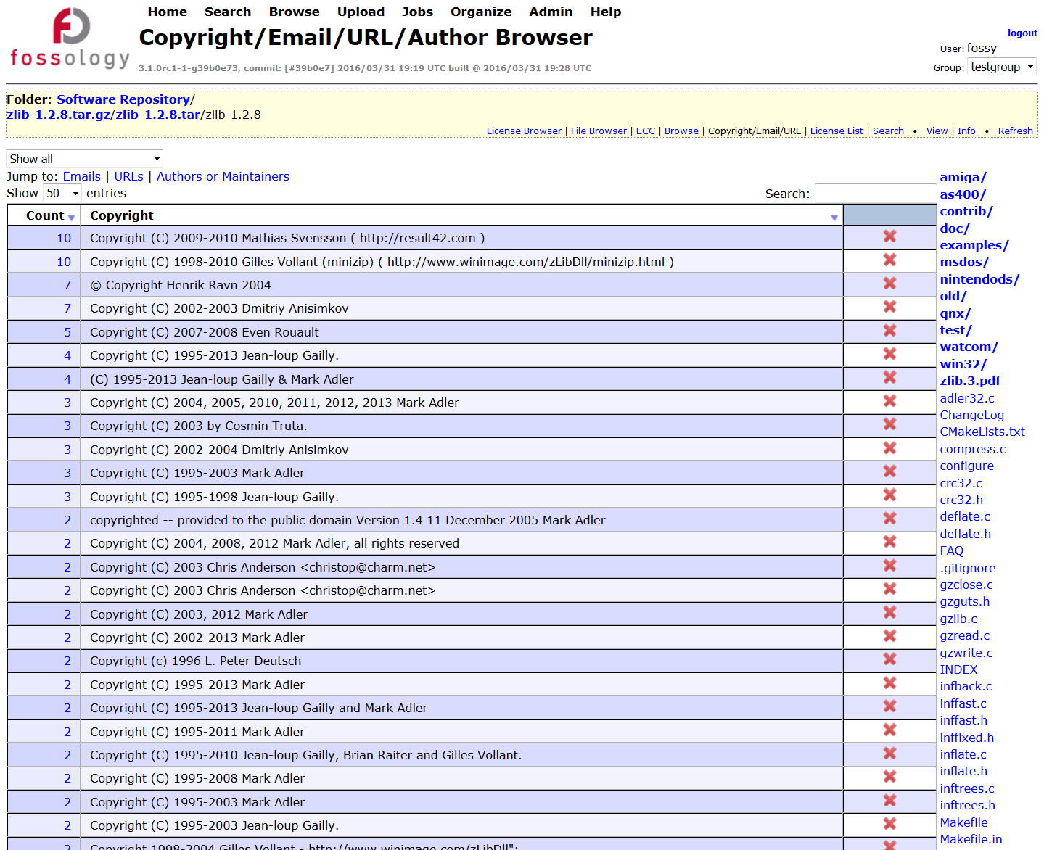
Feature: Processing Copyright Statements
User Interface
Copyright findings are presented in an aggregated view
For single files
All found items at folder level
All items of the upload
Copyright statements can be deleted
false positives
Copyright statements can be tracked back to the referring files

Slide 14
Feature: Edit License Conclusions in License Browser

Slide 15
Feature: Edit License Conclusions in License Browser
Edit is about a short cut at license review
Use Case
Solution
Within a software component, I know files / folders already.
With a software component, I know that files are irrelevant.
Unused architecture
Test files, code examples
Build infrastructure
Do I need to look at the files?
FOSSology allow to set / unset license on folder level
In license browser, the user can set the licenses on folders
Set or confirm licenses
Remove scan results from the clearing decision
Mark files as irrelevant
What happens actually?
The “Edit” creates clearing decisions
The scan results are not touched (and preserved)
No clearing decision final on scan result conflicts
Notes:
Memo

Slide 16
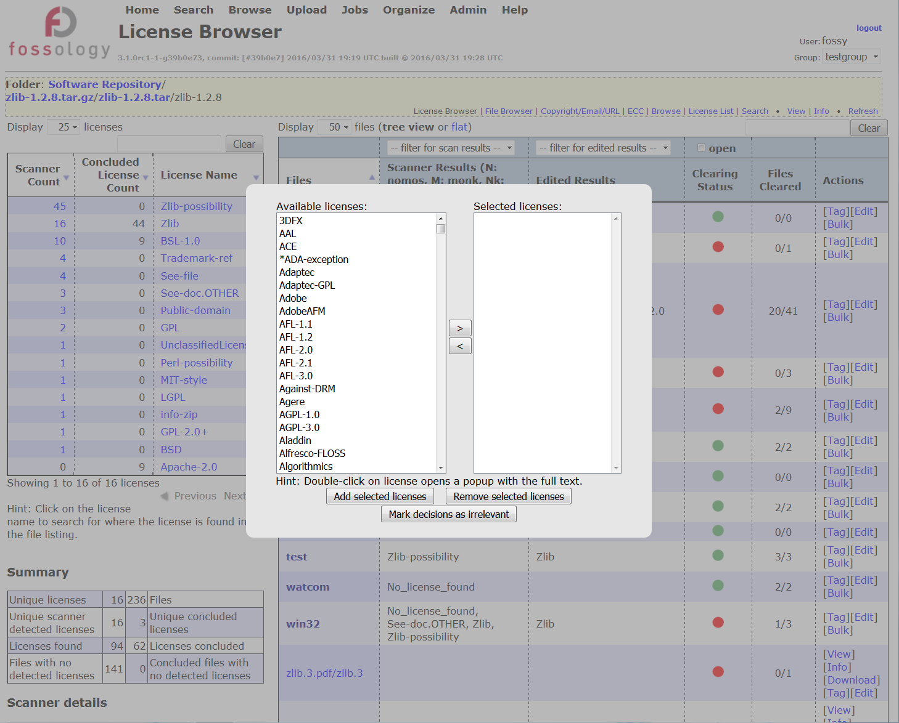
Feature: Using License Conclusions in License Browser
User Interface
At aggregated license browser view select link [Edit]
Select either licenses for decision …
… or mark file trees irrelevant (for distribution)
2
1

Slide 17
Features:
Reuse of License Corrections
Candidate License Handling
Custom License Text
License Set Handling

Slide 18
Feature: Reuse of License Corrections
Reuse is about reusing already done work.
Use Case
Solution
Upload and clearing of a component:
Going file-based
Maybe using bulk phrase
Reviewing copyrights
Uploading a newer version
Do I need to go through all files again?
FOSSology maintains hash values of every file
It already reuses scans (rescan possible for new agent)
Users want to reuse clearing decisions = what the user has decided
Three different reuse functions
Reuse clearing based on same file hashes
Reuse bulk scan operation = individual text phrases
Reuse where file differs by one line (using diff-tool = slow!)
Notes:
Memo

Slide 19
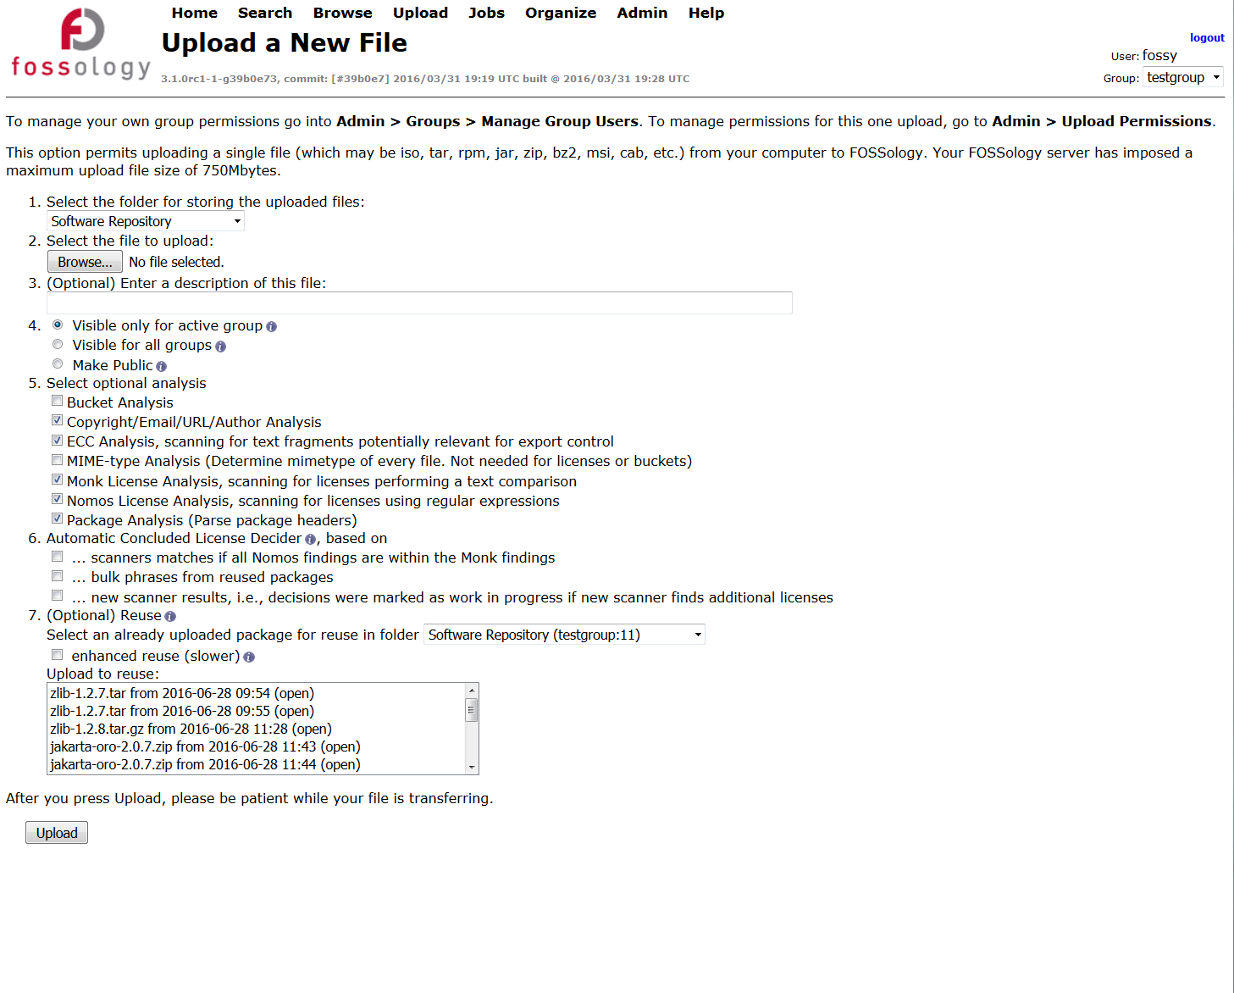
Feature: Using Reuse of License Corrections
User Interface
At upload you can select another existing package on server for reusing license review data
Three main reuse options given:
Reuse license review data at same hash value calculated for files (1)
Reuse license review data at one-line tolerance using the diff tool (2)
Reuse bulk scan tasks entered for selected existing package also for new package (3)
3. Choose not only clearing decision from same files, but also identified text phrases
2. Choose same files either by hash-match or by diff-tool with 1-line tolerance
1. Select existing upload from where to reuse license decisions

Slide 20
Hands-On: Reuse of License Corrections
Functionality
Example
Upload open source package
Do the clearing work
… or just some examples
Upload a newer version of the package
(it works actually with an older version as well)
Assumption: using text phrases within an upload appears safe
Select the appropriate reuse settings
Select the existing upload
Select the bulk phrases if appropriate
Select the extended reuse if appropriate
Check the reuse ratio in aggregated view
It should be possible to reuse from multiple uploads
zlib 1.2.7 source was uploaded
Some clearing work was done
From the previous part
Upload “From File” zlib 1.2.8 source
Select reuse uploaded package 1.2.7
Nothing else
Review the files reused
Upload “From File” zlib 1.2.8 source again
Select reuse package …
Select bulk phrases reuse too
Upload … again
Select also extended reuse

Slide 21
Features:
Candidate License Handling
Custom License Text
License Set Handling

Slide 22
Hands-On: Custom License Text
Functionality
Example
During clearing you see a new license text
Overriding the standard text is required
For some licenses, the provided text in FOSSology is not helpful
Adding text replacement for license
Candidate licenses are valid for clearing
But not scanning – important for not altering scans
Create a candidate entry with a merge request
Check the output of the report
Create a report to review the license output
Zlib 1.2.7 source was uploaded
Go to license browser
From the license histogram, select the public domain license occurrences: click on number
Select one file, optionally: select multiple files with tabs
Adding a text finding
Review public domain license text
Select the appropriate text phrase
Add text in the license table
Save decision
Check output
Go back to browse view
Generate readme to review file result

Slide 23
Hands-On: Candidate License Handling
Functionality
Example
During clearing you see a new license text
There is the possibility of saving that license text in the license entry for that file
Good, but only for that file
Create a license candidate
Candidate licenses are valid for clearing
But not scanning – important for not altering scans
Create a candidate entry with a merge request
Admins can add candidate licenses
Candidate licenses can be transferred into normal licenses
Will be considered for full text matches by Monk agent, but not regular expressions
UI allows for text comparison with exiting licenses
zlib 1.2.7 source was uploaded
Checking the ada example in contrib
Reviewing the ada exception text
Create a candidate license
Filling out the entry
Clean the text before
Go back to the file occurrence
Select from the candidate license
Admin login
See the candidate license
Do the merge request

Slide 24
Hands-On: License Set Handling
Functionality
Example
FOSSology can actually handle a larger set of licenses
Can be imported by CSV-files
Implemented is both: export and import
Export is useful for actual format definition
Import works vice versa
Importer checks for existing texts by the way using an FOSSology scanner
Import can distinguish between three things
License text in file or just reference
License variant or same – for deciding
Import adds provisioning functionality
Login with admin account
Review the license export to learn about the format
Add your own license text to it: Apache-2.0 header
Upload the licenses
Run an upload which is Apache-2.0 licensed, for example commons-collections-4-4-1-src.zip, to see that header is matched
Use the example CSV-file from the WIKI

Slide 25
Feature: Auto Deciding

Slide 26
Feature: Auto Deciding
Review work can be tedious, if there are two scanner, why not letting them do the work?
User Case
Solution
There are several scanners, Nomos with regular expressions, Monk with text similarity.
If both scanners find the same license, do I need to check?
Decider agent reviews licenses found for this file
If there are no conflicts in the identified licenses from the two different scanners, you can apply automatically apply decisions
Example for “no conflict situations” for a decider
regular expression and text comparison the same license
and all regex matches are inside a text match
no other license information detected in file -> no review necessary
It works with the third Ninka scanner as well
Notes:
Memo

Slide 27

Feature: Using Auto Deciding
User Interface
At upload you can select auto deciding
Select the checkbox for the setting auto deciding for Nomos and Monk
If you have installed Ninka, you can select auto deciding considering result from all three scanners
1. Select existing upload from where to reuse license decisions

Slide 28
Hands-On: Auto Deciding
Functionality
Example
Automated license conclusions are selected at upload
At upload form, when selecting options for upload, the file automated license decider can be selected
Two modes are available
First: Monk text license match and Nomos regular expression matches are in same area.
Second: Monk and Ninka and Nomos agents have identified the same license
In case of conflicts (= on agents finds another different license), no decision is applied to this file
Review license results by picking examples
Get experience and understanding about this feature by reviewing individual results
(Assume license set including Apache 2.0 header has been uploaded
Go to upload file
Select commons-collections-4-4-1-src.zip,
Upload with automated license conclusions on, for Nomos and Monk combination
Upload
Review result in license file browser

Slide 29
Feature: Reporting

Slide 30
Features: Reporting
For distribution of OSS, the license relevant information must be provided
Use Case
Solution
All the package has been analyzed, but to get the notice file contents: how do I get my results?
FOSSology allows for exporting license and copyright information about the open source package in various formats:
The Linux Foundation / OpenChain:
SPDX 2.0 reporting in both Tag:Value and RDF/XML notations
Debian ecosystem: Debian-copyright (a.k.a. DEP5) files
For your use:
Plain listing of licenses with files
Generation of contents for Readme or notice files
Template based (using twig): extend with your own report
Notes:
Memo

Slide 31
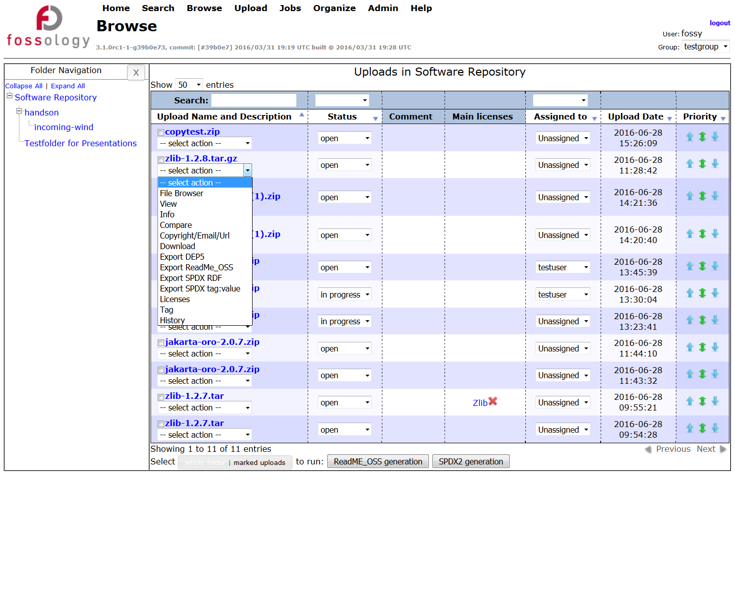
Features: Using Reporting
User Interface
All upload items are listed in browser
Selection of different report items in pop-up menu at every uploaded item, export
Debian-copyright, DEP5
Readme, notice file
SPDX RDF/XML
SPDX Tag:Value
LibreOffice: Writer Report
1. Select existing upload from where to reuse license decisions

Slide 32
Feature: Administering FOSSology Server

Slide 33
Hands-On: Organizing Uploads, Users and Groups
Functionality
Example
Creating folders
Folders allow to organize your uploads
You could create folders by software groups (e.g. all Apache projects)
Or by your products or projects
Or by your teams and involved persons
Long term perspective: create a repository of reusable cleared components
Create users and groups
User creation (and modify existing users)
Creating groups
Groups cannot see other groups’ clearing decisions
Move uploads and folders
Access rights copying
Create folders
Trains
Wind
Create groups
Train group
Wind group
Create users
Robert (trains)
Dan (trains)
Andreas (wind)
Daniele (wind)

Slide 34
What is FOSSology?
A Web server application for license and copyright compliance of software components.
FOSSology Project
https://www.fossology.org/
FOSSology Development
https://www.github.com/fossology/fossology
Published first in 2008, GPL-2.0
2015: Linux Foundation collaboration project
Web server based and command line interfaces
Scanning agents searching for license and copyright relevant hits (and more …)
A multi-user / multi-tenant Web UI for review organizing clearing job
Standard Web application stack:
Linux, Apache 2, PostgreSQL, PHP,
Web-based UI in PHP, but scanners written in C / C++
Besides Web UI:
Command line utilities
Notes:
Memo

Slide 35
Basic End-to-End Workflow
The summary of the basic way how to use FOSSology
Upload the open source package
Do the licenses until all files are clarified (= green dots)
Correct the copyrights, check authorship statements
Check the ECC findings
Generate an output reporting (SPDX, Debian Copyright, Readme)

Slide 36
Hands-On: “Not-So-Basic” End-to-End Workflow
Functionality
Example
Using FOSSology End-to-End
From uploading …
… to generating report: SPDX
Uploading - offers a variety of selections
Review the uploaded file in the license browser
Review the found licenses in the aggregated view
Do the clearing work
Review the copyrights
Review the Export Control and Customs (ECC)
Generate desired report output
Upload the example file, time-1.7.tar.gz
Select the options in the upload menu
Go to browse and review the UI there
Select licenses from drop-down menu at upload
See the aggregated views and single file view: create decisions
First use of the bulk
Go to copyrights and correct found matches
ECC will be the same
Select output from drop-down

Slide 37
FOSSology Major Takeaways
It is open source software
No vendor lock-in, it can be shared among partners
It is a server-based Web application
Allowing for multi user operations, allowing for reuse
It is many features for efficiency
Reducing the actual efforts for analyzing OSS components

Slide 38
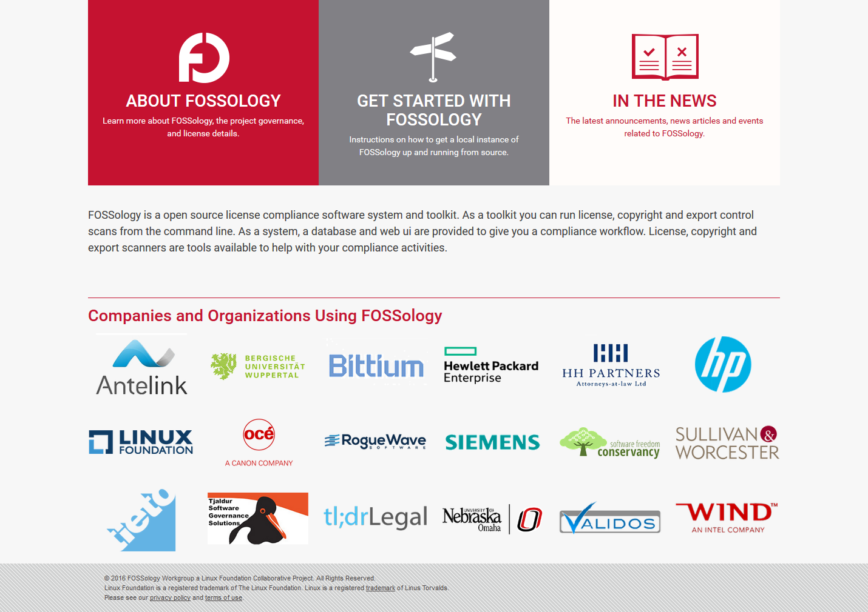
You like it, and would like to contribute?
See the FOSSology.org website for the most recent list of public supporters.
Not on this list? – Consider supporting the project with putting your logo there. To be included, send email to fossology-steering@fossology.org.
Report issues on Github: https://github.com/fossology/fossology
And of course… code contributions to extend and improve FOSSology are welcome!

Slide 39
And Help us Improve this FOSSology training :-)
Please fill out survey to help us improve this course:
https://tobe.creat.ed/newsurvey
If you include your email address, we will mail you back these slides from today.

Slide 40
Thank you for your attention!
© 2016-2018 Siemens AG, The Linux Foundation
CC-BY-SA 4.0 https://creativecommons.org/licenses/by-sa/4.0/
Internet https://www.fossology.org
Github https://github.com/fossology/fossology
Further Links https://www.spdx.org
https://www.openchainproject.org
https://github.com/sw360/sw360portal
Notes:
Notes

