Slide 1
Optimizing
Apache Spark SQL Joins
Vida Ha
Solutions Architect
Notes:
PRESENTER:
Underline text added for extra emphasis

Slide 2

About Me
2005 Mobile Web & Voice Search

Slide 3

About Me
2005 Mobile Web & Voice Search
2012 Reporting & Analytics

Slide 4

About Me
2005 Mobile Web & Voice Search
2012 Reporting & Analytics
2014 Solutions Architect

Slide 5
Evolution of Spark…
2014:
Spark 1.x
RDD based API’s.
Everyday I’m Shufflin’
2017:
Spark 2.x
Dataframes & Datasets
Adv SQL Catalyst
Optimizing Joins

Slide 6

Spark SQL Joins
SELECT … FROM TABLE A
JOIN TABLE B
ON A.KEY1 = B.KEY2

Slide 7
Topics Covered Today
Basic Joins:
Shuffle Hash Join
Troubleshooting
Broadcast Hash Join
Cartesian Join
Special Cases:
Theta Join
One to Many Join

Slide 8
Shuffle Hash Join
A Shuffle Hash Join is the most basic type of join, and goes back to Map Reduce Fundamentals.
Map through two different data frames/tables.
Use the fields in the join condition as the output key.
Shuffle both datasets by the output key.
In the reduce phase, join the two datasets now any rows of both tables with the same keys are on the same machine and are sorted.

Slide 9
Shuffle Hash Join
MAP
Table 1
Table 2
SHUFFLE
REDUCE
Output
Output
Output
Output
Output

Slide 10
Shuffle Hash Join Performance
Works best when the DF’s:
Distribute evenly with the key you are joining on.
Have an adequate number of keys for parallelism.
join_rdd = sqlContext.sql(“select *
FROM people_in_the_us
JOIN states
ON people_in_the_us.state = states.name”)

Slide 11
Uneven Sharding & Limited Parallelism,
US DF
Partition 1
US DF
Partition 2
US DF Partition N
Small State DF
All the data for the US will be shuffled into only 50 keys for each of the states.
Problems:
Uneven Sharding
Limited parallelism w/ 50 output partitions
US RDD
Partition 2
**All** the Data for RI
US RDD
Partition 2
**All** the Data for CA
CA
RI
A larger Spark Cluster will not solve these problems!

Slide 12
Uneven Sharding & Limited Parallelism,
US DF
Partition 1
US DF
Partition 2
US DF Partition N
Small State DF
All the data for the US will be shuffled into only 50 keys for each of the states.
Problems:
Uneven Sharding
Limited parallelism w/ 50 output partitions
US RDD
Partition 2
**All** the Data for RI
US RDD
Partition 2
**All** the Data for CA
CA
RI
Broadcast Hash Join can address this problem if one DF is small enough to fit in memory.

Slide 13
More Performance Considerations
join_rdd = sqlContext.sql(“select *
FROM people_in_california
LEFT JOIN all_the_people_in_the_world
ON people_in_california.id =
all_the_people_in_the_world.id”)
Final output keys = # of people in CA, so don’t need a huge Spark cluster, right?

Slide 14
Left Join - Shuffle Step
All CA DF
All World DF
Shuffles everything before dropping keys
All the Data from Both Tables
Not a Problem:
Even Sharding
Good Parallelism
Final Joined Output
The Size of the Spark Cluster to run this job is limited by the Large table rather than the Medium Sized Table.

Slide 15
A Better Solution
Filter the World DF for only entries that match the CA ID
All CA DF
All World DF
Filter Transform
Benefits:
Less Data shuffled over the network and less shuffle space needed.
More transforms, but still faster.
Partial World DF
Shuffle
Final Joined Output

Slide 16
What’s the Tipping Point for Huge?
Can’t tell you.
There aren’t always strict rules for optimizing.
If you were only considering two small columns from the World RDD in Parquet format, the filtering step may not be worth it.
You should understand your data and it’s unique properties in order to best optimize your Spark Job.

Slide 17
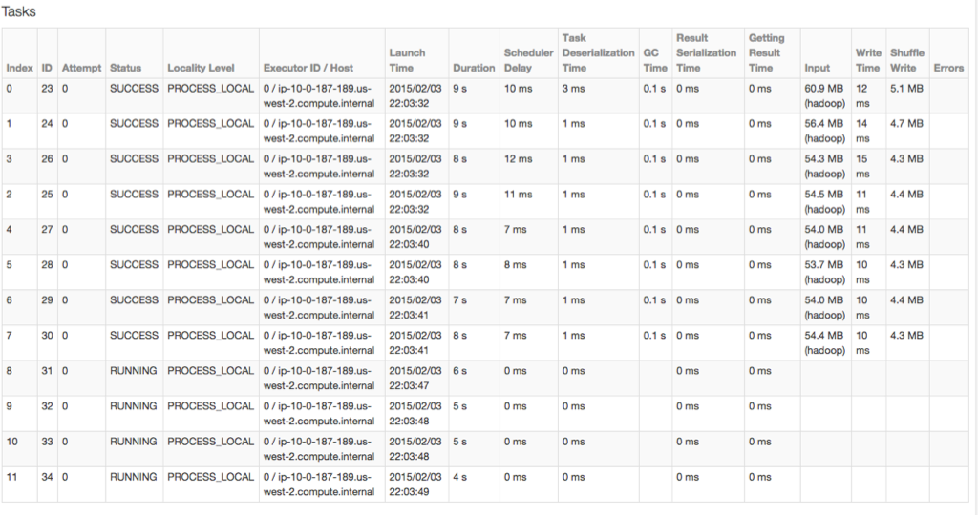
In Practice: Detecting Shuffle Problems
Check the Spark UI pages for task
level detail about
your Spark job.
Things to Look for:
Tasks that take much longer to run than others.
Speculative tasks that are launching.
Shards that have a lot more input or shuffle output.

Slide 18
Broadcast Hash Join
Optimization: When one of the DF’s is small enough to fit in memory on a single machine.
Small DF
Broadcast
Large DF
Partition 1
Large DF
Partition 2
Large DF
Partition N
Small DF
Small DF
Small DF
Parallelism of the large DF is maintained (n output partitions), and shuffle is not even needed.

Slide 19
Broadcast Hash Join
Often optimal over Shuffle Hash Join.
Use “explain” to determine if the Spark SQL catalyst hash chosen Broadcast Hash Join.
Should be automatic for many Spark SQL tables, may need to provide hints for other types.

Slide 20
Cartesian Join
A cartesian join can easily explode the number of output rows.
100,000 X 100,000 = 10 Billion
Alternative to a full blown cartesian join:
Create an RDD of UID by UID.
Force a Broadcast of the rows of the table .
Call a UDF given the UID by UID to look up the table rows and perform your calculation.
Time your calculation on a sample set to size your cluster.

Slide 21
One To Many Join
A single row on one table can map to many rows on the 2nd table.
Can explode the number of output rows.
Not a problem if you use parquet - the size of the output files is not that much since the duplicate data encodes well.

Slide 22
Theta Join
join_rdd = sqlContext.sql(“select *
FROM tableA
JOIN tableB
ON (keyA < keyB + 10)”)
Spark SQL consider each keyA against each keyB in the example above and loop to see if the theta condition is met.
Better Solution - create buckets for keyA and KeyB can be matched on.

Slide 23

Thank you

Slide 24
Questions?

