Slide 1
Mitigating Multipath Effect for DSSS Positioning – Using Deep Learning
Justin Yang

Slide 2
Motivation
DSSS (Direct Sequence Spread Spectrum) is a common technique for measuring the distance between the transmitter and receiver.
For the positioning using DSSS, it is reported that reducing the transmission bandwidth will lower the positioning accuracy when multipath channel exists.
Traditionally, the rectangular pulse shape is used as the transmission waveform for the sake of the positioning accuracy.
However, bandwidth is a precious resource. Thus, it is desired to reduce the bandwidth requirement if possible.
This is especially true if we use the radio broadcasting the DSSS waveforms for the indoor or outdoor positioning service.
To have the accuracy not limited by the multipath channel and the non-rectangular transmission pulse shaping such as Raised Cosine pulse shaping, it is commonly thought that channel estimation is required.
Channel estimation means that higher computation power is required.
We proposed that Deep Learning technique can be used for the sake of the regression.

Slide 3
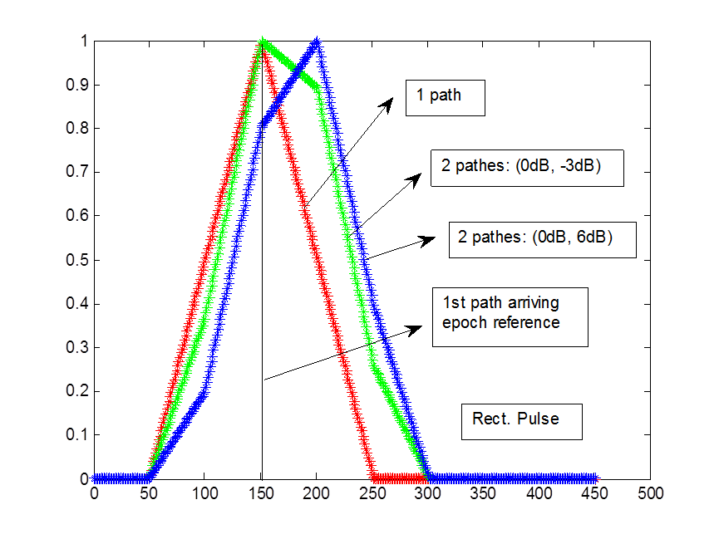
Multipath Error -- Rectangular Shape
Peak searching algorithm (such as narrow correlator) won’t work well, especially when the 2nd path is stronger than the 1st path.
Rectangular pulse
shape
Each waveform is
associated with
their own bias
error.
Waveform learning
can solve this bias
estimation problem.

Slide 4
Multipath Error – Raised Cosine
Case: Raised Cosine with Alpha = 1.0
Waveforms are more
similar, implying that
it is more difficult
to learn.
Each waveform is
still associated with
their own bias
error.
Waveform learning
also work based on
our simulation results.

Slide 5
Some Comments from the previous 2 Figures
Bandwidth versus Positioning Accuracy
Traditional scheme NC (Narrow Correlator): Pulse shaping for conserving the BW will enlarge the positioning uncertainty when multipath channel exists.
Extreme Case -- when the first path is not the one carrying the largest energy:
The scheme NC won’t work.
Use DSSS broadcasting for the positioning in the indoor / outdoor environment requires new technique.
We propose the waveform learning based on Deep Learning to reduce the positioning uncertainty.

Slide 6
Survey on Techniques of Mitigating Multipath Error
References can be found at P.14 and P.15.
Pulse shaping design:
Several papers address this problem, especially before launching the GNSS system [1] ~ [3].
Signal Processing:
[10]: compute the channel for the bias estimation.
[5]: original paper, in 1992, of using the Narrow correlator (reducing the space between Early and Late) to do the positioning calculation.
[6]: The reference [6] provides the survey of the multipath mitigating technique such as D-D (which uses the 2nd derivatives for eliminating the bias caused by multipath).
[4]: SVM approach based on the analytic equation to estimate the positioning bias. The analytic equation can only be derived under the assumption of the rectangular pulse without any filtering. The first paper uses the machine learning algorithm to solve this problem.
Our Approach: Deep Learning Technique based on waveform study.
We propose the waveform learning to reduce the positioning uncertainty.

Slide 7
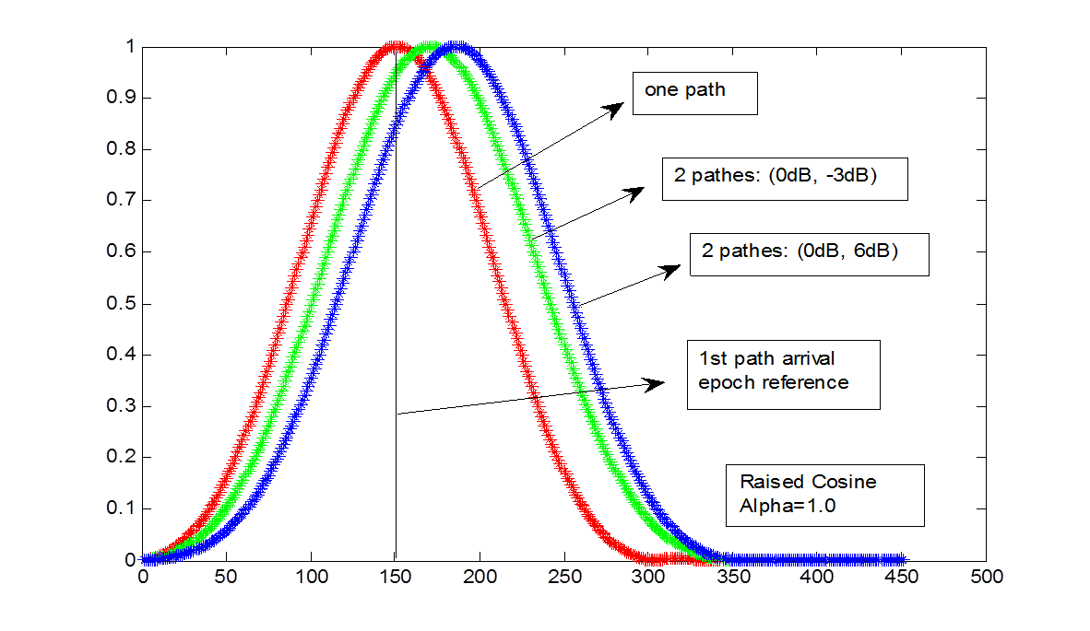

Waveform Based Learning
Will it work?
The answer is YES. But we need to run the simulation to confirm.
YES. We can give the answer
without running the simulations.

Slide 8
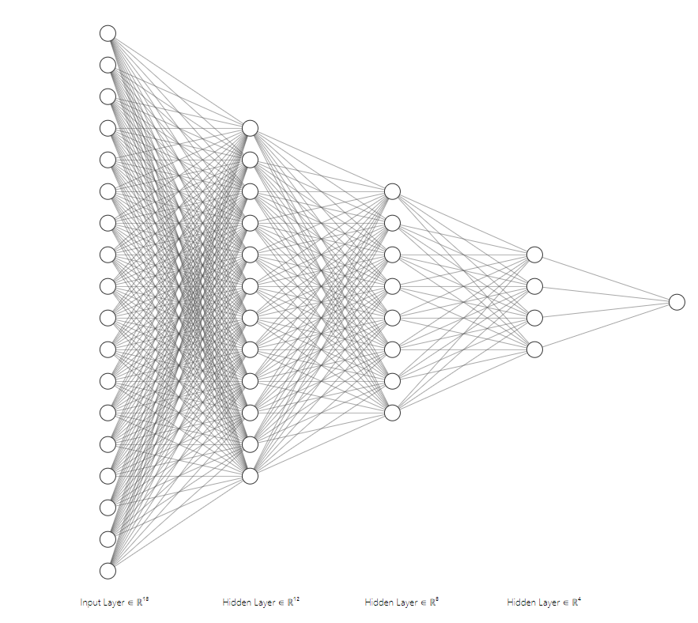
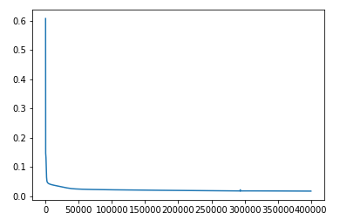
Proposed Neural Network
Sample 8 points (around the peak) of the de-spreaded signal as input of the Deep Neural Network (normalized to the peak).
Output: estimated error bias (in terms of chip).
Loss function : mean square error
Learning rate = 0.2
epoch
Model: 18-12-8-4-1
Learning Curve

Slide 9
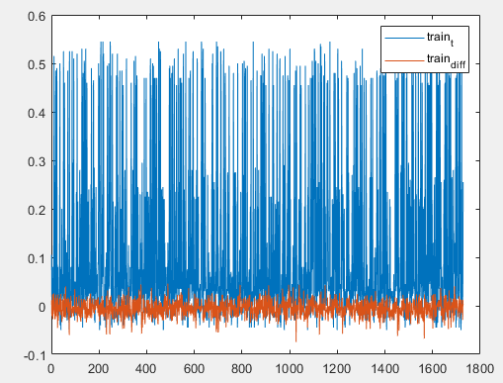
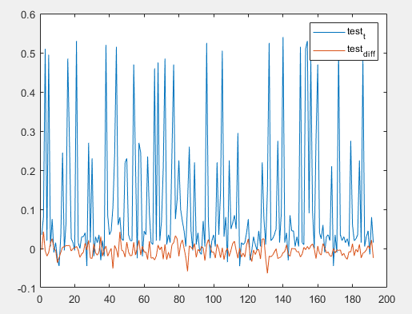
Simulation Results (1)
Rectangular-Pulse + receiver 8MHz LPF

Slide 10
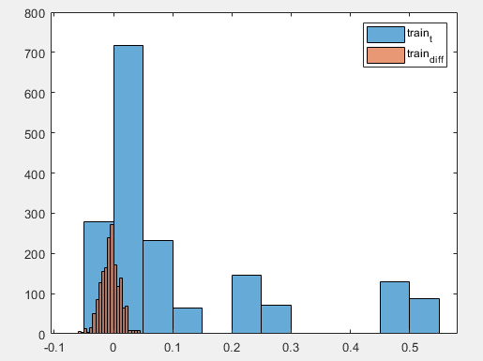
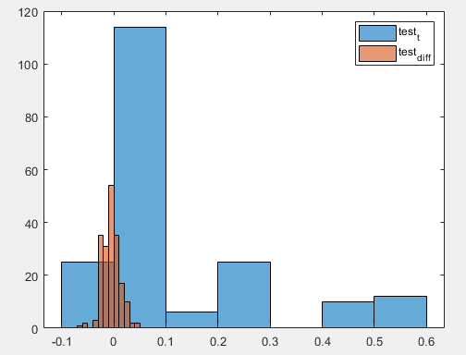
Simulation Results (2)
Training Error mean = 0.005416995025196702
Testing Error mean = 0.005860933826381527
Training MS Error std = 0.016036407205876374
Test MS Error std = 0.016632837080331097
Diff : Residual Error after the compensation of our approach

Slide 11
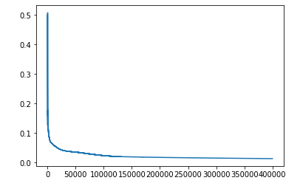
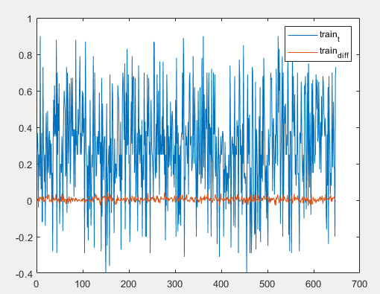
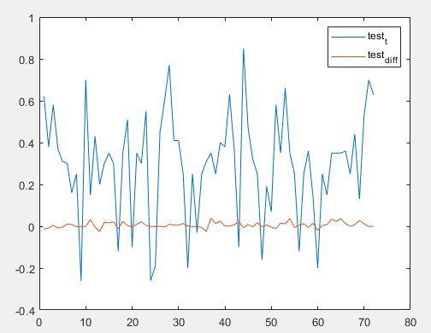
Simulation Results (3)
Raised Cosine Pulse Shape

Slide 12
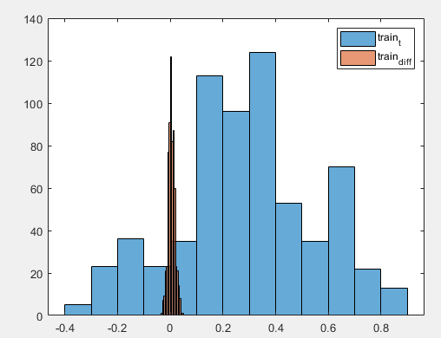
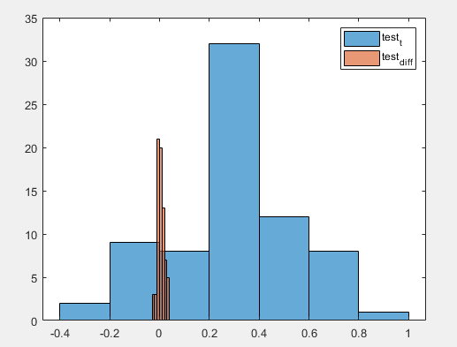
Simulation Results (4)
Training Error mean = -0.004777672044939124
Testing Error mean = -0.005929175040308779
Training MS Error std = 0.012709416500262825
Test MS Error std = 0.01367870038915605
Diff : Residual Error after the compensation of our approach

Slide 13
To Do
To-Do List:
Test the cases of different multipath spacing, under two-path cases
Test the cases of more general channel condition
Add noise to see the performance versus SNR

Slide 14
References – Part 1
[1] J. A. Nossek and Felix Antreich, “On chip pulse shape design for precise synchronization of DS-CDMA systems”, INTERNATIONAL JOURNAL OF CIRCUIT THEORY AND APPLICATIONS Int. J. Circ. Theor. Appl. 2007; 35:565–574.
Mainly concern on the design of pulse shaping for the sake of synchronization.
[2] J. A. Nossek and Felix Antreich, “OPTIMUM CHIP PULSE SHAPE DESIGN FOR TIMING SYNCHRONIZATION”, link: http://www.mirlab.org/conference_papers/International_Conference/ICASSP%202011/pdfs/0003524.pdf
Similar to the reference [1].
[3] Luca Giugno, Marco Luise, “OPTIMUM PULSE SHAPING FOR DELAY ESTIMATION IN SATELLITE POSITIONING”, Invited Paper, link: http://kilyos.ee.bilkent.edu.tr/~signal/defevent/papers/cr1314.pdf
Use the CRB of the delay as the performance criterion to design pulse shape.
[4] Quoc-Huy Phan, Su-Lim Tan and Ian McLoughlin, “GPS multipath mitigation: a nonlinear regression approach”, GPS Solutions, July 2013, Volume 17, Issue 3, pp 371–380.
Based on the close-form equation of the multipath errors (which is only possible under the rectangular pulse without any receiver filtering), the authors formulate the multipath errors as the parameters estimation problem, and hence the SVM is used for estimating the positioning bias.
[5] A. J. V. Dierendonck, P. Fenton and T. Ford, “Theory and Performance of Narrow Correlator Spacing in a GPS Receiver”, Navigation: Journal of The Institute of Navigation, Vol. 39, No. 3, Fall 1992.
Original paper on using the Narrow Correlator to solve the GPS positioning problem.

Slide 15
References – Part 2
[6] M. Zahidul, H. Bhuiyan and E. S. Lohan, “Multipath Mitigation Techniques for Satellite-Based Positioning Applications”, Chapter 17, Global Navigation Satellite Systems. Link: https://www.intechopen.com/books/global-navigation-satellite-systems-signal-theory-and-applications/multipath-mitigation-techniques-for-satellite-based-positioning-applications
This paper offers a survey of the multipath mitigating technique.
[7] M. Nguyen-H and C. Zhou, “Improving GPS/INS Integration through Neural Networks, Journal of Telecommunications, Vol. 2, Issue 2, May 2010.
Neural network approach is used to do the information fusion for calculating the user position.
[8] J. Soubielle, I. Fijalkow, P. Duvaut and A. Bibaut, “GPS Positioning in a Multipath Environment”, IEEE Transactions on Signal Processing, Vol. 50, No. 1, Jan. 2002
This is mainly a performance analysis paper regarding the CRB of GPS errors.
[9] S. Lohan, Lecture Note 9: Code acquisition and tracking – advanced strategies, positioning oriented, Link: http://www.cs.tut.fi/courses/TLT-5606/Lec9_TLT5606_S.pdf
This is a course lecture note offered by S. Lohan.
[10] C. Sun, H. Zhao, W. Feng and S. Du, “A Frequency-Domain Multipath Parameter Estimation and Mitigation Method for BOC-Modulated GNSS Signals”, Sensors (Basel). 2018 Mar; 18(3): 721. Published online 2018 Feb 28, link: https://www.ncbi.nlm.nih.gov/pmc/articles/PMC5876711/
Estimating the channel parameters for determining the bias.

Slide 16
Appendices
Baseband equivalent model
Raised cosine waveform

Slide 17
Baseband Equivalent
From Tse’s Book Eq. 2-19 ~ Eq. 2-28:

Slide 18
Pulse Shaping Function
Wiki: https://en.wikipedia.org/wiki/Raised-cosine_filter

