Slide 1
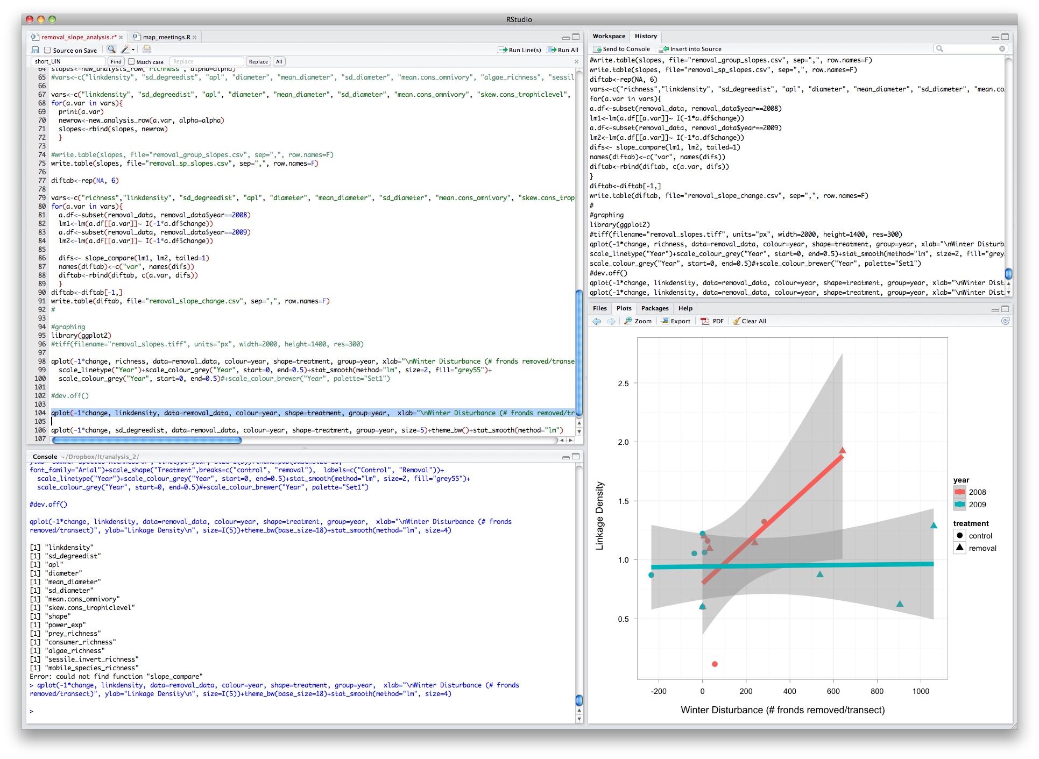
Source 창
Environment 창
Console 창
help 창

Slide 2
Source 창
Environment 창
Console 창
help 창

Slide 3
Source 창
Environment 창
Console 창
help 창

Slide 4
Source 창
Environment 창
Console 창
help 창

Slide 5
Source 창
Environment 창
Console 창
help 창

