Slide 1
WHEEL'S AUTOMOTIVE DEALER SUPPLIES
ACCOUNT SIGN-UP REDESIGN
One email = one account · One business = one company · Anyone can sign up
October 2026 · For discussion

Slide 2
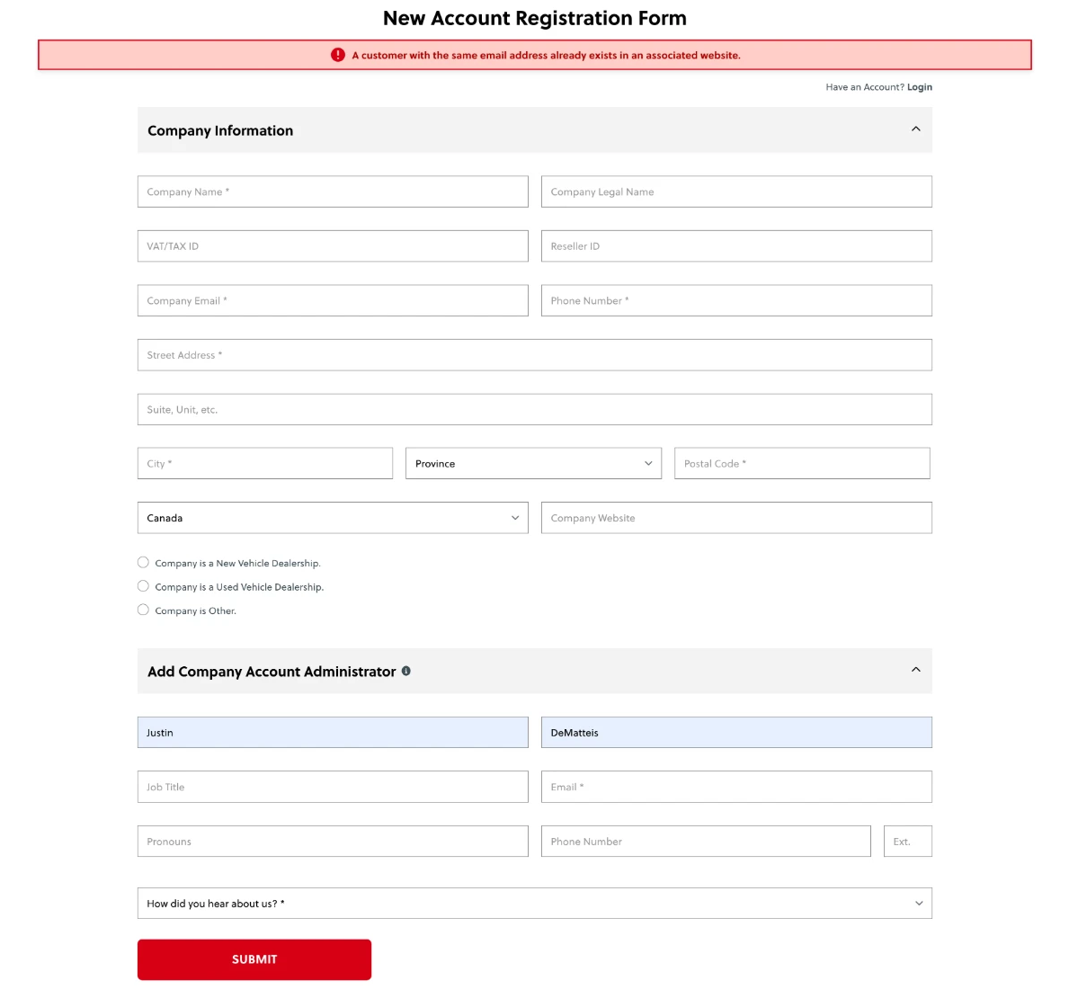
TODAY'S REGISTRATION FORM
wheelsauto.com → Login / Register → New Account Registration Form
Company first, person second
"Add Company Account Administrator" is really the person filling it in
Every sign-up creates a new company
Email and phone asked twice
Jargon: Legal Name, VAT/TAX ID, Reseller ID, Pronouns
No password, no "what happens next"
The red error ("email already exists in an associated website") gives no way forward
Wheel's Automotive Dealer Supplies · Account sign-up redesign
2

Slide 3
WHAT GOES WRONG TODAY
Duplicate companies. Three people from one dealership sign up → "Smith Ford", "Smith Ford Inc.", "Smith Ford Ltd". Orders, pricing and discounts split across them.
No common denominator. Nothing ties people to the same business except how they spell the name.
Not everyone is a dealership. Individuals and other businesses (body shops, fleets, agencies) get dealership questions.
Support calls. "Do I have an account?" · "Reset my password" · "I can't get in".
People get stuck. The duplicate-email error gives no Log in or Reset option.
Hard to finish. One long page, company and person mixed, fields repeated.
Wheel's Automotive Dealer Supplies · Account sign-up redesign
3

Slide 4
GOALS
1
2
3
4
One email = one account
One business = one company
Anyone can sign up
Customers help themselves
Checked first. Already used → Log in or Reset password.
Found first by a common denominator. Joined, never retyped.
Just me · A dealership · Another business. Each gets the right form.
Email check + Forgot password. Staff reset in one click.
Wheel's Automotive Dealer Supplies · Account sign-up redesign
4

Slide 5
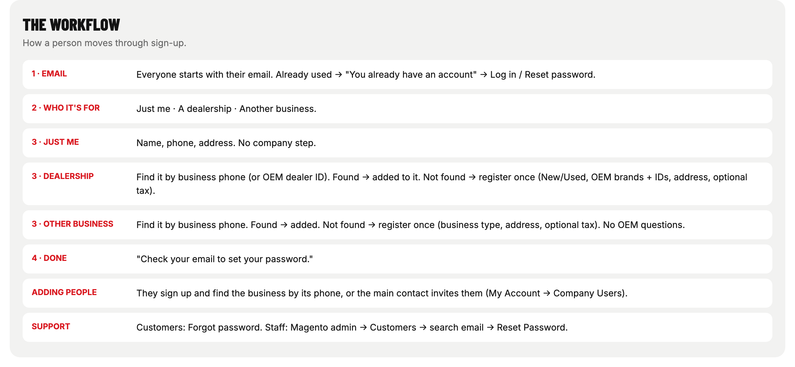
THE NEW WORKFLOW
Email → Who it's for → the right form → Done
Wheel's Automotive Dealer Supplies · Account sign-up redesign
5

Slide 6
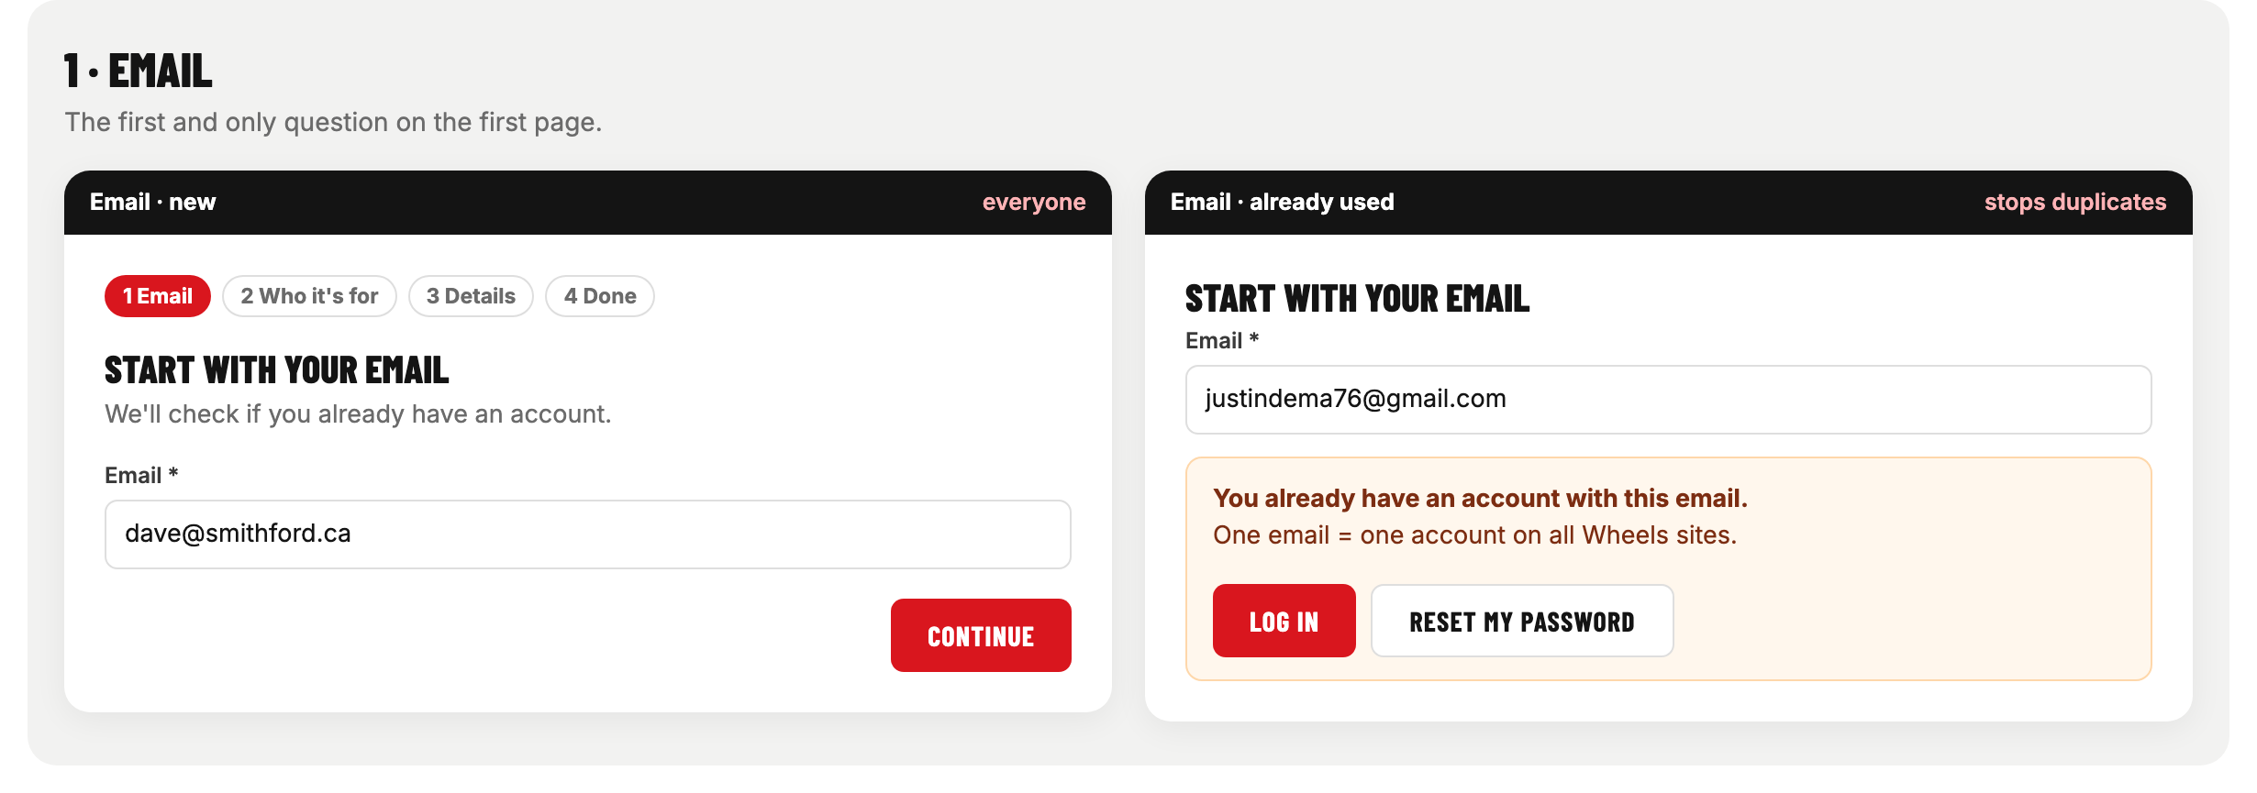
STEP 1 · EMAIL
Everyone starts here. Already used → Log in / Reset my password.
Wheel's Automotive Dealer Supplies · Account sign-up redesign
6

Slide 7
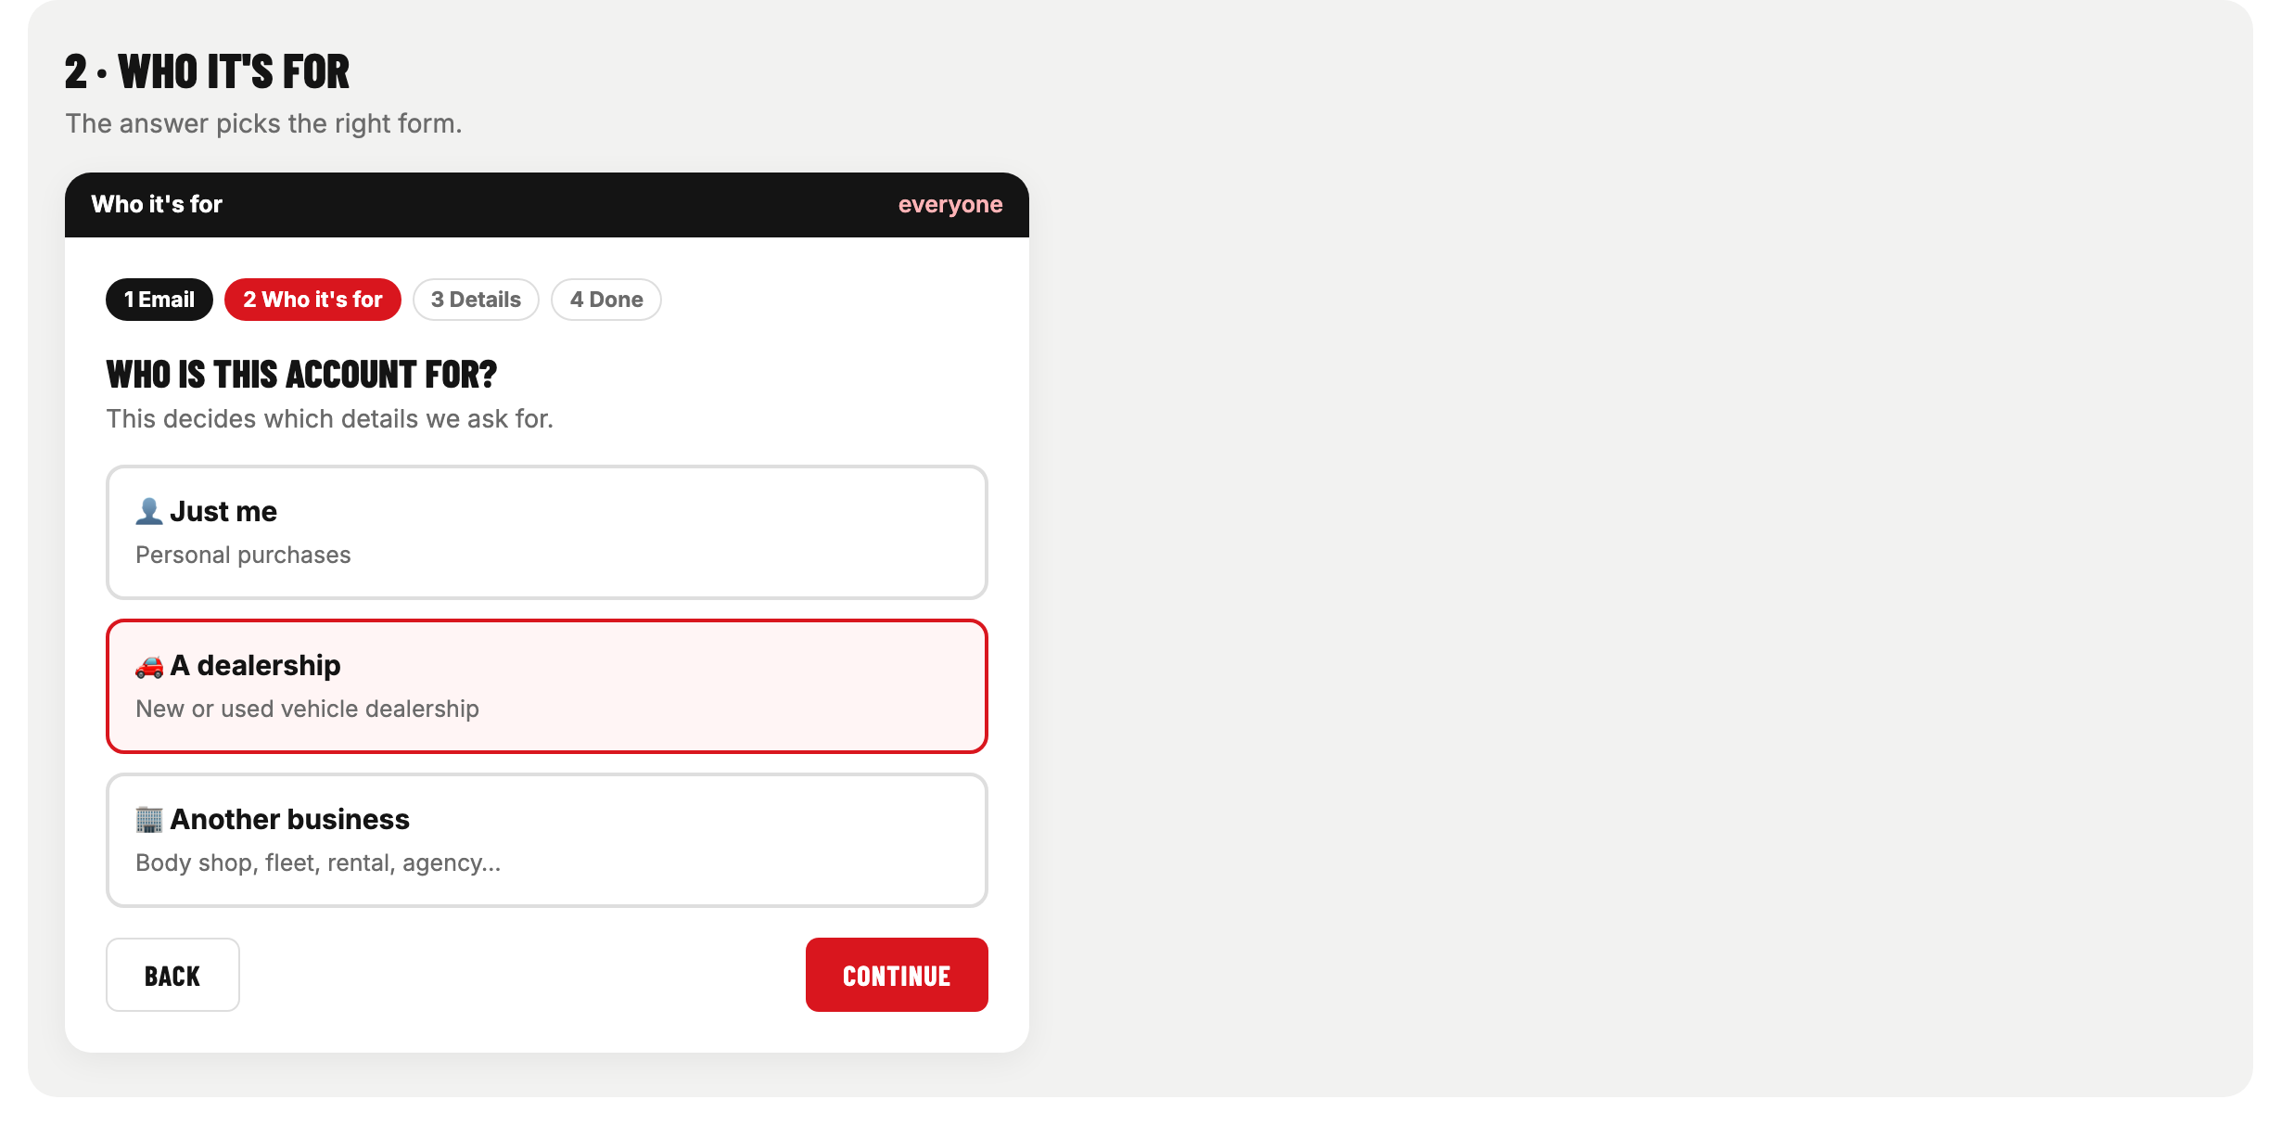
STEP 2 · WHO IS THIS ACCOUNT FOR?
Just me · A dealership · Another business
Wheel's Automotive Dealer Supplies · Account sign-up redesign
7

Slide 8
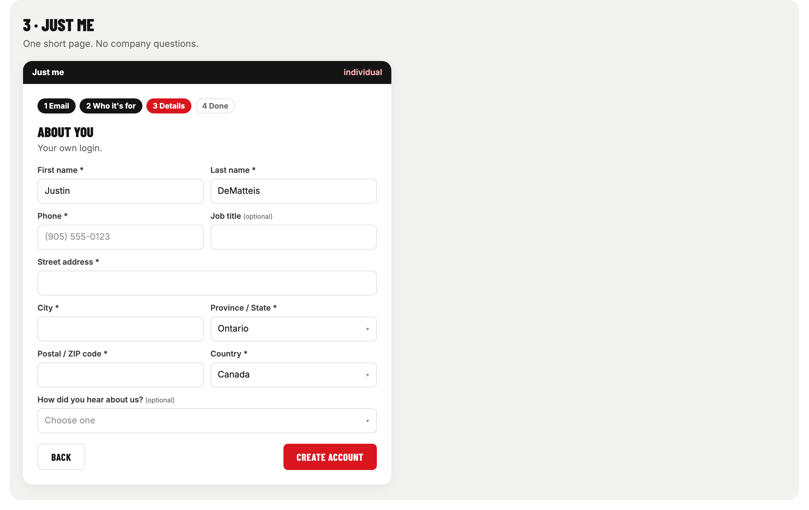
STEP 3 · JUST ME
Name, phone, address. No company questions.
Wheel's Automotive Dealer Supplies · Account sign-up redesign
8

Slide 9
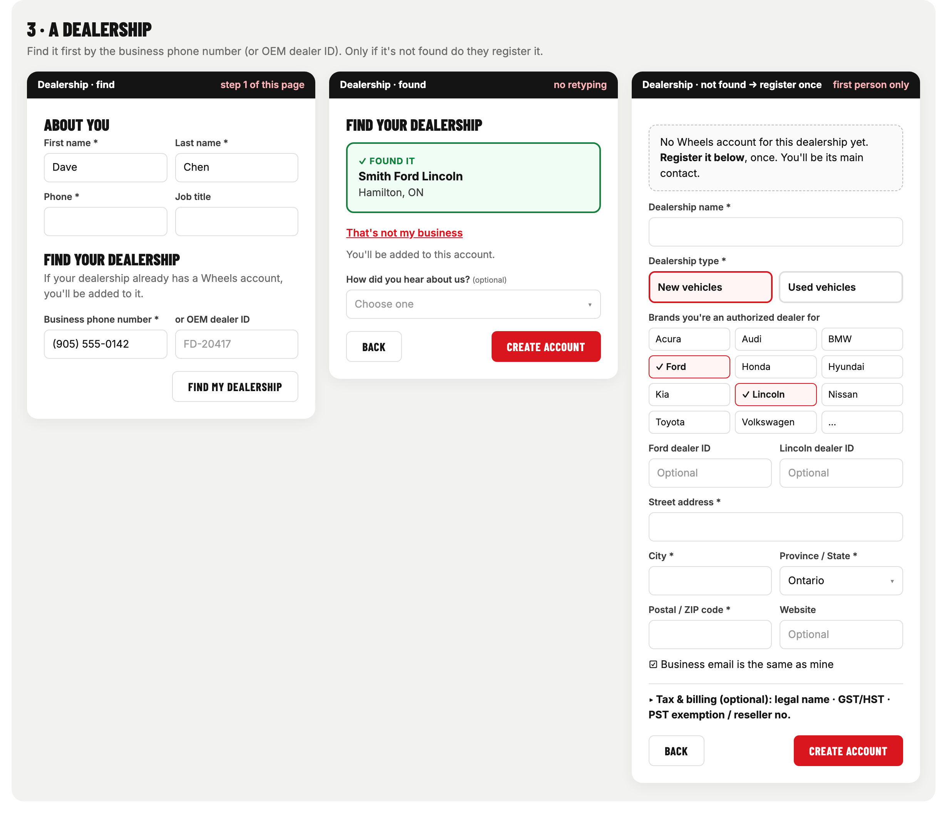
STEP 3 · A DEALERSHIP
Find by business phone (or OEM dealer ID). Found → join. Not found → register once.
Wheel's Automotive Dealer Supplies · Account sign-up redesign
9

Slide 10
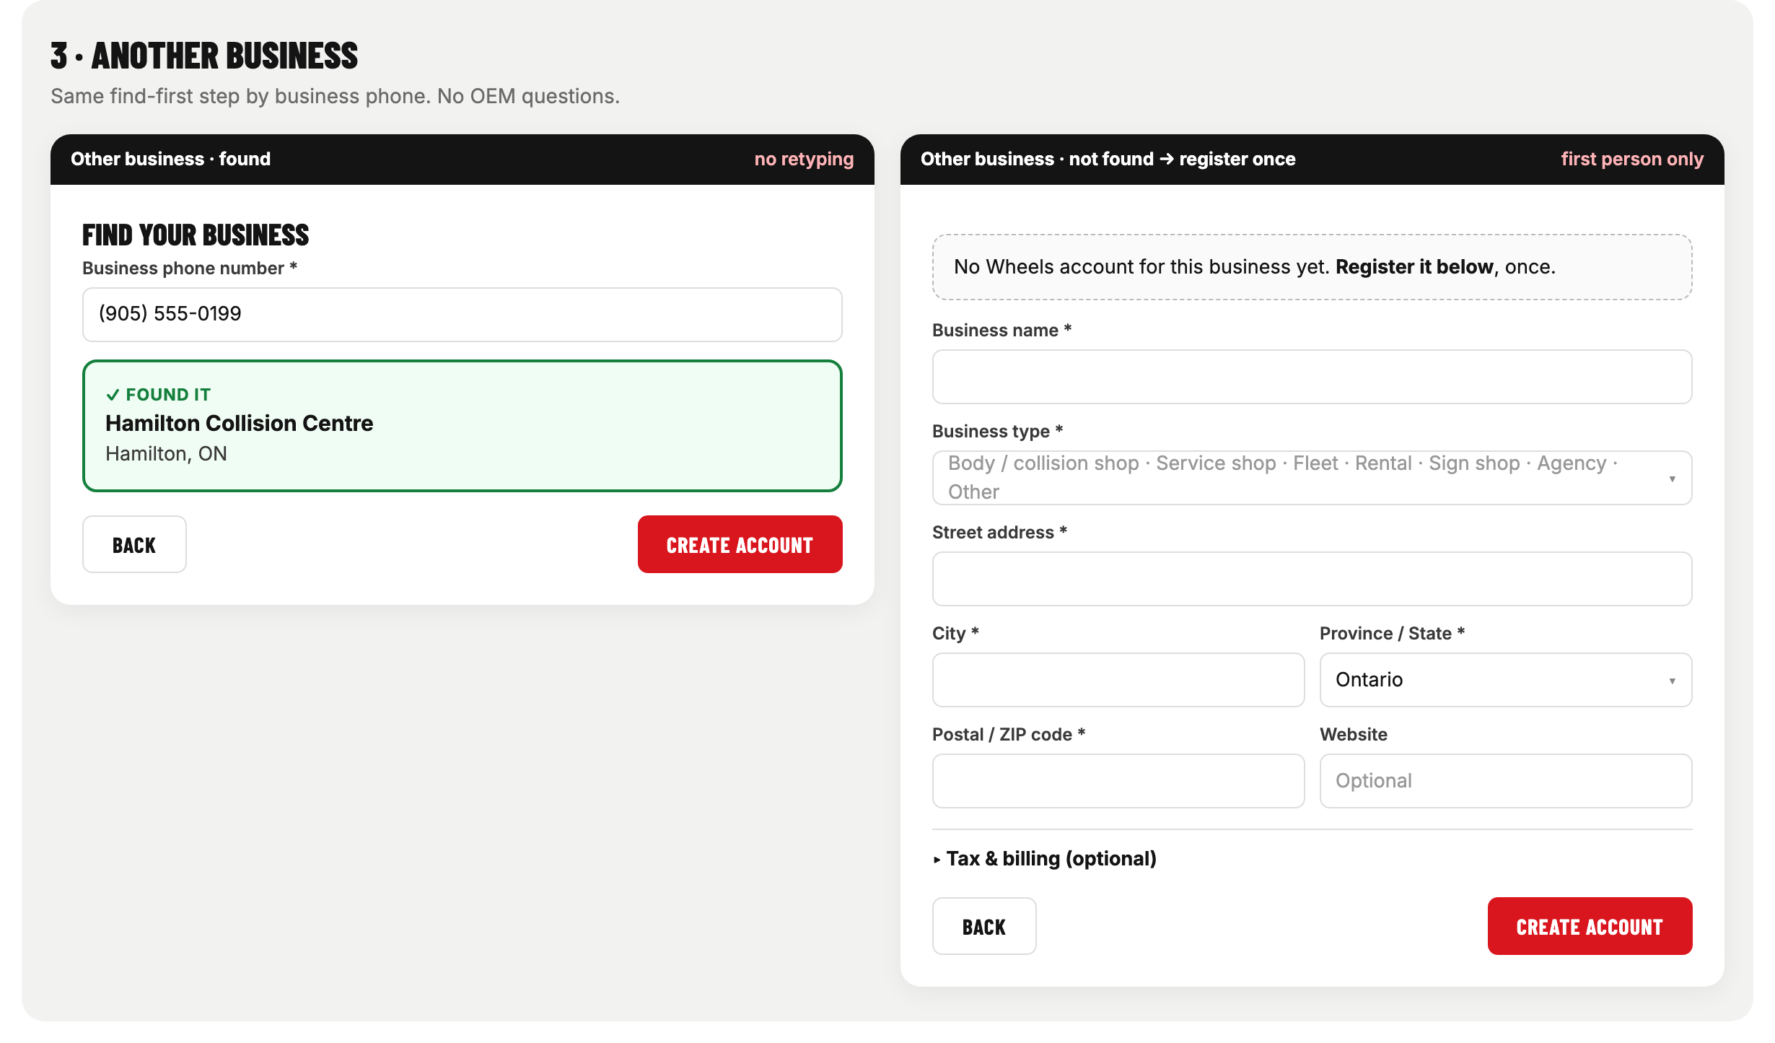
STEP 3 · ANOTHER BUSINESS
Same find-first step. Business type instead of OEM questions.
Wheel's Automotive Dealer Supplies · Account sign-up redesign
10

Slide 11
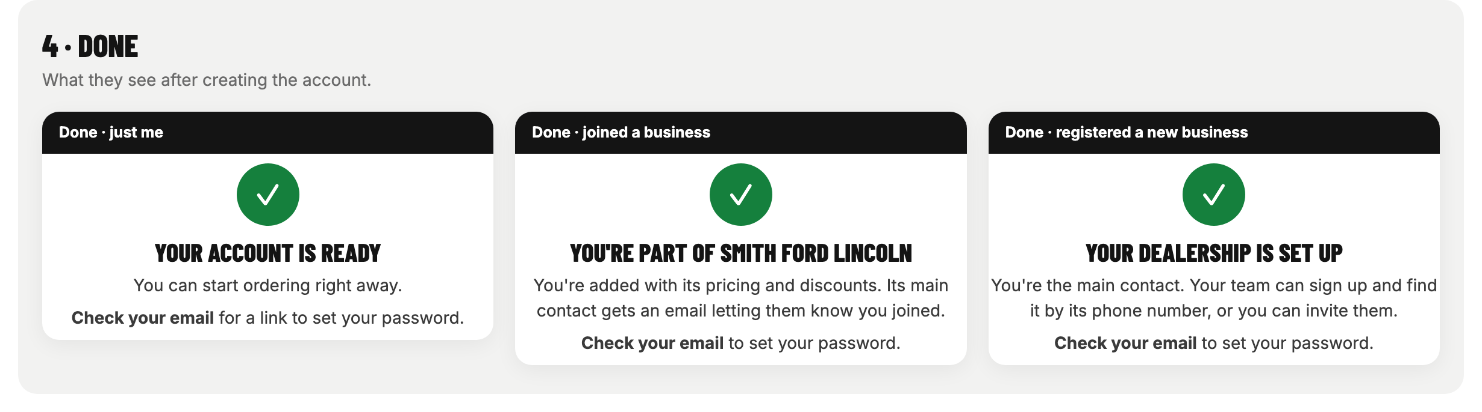
STEP 4 · DONE
Clear next step: check your email to set your password.
Wheel's Automotive Dealer Supplies · Account sign-up redesign
11

Slide 12
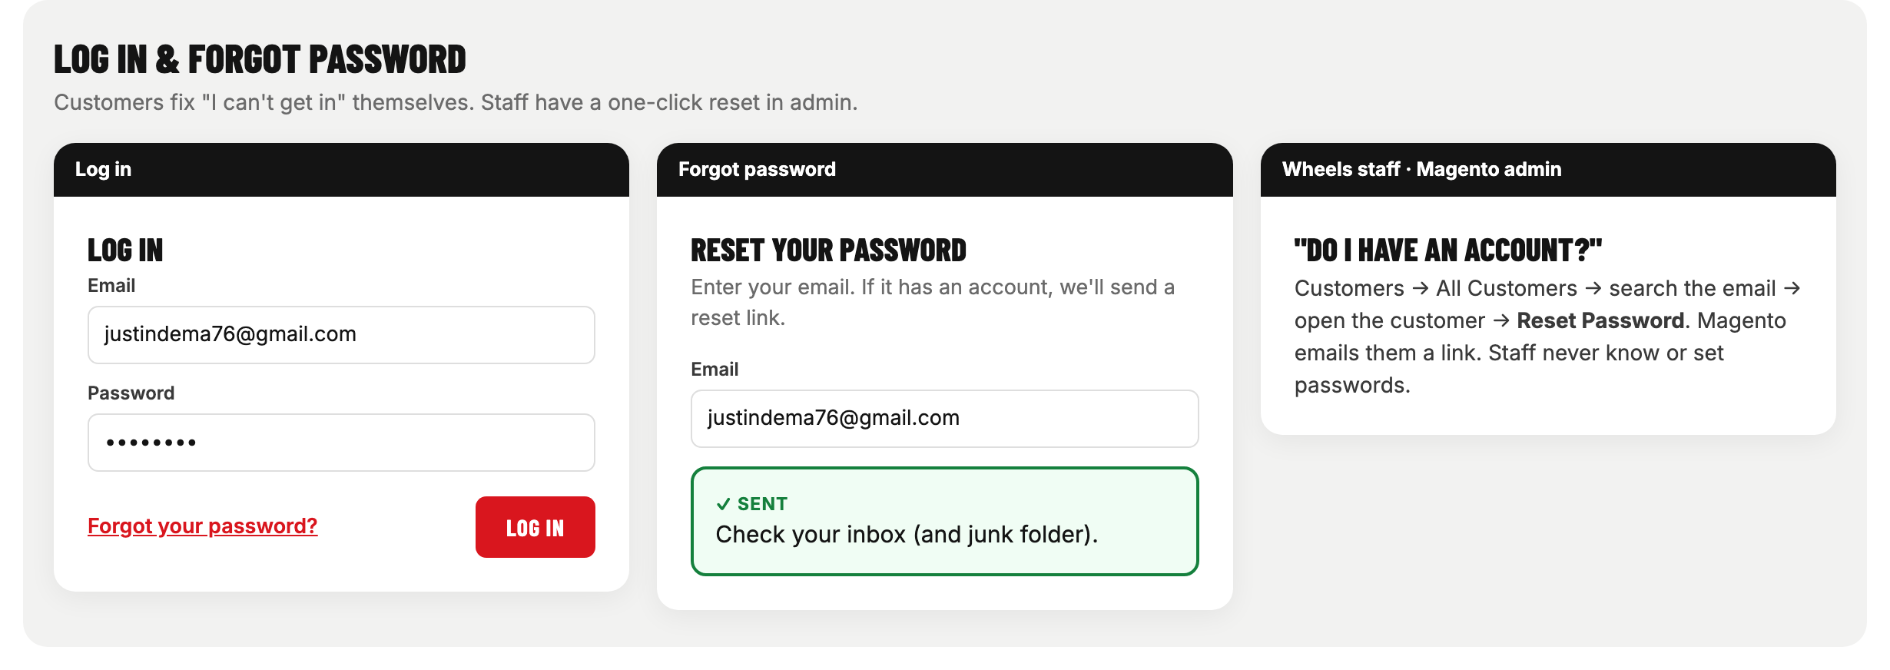
LOG IN & FORGOT PASSWORD
Customers reset it themselves. Staff: Magento admin → Customers → Reset Password.
Wheel's Automotive Dealer Supplies · Account sign-up redesign
12

Slide 13
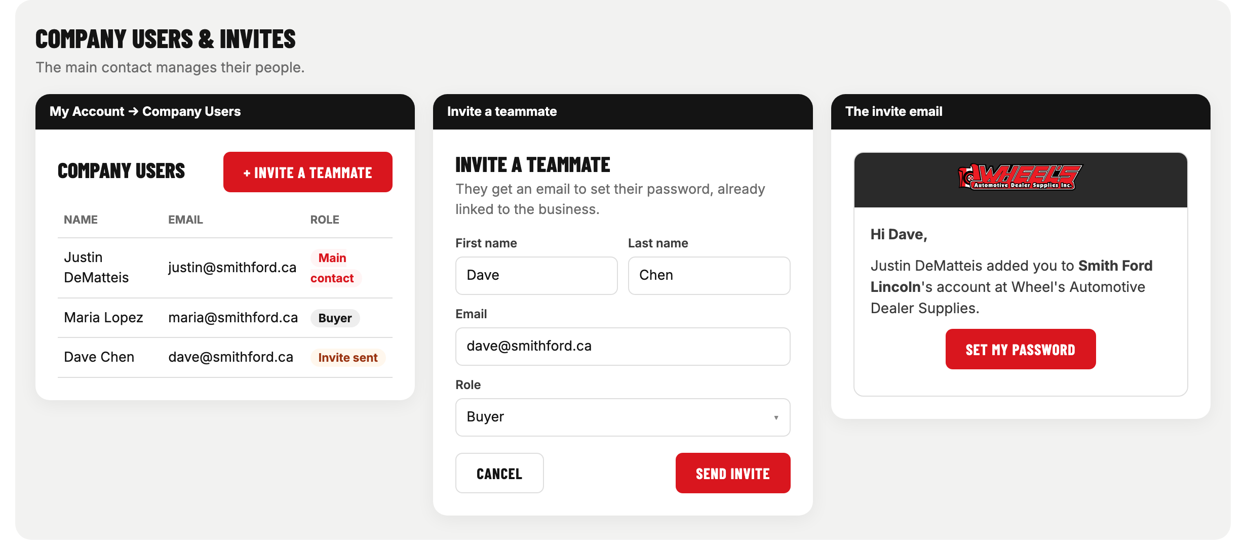
COMPANY USERS & INVITES
The main contact sees everyone and can invite teammates by email.
Wheel's Automotive Dealer Supplies · Account sign-up redesign
13

Slide 14
THE COMMON DENOMINATOR
How the system knows two people work at the same business. To decide in the meeting.
Option | Good | Watch out
Business phone number (proposed) | Every business has one; doesn't depend on spelling | Must be stored in one format (digits only)
OEM dealer ID | Exact match for franchised dealerships | Only dealerships have one
Email domain (@smithford.ca) | Automatic, nothing extra to type | Gmail/Hotmail users; groups share domains
Name + postal code | Works for anyone | Spelling differences → still duplicates
Recommendation: business phone number for everyone, plus OEM dealer ID for dealerships. Name spelling never decides a match.
Wheel's Automotive Dealer Supplies · Account sign-up redesign
14

Slide 15
WHAT NEEDS TO BE BUILT
For the developer (Hafiz)
Email check first: tell the person if the email already has an account; offer Log in / Reset.
"Who is this for?" step that routes to Just me / Dealership / Other business forms.
Business search by the common denominator (phone, dealer ID); show only name + city.
Join existing company: attach the new person to the found company, no approval; email the main contact.
Register a new company once; the person becomes the main contact.
Invite a teammate from My Account → Company Users.
Clean up the form: no repeated fields, no pronouns, plain labels (GST/HST), tax section optional.
Clear done message: "Check your email to set your password."
Merge existing duplicate companies (one-time clean-up).
Wheel's Automotive Dealer Supplies · Account sign-up redesign
15

Slide 16
DECISIONS FOR THE MEETING
1. Common denominator: business phone number? plus OEM dealer ID for dealerships?
2. Joining: instant (no approval), with an email to the main contact. Agreed?
3. New joiners' role: Buyer by default; main contact can change it?
4. Business types list for "Another business".
5. Required vs optional fields (tax, website, job title).
6. Existing duplicates: who reviews and merges them?
Wheel's Automotive Dealer Supplies · Account sign-up redesign
16

