Slide 1
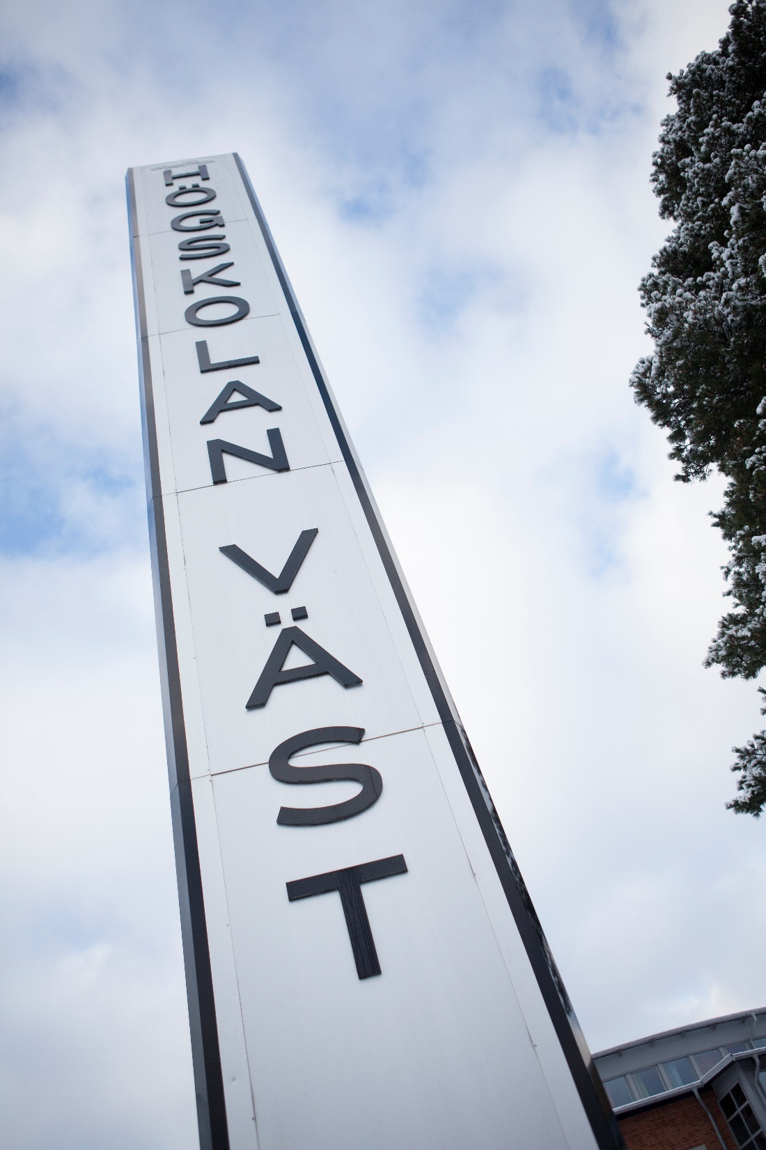
Degree project mid time presentation www.hv.se/en
Notes:
Do not change this slide

Slide 2
Title
Enhancing Efficiency in Metal 3D Printing Through AI and Simulation
JUSTINE Jean
Notes:
All red text shall be replaced AND changed to BLACK colour

Slide 3
Introduction
Metal 3D printing allow complex and customized parts
However, there is room to improve, as there is still some inefficiencies because of suboptimal build sequence, material waste, and no accuracy for the pieces printed.
This project focus on integrating AI and simulation to address those issues
This projects fits within the bigger context of Industrial Automation and digital manufacturing

Slide 4
Aims
Develop and validate a simulation model for 3D metal printing
Implement Learning Algorithms, to optimize printing sequence
Test and Refine the model with Real equipment

Slide 5
Literature study
The results for the literature study are not fructiful, very few article, most of it is about selective laser melting, but sometimes they can apply to our case such as:
Reinforcement learning is widely used to reduce the cost, trial and error and has been explore for process optimization. [1]
Theories Used:
Reinforcement Learning for decision making
Thermal modeling of printed parts
Voxel method for pieces reconstruction [2]

Slide 6
Literature study
Objectives of the Study:
Identify current gaps in 3D printing optimization
Apply AI to improve efficiency and reduce waste
Academic Skills:
Critical analysis of recent research
Identified lack of AI use in build sequence optimization
Built literature base combining AI, robotics, and additive manufacturing

Slide 7
Methodology
Present the methods that you have chose and why to answer on your aims
Tools: Python for AI and reproduction of the heat, RobotStudio for simulation of the printing.
Process:
Develop a 3D printing simulation environment.
Integrate ML algorithms for optimization.
Run multiple test scenarios to evaluate outcomes.

Slide 8
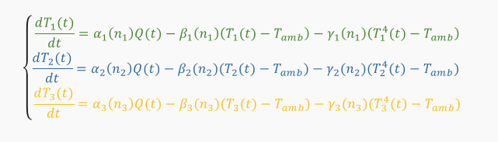
Approach
Step-by-step:
Literature and data gathering.
Simulation model development using Voxel method and first-order ordinary differential equations (ODEs) for the heat propagation.
Integration of ML algorithms (training, testing), using reinforcement learning or Random Forest.
Evaluation and tuning with real ABB robot system.
Timeline:
April: End of development of the simulation and start of the training
May: Refinement and real world test
June: Report and evaluation

Slide 9
References
[1] https://www.sciencedirect.com/science/article/abs/pii/S0278612519301207?via%3Dihub , Fangwei Ning, Manufacturing cost estimation based on a deep-learning method 2020
[2]https://www.analyticsinsight.net/latest-news/everything-that-you-need-to-know-about-voxel-based-modelling#:~:text=Voxel-based%20modeling%20is%20a,using%20a%203D%20model%20maker. Everything That you Need to Know About Voxel-based Modelling, 21 Aug 2023
[3] https://www.hubs.com/knowledge-base/introduction-metal-3d-printing, What is metal 3D printing and how does it work?
[4] https://advanced.onlinelibrary.wiley.com/doi/10.1002/aisy.202000204, Joshua Giltinan, 3D Microprinting of Iron Platinum Nanoparticle-Based Magnetic Mobile Microrobots, 13 November 2020

