Slide 1

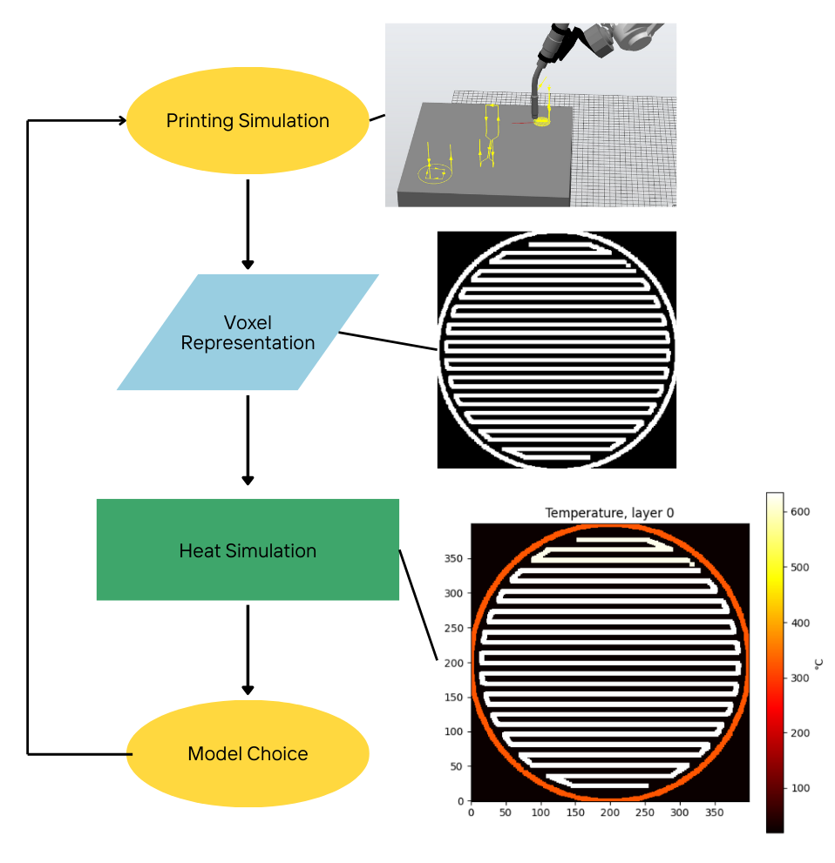
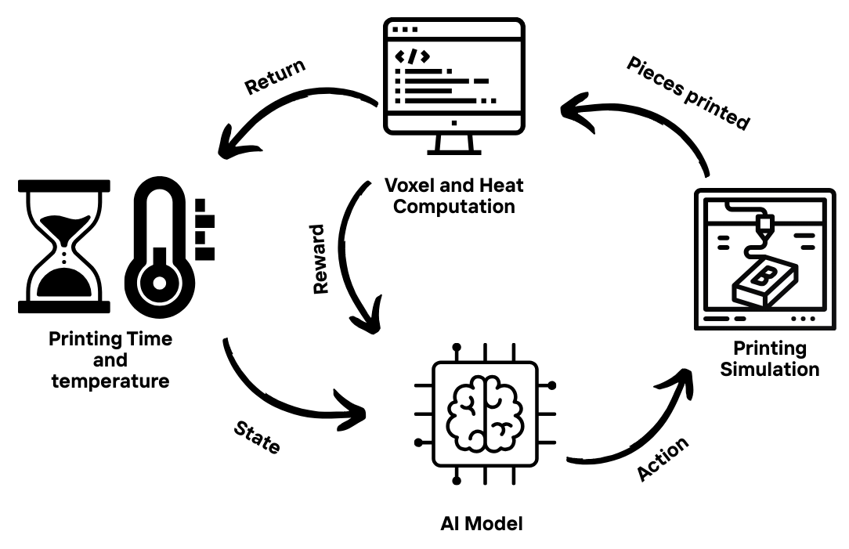

Improving Metal 3D Printing Efficiency with Heat Simulation and AI
Aims:
Create a metal 3D printing simulation
Create an accurate thermal simulation using voxel representation
Implement AI decision making to optimize the printing sequence
Methodology:
Robot Studio Simulation
Voxel Based Geometry
Heat Simulation
Reinforcement learning implementation
Results:
RL achieved up to 13% time saving compare to deterministic algorithm
Successfully reduce waiting time in between pieces print
Validate AI effectiveness across multiple scenarios
Date: 21/05/2025
JUSTINE Jean
Masters-Student in
AI & Automation
2024-2025
Division of Production Systems
Department of Engineering Science
University West
www.hv.se

