Slide 1
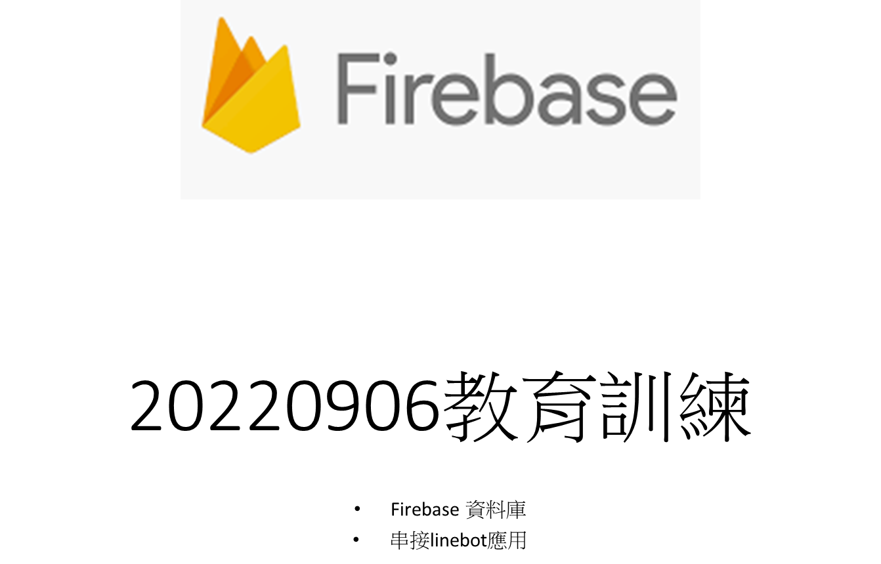

Slide 2

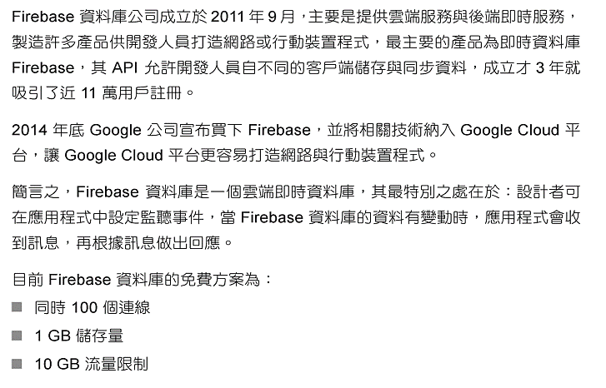

Slide 3
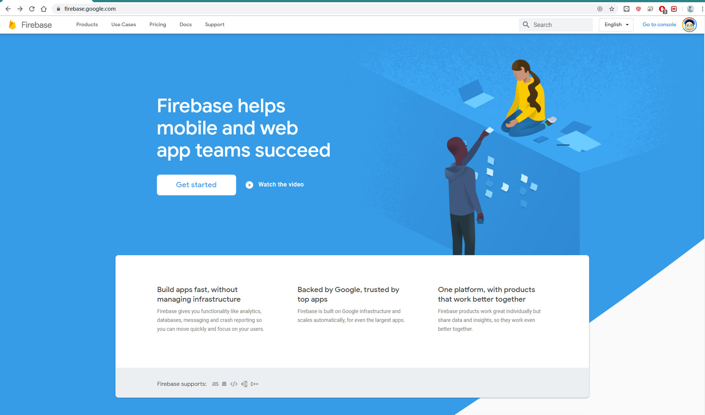
https://firebase.google.com/

Slide 4
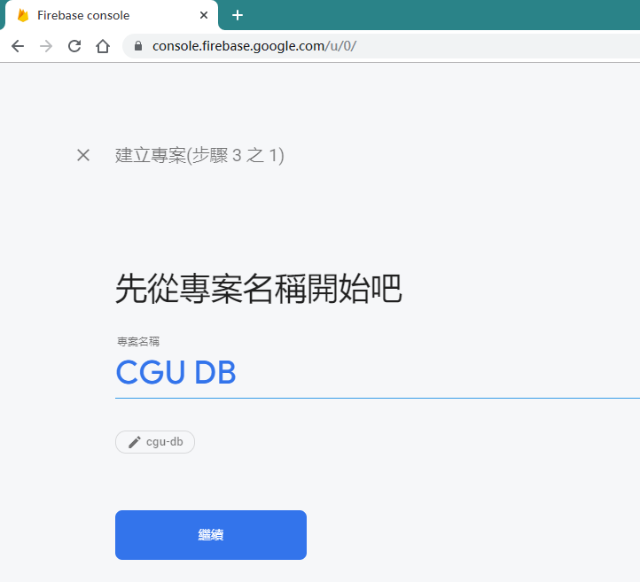

Slide 5
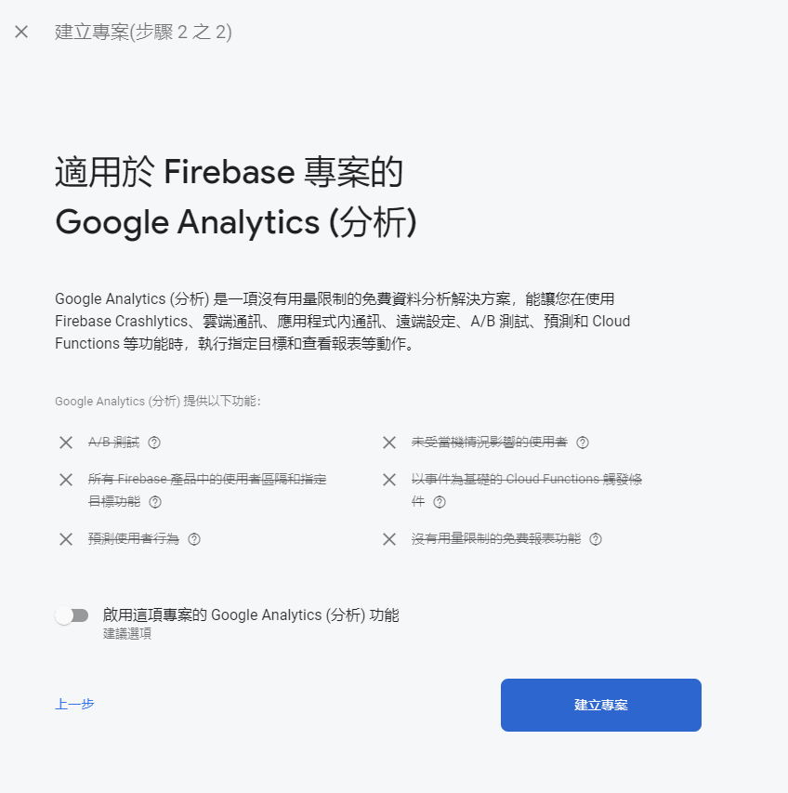

Slide 6


Slide 7
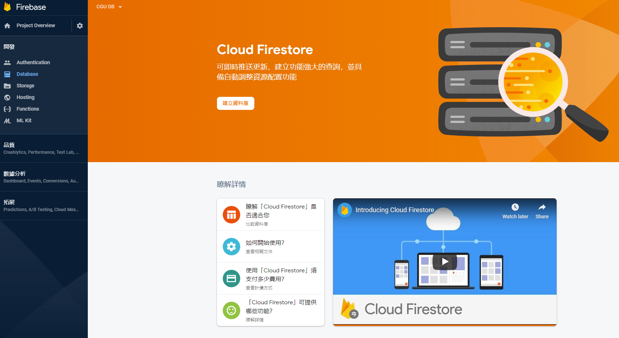

Slide 8
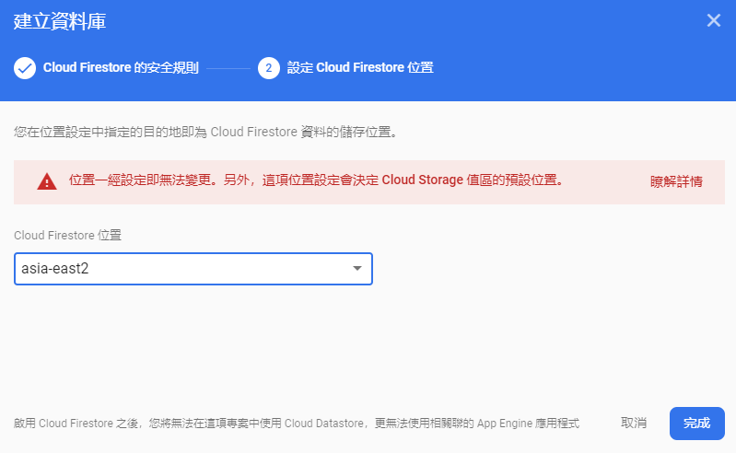
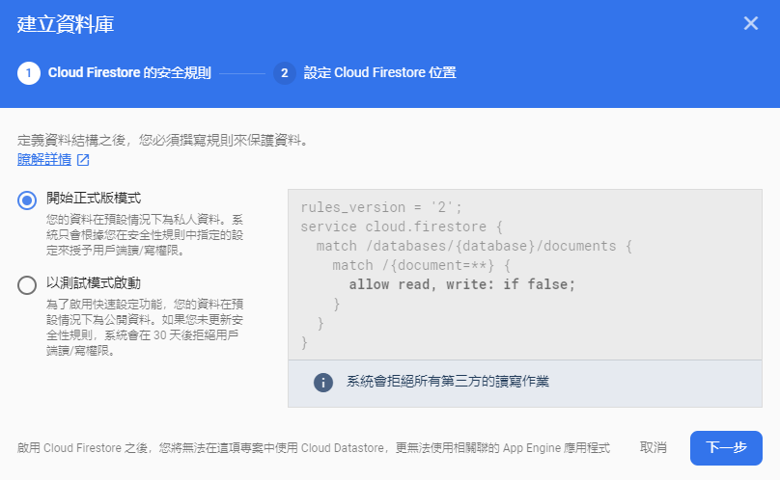

Slide 9
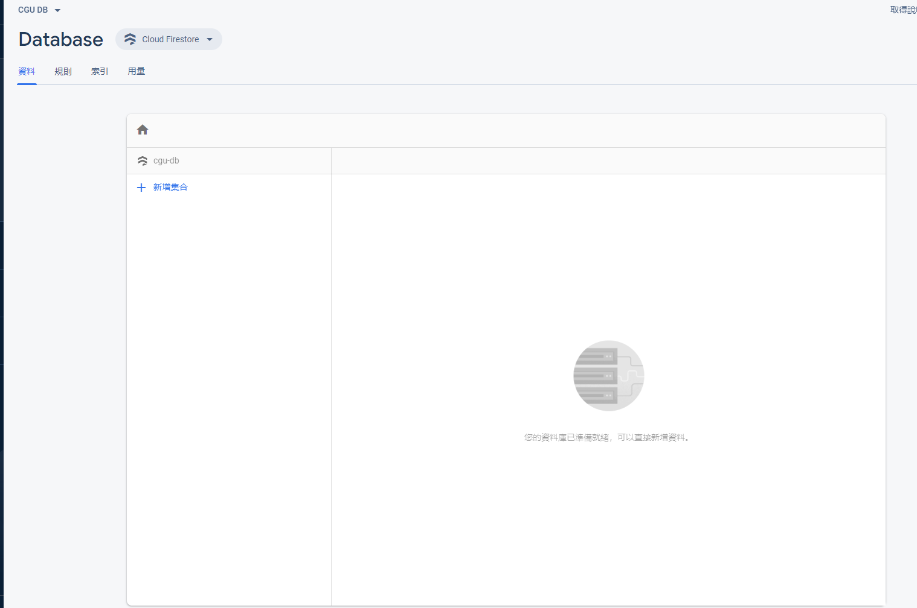

Slide 10
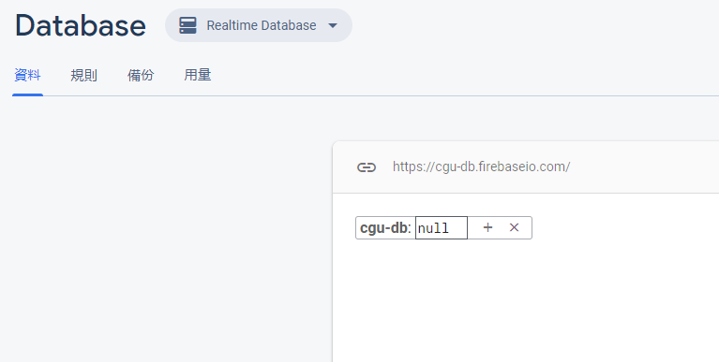

Slide 11
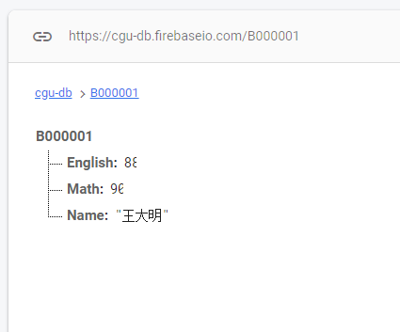
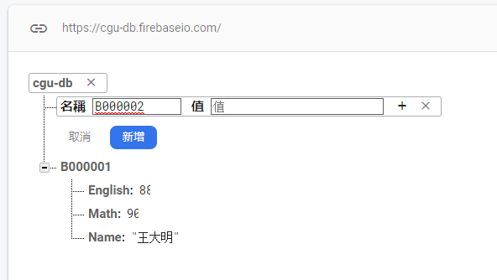
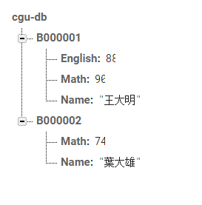

Slide 12
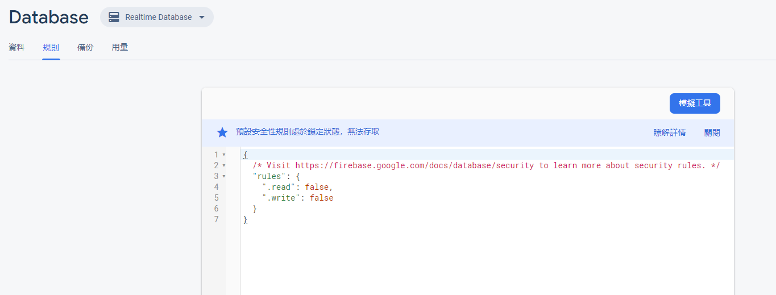
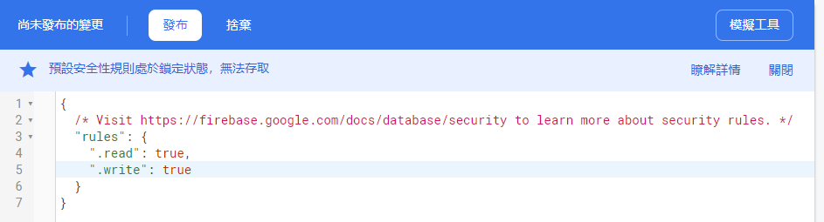
開放權限
把 false 改成 true, 按下發布

Slide 13
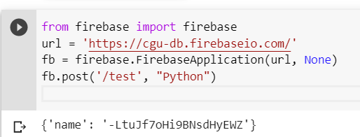
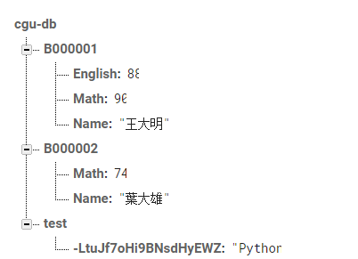
測試寫入資料
!pip install python-firebase
Notes:
!pip install python-firebase
from firebase import firebase
url = 'https://cgu-db.firebaseio.com/'
fb = firebase.FirebaseApplication(url, None)
fb.post('/test', "Python")

Slide 14
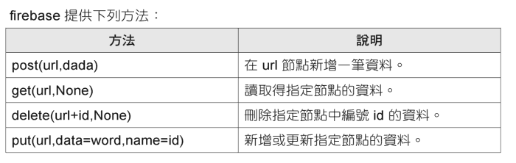

Slide 15
寫入資料 .post()
fb = firebase.FirebaseApplication(url, None)
fb.post(‘/test’, ‘python’)

Slide 16
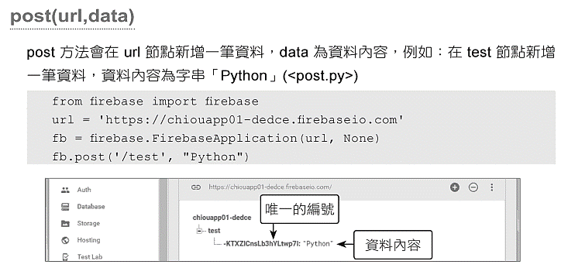

Slide 17
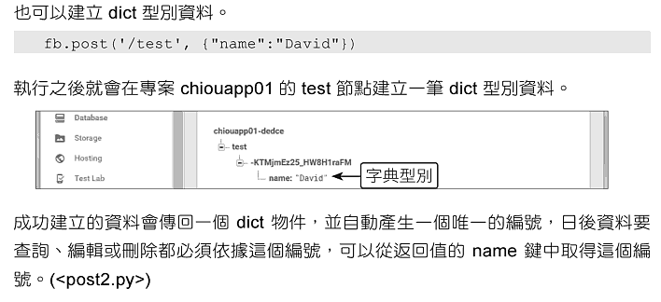
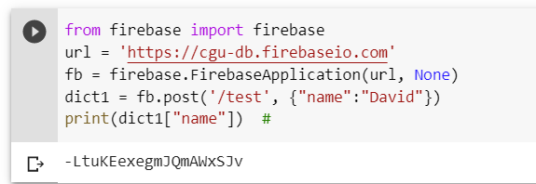

Slide 18
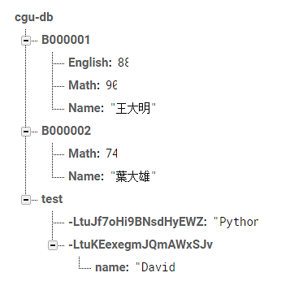
!pip install python-firebase
from firebase import firebase
url = 'https://cgu-db.firebaseio.com'
fb = firebase.FirebaseApplication(url, None)
dict1 = fb.post('/test', {"name":"David"})
print(dict1["name"])

Slide 19
Exercise 1: 批次新增資料
學號 (stuid) | 名字 (name) | 數學 (Math) | 英文 (English) | 藝術 (Art)
B000001 | 大雄 | 90 | 88 | 89
B000002 | 靜香 | 86 | 58 | 73
B000003 | 胖虎 | 74 | 75 | 84

Slide 20
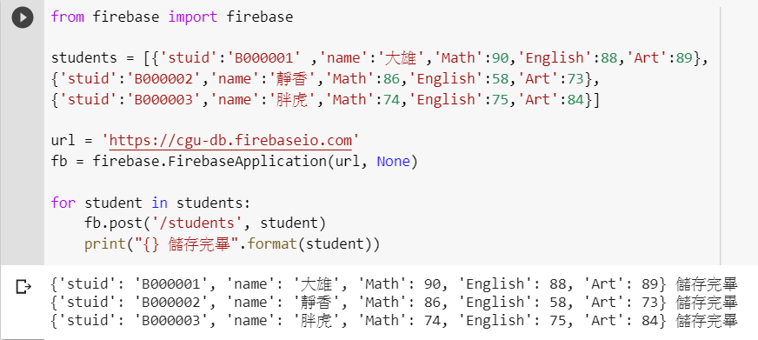
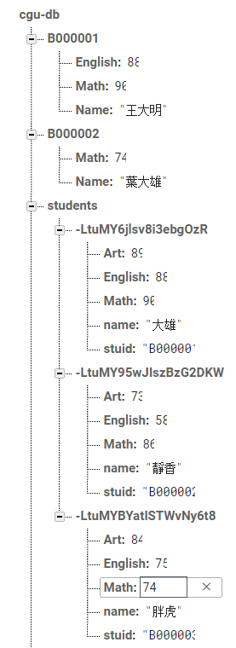

Slide 21
讀取資料 .get()
fb = firebase.FirebaseApplication(url, None)
fb.get('/students/’, None)

Slide 22
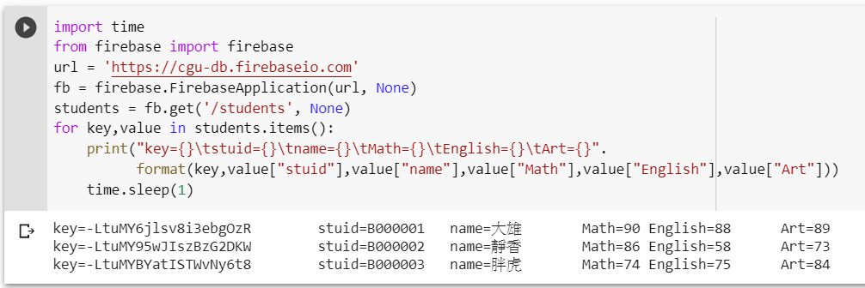

Slide 23
刪除資料 .delete()
fb = firebase.FirebaseApplication(url, None)
fb.delete('/students/', key_id)
要先找到 key_id

Slide 24
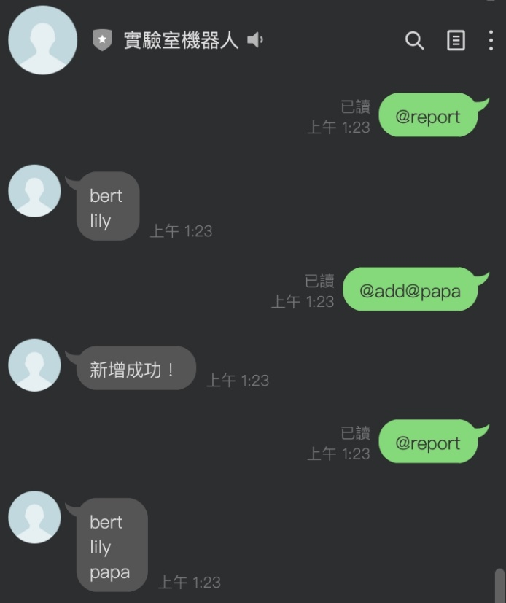
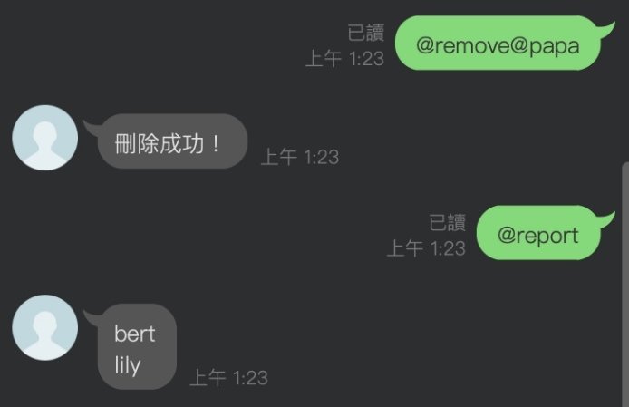
#Homework
Linebot串接firebase製作一份即時名單
輸入功能包含：
＠add@name : 將name加入名單
＠remove@name ：將name從名單移除
＠report ：回報名單上所有的name
#HW繳交截圖和code，壓縮上傳line :D

Slide 25
#HINT
@handler.add(MessageEvent, message=TextMessage)
def handle_message(event):
mtext = event.message.text
if mtext[:5] == ‘＠add@’:
＃＃
url = ‘your firebase url'
fb = firebase.FirebaseApplication(url,None)
fb.put("/userlist/”,”name”,”name”)
＃＃
try:
message = TextSendMessage(
text = ”新增完成！”)
line_bot_api.reply_message(event.reply_token,message)
except:
line_bot_api.reply_message(event.reply_token,TextSendMessage(text='發生錯誤！'))
Notes:
conda activate live_env
python linebotTest.py

