Slide 1
環境安裝

Slide 2
Python2.7 and Tensorflow
sudo apt install python2.7
sudo apt install python-pip
pip install tensorflow==1.0.1
pip install tensorboard==1.0.0a6
sudo apt-get install libhdf5-dev
sudo pip install h5py

Slide 3
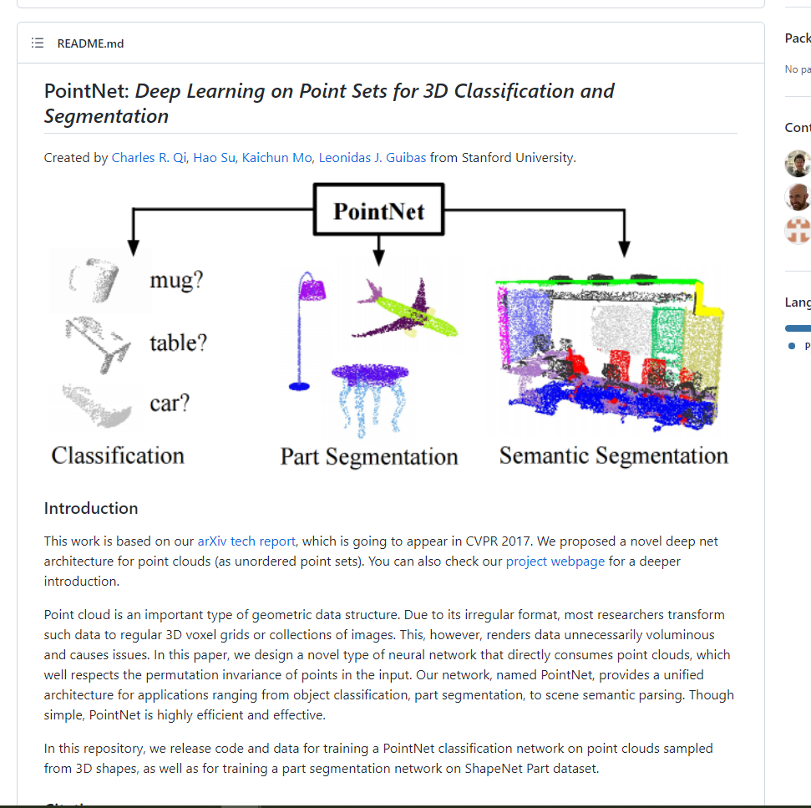
下載pointNet and 執行train
cd 桌面
sudo apt update
sudo apt install git
git clone https://github.com/charlesq34/pointnet
cd pointnet
python train.py

Slide 4
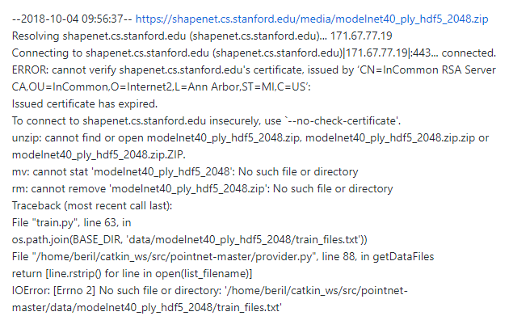

Slide 5
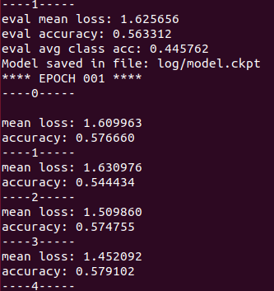
1.打開pointNet資料夾
2.開啟provider.py
3.將第15行:os.system(‘wget %s; unzip %s’ % (www, zipfile))改成
-> os.system('wget %s --no-check-certificate; unzip %s' % (www, zipfile))
4.再執行一次python train.py
Result:

Slide 6
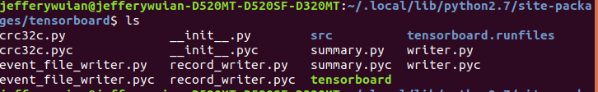
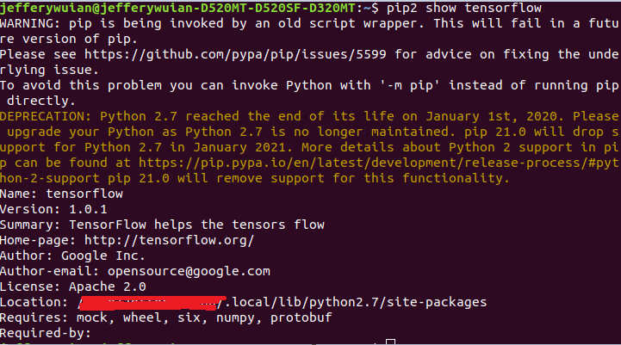
1.新開一個terminal
2.輸入pip show tensorflow後，會顯示tensorflow路徑
3.cd 路徑/tensorboard
4.該資料夾下有個tensorboard的執行檔
5.輸入./tensorboard –-logdir ~/桌面/pointnet/log

Slide 7
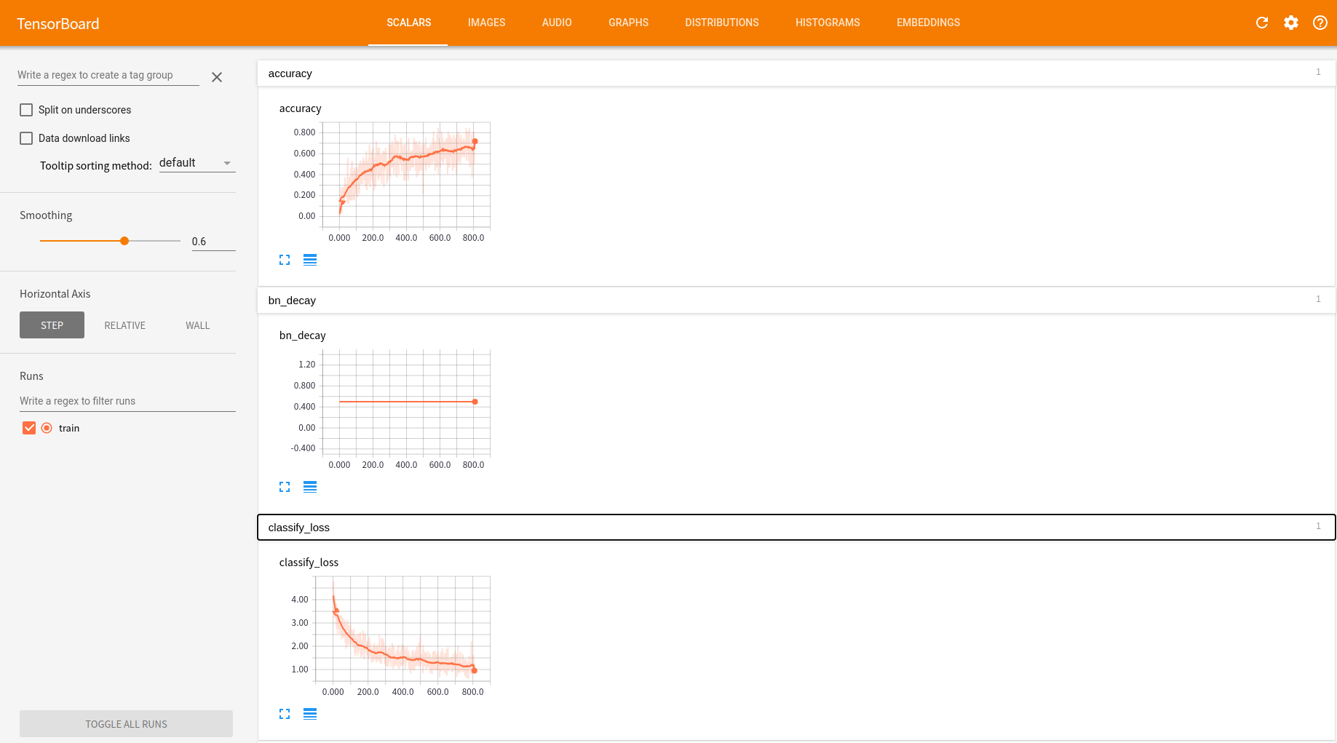
在chrome輸入localhost:6006

